Slide 1

गणकको काम, कर्तव्य र दायित्व cGtu{t
3/ tyf 3/kl/jf/ ;"rLs/0f cBfjlws sfo{
नमुना (पाइलट) जनगणना
Uf0fs तालिम
पोखरा, कास्की
kmfNu'0f @( – r}q %, @)&^

Slide 2
;"rLs/0f kmf/fddf ;'wf/, kl/dfh{g tyf cBfjlws
hgu0fgfsf] klxnf] r/0fdf ;'kl/j]Ifsn] 3/ tyf 3/kl/jf/ ;"rLs/0f kmf/fd eb{5g\ / To;sf] cfwf/df u0fsn] ;"rLs/0fdf ePsf 3/kl/jf/df uO{ ljj/0f ;+sng ug'{ kb{5 .
u0fs hfg] cjlw / ;'kl/j]Ifsn] u/]sf] sfdsf] cjlw !% lbg jf ;f]eGbf a9Lsf] km/s klg x'g ;Sb5 .
To;}n} s]xL kl/jf/ tyf JolQm yk36 x'g ;Sg] ePsf]n] u0fsn] cj:yf x]/L x]/L ;"rLs/0f kmf/fddf ;'wf/, kl/dfh{g tyf cBfjlws ug'{ kb{5 .

Slide 3
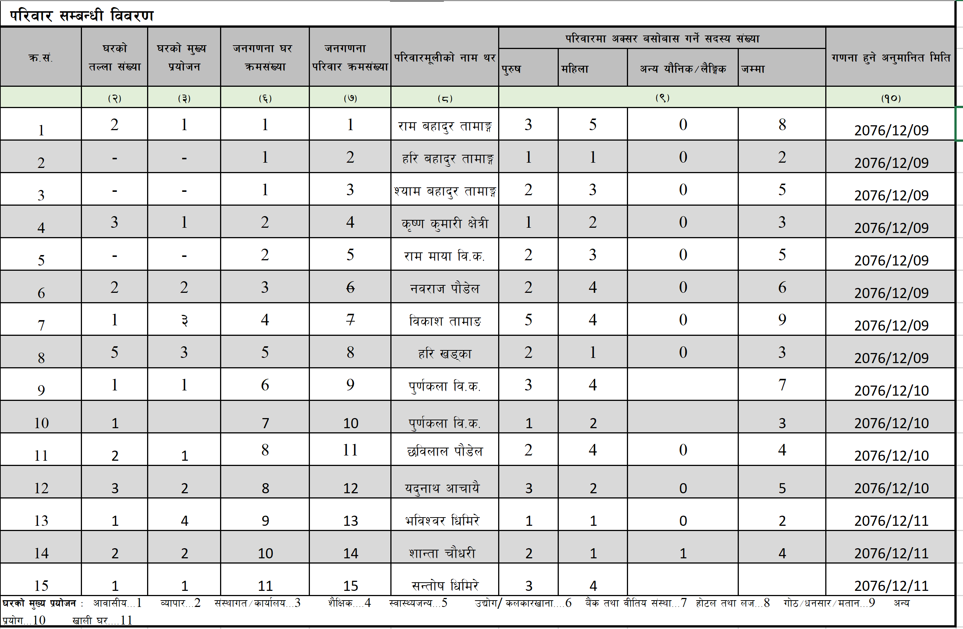
;'kl/j]Ifsn] lbPsf] ;"rLs/0f ptf/sf] pbfx/0f M

Slide 4
3/ tyf 3/kl/jf/ ;"rLs/0f kmf/fddf ;'wf/, kl/dfh{g tyf cBfjlws ug'{kg]{ cj:yfx? M
!= kl/jf/sf s'g} ;b:osf] d[To' jf aRrfsf] hGd ePsf] cj:yf
;"rLs/0f / d'Vo u0fgf b'a} u/L ;s]kl5 kl/jf/sf s'g} ;b:osf] d[To' ePsf] x'g ;Sb5 eg] s'g} kl/jf/df aRrfsf] hGd ePsf] x'g ;Sb5 . ;"rLs/0f ug]{ qmdd} o:tf] cj:yf ePsf] yfxf ePdf ;Rofpg ;lsG5 t/ ;"rLs/0f sfo{ ;DkGg eP kl5 ;Rofpg ;lsb}g .
o:tf] cj:yfdf u0fssf] dxTjk"0f{ e"ldsf x'G5 . d'Vo u0fgfdf o:tf] cj:yf w]/} x'g ;S5 . ;"rLs/0f kmf/fddf el/Psf] ljj/0fdf d[To' / hGdsf cfwf/df ;d]t kl/jf/ ;b:o ;+Vof km/s kg{ ;Sb5 .
u0fsn] u0fgfs} ;dodf tTsfn d'Vo k|ZgfjnL kmf/fddf cBfjlws ug'{kb{5 . To;}u/L u0fgf ug]{ clGtd lbg cyf{t cfiff9 * ut] o:tf] cj:yf ufpF 3/df eP gePsf] 3'dL a'emL b'a} kmf/fddf yk 36 ug'{ kb{5 .

Slide 5
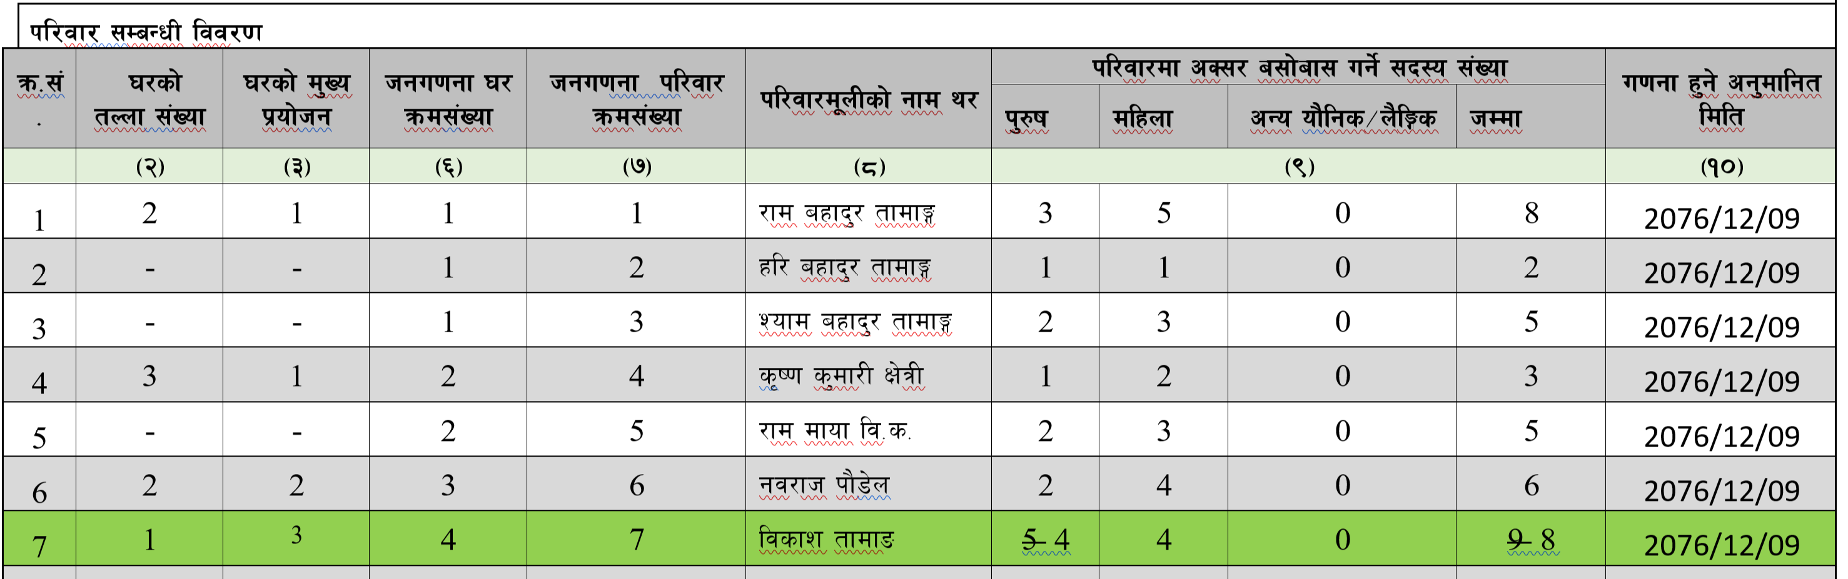
3/ tyf 3/kl/jf/ ;"rLs/0f kmf/fddf ;'wf/, kl/dfh{g tyf cBfjlws ug'{kg]{ cj:yfx? M
!= kl/jf/sf s'g} ;b:osf] d[To' ePsf] cj:yfsf] pbfx/0f M
ljsf; tfdfªsf] 3/df Ps hgf k'?ifsf] d[To' ePsf] 5 eg]

Slide 6
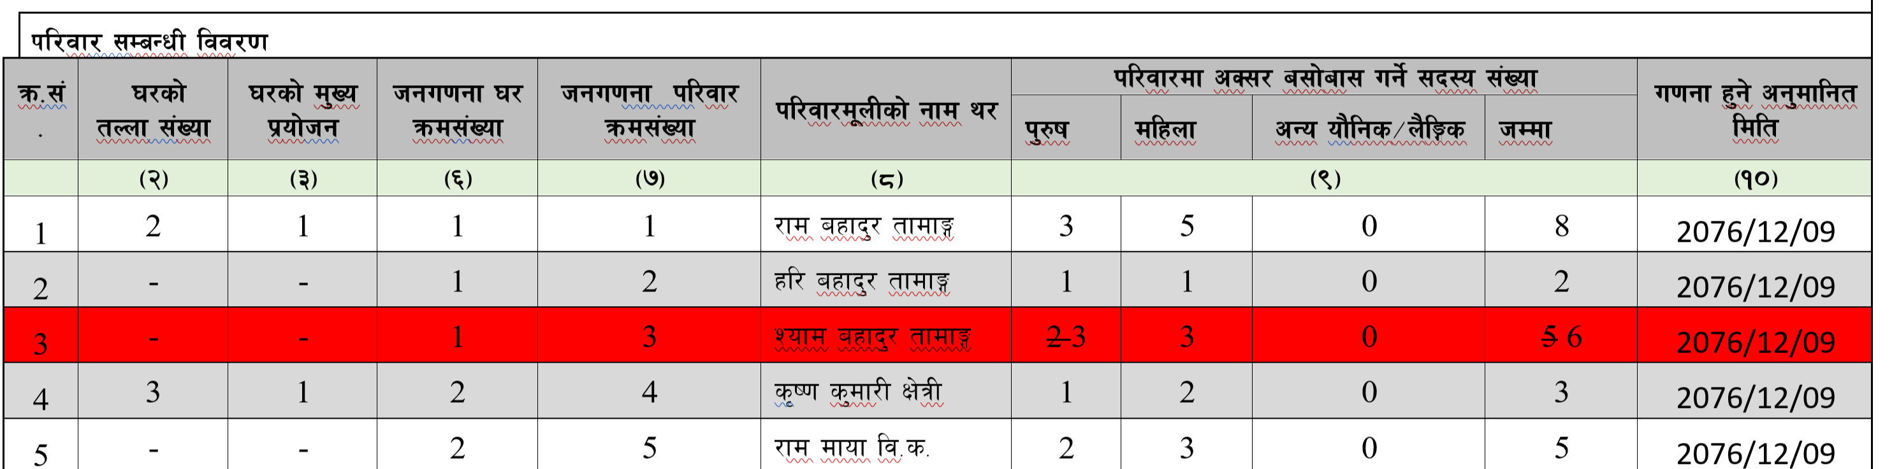
3/ tyf 3/kl/jf/ ;"rLs/0f kmf/fddf ;'wf/, kl/dfh{g tyf cBfjlws ug'{kg]{ cj:yfx? M
@ kl/jf/sf s'g} aRrfsf] hGd ePsf] cj:yfsf] pbfx/0f M
Zofd axfb'/ tfdfªsf] kl/df 5f]/fsf] hGd ePsf] /x]5 eg] o;/L cBfjlws ug'{kb{5 .

Slide 7
3/ tyf 3/kl/jf/ ;"rLs/0f kmf/fddf ;'wf/, kl/dfh{g tyf cBfjlws ug'{kg]{ cj:yfx? M
@= kl/jf/ a;fO{ ;/fO{ u/L uPsf] cj:yf
;'kl/j]Ifsn] ldlt @)&^ kmfu'g ( b]lv @)&^ kmfu'g @* ;Dd dxTjk"0f{ lhDd]jf/L lgjf{x u/L 3/ tyf 3/kl/jf/ ;"rLs/0f kmf/fddf cg';f/sf] ljj/0f k|To]s 3/kl/jf/af6 ;+sng ub{5g .
pQm el/Psf] ljj/0fdf u0fs k'Ug] ;dodf s]xL kl/jf/ a;fO{ ;/L aflx/ uPsf x'g;S5g\ .
o:tf] cj:yfdf pQm kl/jf/nfO{ ;"lrs/0f kmf/daf6 x6fpg'kb{5 . o;/L a;fO{ ;/L uPsf] kl/jf/sf] ljj/0fnfO{ t];f]{ w;f]{n] sf6L 3/ qmd;+Vof oyfjt\ /fvL 3/ cGtu{tsf] kl/jf/ qmd;+Vof nufotsf] ljj/0f cBfjlws ug'{kb{5 .

Slide 8
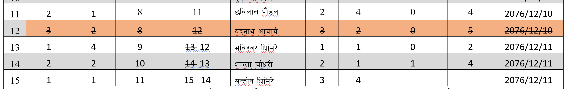
3/ tyf 3/kl/jf/ ;"rLs/0f kmf/fddf ;'wf/, kl/dfh{g tyf cBfjlws ug'{kg]{ cj:yfx? M
@= kl/jf/ a;fO{ ;/fO{ u/L uPsf] cj:yfsf] pbfx/0f M
h:t}M ;"rLs/0f ptf/ eP cg';f/sf] ob'gfy cfrfo{sf] kl/jf/ a;fO{ ;/L uPsf] /x]5 eg] b]xfo cg';f/ ug'{kb{5 .

Slide 9
3/ tyf 3/kl/jf/ ;"rLs/0f kmf/fddf ;'wf/, kl/dfh{g tyf cBfjlws ug'{kg]{ cj:yfx? M
#= kl/jf/ a;fO{ ;/L cfPsf] cj:yf
s'g} u0fgf If]qdf s]xL kl/jf/g} a;fO{ ;/L cfPsf x'g ;S5g .
o:tf] cj:yfdf pQm kl/jf/ h'g 3/df a;f];f; ul//x]sf 5g\ ToxL 3/sf] 3/ g+= /fvL ;"lrs/0f kmf/fdsf] cGTodf hgu0fgf kl/jf/ qmd;+Vof yk ul/ kl/jf/ ;DaGwL ljj/0f / d'Vo k|ZgfjnLsf] ljj/0f eg'{kb{5 .

Slide 10
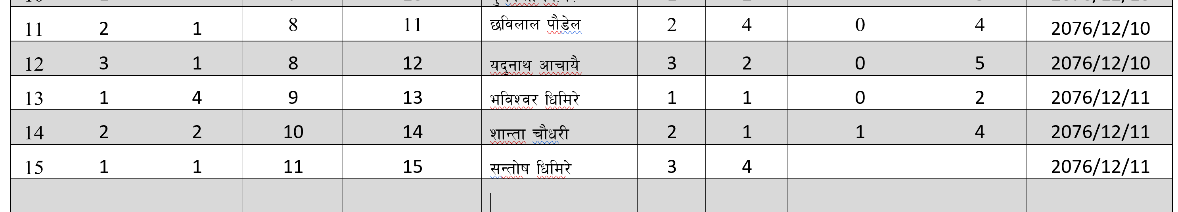
3/ tyf 3/kl/jf/ ;"rLs/0f kmf/fddf ;'wf/, kl/dfh{g tyf cBfjlws ug'{kg]{ cj:yfx? M
dfgf} !@ cf} ob'gfysf] 3/df w'|j a=du/sf] gofF kl/jf/ a;fO{ ;/L cfPsf] eP / ;f] u0fgf If]qdf !(% ;Dd hgu0fgf kl/jf/ ;+Vof k'u]sf] eP b]xfo cg';f/ cBfjlws ug'{kb{5 .
kl/jf/ a;fO{ ;/L cfPsf] cj:yf

Slide 11
3/ tyf 3/kl/jf/ ;"rLs/0f kmf/fddf ;'wf/, kl/dfh{g tyf cBfjlws ug'{kg]{ cj:yfx? M
$ =kl/jf/sf] ;b:ox¿sf] cS;/ a;f]jf;sf] :yfg kl/jt{g ePsf] cj:yf
kl/jf/df /x]sf s'g} JolQm nfdf] ;dosf] nflu aflx/ uO{ jf kl/jf/df kmls{ cfO{ kl/jf/sf ;b:o yk36 x'Gf ;S5 .
o:tf] cj:yfdf 3/kl/jf/ ;"lrs/0f kmf/ddf kl/jf/ ;DaGwL ljj/0f cBfjlws ug'{kb{5 .
o;/L cBfjlws ubf{ olb s'g] Kfl/jf/sf] ;b:o aflx/ uPsf] eP ;"rLs/0fdf 36fpg] / aflx/af6 kl/jf/df kmls{{ cfPdf ;"rLs/0fdf yk ug'{kb{5 .

Slide 12
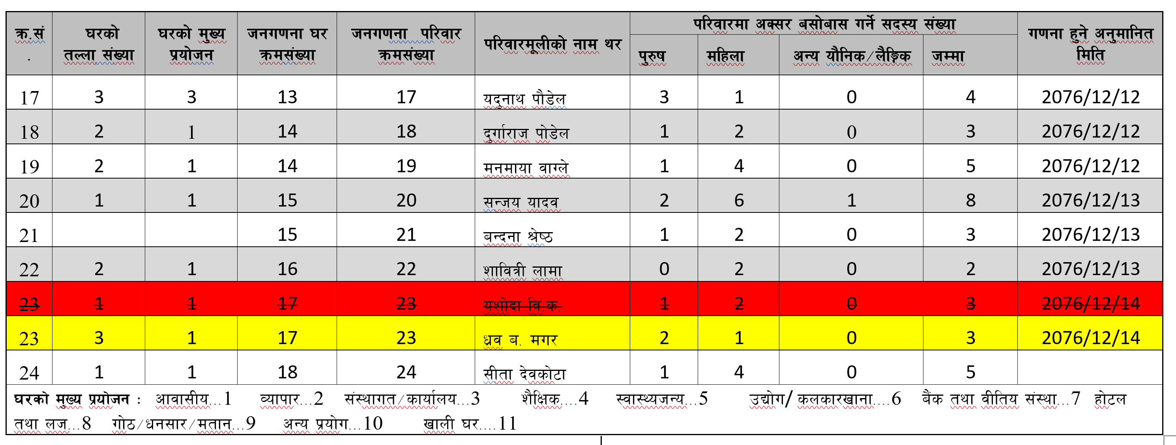
3/ tyf 3/kl/jf/ ;"rLs/0f kmf/fddf ;'wf/, kl/dfh{g tyf cBfjlws ug'{kg]{ cj:yfx? M
;"rLs/0f ubf{ 3/ 5'6 ePsf] cj:yf
o:tf] cj:yf ePdf u0fsn] pQm ;"rLs/0fsf] clGtd 3/kl5 qmdzM yk ub}{ 3/ g+= tyf cGo ljj/0fx¿ cBfjlws u/L d'Vo k|ZgfjnL kmf/fddf ;d]t ljj/0f eg'{ kb{5 .
@$ g++= df 5'6 ePsf] 3/sf] ljj/0f ylkPsf]

Slide 13
3/ tyf 3/kl/jf/ ;"rLs/0f kmf/fddf ;'wf/, kl/dfh{g tyf cBfjlws ug'{kg]{ cj:yfx? M
;"rLs/0f ubf{ 3/kl/jf/ 5'6 ePsf] cj:yf
;'kl/j]Ifsn] 3/ tyf 3/kl/jf/ ;"rLs/0f (Household Listing) ubf{ s'g} 3/kl/jf/ 5'6 x'g ;Sb5 .
o:tf] cj:yf ePdf u0fsn] pQm ;"rLs/0fsf] clGtddf 5'6]sf] 3/sf] tnf ;+Vof, k|of]hg, hgu0fgf 3/ g++= n]vL gofF hgu0fgf kl/jf/ ;+Vof n]lv cGo ljj/0fx¿ cBfjlws u/L d'Vo k|ZgfjnL kmf/fddf ;d]t ljj/0f eg'{ kb{5 .

Slide 14
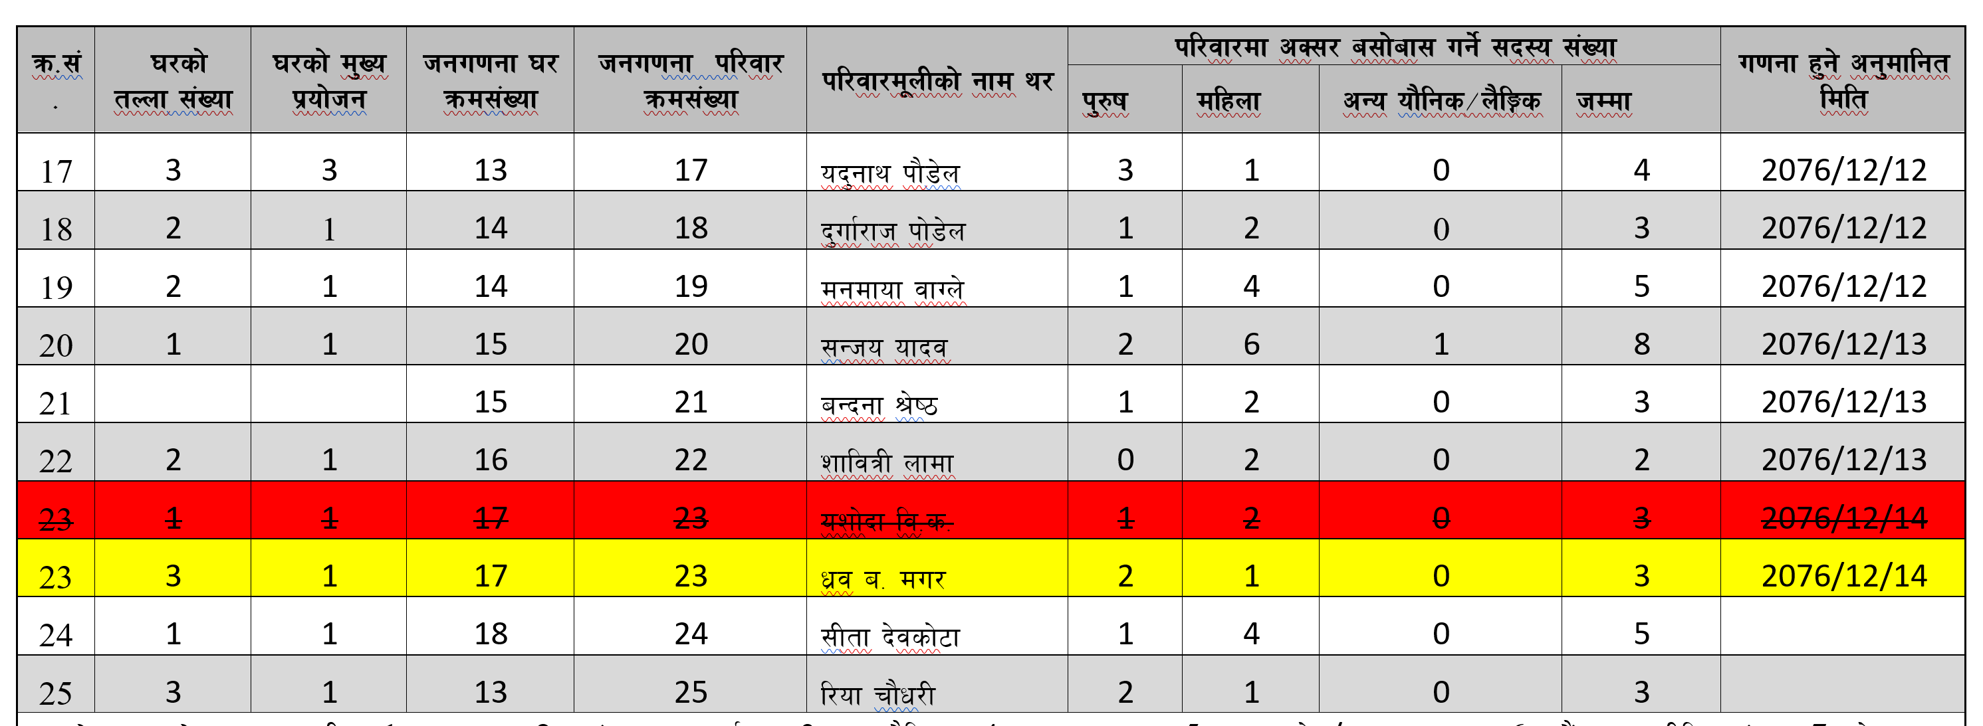
3/ tyf 3/kl/jf/ ;"rLs/0f kmf/fddf ;'wf/, kl/dfh{g tyf cBfjlws ug'{kg]{ cj:yfx? M
;"rLs/0f ubf{ 3/kl/jf/ 5'6 ePsf] cj:yfsf] pbfx/0f M dfgf} ob'gfy kf}8]nsf] 3/df a:g] l/of rf}w/Lsf] kl/jf/ ;"rLs/0fdf 5'6]sf] /x]5 eg] M
!# g++= 3/df a:g] 5'6]sf]
!# g++= 3/df 5'6]sf] kl/jf/ yk ul/Psf]

Slide 15
3/ tyf 3/kl/jf/ ;"rLs/0f kmf/fddf ;'wf/, kl/dfh{g tyf cBfjlws ug'{kg]{ cj:yfx? M
;"rLs/0f ubf{ bf]xf]/f] el/Psf] cj:yf
s'g} 3/ tyf 3/kl/jf/sf] ljj/0f bf]xf]/f] u0fgf ePsf] eP pQm 3/ tyf kl/jf/ ;"lrs/0f kmf/fdaf6 x6fO{ 3/ tyf kl/jf/ g+= ;RofO{ n]Vg'kb{5 .

Slide 16
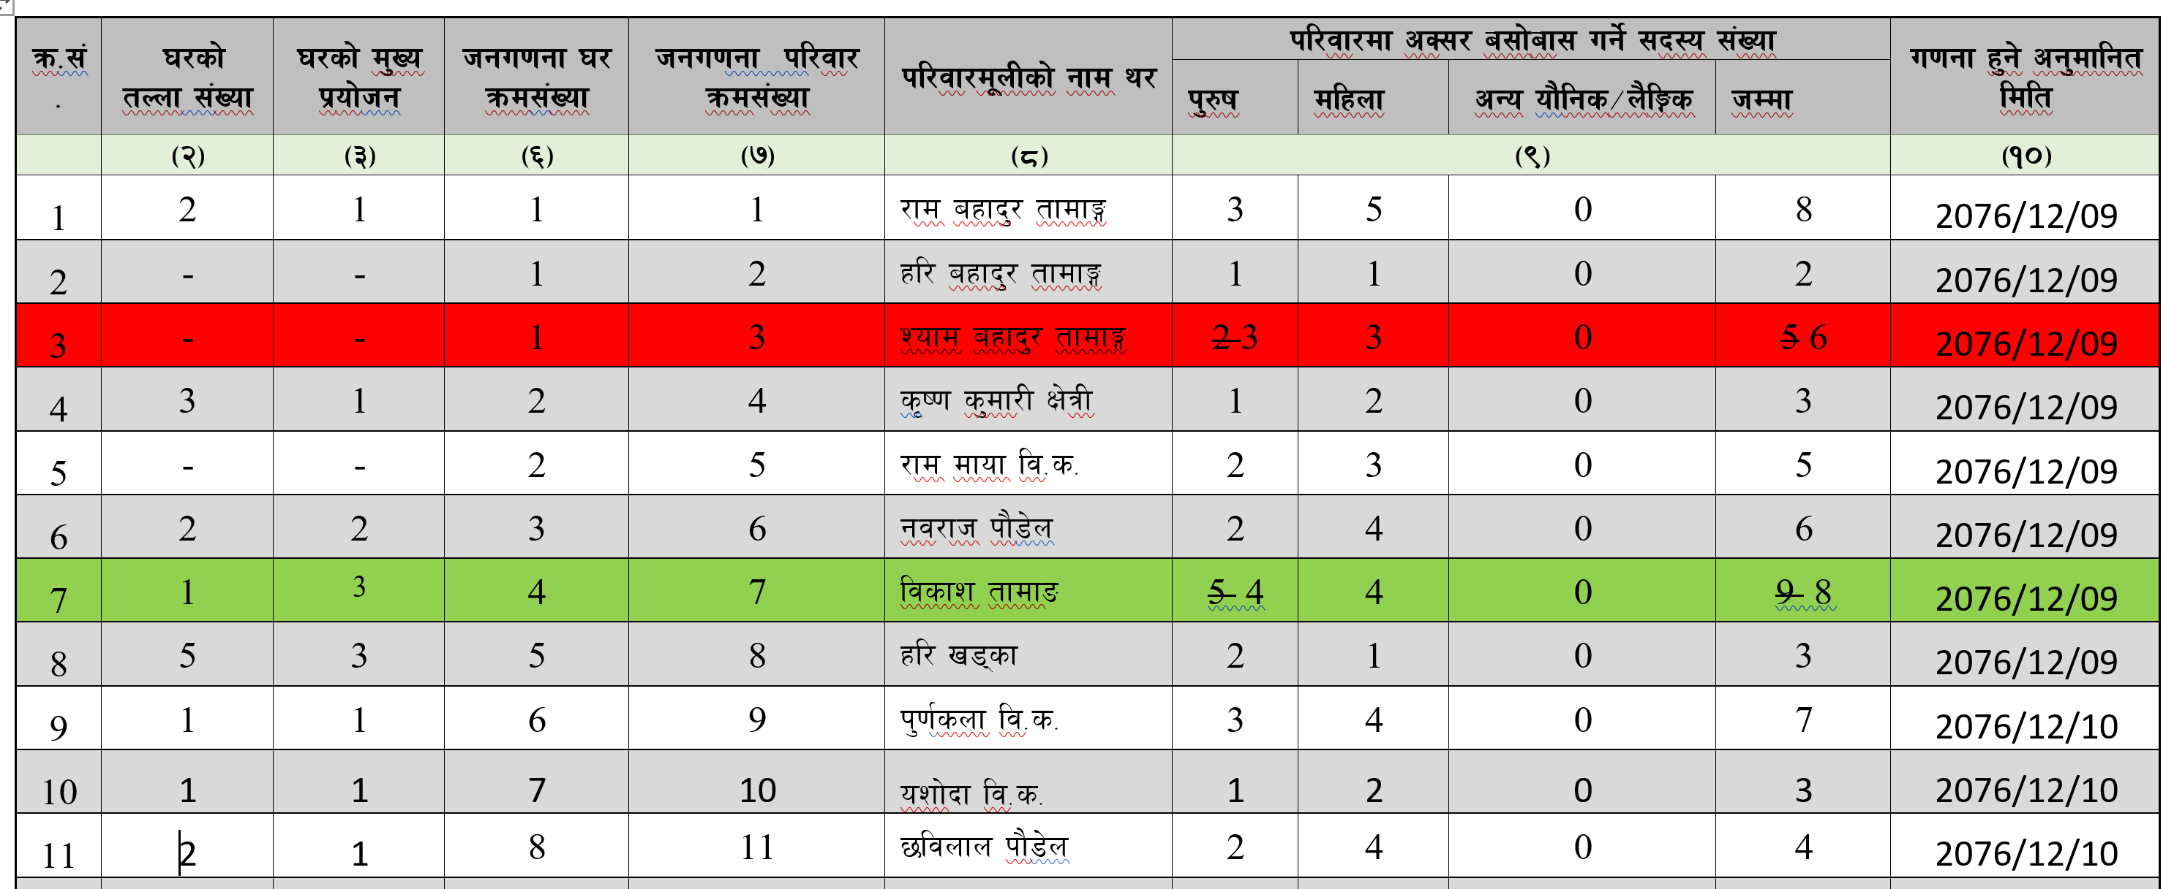
;"rLs/0f ubf{ bf]xf]/f] el/Psf] cj:yfsf] pbfx/0f
!) / @# qmd;+Vof df Pp6} JolQmsf] ljj/0f el/Psf] cj:yf

Slide 17
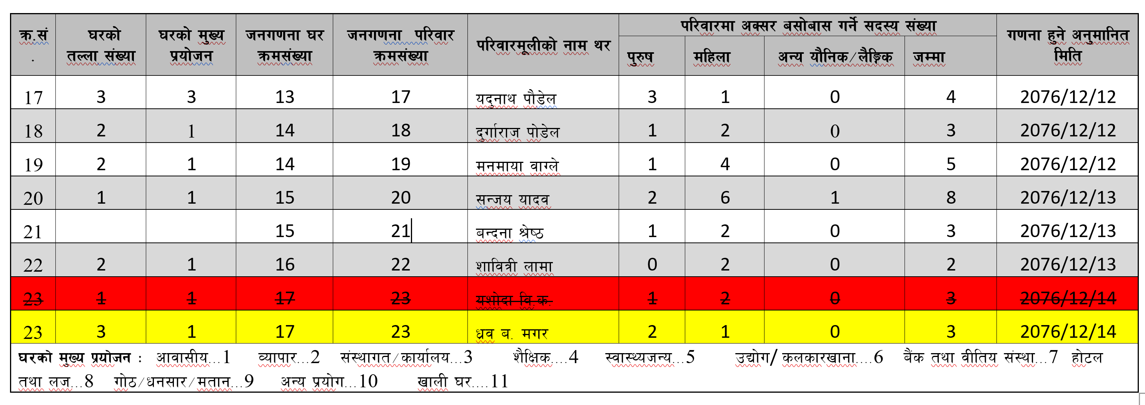
;"rLs/0f ubf{ bf]xf]/f] el/Psf] cj:yfsf] ;RofOPsf] pbfx/0f
@# qmd;+Vof df /x]sf] ozf]b lj=s= sf] ljj/0f x6fOPsf]

Slide 18
3/ tyf 3/kl/jf/ ;"rLs/0f kmf/fddf ;'wf/, kl/dfh{g tyf cBfjlws ug'{kg]{ cj:yfx? M
%= ef8fdf a:g] kl/jf/ 5'6 x'g] cj:yf
ef8fdf a:g]] kl/jf/ 5'6 x'g] ;Defjgf k|foM zx/L If]qdf x'g] ub{5 . Pp6f 3/df w]/} kl/jf/ a;f]af; ug]{ / 3/wgLx¿n] 3/ef8f nufPsf] 5}g eGg] ;Defjgf klg x'g ;Sb5 .
o;sf] sf/0fx¿df ef8fdf a:g] kl/jf/ ge]l6g', 3/wgL ljj/0f lbg pT;'s gx'g'', 3/jxfn s/ ltg'{ k5{ ls eGg] e|d /xg' cflb x'g ;Sb5 .
t;y{ u0fsn] ;fjwfgL k"j{s ef8fdf a:g] kl/jf/sf] ljj/0f 5'6 eP gePsf] Plsg u/L 3/kl/jf/ ;"rLs/0f cBfjlws u/L d'Vo k|ZgfjnL kmf/ddf ljj/0f eg'{ kb{5 .

Slide 19
3/ tyf 3/kl/jf/ ;"rLs/0f kmf/fddf ;'wf/, kl/dfh{g tyf cBfjlws ug'{kg]{ cj:yfx? M
^= cGo sf/0f
u0fgfsf] ;dodf xfn;fn} s'g} kl/jf/df >Ldfg >Ldlt ;DaGw ljR5]b ePsf], ev/} ljjfx eP/ sf]lx cfPsf] jf uPsf], 5'6\6LleGg eO{ pQm 3/df gofF 3/kl/jf/ sfod x'g cfPsf] x'g ;Sb5 .
o:tf] cj:yfdf 3/kl/jf/ ;"lrs/0f kmf/fdx¿df ljj/0f cBfjlws u/L d'Vo k|ZgfjnL kmf/fddf ljj/0f eg'{ kb{5 .

Slide 20
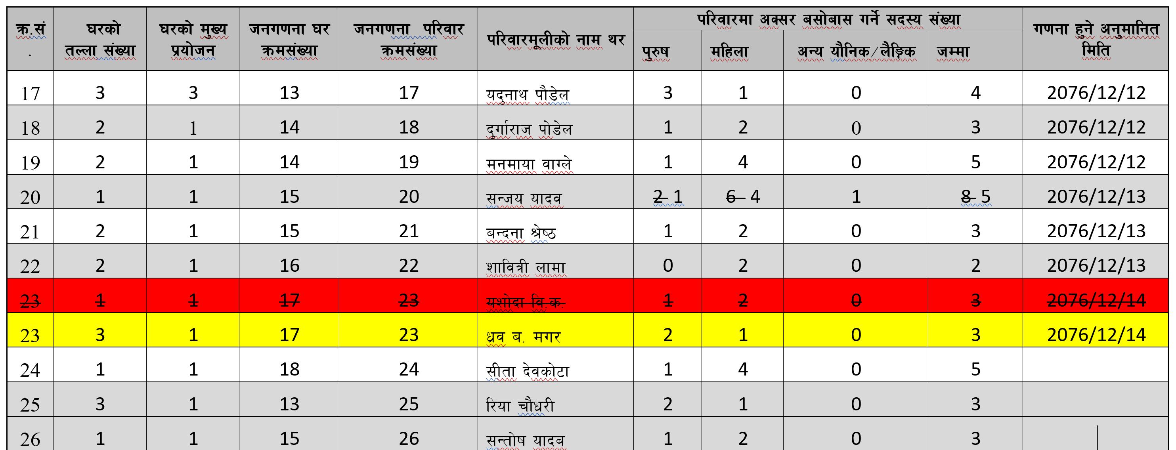
3/ tyf 3/kl/jf/ ;"rLs/0f kmf/fddf ;'wf/, kl/dfh{g tyf cBfjlws ug'{kg]{ cj:yfx? M
^= cGo sf/0fsf] pbfx/0f M dfgf} @) g++= qmd;+Vofsf] kl/jf/ 5'6\6LleGg eO{ @ kl/jf/ ePsf] /x]5 eg b]xfo cg';f/ cBfjlws ug'{Kfb{5
;~ho ofbjsf] kl/jf/af6 ;Gtf]ifsf] kl/jf/ 5'l6\6Psf]

Slide 21
अतिरिक्त जानकारीको लागि निर्देशिकाको विस्तृत अध्ययन गर्नुहोला ।
धन्यवाद!

Slide 22
केही जिज्ञासा?

