Slide 1
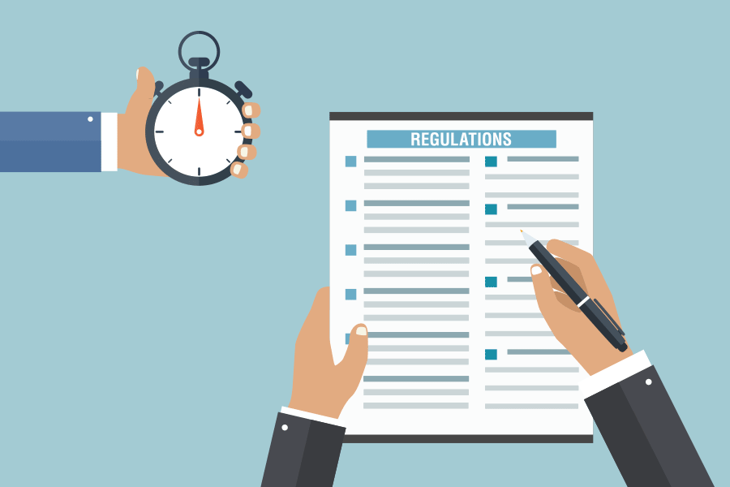
/fli6\|o hgu0fgf @)&*
6\ofan]6 k|of]ustf{x?sf] nflu k|lzIfs tflnd
ldlt @)&* sflt{s # b]lv * /
sflt{s ^ b]lv !!
1

Slide 2


प्रस्तुतिका विषय
kl/ro / hgu0fgf nut Joj:yfkg ;~rfng ;DaGwL ;fdfGo hfgsf/L
/fli6«o hgu0fgf @)&* M nut Joj:yfkg k|0ffnL ;Grfng ug]{ tl/sf
6\ofan]6sf] dxTjk"0f{ Button x? / To;sf] k|of]u ;DaGwL hfgsf/L
3/kl/jf/ d'Vo k|ZgfjnLsf] nut ;+sng ;DaGwL hfgsf/L -u0fs tyf ;'kl/j]Ifssf] nflu_
d]g' l;:6daf6 ul/g] yk sfdsf] ;DaGwdf hfgsf/L
ljljw
2

Slide 3

सन्दर्भ सामाग्री
hgu0fgf nut Joj:yfkg ;~rfng k'l:tsf

Slide 4
u0fgf tyf ;j]{If0fdf nut Joj:yfkg
k/Dk/fut nut Joj:yfkg (PAPI)
cfw'lgs nut Joj:yfkg (CAPI, TAPI, CAWI)
nut Joj:yfkgdf s]Gb|Lo tYof+s ljefusf] cg'ej
b'O{ j6f sfnv08 @)&# cl3 / kl5
  lj=;+= @)&# eGbf cl3 k"0f{?kdf PAPI ljlw
  lj=;+= @)&# eGbf kl5 CAPI ljlwsf] ;'?jft
  -hnjfo' kl/jt{g k|efj ;j]{If0f @)&# -cfGtl/s Joj:yfkg_, e"sDk k|efljt cfjf; k'gMlgdf{0f nut ;+sng sfo{qmd, @)&# -afX\o Joj:yfkg_
  tYof+s ljefuaf6 ;Grflnt u0fgf tyf ;j]{If0fdf CAPI ljlw k|of]u ePsf u0fgf tyf ;j]{If0fx? M Climate Change Impact Survey 2016, CRVS Survey 2017, Nepal Labour Force Survey 2017, National Economic Census 2018 (Partially), Multiple Indicator Cluster Survey 2019
cfufdL hgu0fgf @)&* df PAPI, CAPI, CAWI u/L tLg j6f ljlw k|of]u x'g] .
CAPI ljlwdf k|of]u x'g] ;km\6j]o/
CSPro, ODK, KOBO collect, SurveySolution, SurveyCTO, Blaise cflb
cfufdL hgu0fgfdf k|of]u x'g] software package : CSPro

Slide 5
/fli6«o hgu0fgfdf k|of]u x'g] k|ZgfjnLx?
/fli6«o hgu0fgf d'Votof $ k|sf/sf k|ZgfjnL / kmf/fdsf] k|of]u x'g]5 M
!= sG6«f]n kmf/fd – k|b]z/lhNnf hgu0fgf clwsf/Ln] eg]{ Joj:yf ldnfpg] / k|b]z / lh=h=c=n] g} 8f6f k7fpg]
@= 3/ tyf 3/kl/jf/ ;"lrs/0f kmf/fd – ;'kl/j]Ifsn] eg]{, ;'kl/j]Ifsn] g} 8f6f k7fpg]
#= hgu0fgf d'Vo k|ZgfjnL – u0fsn] eg]{, ;'k/efO{h/n] 8f6f k7fpg]
$= ;fd'bflos k|ZgfjnL – ;'kl/j]Ifsn] eg]{, ;'kl/j]Ifsn] g} 8f6f k7fpg]

Slide 6
PlKn]s]zg ;Grfng ;'rf? ug{' eGbf cl3sf] dfGotf (Assumption) / tof/L sfo{
dfGotf (Assumption)
rf/ k|sf/sf k|ZgfjnLx?af6 s] s:tf ljifoa:t'df ljj/0f ;+sng ug{ vf]lhPsf] xf] ;f] ;DaGwL k"0f{ 1fg eO{;s]sf] x'g'kg]{5 .
rf/ k|sf/s} k|ZgfjnLsf] ljj/0f ;+sng ;DaGwdf ;}4flGts ljifoj:t'sf] ;DaGwdf hfgsf/L xfl;n eO{;s]sf] x'g'kg]{5 .
tof/L sfo{
6\ofan]6 k|fKt u/L Jof6«L k"0f{ rfh{ ePsf] x'g'kg]{5 .
cfkm\gf] 6\ofan]6sf] gfd s] xf] / 6\ofan]6sf] gDa/ slt xf] 8fo/Ldf l6kf]6 ug{'kg]{5 .
k|lzIf0fsf] qmddf cfk'mn] sfd ug{'kg]{ :yfgsf] jf:tljs ljj/0f ge/L tfKn]h'8)\ lhNnfsf] ljleGg ef}uf]lns If]qnfO{ k|of]u ug{ ;lsg] 5 .
u0fgfsf] sfo{ z'? ug{' cl3 cfk'mn] sfd ug]{ af:tljs 7fpFsf] update lng' kg]{5 .
cEof;sf] nflu lnO{Psf] ef}uf]lns If]q / af:tljs u0fgfsf] ;dodf lhNnf hgu0fgf clwlsf/Ln] v6fPsf] ef}uf]lns If]q -k|b]z, lhNnf, gu/kflnsf, j8f g+=, u0fgf If]q / cfjZos k/]df Anssf] gfd_ clgjfo{ ?kdf cfkm\gf] 8fo/Ldf l6Kg' kg]{5 .

Slide 7
PlKn]s]zg ;Grfng ;'rf? ug{' eGbf cl3sf] dfGotf (Assumption) / tof/L sfo{
tof/L sfo{
u0fs tyf ;'kl/j]Ifsn] cfkm\gf] sf]8 / cfk'mn] sfd ug{' kg]{ ef}uf]lns If]qsf] ljj/0f -gfd / sf]8_ cfkm\gf] 8fo/Ldf l6Kg' kg]{5 .
;'kl/j]Ifssf] xsdf cfk'm cGt/utsf u0fsx? s'g s'g ef}uf]lns If]qdf vl6Psf 5g\ jxfFx?sf] sf]8 / ef}uf]lns If]qx? ;d]t l6Kg' kg]{5 .
hgu0fgf d'Vo k|ZgfjnLsf] slDtdf % kl/jf/sf] el/Psf] gd"gf k|ZgfjnL x'g'kg]{5 .
u0fgfsf] sfo{ z'? ug{' cl3 ;'kl/j]Ifsn] ;DalGwt u0fsnfO{ u0fgf If]qsf] hfgsf/L u/fpg' kg]{5 .

Slide 8
8fo/Ldf l6kf]g ug{'kg]{ ljifox? M
!= cfkm\gf] cfO{=l8= sf]8 M ============================-lhNnf hgu0fgf clwsf/L jf :yfgLo hgu0fgf clwsf/Ln] pknAw u/fpg]5_
@= cfkm'n] sfd ug{ nfu]sf] ef}uf]lns If]q -cEof;sf] nflu / af:tljs u0fgf b'j}sf] nflu cnu cnu l6kf]6 ug{'kg]{5_
@=! k|b]zsf] gfd M ===================================== sf]8M ===============
@=@ lhNnfsf] gfd M ===================================== sf]8M ===============
@=# uf=kf=g=kfsf] gfdM M ============================ sf]8M ===============
@=$ j8f g+= M==========================
@=% u0fgf If]q g+= M ==================== -u0fssf] nflu dfq_
@=^ Ans M ========== -u0fssf] nflu dfq_ -Ans 5}g eg] Ans gePsf] n]Vg' xf]nf, Ans 5 eg] A, B, C, D s'g Block xf] ;f] n]Vg'xf]nf_
#= cfkm'n] k|of]u ug]{ 6\ofan]6 g+= M =================================== -6\ofan]6sf] k5f8Lk6\6L :6Ls/df n]lvPsf] 5_
$= cfkm'n] k|of]u ug]{ 6\ofan]6sf] gfd= M ===================================
%= u0fssf] xsdf cg';'rL @ cg';f/sf] ljj/0f cfkm\gf] 8fo/Ldf l6Kg' kg]{5 .
^= ;'kl/j]Ifssf] xsdf cg';"rL ! cg';f/ cfkm\gf] ljj/0f / cg';"rL @ cg';f/ cfk'm cGt/utsf u0fsx?sf] ljj/0f klg cfkm\gf] 8fo/Ldf clgjfo{ ?kdf n]Vg'kg]{5 .

Slide 9
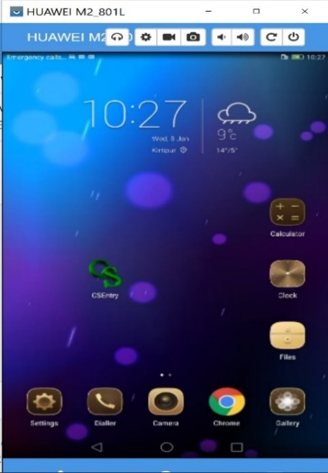

/fli6«o hgu0fgf @)&* sf] nut Joj:yfkg PlKns]zg ;'rf? ug]{ tl/sf
!_ CSEntry apps df Click ug{'xf];\ .
@_ cj /fli6«o hgu0fgf @)&* sf] nflu tof/ kfl/Psf] nut Joj:yfkg k|0ffnLsf] d]g' l;:6d v'Ng]5 .
Click this icon

Slide 10
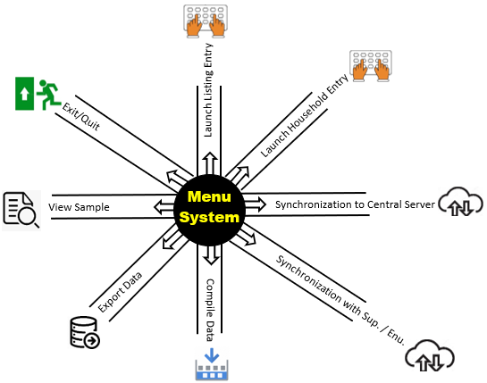
d]g' l;:6d eg]sf] s] xf] <
d]g' l;:6d /fli6«o hgu0fgfsf] ljB'tLo k|ljlw -6\ofan]6_ k|of]u u/L nut ;+sng tyf sfuhL k|ZgfjnLsf] nut k|ljli6sf] nflu agfO{Psf] 5ftf -Umbrella_ k|f]u|fd xf] . o;}af6 /fli6«o hgu0fgfsf] nut Joj:yfkgdf ;+nUg JolQm -s]Gb|Lo ;d"x, ;'k/efO{h/, u0fs_ sf nflu agfOPsf ljleGg PlKns]zgx? / sfo{ (function) ;Grfng / lgoGq0f x'g]5 . d]g' l;:6dnfO{ tnsf] lrqaf6 k|i6 kfg{ vf]lhPsf] 5.
æd]g' PlKns]zg Tof] rf}af6f] xf] hxf+af6 cfkm\gf] uGtJodf hfg] af6f] klxrfg ub{5f}+ / cfkm\gf] uGtJodf k'Ug]5f}+Æ

Slide 11
Population Census Data Management System
Menu System
Miscellaneous work
Control Form Entry
Synchronization
Household Listing Application
Census Main Questionnaire
Community Questionnaire

Slide 12
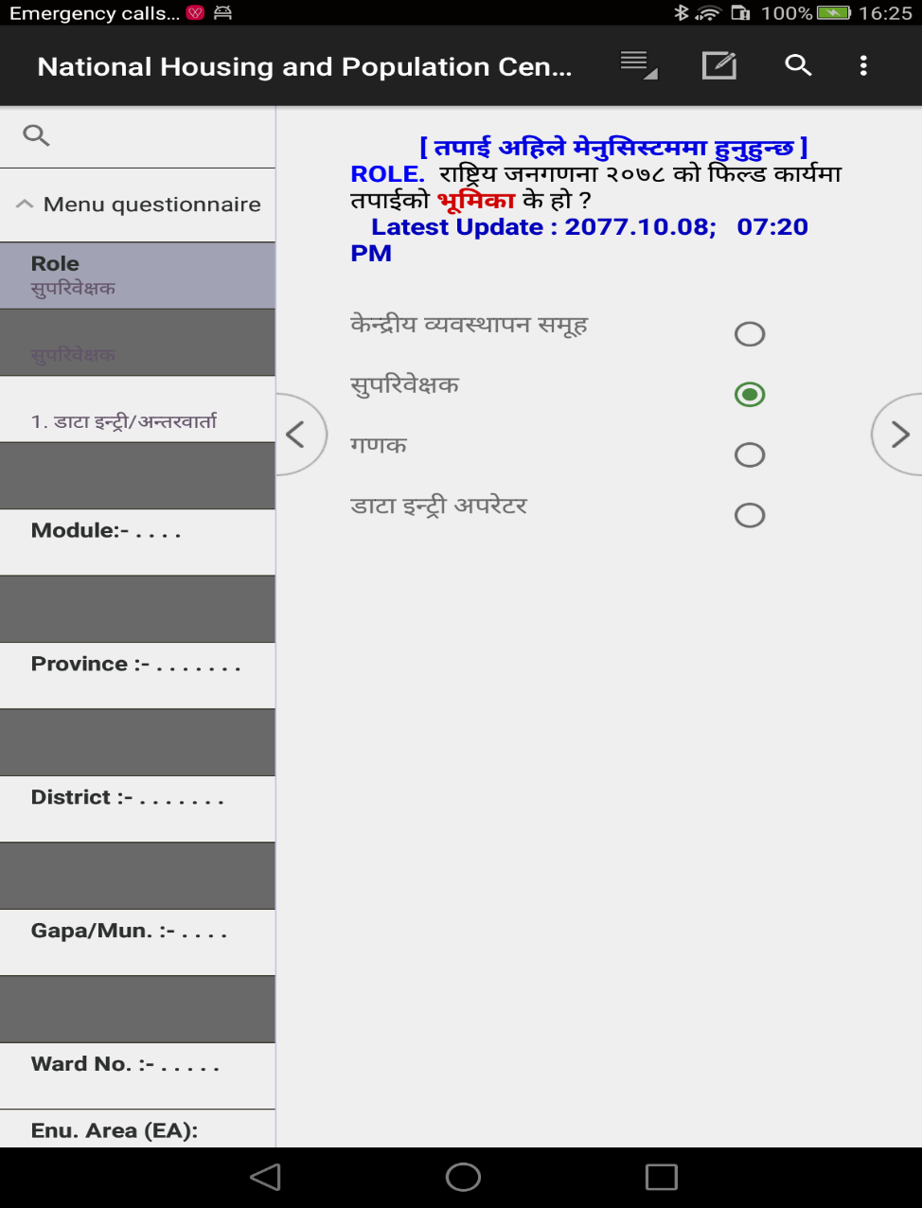
Menu System df k|of]u ePsf ljleGg variable
Menu System af6 hgu0fgfdf agfOPsf] PlKns]zgx? run ug{' cl3 o; d]g' l;:6ddf s]xL ljj/0fx? k|ljli6 ug{' kg]{5 . d]g' l;:6ddf /x]sf] hfgsf/Lsf] ?kdf ætkfO{ clxn] d]g' l;:6ddf x'g'x'G5Æ eGg] hfgsf/L cfO{ /x]sf] x'g]5 .
d]g'l;:6ddf k|of]u ePsf] ljj/0f lgDgfg';f/ 5g\ .
Role :
tkfO{ ;'k/Lj]Ifssf] /f]ndf sfd ub}{ x'g'x'G5 eg] ;'k/Lj]Ifs 5fGg'xf]; .
tkfO{ u0fssf] /f]ndf sfd ub}{ x'g'x'G5 eg] u0fs 5fGg'xf]; .

Slide 13
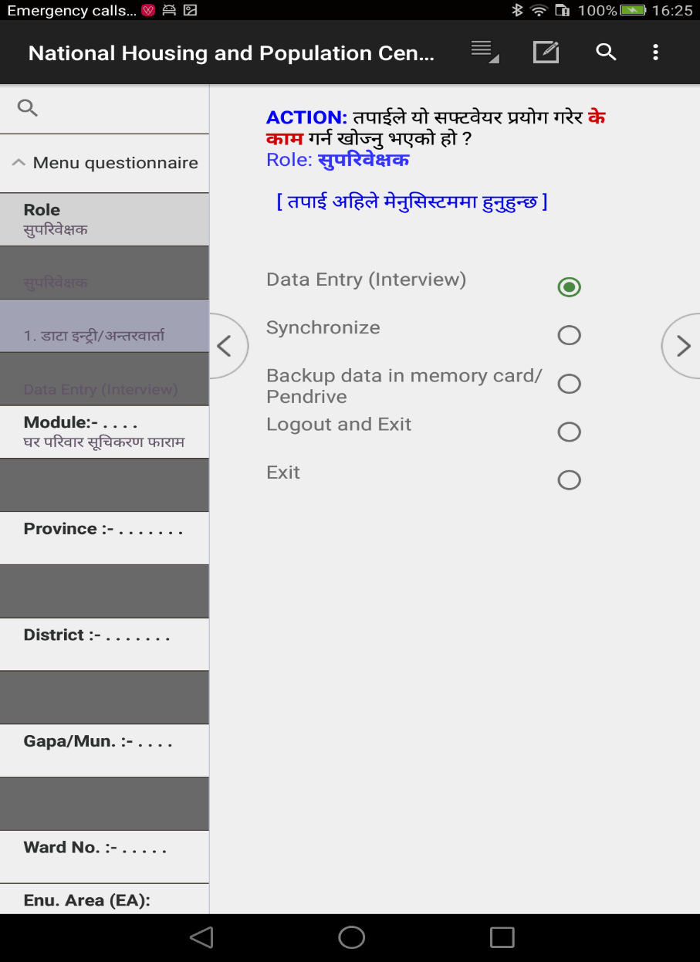
Action :
tkfO{ k|ZgfjnLsf] ljj/0f ;+sng ug{ nfUg' ePsf] xf] eg] 1. Data Entry (Interview) 5fGg'xf]; .
tkfO{n] csf]{ d]l;g -sDKo'6/ jf 6\ofan]6_ ;+Fu kmfOn cfbfg k|bfg ug{ nfUg' ePsf] xf] eg]
2. Synchronize 5fGg'xf]; .
tkfO{ 6\ofan]6df cfGtl/s ?kdf save ePsf] ljj/0fx? clear u/L PlKns]zgaf6 aflx/ lg:sgsf] nflu 8. Logout and Exit 5fGg'xf]; .
tkfO{ 6\ofan]6df cfGtl/s ?kdf save ePsf] ljj/0fx? clear gu/L PlKns]zgaf6 aflx/ lg:sgsf] nflu 9. Exit 5fGg'xf]; .

Slide 14
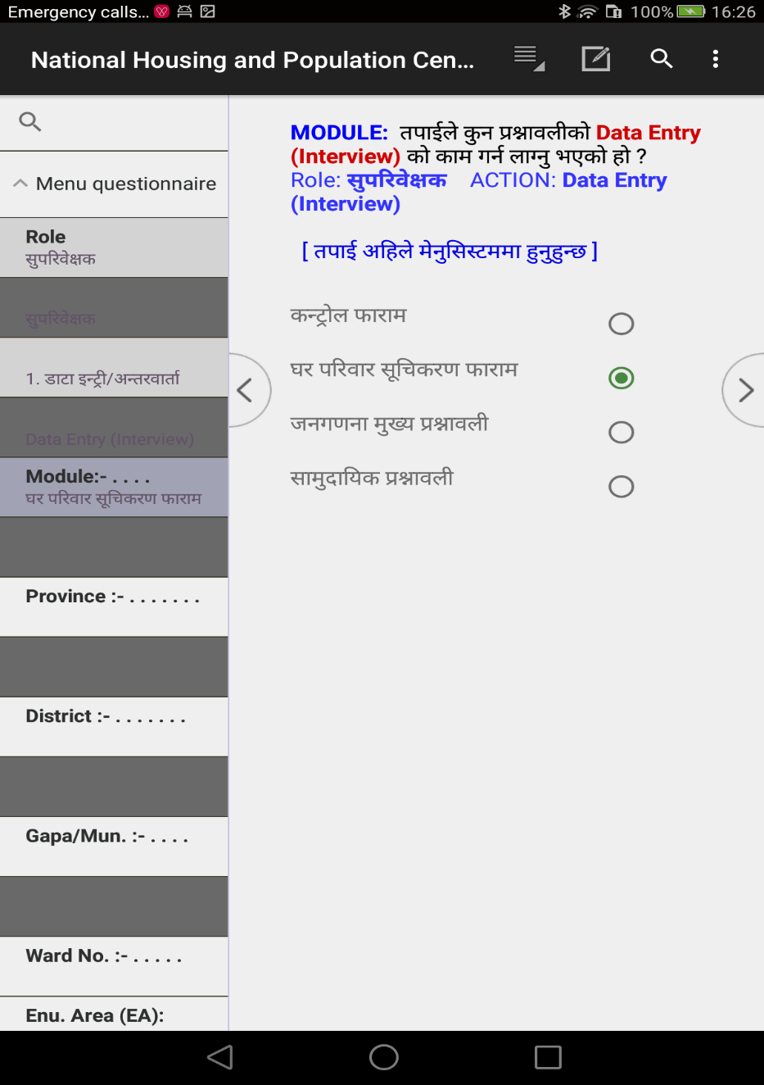
Module:
sG6«f]n kmf/fdsf] nflu sfd ug{' k/]df != sG6|f]n kmf/fd 5fGg'xf]; .
3/kl/jf/ ;"lrs/0f kmf/fdsf] nflu sfd ug{' k/]df @= 3/ tyf 3/kl/jf/ ;"lrs/0f kmf/fd 5fGg'xf]; .
hgu0fgf d'Vo k|ZgfjnLsf] nflu sfd ug{' k/]df #= hgu0fgf d'Vo k|ZgfjnL 5fGg'xf];.
hgu0fgf d'Vo k|ZgfjnLsf] nflu sfd ug{' k/]df $= ;fd'bflos k|ZgfjnL 5fGg'xf]; .

Slide 15
ef}uf]lns If]qsf] klxrfg (Identification of Geographic Area)
o; cGt/ut tkfO{n] sfd ug{' kg]{ :yfgsf] ef}uf]lns klxrfg (Geographical Identification) k|lji6L ug{'kg]{5 .
PROVRINCE: tkfO{n] sfd ug{ nfUg'ePsf] k|b]z s'g xf] ;f] k|b]zsf] gfd 5fGg'xf];\ .
DISTRICT: tkfO{n] sfd ug{ nfUg'ePsf] lhNnf s'g xf] ;f] lhNnfsf] gfd 5fGg'xf];\ .
GAPA/NAPA: tkfO{n] sfd ug{ nfUg'ePsf] ufpFkflnsf÷gu/kflnsf s'g xf] ;f] ufpFkflnsf÷gu/kflnsfsf] gfd 5fGg'xf];\ .
Ward: tkfO{n] sfd ug{ nfUg'ePsf] j8f g+= slt xf] ;f] j8f g+= n]Vg'xf];\ .
EA: tkfO{nfO{ sfd ug{ tf]lsPsf] u0fgf If]q slt xf] ;f] u0fgf If]q n]Vg'xf];\ .
BLOCK: olb Pp6f u0fgf If]qdf Ps} hgf u0fsn] hgu0fgfsf] sfd ug]{ ePdf Ans 5}g eGgsf] nflu X 5fGg' kb{5 . olb Ps hgf u0fsn] Pp6f u0fgf If]qdf sfd ug{ g;sfpg] eP/ Ps eGbf a9L u0fs k|of]u u/]sf] eP lhNnf hgu0fgf clwsf/Lsf] k|ToIf lgb]{zgdf klxnf] u0fsn] Ans A, bf];|f] u0fsn] Ans B, t];|f] u0fsn] Ans C 5fGg' kb{5 .
gf]6 M u0fgf If]q -EA_ gDa/ / Ans gfd n]Vg' kg]{ eP lhNnf hgu0fgf clwsf/L jf :yfgLo hgu0fgf clwsf/Ln] pknAw u/fpg] 5 .

Slide 16
ENUMERATOR: lhNnf hgu0fgf sfof{non] u0fssf] nflu pknAw u/fPsf] IDCODE oxfF k|lji6L ug{' kb{5 . Enumerator sf] ID entry u/L;s]kl5 u0fsnfO{ sfd ug{ tf]lsPsf] ljj/0f l;:6daf6 lng]5 . olb l;:6d kmfOndf tkfO{sf] ID code k]mnf k/]g jf tkfO{nfO{ lhNnf hgu0fgf clwsf/Ln] tf]s]sf] :yfg eGbf tkfO{n] k|lji6L u/]sf] ef}uf]lns klxrfg ldn]g eg] unt ;"rgf cfO{ cuf8L a9\g] 5}g .
Type of Household: hgu0fgfdf ;fdfGotof # k|sf/sf] 3/kl/jf/sf] nut ;+sng ul/g]5 — ;fdfGo 3/kl/jf/, ;+:yfut 3/kl/jf/ / 3/af/ lalxg . clxn] s:tf] k|sf/sf] 3/ kl/jf/sf] nut ;+sng ug{ nfUg' ePsf] To; k|sf/sf] 3/kl/jf/ oxfF 5fGg' kg]{5 . Pp6f k|sf/sf] 3/kl/jf/ 5flg/x]sf] a]nf csf]{ k|sf/sf] 3/kl/jf/sf] nut ;+sng ug{ ldNg] 5}g . olxaf6 ;RofO{ cuf8L hfg'kg]{5 .
Tablet Number : 6\ofan]6sf] k5f8L :6Ls/df n]lvPsf] 6\ofan]6 gDa/ n]Vg'xf];\ .
Interview Date (Month/Day): nut ;+sng ug{ uO{ /x]sf] dlxgf / ut] n]Vg'xf];\ .

Slide 17
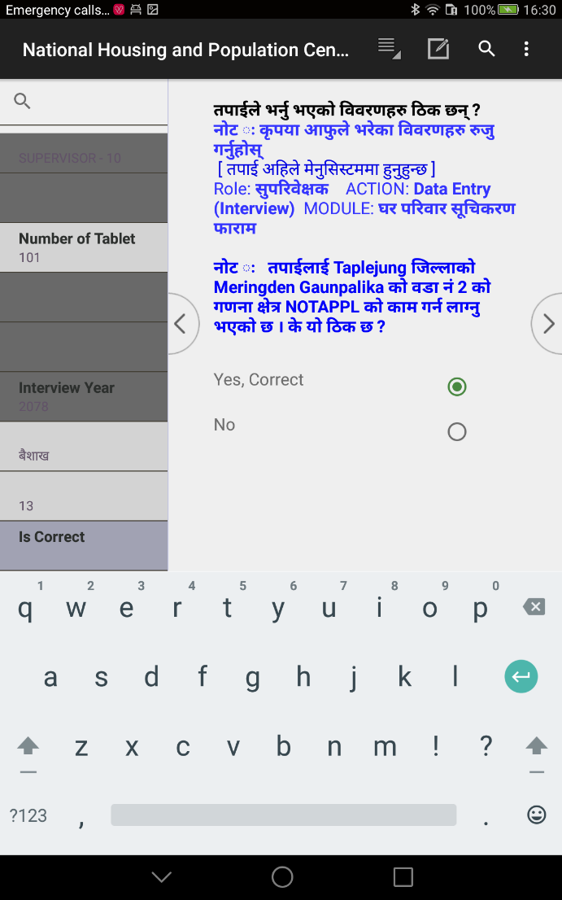
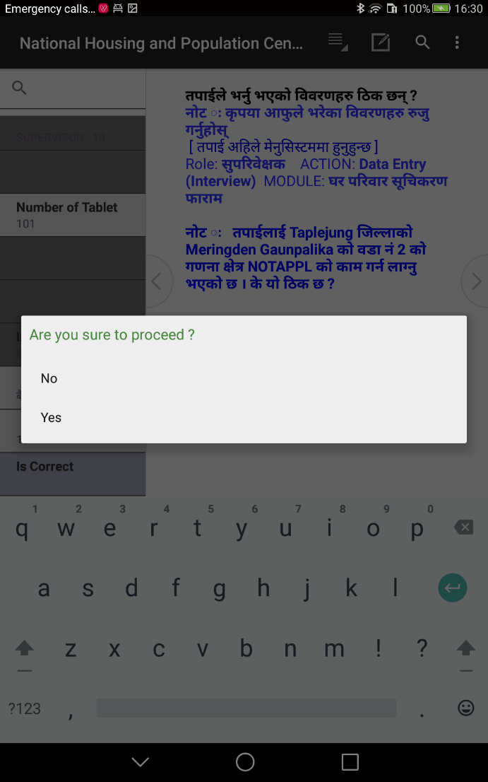
Is Correct ? : tkfO{n] o; cl3 5fg]sf] jf OG6«L u/]sf] ljj/0fx? l7s 5 eg] Yes 5fGg'xf];\ .
Do you want to proceed ? : tkfO{n] 5fg]sf] jf OG6«L u/]sf] ljsNk cg';f/sf] sfd ug{ hfgsf] nflu Yes 5fGg'xf];\ .

Slide 18
;+lIfKtdf d]g' l;:6ddf hgu0fgf nut Joj:yfkg k|0ffnL ;Grfngsf] nflu lgDg Step x? k'/f ug{'kg]{5 .
STEP 1 |  | STEP 2 |  | STEP 3 |  | STEP 4 |  | STEP 5 |  | STEP 6
ROLE (Supervisor OR Enumerator) |  | ACTION (1.Data Entry OR 2. Synchronization) |  | MODULE (1. Control 2. Listing 3. Main Quationnaire 4. Community Quest.) |  | GEOGRAPHIC IDENTIFICATION (Province, District, GAPA/NAPA, Ward, EA, BLOCK) |  | OTHER INPUT (Tablet Number, Type of House, Date of Enumeration) |  | Confirmation (Iscorrect?, Proceed ?)
gf]6M ;a} sfdsf] nflu ;a} Step df uO{/xg' kg]{5}g, cfjZostf cg';f/ hfg]5 .
d]g' l;:6ddf /x]sf] hfgsf/Lsf] ?kdf ætkfO{ clxn] d]g' l;:6ddf x'g'x'G5Æ eGg] hfgsf/L cfO{ /x]sf] x'g]5 .

Slide 19
CSPro Application sf] Interface / Button x?sf] af/]df ;+lIfKt hfgsf/L

Slide 20
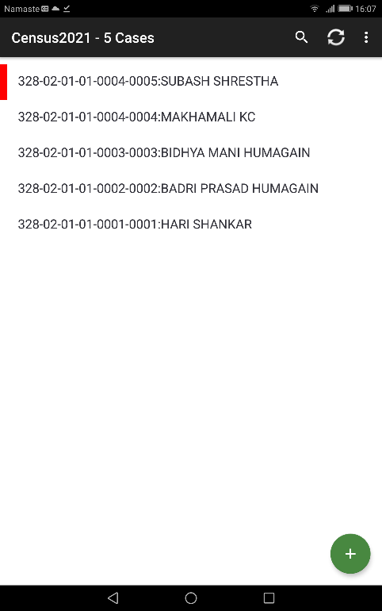
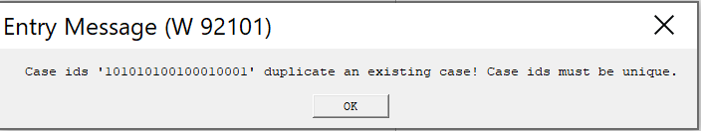
d]g' l;:6daf6 hgu0fgf k|ZgfjnLdf k|j]z u/]kl5sf] tnsf] l:qmg cfpg] 5
klxn] O{G6«L ePsf] Case oxfF b]lvg] 5 . klxn] OG6«L ePsf] ljj/0f ;Rofpg k/]df h'g Case df ;Rofpg' kg]{ xf] To;df click ug{'kg]{5 .
gofF case yk ug{ oxfF lSns ug{'xf];\ .
Pp6f u0fgf If]qdf Pp6} Identity ePsf] b'O{ j6f case lng] 5}g . "Case ids must be unique" eGg] error message cfpg] 5 .

Slide 21
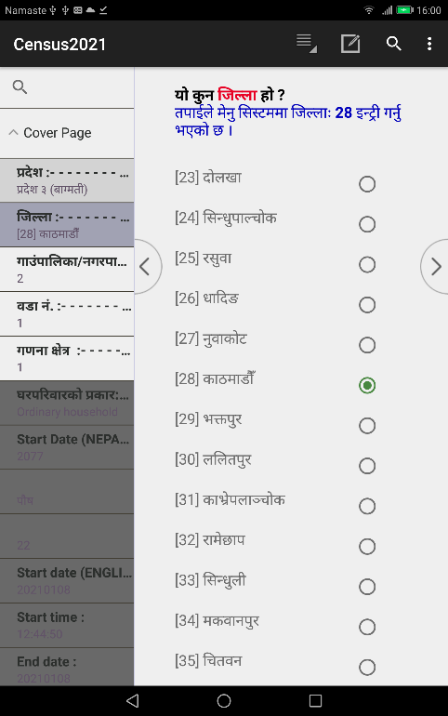
Add/Modify Mode df 6\ofjn]6sf] dxTjk"0f{ Button x? / To;sf] k|of]u ;DaGwL hfgsf/L
Add Mode df b]lvg] s]xL pkof]uL Button x? lgDgfg';f/ 5g\ .
Name of apps
System Button
User Button
Left Navigator Key
Right Navigator Key
ADD/MODIFY MODE
Left Panel
Right Panel
Minimize Key
Restore minimized apps
Back key : to stop entry mode

Slide 22
6\ofjn]6sf] dxTjk"0f{ Button x? / To;sf] k|of]u ;DaGwL hfgsf/L
Number of completed or Partial completed case
Partial Save household are shawn in red border
STOP MODE
List of Saved case
Back key : to exist from entry application, return back to Meny System
Add button

Slide 23
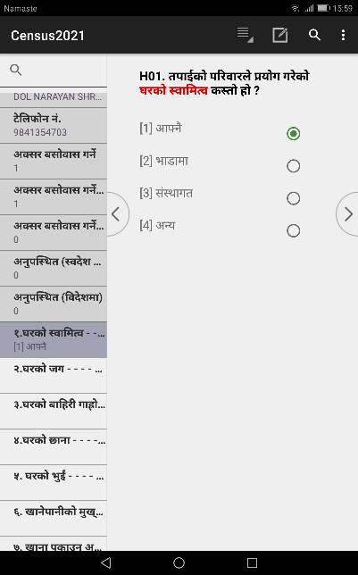
Navigation Key :
Navigation Key > df lSns ubf{ Ps l:qmg k5f8L hfg]5 eg] < df lSns ubf{ Ps l:qmg cuf8L hfg]5 . cyf{t ;fdfGotof Pp6f k|Zgaf6 cuf8Lsf] k|Zgdf jf k5f8Lsf] k|Zgdf hfg'kbf{ o;df Press ug{'kg]{5 . Back button df lSns ug{' eg]sf] cj:yfdf < df / Forward Button df lSns ug{' eg]sf] cj:yfdf > df lSns ug{] eGg] ;Dem'g'xf];\ .
Tablet sf] k'5f/sf button x?
Android Tablet sf] k'5f/df /x]sf tLg j6f button x? CSPro Application sf] Button x? xf]Ogg\ oL Button x? 6\ofan]6sf] Button xf], h'g dxTjk"0f{ 5g\ . oL button x? dWo] n] application back ug]{5, button n] v'Nnf ePsf] application minimize ug]{5 / button n] v'n]/ minimize ePsf application x? s'g active ug]{ eg]/ 5fGgsf] nflu b]lvg]5 . Button n] application g} Close ug]{ ePsf]n] of] Button k|of]u ubf{ lj:tf/} xf]l;of/Lsf ;fy ug{' kb{5 .
Tablet sf] k'5f/sf] Tringle Button df lSns ug{' eg]sf] cj:yfdf Button df lSns ug{'xf]nf . Square Button df lSns ug{' eg]sf] cj:yfdf Button df lSns ug{'xf]nf .

Slide 24
Down Key
olb text field jf numeric field 5 eg] Keyboard/Numeric Key Pad b]lvg] 5 . Keyboard/Numeric Key pad aGb ug{ cfjZos ePdf of] Key df Press ug{ ;lsG5 . of] key press ubf{ Keyboard/Numeric Key Pad aGb x'g]5 . of] button keyboard jf numeric Key pad cfPsf] a]nfdf dfq b]lvg]5 .
Tringle (Back) button
of] Key df Press ubf{ clxn] v'n]sf] jf Add mode /x]sf] Program Close x'g]5 . cyf{t k|f]u|fdsf] Add mode jf Edit Mode af6 Stop Mode df hfg]5 . of] dxTjk"0f{ Key xf] lsgeg] o;n] Add jf Edit mode af6 Stop mode df Nofpg] 5 . of] key press ug{' cl3 tkfO{n] clxn] ;Dd e/]sf ljj/0fx? ;'/lIft (Save) ePsf] ;'lglZrt x'g'kg]{5 . Mode Stop ePsf] cj:yfdf clxn] ;Dd el/Psf 3/kl/jf/x?sf] ln:6 / ;+Vof b]lvg] 5 . olb Mode Stop ePsf] cj:yfdf k]m/L Back Arrow Key press u/]df k|f]u|fd g} Close x'g]5 . Mode Stop ePsf] a]nfdf gofF kl/jf/sf] af/]df OG6«L ug{' k/]df + sign (Add button) df Click ug{' kb{5 . olb 8f6f OG6«L eO{ /x]sf] a]nfdf Back Key press u/]df 8f6f save geO{ stop Mode df hfg]5 . t;y{ of] Key press ug]{ a]nfdf xf]l;of/L k'/\ofpg' kb{5 .

Slide 25
Circle (Minimize) button
of] Key df Press ubf{ clxn] v'n]sf] Application aGb geO{ Minimize x'g]5 / k]m/L Tolx 7fpFdf Tolx l:ytLdf Nofpg ;S5f}+ .
Square (Restore) button
of] Key df Press ubf{ Minimize ePsf k|f]u|fdx? b]lvg] 5 / To;dWo] s'g k|f]u|fdnfO{ Restore [jf active] ug]{ xf] Tof] k|f]u|fdnfO{ Click ug{'kg]{5 .
Left or Right Navigation Key
< >
of] Key df Press ubf{ Ps Screen cuf8L jf k5f8L hfg]5 . To;/L hfFbf k|Zgx?sf] pQ/sf aLr ;fdfGh:tf kl/If0f u/L hfg]5 . olb k|Zgx?sf] pQ/sf] ljrdf ;fdfGh:otf 5}g eg] error jf warning message cfpg]5 . error message cfPsf] cj:yfdf cuf8L a9\g] 5}g . Warning Message cfPsf] v08df u0fsn] ljj]s k|of]u ug{'kg]{5 . 5gf}6 ul/Psf] ljsNk pQ/bftfsf] jf:tljstf g} xf] ls 5gf}6 ubf{ uNtL x'g uPsf] xf] . olb pQ/bftfsf] af:tljstf xf] eg] ;'wf/ gu/L cuf8L a9\g' kb{5 eg] xfdLn] 5gf}6 ubf{ jf n]Vbf uNtL x'g uPsf] xf] eg] ;'wf/ u/L cuf8L a9\g' kb{5 .

Slide 26
System Button of CSEntry ( )
nut ;+sngsf] PlKns]zg ;'rf? (Run) eO{/x]sf] cj:yfdf 6\ofan]6sf] Top Right Corner df /x]sf] Button lyRbf tnsf laNsNkx? b]lvg] 5g\ h;sf] sfd 5f]6sf/Ldf lgDgfg';f/ /x]sf] 5 .
Change Language : o; af6 PlKns]zgsf] efiff kl/jt{g ug{ ;lsg]5 .
Advance to End : o; af6 Modification u/]sf] cj:yfdf PlKns]zgsf] h'g;'s} efuaf6 k"0f{?kdf Save u/L Close ug{ ;lsg]5 . Data Modification df of] Option clt pkof]uL x'g]5 .
Hide/Show Navigation Controls : o; af6 Navigation Key On/Off ug{ ;lsg]5 .
Hide/Show Case Tree : o; af6 Left Panel On/Off ug{ ;lsg]5 .
User's Button
PlKns]zgsf] cfjZostf x]/L PlKns]zg lgdf{0fstf{n] ljz]if sfdsf] nflu Button agfPsf] x'G5 . of] PlKns]zgsf] cfjZostf cg';f/ km/s km/s x'g] ePsf]n] ;DalGwt PlKns]zg d} User's Button sf] af/]df rrf{ ul/Psf] 5 . oxfF User's button sf] nflu of] button k|of]u ug{ ;lsG5 eGg] dfq b]vfOPsf] 5 .

Slide 27
hgu0fgf d'Vo k|ZgfjnLsf] nut ;+sng

Slide 28

3/kl/jf/ d'Vo k|ZgfjnLsf] nut ;+sng ;DalGwt hfgsf/L -u0fs / ;'kl/j]Ifssf] nflu_
hgu0fgfsf $ k|sf/sf k|ZgfjnL jf kmf/fd dWo] u0fsn] hgu0fgf d'Vo k|ZgfjnLsf] nut ;+sng ug]{ 5 .
of] hgu0fgfsf] d'Vo k|ZgfjnL xf] .
3/kl/jf/ d'Vo k|ZgfjnLsf] nut ;+sng sfo{ s;/L ;'?jft ug]{
!= /fli6«o hgu0fgf @)^* sf] nut Joj:yfkg k|0ffnLsf] d]g' k|0ffnL Run ug{] -Click on CSEntry)
@= ROLE: -3_ u0fs 5fGg'xf];\ . of] Ps k6s 5fg]kl5 k6s k6s OG6«L u/L/xg' kg]{5}g . Device sf] memory df Save x'g]5 / ;f]xL sf]8 Automatic cfpg] 5 .
#= ACTION: nut ;+sngsf] nflu ACTION df 1.Data Entry (Interview) 5fGg'xf];\ .
$= MODULE: 3. Census Main Questionnaire 5fGg'xf];\ .
Click this icon

Slide 29
%= ef}uf]lns If]qsf] klxrfg (Identification of Geographic Area)
o; cGt/ut tkfO{n] sfd ug{' kg]{ :yfgsf] ef}uf]lns klxrfg (Geographical Identification) k|lji6L ug{'kg]{5 .
PROVINCE: tkfO{n] sfd ug{ nfUg'ePsf] k|b]z s'g xf] ;f] k|b]zsf] gfd 5fGg'xf];\ .
DISTRICT: tkfO{n] sfd ug{ nfUg'ePsf] lhNnf s'g xf] ;f] lhNnfsf] gfd 5fGg'xf];\ .
GAPA/NAPA: tkfO{n] sfd ug{ nfUg'ePsf] ufpFkflnsf÷gu/kflnsf s'g xf] ;f] ufpFkflnsf÷gu/kflnsfsf] gfd 5fGg'xf];\ .
Ward: tkfO{n] sfd ug{ nfUg'ePsf] j8f g+= slt xf] ;f] j8f g+= n]Vg'xf];\ .
EA: tkfO{nfO{ sfd ug{ tf]lsPsf] u0fgf If]q slt xf] ;f] u0fgf If]q n]Vg'xf];\ .
BLOCK: olb Pp6f u0fgf If]qdf Ps} hgf u0fsn] hgu0fgfsf] sfd ug]{ ePdf Ans 5}g eGgsf] nflu X 5fGg' kb{5 . olb Ps hgf u0fsn] Pp6f u0fgf If]qdf sfd ug{ g;sfpg] eP/ Ps eGbf a9L u0fs k|of]u u/]sf] eP lhNnf hgu0fgf clwsf/Lsf] k|ToIf lgb]{zgdf klxnf] u0fsn] Ans A, bf];|f] u0fsn] Ans B, t];|f] u0fsn] Ans C 5fGg' kb{5 .

Slide 30
^= ENUMERATOR: lhNnf hgu0fgf sfof{non] u0fssf] nflu pknAw u/fPsf] IDCODE oxfF k|lji6L ug{' kb{5 . Enumerator sf] ID entry u/L;s]kl5 u0fsnfO{ sfd ug{ tf]lsPsf] ljj/0f l;:6daf6 lng]5 . olb l;:6d kmfOndf tkfO{sf] ID code k]mnf kf/]g jf tkfO{nfO{ lhNnf hgu0fgf clwsf/Ln] tf]sf] :yfg eGbf tkfO{n] k|lji6L u/]sf] ef}uf]lns klxrfg ldn]g eg] unt ;"rgf cfO{ cuf8L a9\g] 5}g .
&= Interview Date (Month/Day): tkfO{n] nut ;+sng ug{ nfUg' ePsf] ldlt s'g xf] -dlxgf / ut]_ < ;f] n]Vg' kb{5 .
*= TABLET NUMBER: hgu0fgfsf] lkmN8 sfo{df tkfO{nfO{ pknAw u/fPsf] 6\ofan]6sf] gDa/ slt xf], 6\ofan]6sf] k5f8L k§L n]lvPsf] gDa/ x]/L n]Vg' kb{5 .
(= Is Correct: tkfO{n] o; 5fg]sf jf OG6«L u/]sf] ljj/0fx? l7s 5 eg]/ ;f]lwPsf] xf] . olb l7s 5 eg] Yes 5fGg'xf];\, xf]Og 5fg]sf] jf OG6«L u/]sf] ldn]sf] 5}g eg] NO 5fg]/ ;'wf/ ug{' kg]{5 .
!)= Are you sure to Proceed : cj tkfO{n] 5fg]sf] Action cg'';f/sf] sfd ug{ hfgsf] nflu clGtd :jLs[lt lnOPsf] xf] . oxfF Yes 5fg]df Action df 5fg] cg';f/sf] sfd ug{ hfg]5 . h:t} olb 8f6f OG6«L 5fg]sf] 5 eg] nut ;+sngsf] PlKns]zg v'Ng]5 . Synchronization 5fg]sf] 5 ;f] ;f]lx cg';f/sf] action df hfg]5 . t;y{ oxfF clGtd k6s cuf8L a9\g] ls ga9\g] eg]/ ;f]Wg]5 . olb Yes 5fg]sf] v08df cuf8L a9\g]5 / No 5fg]sf] v08df Menu system d} /xg] 5, cuf8L a9\g] 5}g .

Slide 31
Tablet Number : 6\ofan]6sf] k5f8L :6Ls/df n]lvPsf] 6\ofan]6 gDa/ n]Vg'xf];\ .
Type of Household :
;fdfGo 3/kl/jf/ M ;fdfGo 3/kl/jf/sf] d'Vo k|ZgfjnL eg{ uO{ /xg' ePsf] eP ;fdfGo 3/kl/jf/ 5fGg'xf];\ .
  ;+:yfut 3/kl/jf/ M ;d"xdf a;f]jf; ePsf] 3/kl/jf/df hgu0fgf d'Vo k|ZgfjnL eg{ uO{ /xg' ePsf] eP ;+:yfut 3/kl/jf/ 5fGg'xf];\ .
  3/af/ lalxg M 3/af/ lalxgx?sf] hgu0fgf d'Vo k|ZgfjnL eg{ uO{/xg' ePsf] xf] eg] 3/af/ lalxg 5fGg'xf];\ .
lkmN8 sfo{sf] ldlt -dlxgf / ut]_ Mnut ;+sng ug{ uO{ /x]sf] dlxgf / ut] n]Vg'xf];\ .
Is Correct ? : tkfO{n] o; cl3 5fg]sf] jf OG6«L u/]sf] ljj/0fx? l7s 5 eg] Yes 5fGg'xf];\ .
Do you want to proceed ? : tkfO{n] 5fg]sf] jf OG6«L u/]sf] ljsNk cg';f/sf] sfd ug{ hfgsf] nflu Yes 5fGg'xf];\ .

Slide 32
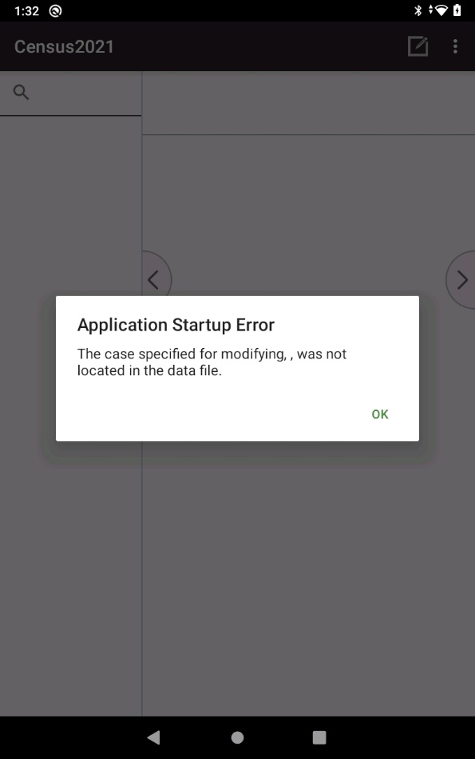
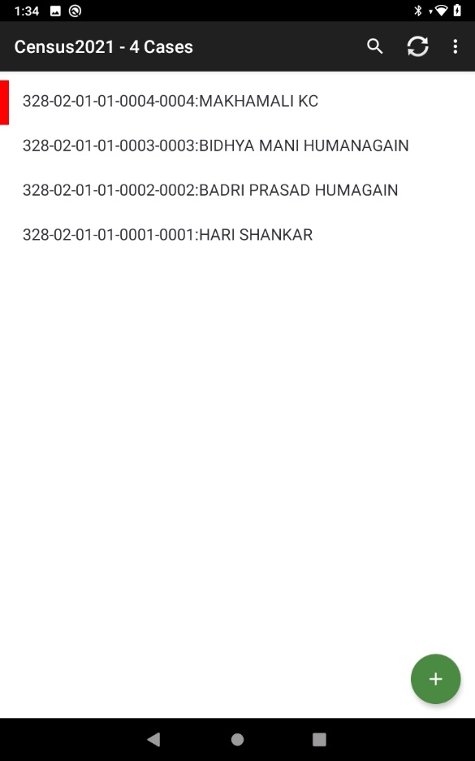
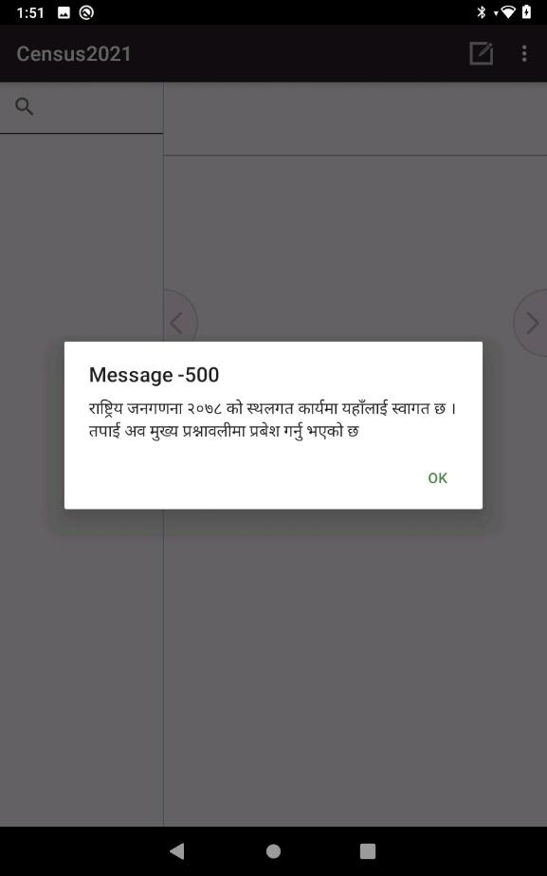
d]g' l;:6ddf Do you want to Proceed < df Yes df lSns u/kl5 tnsf] l:qmg cfpg] 5 . cj tkfO{ lnl6ªsf] nut ;+sngsf] nflu agfOPsf] PlKns]zg v'Ng]5 . d]g' l;:6daf6 3/kl/jf/ ;"lrs/0f kmf/fddf k|j]z u/]sf] hfgsf/Lsf] ;"rgf æ/fli6«o hgu0fgfsf] lkmN8 sfo{df oxfFnfO{ :jfut 5 . ca tkfO{ 3/kl/jf/ ;"lrs/0f kmf/fddf k|j]z ug{'ePsf] 5Æ cfP kl5 k|f]u|fd 8f6fOG6«L -k|ZgfjnL eg]{_ cj:yfdf hfg]5 . o;df Ok df click u/kl5 tnsf] l:qmg cfpg]5 .
Pp6f u0fgf If]qdf hltklg 3/kl/jf/x? 5g\ tL ;a} 3/kl/jf/x?sf] cnu cnu Case aGg] 5 .
klxn] O{G6«L ePsf] 3/kl/jf/sf] ljj/0f ;Rofpg' k/]df ;DalGwt 3/kl/jf/sf] Case df Click ug{' xf]nf .
Ok df lSns ug{'xf]nf .
Pp6f klg Case O{G6«L ePsf] 5}g eg] gof+ Case O{G6«L ug{sf] nflu + df Click ug{'xf]nf .

Slide 33
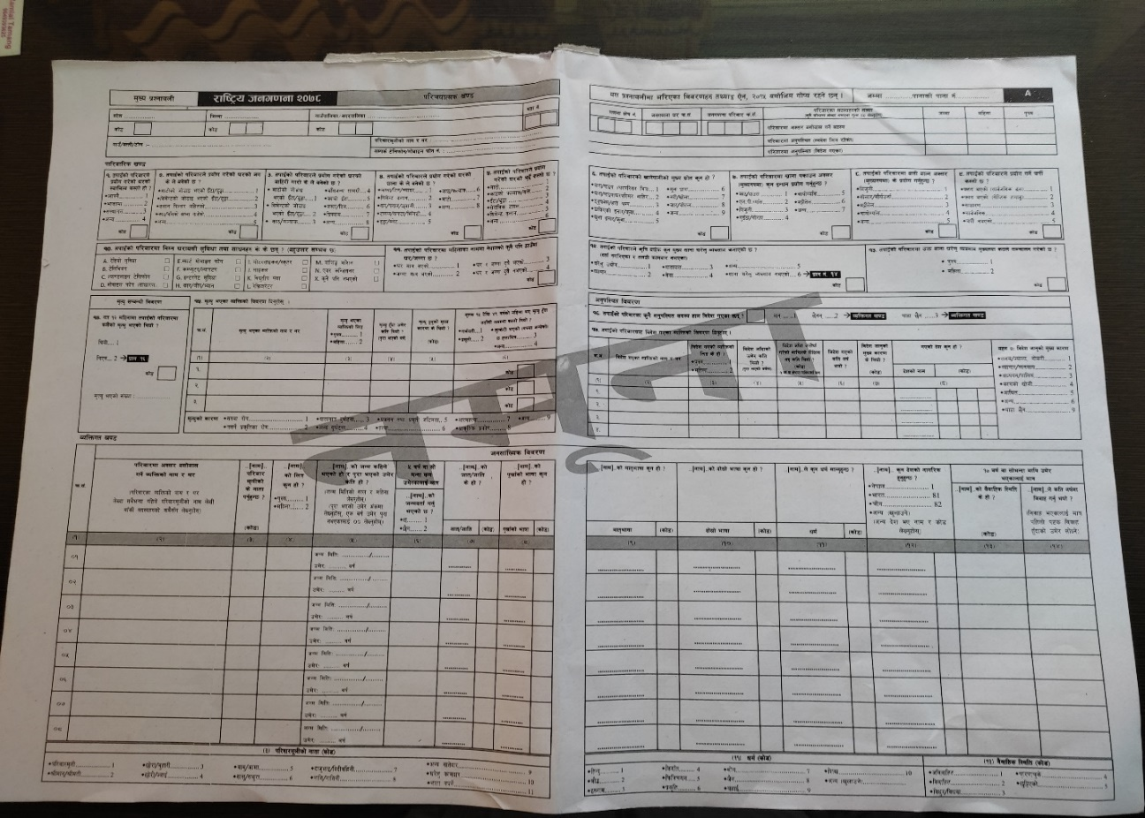
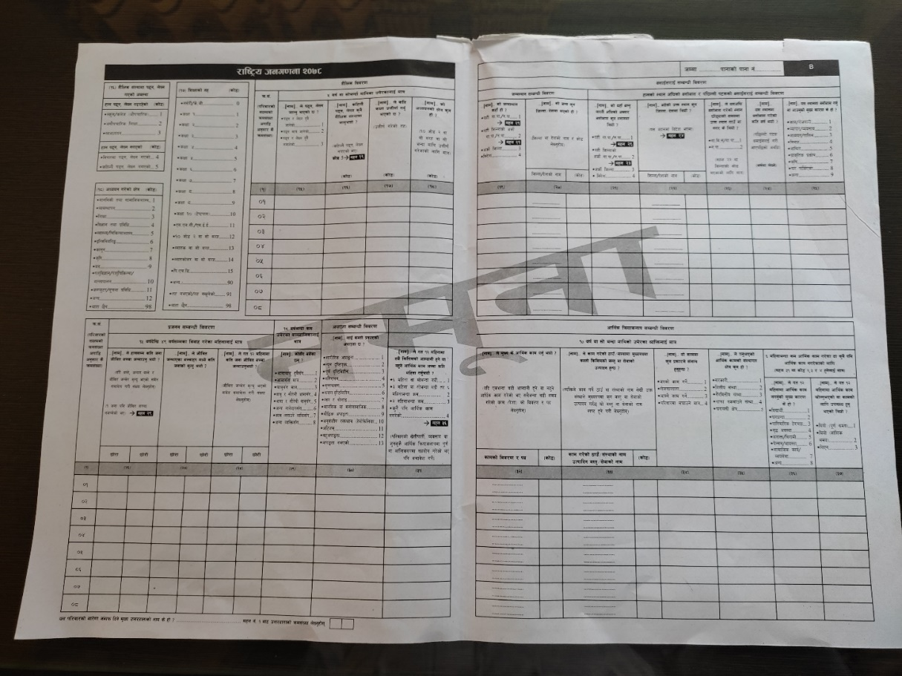
hgu0fgf d'Vo k|ZgfjnLsf] 6\ofan]6df nut ;+sngsf] axfj
1
2
3
4
1
2
1
3
2
4
3
4
gf]6M Pp6f 3/kl/jf/sf] nutsf] Pp6f Case x'g]5 .

Slide 34
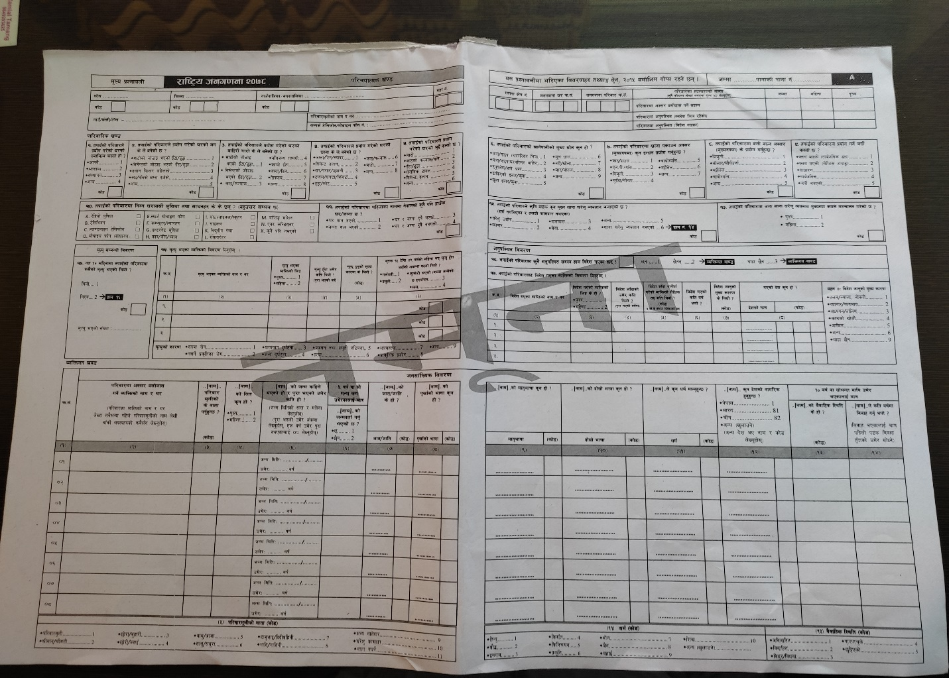
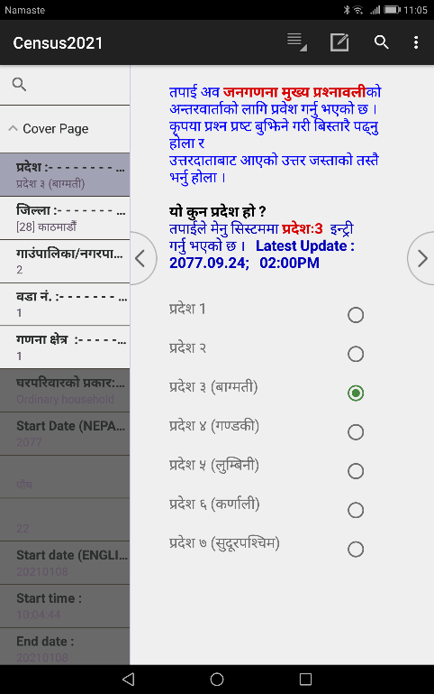
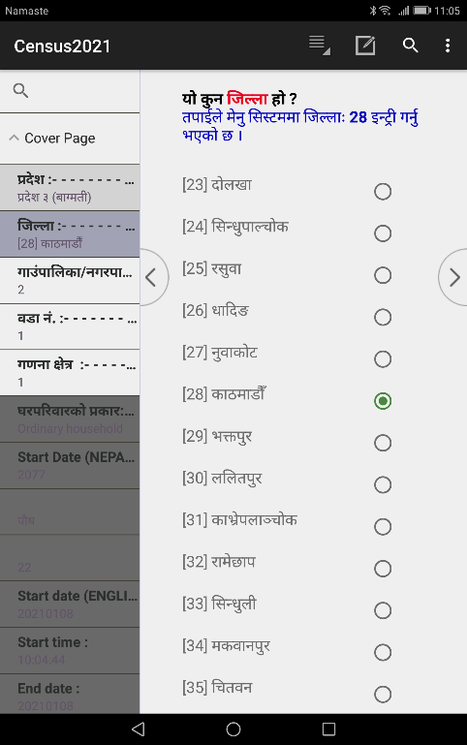
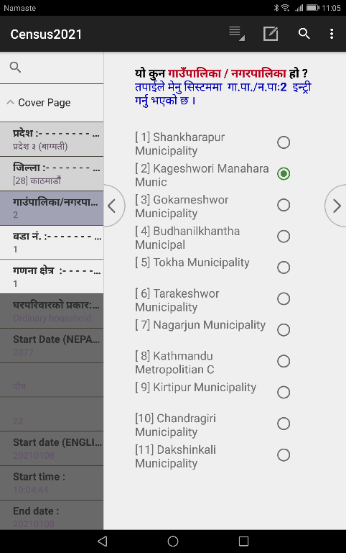
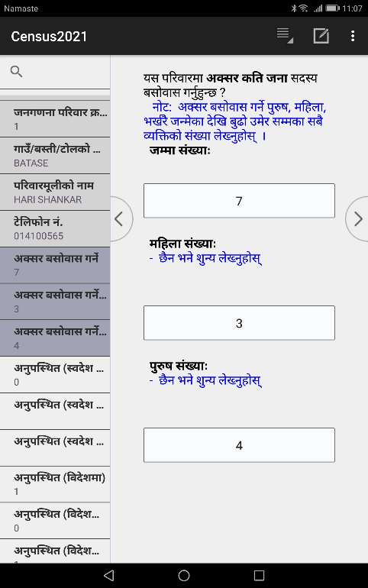
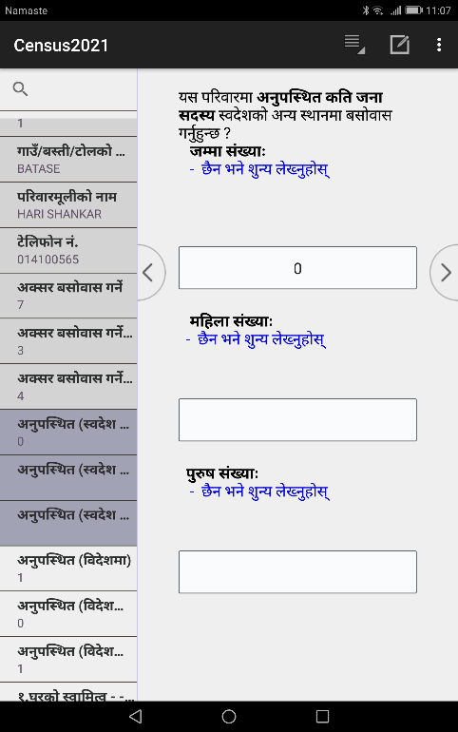
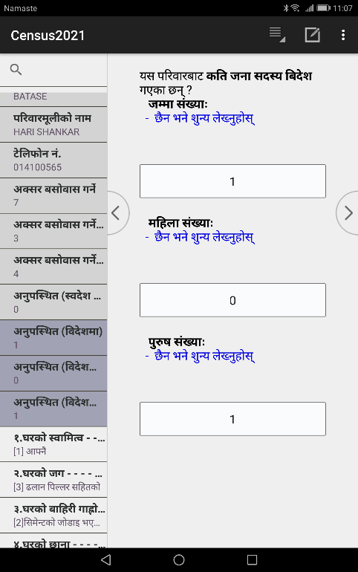
kl/rofTds ljj/0f
hgu0fgf d'Vo k|ZgfjnLsf] nut ;+sng ubf{ ;j}eGbf klxn] kl/rofTds ljj/0f eg{'kg]{5 . ef}uf]lns If]qsf] ljj/0f lbbf d]g' l;:6ddf h'g ef}uf]lns If]qsf] ljj/0f n]v]sf] xf] oxfF klg x'ax' ldNg' kb{5 . gldn]df unt ;Gb]z cfpg] 5 .
pbfx/0f nflu kl/rofTds ljj/0fsf s]xL k|Zgx?sf] 6\ofjn]6sf screen shot lgDgfg';f/ /x]sf] 5 .

Slide 35
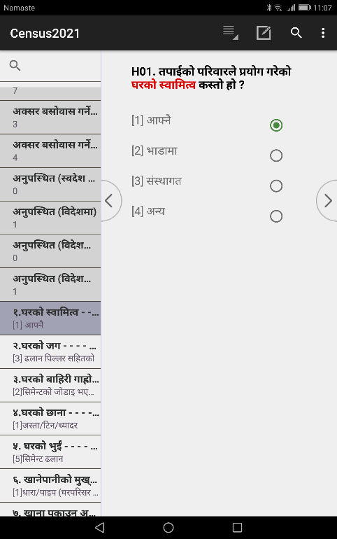
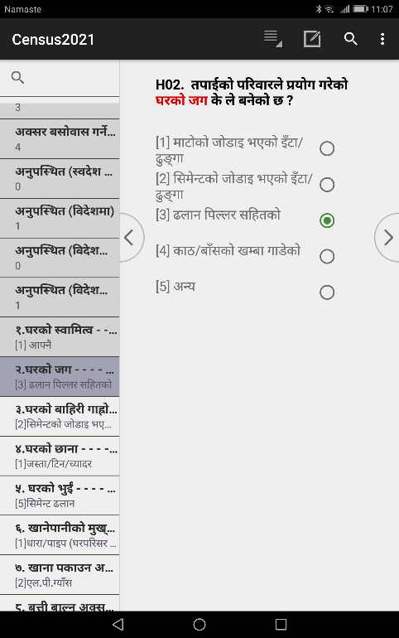
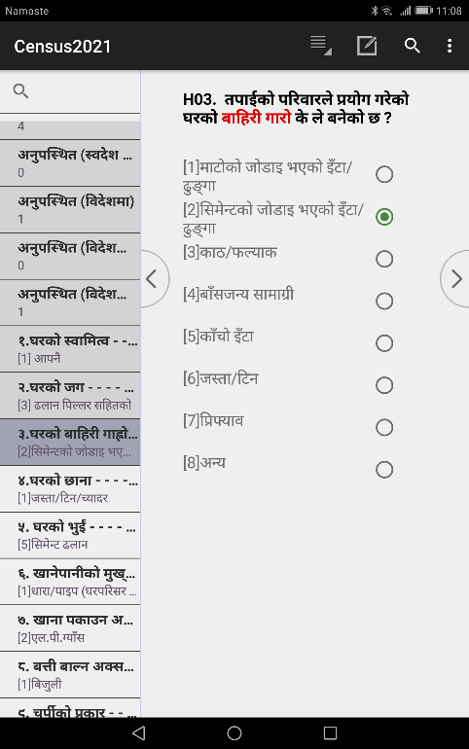
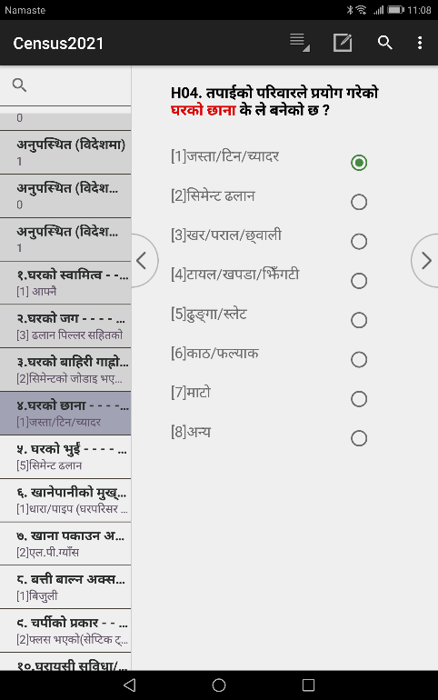
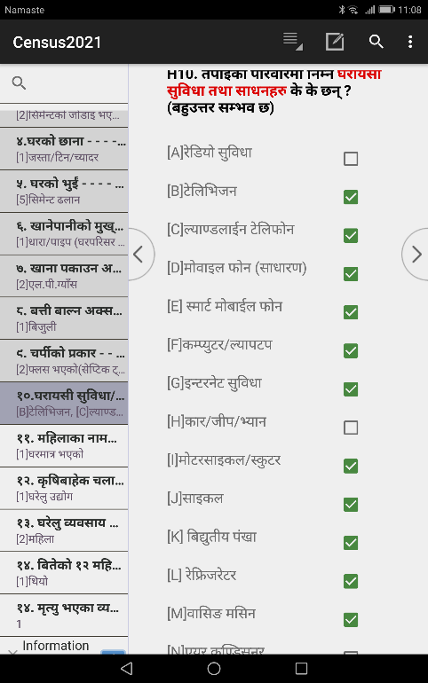
kfl/jfl/s ljj/0f
gf]6M pQ/ eg]{ qmddf Pp6f k|Zg / csf]{ k|Zgsf] ljrsf] ;fdfGh:otf gldn]df ;r]t tyf uNtL ;Gb]z cfpg]5 . lj:t[t ljj/0fsf] nflu ;fdGh:otf ;]S;g x]g{'xf]nf .

Slide 36
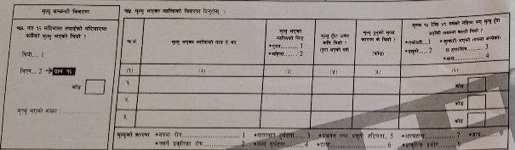
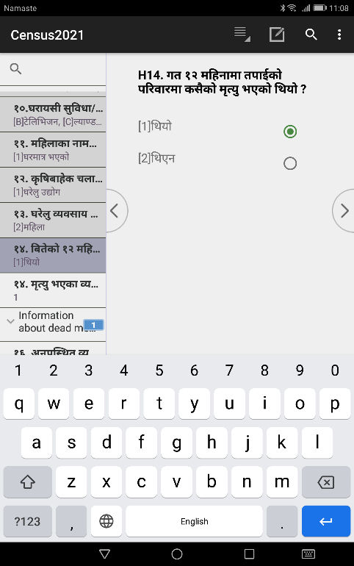
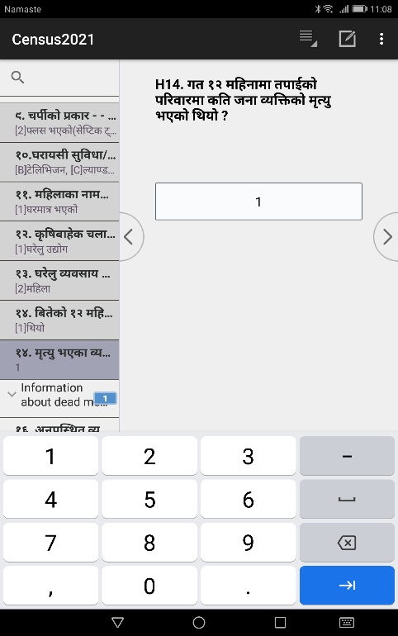
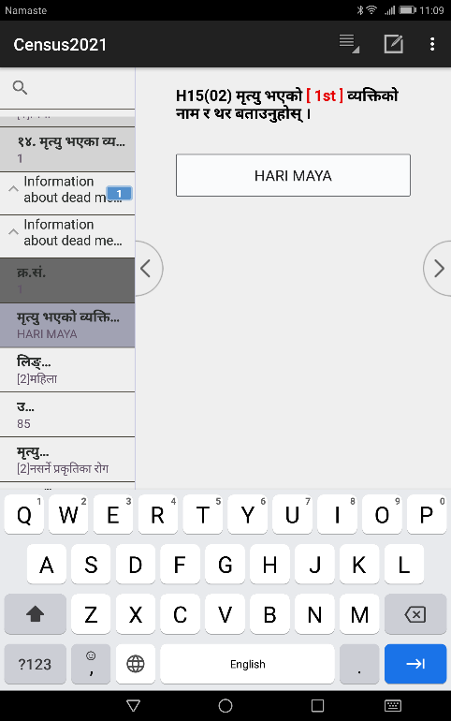
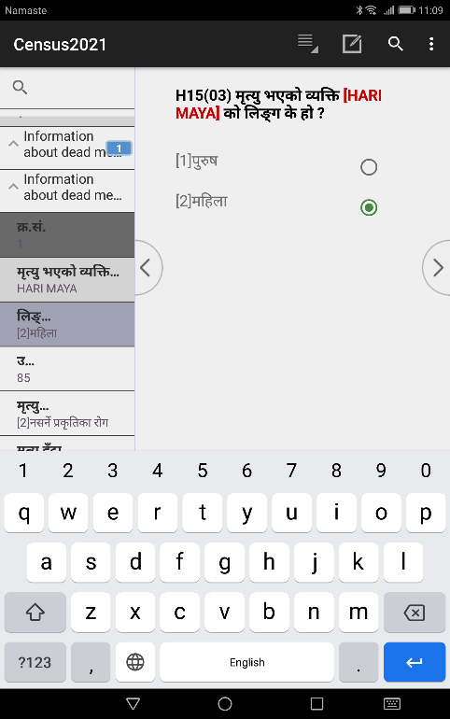
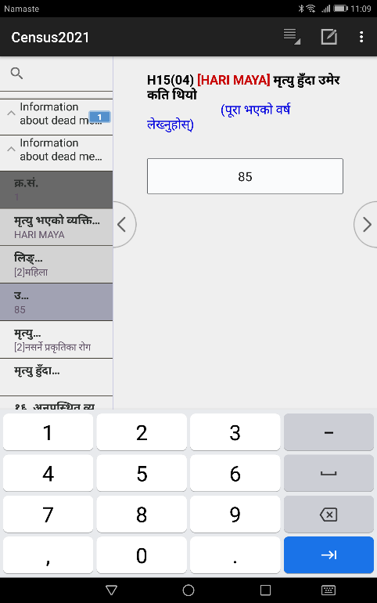
d[To' ;DaGwL ljj/0f
olb 3/kl/jf/df ljut ! jif{ leq kl/jf/sf ;b:osf] d[To' ePsf] 5 eg] ækl/jf/df ljut ! jif{df s;}sf] d[To' ePsf] lyof] <Æ eGg] k|Zgdf æ!= lyof]Æ eg]/ 5fGg'kb{5 / slt hgf JolQmsf] d[To' ePsf] lyof] ;f] ;+Vof n]Vg' kb{5 . oxfF hlt hgf JolQmsf] d[To' ePsf] lyof] Tolt g} hgf JolQmsf] ljj/0fsf] af/]df nut ;+sng ug{' kb{5 . olb d[To' ePsf] 5}g eg] æ@= lyPgÆ eg]/ 5fGg'kb{5 .

Slide 37

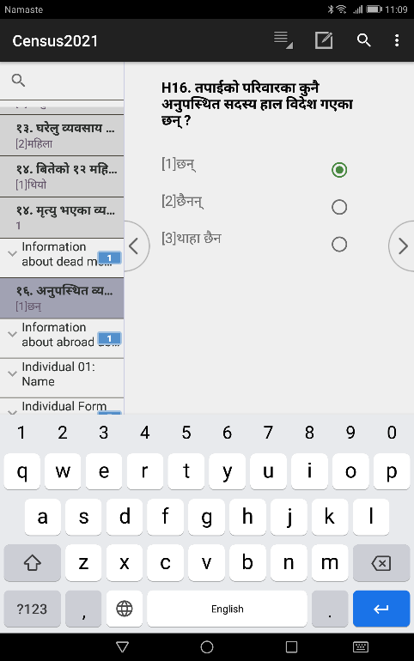
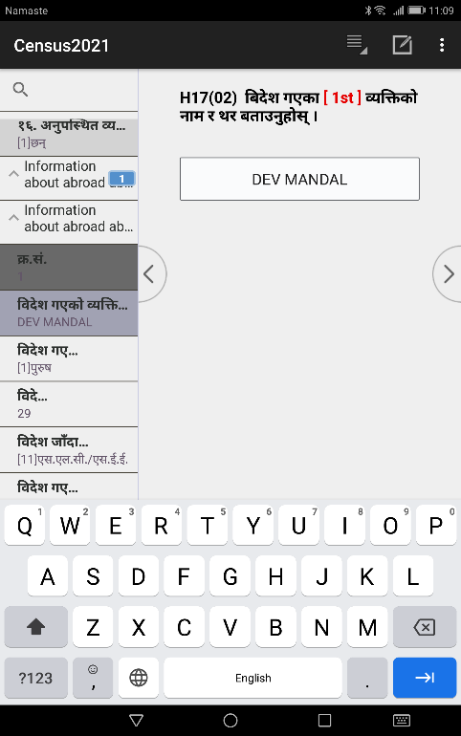
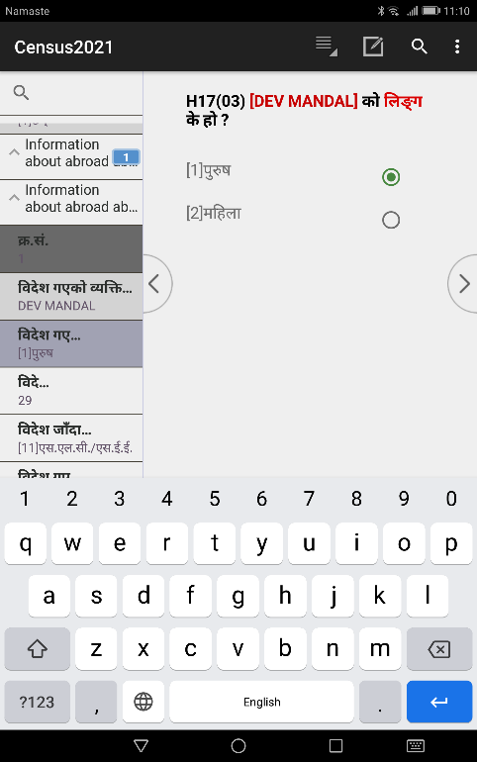
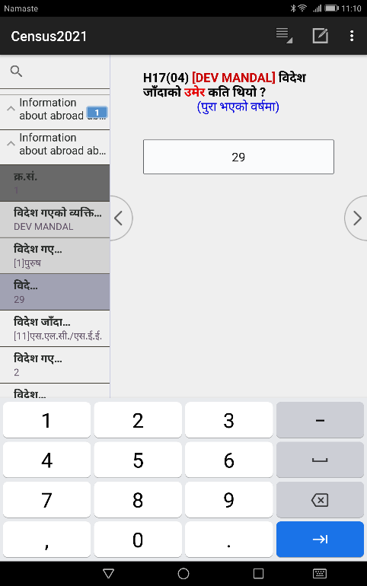
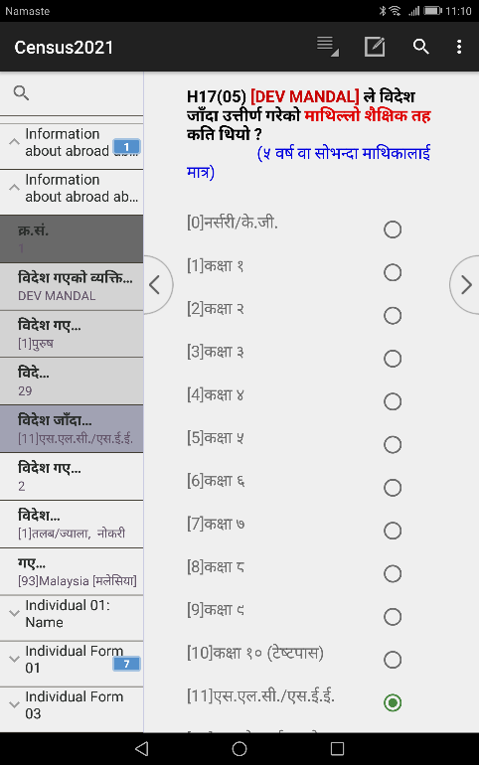
ljb]z cg'kl:yt ;DaGwL ljj/0f
olb 3/kl/jf/sf ;b:o dWo] sf]xL ;b:o ljb]zdf cg'kl:yt ePsf] eP kl/rofTds ljj/0fdf cg'kl:yt ljb]z uPsf ;+Vofsf] nx/df dlxnf / k'?ifsf] ;+Vof n]lvPsf] x'g]5 . kl/rofTds ljj/0fdf slt hgf JolQm ljb]zdf cg'kl:yt x'g'x'G5 oxfF Tolt g} hgf JolQm -dlxnf / k'?if ;d]t_ sf] ljj/0f cfpg' kg]{5 . Pp6f JolQmsf] ljj/0f el/ ;s]kl5 bf];|f] JolQmsf] af/]df ;f]Wg]5.

Slide 38
JolQmut v08
hgu0fgf d'Vo k|ZgfjnLsf] 6\ofan]6df nut ;+sngsf] axfj
JolQmut ljj/0fsf] nut ;+sng ubf{ k|To]s JolQmsf] gfd b]lv ;Dk"0f{ ljj/0f Ps} k6s ;f]4f s'g} JolQmsf] ljj/0f ;f]Wg 5'6\g ;S5 -h:t} ev{/} hGd]sf afnaflnsf, kl/jf/sf h]i7 ;b:o cflb_ t;y{ oxfF JolQmsf] lj:t[t ljj/0f ;f]Wg' cl3 pQm 3/kl/jf/df sf] sf] JolQm cS;/ ?kdf a;f]jf; ug{'x'G5 kl/jf/d"nL b]lv lnP/ kfl/jfl/s xfFuf] (Family Tree) cg';f/ kl/jf/sf ;a} JolQmsf] gfd n]Vg] / To;kl5 qmd};Fu k|To]s JolQmsf] cnu cnu ljj/0f lng] u/L PlKns]zgsf] 9fFrf tof/ kfl/Psf] 5 . kl/jf/df cS;/ a;f]jf; ug]{ JolQm slt hgf 5g\ tL JolQmsf] gfd qmd};Fu ;f]lw ;s]kl5 bf];|f] r/0fdf klxnf] JolQmb]lv k|To]s JolQmsf] JolQmut ;Dk"0f{ ljj/0fx? ;f]Wg] 5 . Pp6f JolQmsf] ;Dk"0f{ ljj/0f eg{ ;lsPkl5 bf];|f] JolQmsf], t];|f] JolQmsf] u/L ;Dk"0f{ JolQmsf] ljj/0f ;f]Wg] 5 .
l;=g+= | kl/jf/df cS;/ a;f]jf; ug]{ JolQmsf] gfd / y/ -kl/jf/sf JolQmsf] gfd / y/ n]Vbf ;a}eGbf klxn] kl/jf/d"nLsf] gfd n]vL afFsL ;b:ox?sf] qmd};Fu n]Vg'xf];\_
-!_ | -@_
!
@
#
$
%
^
&
*

Slide 39
hgu0fgf d'Vo k|ZgfjnLsf] 6\ofan]6df nut ;+sngsf] axfj
l;=g+= | [gfd] kl/jf/d"nLsf] s] gftf kg{'x'G5 < | [gfd] sf] lnË s'g xf] < | ….. | [gfd] n] slt jif{df ljjfx ug{' eof] < |  | l;=g+= | [gfd] n] k9\n n]Vg hfGg' ePsf] 5 < | ….. | [gfd] o; :yfgdf a;f]jf; ug{' jf cfpg'sf] d'Vo sf/0f s] xf] < |  | l;=g+= | [gfd] xfn;Dd slt hgf hLljt aRrf hGdfpg' eof] < |  | ….. | [gfd] n] ut !@ dlxgfdf cfly{s sfd vf]Hg'ePsf] jf sfdsf] nflu pknAw x'g' ePsf] lyof] <
 |  | k'?if =====!
 |  | dlxnf ====@ |  |  |  |  |  |  |  |  |  | 5f]/f | 5f]/L
-!_ | -#_ | -#_ | .... | -!$_ |  | -!_ | -!%_ | .... | -@%_ |  | -!_ | -@^_ |  | .... | -#&_
! |  |  | ….. |  |  | ! |  | ….. |  |  | ! |  |  | …..
@ |  |  | ….. |  |  | @ |  | ….. |  |  | @ |  |  | …..
# |  |  | ….. |  |  | # |  | ….. |  |  | # |  |  | …..
$ |  |  | ….. |  |  | $ |  | ….. |  |  | $ |  |  | …..
% |  |  | ….. |  |  | % |  | ….. |  |  | % |  |  | …..
^ |  |  | ….. |  |  | ^ |  | ….. |  |  | ^ |  |  | …..
& |  |  | ….. |  |  | & |  | ….. |  |  | & |  |  | …..
* |  |  | ….. |  |  | * |  | ….. |  |  | * |  |  | …..

Slide 40
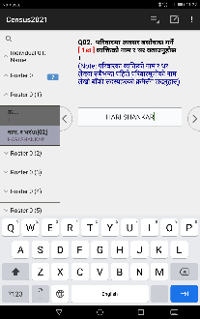
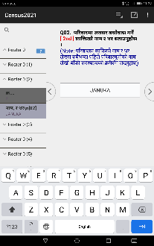
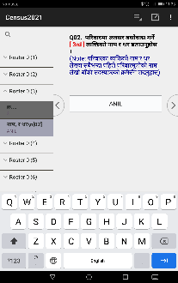

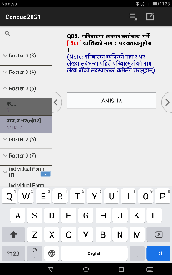
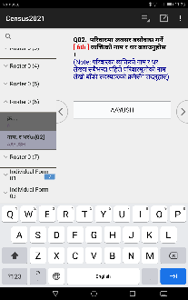
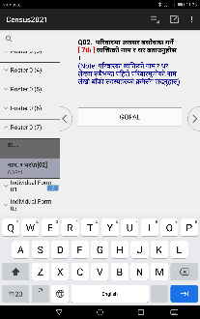
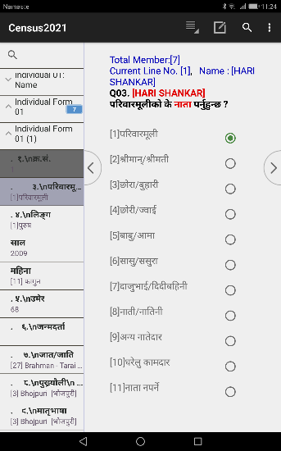
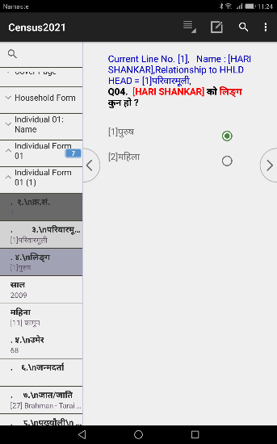
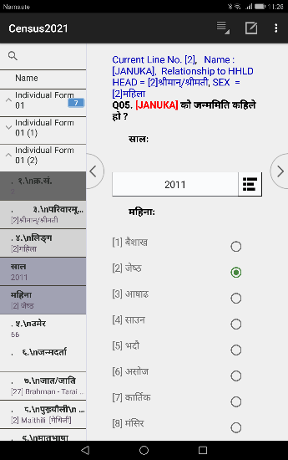
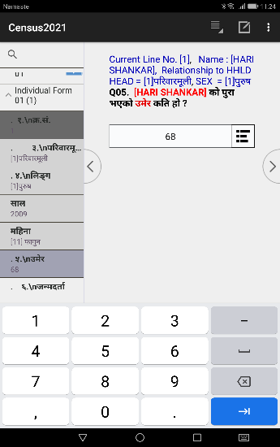



JolQmut k|ZgfjnLsf] 6\ofjn]6sf] s]xL Screen shot
kfl/jfl/s xfFuf] (Family Tree) cg';f/sf] 3/kl/jf/sf k|To]s JolQmsf] gfd
klxnf] JolQmsf] ljj/0f

Slide 41








bf];|f] JolQmsf] ljj/0f
…….>
clGtd JolQmsf] ljj/0f
…….>

Slide 42

Other Answer
s'g} s'g} k|Zgdf xfn eO{/x]sf] 5gf}6 ljsNkeGbf afx]s cfpg] c? pQ/x? klg dxTjk"0f{ x'g ;S5 . t;y{ k|ZGffjnLdf ePsf pQ/x? eGbf afx]s æcGoÆ pQ/ cfPdf cGo eg]sf] s] xf] Text d} pQ/ n]lv nut k|ljli6sf] sfo{ ;DkGg ePkZrft cGodf cfPsf pQ/x?nfO{ ljZn]if0f ug{ ;lsG5 . o;/L ljZn]i0f u/L cGodf Ps} lsl;dsf] w]/} pQ/ cfPdf 5'6\6} 5gf}6 ljsNk agfpg ;lsG5 eg] ToxfF ePs} 5gf}6 ljsNkdf kg{' kg]{ t/ pQ/bftf jf k|Zgstf{n] ga'emL cGodf /flv lbPsf] /x]5 eg] ToxfF ePs} s'g} ljsNkdf ;dfof]hg ug{ klg ;lsG5 jf cGodf guGo dfqfdf pQ/ cfPsf] 5 eg] To:tf] cj:yfdf æcGoÆ ljsNkd} /fVg klg ;lsG5 .
/fli6«o hgu0fgf @)&* df k|of]u ePsf] k|ZgfjnLdf hDdf % k|sf/sf k|ZgfjnLdf cGodf pQ/ cfPdf Tof] cGo eg]sf] s] xf] elg v'nfpg' kg]{5 . o:tf] cj:yfdf cGo sf]8 n]Vgf;fy Pp6f cGo eg]sf] s] xf] Text n]Vgsf] nflu 5'6\6} Secondary form v'Ng]5 .
/fli6«o hgu0fgf @)&* df cGodf pQ/ cfPdf v'nfpg' kg]{ k|Zgx? / cGosf] sf]8 lgDgfg';f/ /x]sf] 5 .
l;=g+= | k|Zg g+= | k|Zg | cGosf] sf]8 | s}lkmot
!= | Q07 | [gfd] sf] hfthflt s] xf] < | 996
@= | Q08 | [gfd] sf] k'vf{sf] efiff s'g xf] < | 996
#= | Q09 | [gfd] sf] dft[efiff s'g xf] < | 996
$= | Q10 | [gfd] sf] bf];|f]efiff s'g xf] < | 996
%= | Q11 | [gfd] n] s'g wd{ dfGg'x'G5 < | 96

Slide 43

SAVE CASE
ADD NEW CASE (ADD MODE)
d]g' l;:6daf6 k|ZgfjnLdf k|j]z u/]sf] hfgsf/Lsf] ;"rgf æ/fli6«o hgu0fgf @)&* sf] :ynut sfo{df oxfFnfO{ :jfut 5 . ca tkfO{ hgu0fgf d'Vo k|ZgfjnLdf k|j]z ug{'ePsf] 5Æ eGg] Message cfP kl5 k|f]u|fd nut ;+sngsf] -k|ZgfjnL eg]{_ cj:yfdf hfg]5 . Tof] eg]sf] 6\ofan]6sf] l:qmgdf ætkfO{n] sfd ug{ nfUg' ePsf] k|b]z s'g xf] <Æ eGg] k|Zg cfpg] 5 . of] cfPdf 8f6f OG6«L PlKns]zg Add mode df /x]sf] eg]/ yfxf kfpg' kg]{5 . olb 8f6f OG6«L PlKns]zg STOP MODE df 5 eg] 6\ofan]6sf] k'5f/df /x]sf] + sign df lSns u/L Add Mode df hfg ;lsg]5 .
SAVE CASE
Pp6f 3/kl/jf/sf] kfl/jfl/s ljj/0f / kl/jf/sf ;Dk"0f{ JolQmsf] JolQmut ljj/0f ;+sng ul/;s]kl5 ljj/0f pknAw u/fpg] JolQmsf] gfd ;f]Wg] 5 . ;f] JolQmsf] ljj/0f pknAw u/fO{;s]kl5 Accept this case ? eg]/ cfpg]5 Tolt a]nf Yes df Click ug{' kb{5 . olb 8f6f OG6«L k|f]u|fd EDIT/MODIFY Mode df uO{ klxn] e/]sf ljj/0fx? ;'wf/ ub}{ x'g'x'G5 eg] ljr}df Complete Save ug{ Tablet sf] Top Right Corner df ePsf] 7f8f] wsf{ - _ df Press u/L Advance to end df Click ug{'xf]nf .

Slide 44
Partial Save
hgu0fgf d'Vo k|ZgfjnLsf] nflu Partial save ug]{ cg'dlt lbO{Psf] 5}g . 3/kl/jf/sf] ljj/0f lng z'? u/]kl5 ;f] 3/kl/jf/sf] ;Dk"0f{ ljj/0f el/ ;Sg'kg]{5, lardf /f]Sg ldNg] 5}g .
STOP CASE (STOP MODE)
OG6«L ePsf 3/kl/jf/x?sf] ;"rL x]g{' k/]df, OG6«L eO{;s]sf 3/kl/jf/sf] ljj/0fdf ;Rofpg' k/]df jf OG6«L eO{;s]sf 3/kl/jf/ bf]xf]l/Psf] cj:yfdf d]6fpg' k/]df Add mode nfO{ stop ug{' kb{5 . Mode Stop ug{sf] nflu Tablet sf] k'5f/df /x]sf] Back button ( ) nfO{ Ps k6s lyRg' kb{5 . of] Button lyRg' cl3 clxn];Dd e/]sf 3/kl/jf/sf] ljj/0f k"0f{?kdf Save ePsf] ;'lglZrtt x'g'kg]{5 . Back Button prese ubf{ "________end Household Entry ? _______" cfpg] 5 olt a]nf olb 3/kl/jf/ ;"lrs/0f kmf/fdsf] O{G6«L PlKns]zgaf6 aflx/ hfg] xf] eg] Yes df lSns ug{'xf];\, 3/kl/jf/ ;"lrs/0f kmf/fdaf6 aflx/ guO{ Mode dfq} Stop ug]{ xf] eg] No ug{' kb{5 .
EDIT/MODIFY CASE
Edit/Modify Mode klg Add Mode h:t} xf] km/s olQ xf] ls o;df klxNo} el/Psf nut jf 5fg]sf ljsNkx? b]lvG5 eg] Add Mode df Data el/Psf] x'g] 5}g .
OG6«L ePsf 3/kl/jf/x?sf] ;"rL x]g{' k/]df jf OG6«L eO{;s]sf 3/kl/jf/sf] ljj/0fdf ;Rofpg' k/]df Add Mode stop ug{'kb{5 / h'g Household sf] Edit ug]{ xf] To;df lSns ug{' kb{5 . olb 8f6f OG6«L k|f]u|fd EDIT Mode df uO{ klxn] e/]sf ljj/0fx? ;'wf/ ub}{ x'g'x'G5 / ljr}df complete save ug{ 6\ofan]6sf] right top corner df /x]sf] 7f8f] wsf{df press u/L advance to end df click ug{' kb{5 .
DELETE CASE
OG6«L ePsf 3/kl/jf/x? x6fpg' 5 eg] / 8f6f OG6«L PlKns]zgsf] df]8 STOP ug{' kb{5 . h'g Household delete ug{'kg]{ xf] To;nfO{ select u/]/ Psl5g Hold ug{'xf];\ / delete df select ug{'xf];\ . gf]6M u0fs tyf ;'k/Lj]Ifsn] el/;s]sf nut d]6fpg ;Sg] 5}g . s]Gb|Lo ut JHoj:yfkgsf ;b:on] dfq el/;s]sf] nut d]6fpg ;Sg]5 .

Slide 45

hgu0fgf d'Vo k|ZgfjnLsf] 8f6f OG6«L k|f]u|fddf /flvPsf User's Button x? / To;sf] k|of]u
English Language : of] Button n] PlKns]zgnfO{ c+u|]hL jf g]kfnL efiffdf kl/jt{g ug]{5 .
Calculator : of] Button df Click ubf{ SofNs'n]6/ v'Ng]5 .
Show HHLD Member
of] Button df Click u/]sf v08df kl/jf/df /x]sf JolQmx?sf] ljj/0f gfd, kl/jf/d"nL;Fusf] gftf, lnË / pd]/ ;lxt b]vfpg] 5 .

Slide 46


3/kl/jf/ ;"lrs/0f kmf/fdsf] PlKns]zgdf k|of]u ePsf User's Button x?
GoTo …
of] Button df Click ubf{ ;DalGwt Section dWo] h'g Section 5fGof] To; Section sf] klxnf] lkmN8df Pointer hfg]5 .
olb Individual information 5fg]sf] v08df s'g JolQmsf]df hfg] xf] 5fGgsf] nflu JolQmx?sf] list cfpg]5 / h'g JolQm 5fGof] Tolx JolQmsf] ;DalGwt section sf] klxnf] lkmN8df hfg]5 . h:t}M olb Migration Section df Click u/]/ kl/jf/sf] t];|f] JolQmdf Click u/]sf] v08df t];|f] JolQmsf] Migration Section sf] klxnf] k|Zgdf hfg]5 .
gf]6 M olb Ps k6s Click ubf{ ;DalGwt 7fpFdf k'u]g eg] t'?Gt} k]m/L 5fGg'xf]nf

Slide 47



Household Report
of] Button df Click ubf{ clxn] h'g Hosuehold v'n]sf] 5 Tof] Household sf] OG6«L ePsf] 8f6f Html format df v'Ng]5 . 6\ofan]6 k|of]ustf{n] Pp6f 3/kl/jf/sf] ljj/0fx? Ps} 7fpFdf x]g{ ;s'g\ eg]/ of] Button sf] Joj:yf ul/Psf] 5 . of] Report v'n]sf] cj:yfdf o;nfO{ aGb ug{ Ps k6s 6\ofan]6sf] k'5f/df /x]sf] Back Button Press ug{'kb{5 .

Slide 48
cEof; M
! Hardcopy df pknAw u/fOPsf] slDtdf # j6f hgu0fgf d'Vo k|ZgfjnLsf] kmf/fd eg]{
@= cfkm\gf] 3/nfO{ cfwf/dfgL hgu0fgf d'Vo k|ZgfjnLsf] nut eg]{
#= rf/ hgfsf] u|'k agfO{ cfk'm' afx]s c?sf] df]s cGt/jftf{ u/L slDtdf # j6f 3/kl/jf/sf] df]s cGt/jftf{ ug]{
$= klxn] e/]sf 3/kl/jf/sf] nut ;'wf/ u/L x]g]{ / o;/L 3/kl/jf/sf] nut ;'wf/ ug{ hfFbf User's Button sf] k|of]u ug]{ .
%= User's Button x?sf] k|of]u u/L x]g]{ .
^=

Slide 49
hgu0fgf d'Vo k|ZgfjnL kmf/fdsf] ;fdGoh:otf ;DaGwL ljj/0f (Consistency Check)
d'Vo k|ZgfjnLsf] nut ;+sng jf 8f6f OG6«L ug]{ qmddf cfpg ;Sg] ;r]t tyf uNtLsf] ;Gb]zx? / To;sf] ;Defljt sf/0fsf] ljj/0f
Household Questionnaire
0001 of] PlKns]zg l;w} rNg] 5}g CENSUS DATA MANAGEMENT MENU SYSTEM af6 z'? ug{'xf]nf .
0003 ufpFkflnsf/gu/kflnsfsf ;DaGwL ljj/0f [GaunPalikaInfo.d%s] nf]8 x'g ;s]g
0004 hft / dft[efiff r]s ug]{ kmfOn pknAw ePg
0005 hft / wd{ r]s ug]{ kmfOn pknAw ePg
0006 cGt/jftf{ ug]{ pko'Qm ;do ePg .
/ftL * ah] b]lv laxfg ^ah] ;Dd nut ;+sngsf] k|f]u|fd rNg] 5}g . t/ el/;s]sf 8f6f x]g{ / ;'wf/ ug{ eg] afwf kg]{ 5}g .
{ ======================== INTRODUCTION ========================}
0101 मेनु सिस्टममा लेखेको प्रदेश [%d] र यहाँ लेखेको प्रदेश [%d] मिलेन
d]g' l;:6ddf n]v]sf] jf 5fg]sf] / oxfF n]v]sf] jf 5fg]sf] k|b]z Pp6} ePg eg] of] unt ;Gb]z cfpg]5 .
0102 मेनु सिस्टममा लेखेको जिल्ला [%d] र यहाँ लेखेको जिल्ला [%d] मिलेन
d]g' l;:6ddf n]v]sf] jf 5fg]sf] / oxfF n]v]sf] jf 5fg]sf] lhNnf Pp6} ePg eg] of] unt ;Gb]z cfpg]5 .
0103 मेनु सिस्टममा लेखेको गाउँपालिका/नगरपालिका [%d] र यहाँ लेखेको गाउँपालिका/नगरपालिका [%d] मिलेन
d]g' l;:6ddf n]v]sf] jf 5fg]sf] / oxfF n]v]sf] jf 5fg]sf] ufpFkflnsf÷gu/kflnsf Pp6} ePg eg] of] unt ;Gb]z cfpg]5 .
0104 मेनु सिस्टममा लेखेको वडा नं. [%d] र यहाँ लेखेको वडा नं. [%d] मिलेन
d]g' l;:6ddf n]v]sf] / oxfF n]v]sf] j8f gDa/ Pp6} ePg eg] of] unt ;Gb]z cfpg]5 .

Slide 50
0105 मेनु सिस्टममा लेखेको गणना क्षेत्र [%d] र यहाँ लेखेको गणना क्षेत्र [%d] मिलेन
d]g' l;:6ddf n]v]sf] / oxfF n]v]sf] u0fgf If]q gDa/ Pp6} ePg eg] of] unt ;Gb]z cfpg]5 .
1002 [HNO]3/ qmd;+Vof z'GoeGbf 7'nf] x'g'kb{5
1003 [HNO] Type of Household [%s] and House Number mismatched [=%d]
1003 [HNO]3/kl/jf/sf] k|sf/ (=%d) / 3/ qmd;+Vof [=%d] ldn]g
;fd'lxs cfjf; ePsf 3/kl/jf/ h:t}M 5fqfaf;, afnu[x, j[4f>d, h]n, k|x/L Jof/]s, cfdL{ Jof/]s nufot ;d"xdf a;f]jf; ePsf 3/kl/jf/x? tyf 3/jf/lalxgx?sf] 3/qmd;+Vof ())) eGbf dfly /fVg' kb{5 eg] ;ffdfGo 3/kl/jf/sf] 3/ qmd;+Vof 9000 eGbf ;fgf] x'g'kg]{ 5 .
1004 [HHLD] 3/kl/jf/ qmd;+Vof (=%d) z'GoeGbf 7'nf] x'g'kb{5
1005 [HHLD] 3/kl/jf/sf] k|sf/ (=%d) / kl/jf/ qmd;+Vof [=%d] ldn]g
;fd'lxs cfjf; ePsf 3/kl/jf/ h:t}M 5fqfaf;, afnu[x, j[4f>d, h]n, k|x/L Jof/]s, cfdL{ Jof/]s nufot ;d"xdf a;f]jf; ePsf 3/kl/jf/x? tyf 3/jf/lalxgx?sf] 3/kl/jf/ qmd;+Vof ())) eGbf dfly /fVg' kb{5 eg] ;ffdfGo 3/kl/jf/sf] kl/jf/ qmd;+Vof 9000 eGbf ;fgf] x'g'kg]{ 5 .
1006 [HHLD] 3/ qmd;+Vof (%d) eGbf 3/kl/jf/ qmd;+Vof (%d) ;fgf] x'g' ePg
1007 [SETTLMNT] ufpF / a:tL / 6f]ndf n]lvPsf] gfd w]/} 5f]6f] [=%d digit] eof]
ufpF / a:tL / 6f]ndf n]lvPsf] gfd # cIf/ eGbf sd eof] eg] of] uNtL ;Gb]z cfpg] 5 .
1008 [SETTLMNT] ufpF/a:tL / 6f]ndf n]lvPsf] gfddf c+s cfof]
ufpF / a:tL / 6f]ndf n]lvPsf] gfddf A b]lv Z afx]ssf c? cIf/ jf c+s cfof] eg] of] uNtL ;Gb]z cfpg]5 .
1009 [HEADNAME] kl/jf/d"nLsf] gfd w]/} 5f]6f] [=%d digit] eof]
kl/jf/d"nLsf] gfd # cIf/ eGbf sd eof] eg] of] uNtL ;Gb]z cfpg] 5 .
1010 [HEADNAME] kl/jf/d"nLsf] gfddf c+s cfof]
kl/jf/d"nLsf] gfddf A b]lv Z afx]ssf c? cIf/ jf c+s cfof] eg]] of] uNtL ;Gb]z cfpg]5 .

Slide 51
1011 [PHONE]6]lnkmf]g gDa/ [=%d digit] w]/} 5f]6f] eof]
6]lnkmf]g g+= % cIf/ eGbf sd eof] eg] of] uNtL ;Gb]z cfpg] 5 .
1012 [PHONE] 6]lnkmf]g gDa/df cIf/ cfof]
6]lnkmf]g g+= n]Vbf cIf/ cfof] eg] of] uNtL ;Gb]z cfpg] 5 .
1015 [TOTAL] WARNING!!! ;fdfGo 3/kl/jf/df hDdf ;b:o ;Vof [=%d] %) hgf eGbf a9L eof]
;fdfGo 3/kl/jf/df cS;/ a;f]af; ug]{ ;b:o ;+Vof %) eGbf a9L 5}gg xf]nf eGg] cg'dfgsf cfwf/df of] Warning message /flvPsf] 5 . olb ;fdfGo 3/kl/jf/df %) hgf eGbf a9L JolQm cfPdf of] warning message cfpg] 5 . of] message cfPdf cfk'mn] OG6«L u/]sf] 8f6f / k|ZgfjnLdf el/Psf] 8f6f Pp6} 5 5}g olsg ug{' kg]{5 .
1016 [TOTAL] ;fdfGo 3/kl/jf/df hDdf ;b:o ;Vof [=%d] !%) hgf eGbf a9L eof]
;fdfGo 3/kl/jf/df cS;/ a;f]af; ug]{ ;b:o ;+Vof !%) eGbf a9L x'Fb}g xf]nf eg]/ of] error message /flvPsf] 5 . olb ;fdfGo 3/kl/jf/df !%) hgf eGbf a9L JolQm cfPdf of] error message cfpg] 5 .
1017 [TOTAL] WARNING!!! ;fd'lxs cfjf; ePsf 3/kl/jf/df hDdf ;b:o ;Vof [=%d] @%) hgf eGbf a9L eof]
;fd'lxs cfjf; ePsf 3/kl/jf/df cS;/ a;f]af; ug]{ ;b:o ;+Vof @%) eGbf a9L 5}gg xf]nf eGg] cg'dfgsf cfwf/df of] Warning message /flvPsf] 5 . olb ;+:yfut 3/kl/jf/df @%) hgf eGbf a9L JolQm cfPdf of] warning message cfpg] 5 . of] message cfPdf cfk'mn] OG6«L u/]sf] 8f6f / k|ZgfjnLdf el/Psf] 8f6f Pp6} 5 5}g olsg ug{' kg]{5 .
1018 [MALE] kl/jf/df cS;/ a;f]jf; ug]{ hDdf ;b:o ;Vof (%d) / dlxnf / k'?if ;b:o ;+Vofsf] hf]8 (%d)a/fa/ ePg
1021 [ABSNT_CNTRY_TOT] ;+:yfut kl/jf/df :jb]z leqsf] cg'kl:yt ;+Vof cfpg' ePg
;+:yfut kl/jf/df :jfb]z leq cg'kl:yt ;b:o ;+Vof x'Fb}g . t;y{ cg'kl:yt -:jb]z leq /x]sf_ hDdf ;b:o ;+Vof z'Go x'g'kb{5 . olb z'Go geO{ c? c+s cfPdf of] error message cfpg] 5 .

Slide 52
1022 [ABSNT_CNTRY_TOT] :jb]z leqsf] cg'kl:yt ;+Vof %) hgf eGbf a9L eof]
;fdfGo kl/jf/df :jb]z leq /x]sf cg'kl:yt ;b:osf] ;+Vof %) hgf eGbf a9L ePdf of] error message cfpg] 5.
1023 [ABSNT_CNTRY_FEML] :jb]z leqsf] cg'kl:yt hDdf ;+Vof(%d) / cg'kl:yt dlxnf / k'?ifsf] ;+Vofsf] hf]8 (%d) a/fa/ ePg
:jb]z leq /x]sf cg'kl:yt k'?if / dlxnf ;+Vofsf] hf]8 hDdf;Fu a/fa/ ePg eg] of] error message cfpg] 5 .
1026 [ABSNT_ABRD_TOT] ;+:yfut kl/jf/df ljb]z uPsf JolQmsf] ;+Vof cfpg' ePg
1027 [ABSNT_ABRD_TOT] ljb]z uPsf JolQmsf] ;+Vof @% hgf eGbf a9L eof]
;fdfGo 3/kl/jf/df ljb]zdf uPsf cg'kl:yt ;b:o ;+Vof @% hgf eGbf a9L ePdf of] error message cfpg] 5 .
1028 [ABSNT_ABRD_MALE] ljb]z uPsf] hDdf ;+Vof(%d) / ljb]z uPsf dlxnf / k'?ifsf] ;+Vofsf] hf]8 (%d) a/fa/ ePg
ljb]zdf uPsf cg'kl:yt k'?if / dlxnf ;+Vofsf] hf]8 hDdf;Fu a/fa/ ePg eg] of] error message cfpg] 5 .

Slide 53
{ ========================< HOUSEHOLD INFORMATION >========================}
2001 [H03] 3/sf] husf] k|sf/ (H02=%d, %s) / 3/sf] aflx/L uf/f]sf] lardf ;fdfGh:otf (H03=%d, %s) ldn]g
k|Zg g+= @ df 3/sf] hu $= sf7sf] vDaf uf8]sf] jf %= cGo 5 t/ k|Zg g+= # df 3/sf] aflx/L uf/f] != df6f]sf] hf]8fO{ ePsf] OF6f÷9'Ëf, @= l;d]G6sf] hf]8fO{ ePsf] OF6f÷9'Ëf, &= lk| ˆofa cfPdf of] uNtL ;Gb]z cfpg] 5 .
2002 [H04] 3/sf] 5fgfsf] k|sf/ (H04=%d, %s) / 3/sf] husf] lardf ;fdfGh:otf (H02=%d, %s) ldn]g
k|Zg g+= @ df 3/sf] hu $= sf7sf] vDaf uf8]sf] jf %= cGo 5 t/ k|Zg g+= # df 3/sf] 5fgf @= l;d]G6 9nfg, %= 9'Ëf÷:n]6, &= df6f] cfPdf of] uNtL ;Gb]z cfpg] 5 .
2003 [H04] WARNING!!!3/sf] aflx/L uf/f] (H03=%s) / 3/sf] 5fgf(H04=%s)sf] ljrdf ;fdfGh:tf ldn]g
k|Zg g+= # df 3/sf] aflx/L uf/f] #= sf7÷kmNofs $= afF;hG; ;fdu|L, h:tf÷l6g 5 t/ k|Zg g+= # df 3/sf] 5fgf @= l;d]G6 9nfg, %= 9'Ëf÷:n]6, &= df6f] cfPdf of] ;r]tsf] ;Gb]z cfpg] 5 .
2004 [H04] WARNING!!! lxdfnL lhNnf cyjf kxf8L lhNnfdf df6f]sf] 5fgf cfof] .
lxdfnL lhNnfsf dgfª, d':tfª, 8f]Nkf, d'u', x'Dnf, h'Dnf lhNnfdf df6f]sf] 5fgf l:jsf/ ug]{5 . oL afx]s lxdfnL / kxf8L lhNnfsf afFsL ;a} lhNnfdf df6f]sf] 5fgf cfPsf of] ;r]t ;"rgf cfpg]5 .
2005 [H04] t/fO{sf] lhNnfdf df6f]sf] 5fgf l:jsfo{ 5}g
2006 [H04] WARNING!!! lxdfnL lhNnfdf vfg]kfgLsf] >f]t (%s) c:jefljs cfof] [District=%s] .
lxdfnL lhNnfdf vfg]kfgLsf] d'Vo >f]t 6\o'jj]n jf hf/÷af]tnsf] kfgL cfPsf of] ;r]t ;Gb]z cfpg]5 .
2007 [H07] WARNING!!! lxdfnL / kxf8L lhNnfdf vfgf ksfpg] d'Vo O{Gwg u'O{7f÷uf]/xf cfof] [District=%s] .
2008 [H08] vfgf ksfpg] d'Vo O{Gwg ljh'nL 5 t/ alQafNg] d'Vo O{Gwg lah'nL jf ;f]nf/ eGbf afx]s c? OGwg (%d) cfPdf cfof] .

Slide 54
2009 [H09] WARNING!!! lxdfnL lhNnfdf ;fj{hlgs 9ndf hf]l8Psf] km\n; zf}rfno cfof], [District=%s]
2021 [H10] kl/jf/df ePsf] s]xL ;'ljwfsf ;fwg 5flgPsf] 5 / To; ;+u;+u} s'g} klg ;'ljwfsf ;fwg gePsf] klg 5flgPsf] 5
k|Zg g+= !) df kl/jf/n] k|of]u u/]sf] ;'ljwfsf] ;fwgx? 5flgPsf] 5 / clGtdsf] s'g} klg ;'ljwf 5}g eGg] ljsNk klg 5flgPsf] 5 eg] of] uNtL ;Gb]z cfpg] 5 . ;'ljwfsf ;fwgx? klg 5flgg] / s'g} klg ;'ljwf gePsf] klg 5flgg] x'g' ePg .
2022 [H10] Warning!!! kl/jf/df sf//hLk/Eofg 5 t/ 6]lnlehg, df]afOn kmf]g jf ;fwf/0f df]afO{n 5}g gePsf] eGg] cfof] .
k|Zg g+= !) df sf//hLk/Eofg ePsf] kl/jf/;Fu 6]lnlehg / df]afO{n kmf]g b'j} ePsf] xf]f eGg] cg'dfg ul/Psf] 5 . olb s'g} kl/jf/;Fu sf//hLk/Eofg 5 t/ 6]lnlehg 5}g / :df6{ jf ;fwf/0f s'g} klg df]afO{n kmf]g 5}g eg] of] uNtL ;Gb]z cfpg] 5 . sf//hLk/Eofg x'g] kl/jf/ ;Fu 6]lnlehg / df]afO{n kmf]g x'g'kb{5 . Superior Goods x'Fbf To;sf] t'ngfdf Inferior Goods x'G5 eGg] dfGotf 5 / x'g} k5{ eGg] afWotf eg] 5}g .
2023 [H10] Warning!!! kl/jf/df sDKo'6/ 5 t/ 6]lnlehg / df]afOn kmf]g gePsf] eGg] cfof] .
k|Zg g+= !) df sDKo'6/ ePsf] kl/jf/;Fu 6]lnlehg / df]afO{g kmf]g 5}g eg] of] uNtL ;Gb]z b]lvg] 5 . sDKo'6/ x'g] kl/jf/;Fu 6]lnlehg / df]afO{n kmf]g b'j} x'G5 eGg] cg'dfg ul/Psf] 5 . sDKo'6/sf] :qmLg k|of]u u/]/ 6]lnlehg x]/]sf] klg 6]lnlehg ePsf] g} dflgg]5 .
2024 [H10] kl/jf/df OG6/g]6 ;'ljwf 5 t/ sDKo''6/ jf :df6{ df]afOn kmf]g gePsf] eGg] cfof] .
k|Zg g+= !) df kl/jf/df OG6/g]6 ;'ljwf 5 elgPsf] 5 t/ OG6/g]6 rnfpgsf] nflu sDKo'6/ / :df6{ df]afO{n kmf]g 5}g eg] of] uNtL ;Gb]z b]lvg] 5 .
2025 [H10] kl/jf/df /]lk|mh]/]6/ -lk|mh_ jf jfl;ª d]l;g jf Po/sl08;g/ dWo] s'g} Ps 5 t/ 6]lnlehg / df]afOn kmf]g gePsf] eGg] cfof] .
k|Zg g+= !) df kl/jf/df /]lk|mh]/]6/ -lk|mh_ cyjf jfl;ª\ d]l;g jf Po/sl08;g/ 5 t/ 6]lnlehg / df]afOn kmf]g 5}g eg] of] uNtL ;Gb]z b]lvg] 5 .
2026 [H10] kl/jf/df alQ afNg lah'L k|of]u ub}{g t/ kl/jf/;Fu ljB'tLo k+vf, /]lk|mh]/]6/ -lk|mh_, jfl;ª\ d]l;g jf Po/sl08;g/ 5 eGg] cfof]
k|Zg g+= !) df alQafNg cS;/ lah'nLsf] k|of]u ub}{g t/ /]lk|mh]/]6/ -lk|mh_ cyjf jfl;ª\ d]l;g jf dfO{qmf]j]e cf]eg 5 eGg] cfPdf of] uNtL ;Gb]z b]lvg] 5 .

Slide 55
2026 [H10] kl/jf/df alQ afNg lah'L k|of]u ub}{g t/ kl/jf/;Fu ljB'tLo k+vf, /]lk|mh]/]6/ -lk|mh_, jfl;ª\ d]l;g jf Po/sl08;g/ 5 eGg] cfof]
k|Zg g+= !) df alQafNg cS;/ lah'nLsf] k|of]u ub}{g t/ /]lk|mh]/]6/ -lk|mh_ cyjf jfl;ª\ d]l;g jf dfO{qmf]j]e cf]eg 5 eGg] cfPdf of] uNtL ;Gb]z b]lvg] 5 .
2027 [H10] kl/jf/df alQafNg ljB't jf ;f}o{ phf{ k|of]u ub}{g t/ 6]lnlehg jf df]afO{n kmf]g 5 eGg] cfof]
2031 [H11] Warning !!! kl/jf/df dlxnf ;b:o 5}g t/ dlxnfsf] gfddf 3/ jf hUuf 5 eGg] cfof] .
kl/jf/df cS;/ a;f]jf; ug]{, :jb]zleq cg'kl:yt / ljb]zdf cg'kl:yt ;d]t dlxnf 5}g t/ dlxnf ;b:osf] gfddf 3/ tyf hUuf 5 eGg] cfof] eg] of] ;r]tsf] ;"rgf cfpg] 5 .
{ =========================< DEATH INFORMATION >============================}
2101 [H15NUM] d[To' ePsf] JolQm ;+Vof z'Go x'g' ePg
olb k|Zg g+= !$ df kl/jf/sf s'g} ;b:o ljut ! jif{df d[To'ePsf] elg;s]kl5 slt hgf lyof] eGg] k|Zgdf z'Go hgf JolQmsf] d[To' ePsf] lyof] eGg] cfPdf of] uNtL ljsNk cfpg] 5 .
2102 [H15NUM] d[To' ePsf] JolQm ;+Vof !% hgf eGbf a9L x'g' ePg
olb k|Zg g+= !% df ljt]sf] !@ dlxgfdf kl/jf/df s;}sf] d[To' ePsf] 5 eg] d[To' ePsf] JolQmsf] ;+Vof !% hgf eGbf a9L cfPdf of] uNtL ;Gb]z cfpg] 5 .
2103 [H16NAME/R-%d] d[To' ePsf] JolQmsf] gfd w]/} 5f]6f] [=%d digits] eof]
k|Zg g+= !^ sf] d[To' ePsf] JolQmsf] gfd # j6f cIf/ eGbf sd cfPdf of] uNtL ;Gb]z cfpg] 5 .
2104 [H16NAME/R-%d] d[To' ePsf] JolQmsf] gfddf c+s cfof]
k|Zg g+= !^ sf] d[To' ePsf] JolQmsf] gfddf A b]lv Z ;Ddsf] cIf/ eGbf afx]s c? cIf/ of] uNtL ;Gb]z cfpg] 5 .

Slide 56
2105 [H16RSN/R-%02d] k|hgg tyf k|;'tL hl6ntf ;DaGwL sf/0f !% b]lv $( jif{sf] dlxnfsf] nflu dfq l:jsf/ x'g]5 (Sex=%d, Age=%d)
k|Zg g+= !^df d[To' ePsf] JolQm !% b]lv $( jif{sf] dlxnf xf]Og t/ d[To'sf] sf/0fdf k|hgg tyf k|;'tL hl6ntf;Fu ;DalGwt sf/0f cfPdf of] uNtL ;Gb]z cfpg] 5 .
2106 [H16CONTD/R-%02d] d[To'sf] sf/0f k|hgg;Fu ;DalGwt 5 t/ d[To'x'Fbfsf] cj:yf æcGoÆ eg]/ cfof]
k|Zg g+= !^ df d[To'sf] sf/0f k|hgg;Fu ;DalGwt 5 t/ d[To'x'Fbfsf] cj:yf $= cGo cfPdf of] uNtL ;Gb]z cfpg]5 . o:tf] cj:yfdf /fd|f];Fu k|Zg ;f]wL d[To'sf] sf/0f / d[To'sf] cj:yf af:tljstf s] xf] ;f]lx adf]lhd n]Vg'kg]{5 .
{ ================< MIGRATION (ABSENTEES) INFORMATION >=====================}
3001 [H17] kl/rofTds ljj/0fdf cg'kl:yt JolQm ljb]zdf uPsf] ;+Vof cfPsf] 5 t/ oxfF ljb]z uPsf] JolQm 5}g jf yfxf 5}g eGg] cfof]
olb kl/rofTds ljj/0fdf cg'kl:yt -ljb]z uPsf_ hDdf ;+Vof z'Go 5 / k|Zg g+= !& kl/jf/df cg'kl:yt JolQm ljb]z uPsf] 5 eGg] pQ/ cfPdf of] uNtL ;Gb]z cfpg] 5 .
3002 [H17] kl/rofTds ljj/0fdf cg'kl:yt JolQm ljb]zdf uPsf] ;+Vof cfPsf] 5}g t/ oxfF ljb]z uPsf] JolQm 5 eGg] cfof]
olb kl/rofTds ljj/0fdf cg'kl:yt -ljb]z uPsf_ hDdf ;+Vof n]lvPsf] cyf{t ljb]z uPsf JolQmsf] ;+Vof n]lvPsf] 5 t/ k|Zg g+= !& kl/jf/df cg'kl:yt JolQm ljb]z uPsf 5|}gg\ jf yfxf 5}g eGg] pQ/ cfPdf of] uNtL ;Gb]z cfpg] 5 .
3003 [H18NAME/R-%d] ljb]z uPsf] JolQmsf] gfd w]/} 5f]6f] eof] [=%d digits]
k|Zg g+= !* sf] ljb]z uPsf JolQmsf] gfd # j6f cIf/ eGbf sd cfPdf of] uNtL ;Gb]z cfpg] 5 .
3004 [H17NAME/R-%d] ljb]z uPsf] JolQmsf] gfddf c+s cfof]
k|Zg g+= !* sf] ljb]z uPsf JolQmsf] gfddf A b]lv Z ;Ddsf] cIf/ eGbf afx]s c? cIf/ of] uNtL ;Gb]z cfpg] 5 .

Slide 57
3005 [H17EDU/R-%02d] ljb]z uPsf] JolQm ljb]z hfFbfsf] pd]/ (=%d)/ ljb]z hfg' cl3 cWoog u/]sf] tx (=%d) ldn]g
ljb]z hfFbfsf] pd]/ / hfFbf plQ0f{ u/]sf] txsf] ljrdf consistent x'g' kg]{ 5 . pd]/ / plQ0f{ u/]sf] txsf] ljrdf ;fdGh:o ePg eg] of] uNtL ;Gb]z cfpg] 5 .
S.No. | Minimum Age | Maximum Class / Grade
1. | 3 | Nursery/LKG/UKG (0)
2. | 4 | Class 1
3. | 5 | Class 2
4. | 6 | Class 3
5. | 7 | Class 4
6. | 8 | Class 5
7. | 9 | Class 6
8. | 10 | Class 7
9. | 11 | Class 8
10. | 12 | Class 9
11. | 13 | Class 10
12. | 14 | SEE/SLC (11)
13. | 16 | I.A./10+2 (12)
14. | 18 | Bachelor / Diploma (13)
15. | 20 | Master level (14)
16. | 22 | M.Phil./Ph.D. or above (15)
3006 [H17DRTN/R-%02d] ljb]z uPsf] JolQm ljb]z hfFbfsf] pd]/ / ljb]z uPsf] cjlwsf] hf]8 !@% jif{ eGbf a9L (%d jif{)eof]
ljb]z hfFbfsf] pd]/ / ljb]z uPsf] jif{sf] hf]8 -h;n] ljb]z ePsf JolQmsf] xfnsf] pd]/ hgfpg] 5_ !@% eGbf a9L ePdf of] uNtL ;Gb]z cfpg] 5 .
3007 [H17RSN/R-%02d] % jif{ eGbf sd jf *) jif{ eGbf a9L pd]/sf] JolQm ljb]z hfg'sf] sf/0f (%d=%s) ldn]g
% jif{ eGbf sd jf *) jif{ eGbf a9L pd]/sf] dfG5] ljb]z hfg'sf] sf/0f != tna Hofnf, @= Jofkf//Joj;fo, #= cWoog/tflnd, $= sfdsf] vf]hL cfPdf of] uNtL ;Gb]z cfpg]5 .

Slide 58
3007 [H17RSN/R-%02d] % jif{ eGbf sd jf *) jif{ eGbf a9L pd]/sf] JolQm ljb]z hfg'sf] sf/0f (%d=%s) ldn]g
% jif{ eGbf sd jf *) jif{ eGbf a9L pd]/sf] dfG5] ljb]z hfg'sf] sf/0f != tna Hofnf, @= Jofkf//Joj;fo, #= cWoog/tflnd, $= sfdsf] vf]hL cfPdf of] uNtL ;Gb]z cfpg]5 .
3008 [H17RSN/R-%02d] % jif{ b]lv !) jif{ ;Ddsf] JolQmsf] nflu ljb]z hfg'sf] sf/0f (%d=%s) ldn]g
% jif{ b]lv !) jif{sf] dflg; dflg; ljb]z hfg'sf] sf/0f != tna Hofnf, @= Jofkf/ / Joj;fo, $= sfdsf] vf]hL cfPdf of] uNtL ;Gb]z cfpg]5 .
3009 [H17RSN/R-%02d] WARNING!!! ljb]z hfg'sf] sf/0f(%d=%s) / ljb]z hfFbfsf] pd]/ (%d year) d]n vfPg
^) b]lv *) jif{ ;Dd pd]/sf JolQmsf] ljb]z hfg'sf] sf/0f cWoog/tflnd cfPdf ;r]tsf] ;Gb]z cfpg]5 . olb o:tf] ;Gb]z cfPdf e/]sf] s'/f l7s 5 5}g olsg ug{'kg]{5 .
3010 [H17RSN/R-%02d] WARNING!!! ljb]z hfg'sf] sf/0f(%d=%s) / ljb]z hfFbfsf] pd]/ (%d year) d]n vfPg
&) jif{ b]lv *) jif{ ;Ddsf dflg; ljb]z hfg'sf] sf/0f sfdsf] vf]hL cfPdf ;r]t x'g] ;Gb]z cfpg]5 . olb o:tf] ;Gb]z cfPdf e/]sf] s'/f l7s 5 5}g olsg ug{'kg]{5 .
3011 [H17CNTRY/R-%02d] Warning!!! ljb]z hfg'sf] sf/0f(%d=%s) / ljb]z hfFbfsf] pd]/ (%d year) ef/t eGbf afx]ssf b]zsf] nflu cfof]
ljb]z hfFbfsf] pd]/ ^ b]lv !% jf &) b]lv dfly 5, ljb]z hfg'sf] sf/0f Jofkf/÷Joj;fo 5 / b]z ef/t eGbf afx]s 5 eg] of] uNtL ;Gb]z cfpg] 5 .

Slide 59
{ ==========================< INDIVIDUAL INFORMATION >========================}
3012 [H17CNTRY/R-%02d] WARNING!!! cg'kl:yt JolQm uPsf] b]z [=%s] cS;/ ?kdf hfg] b]z xf]Og . s[kof olsg ug{'xf];\ .
ljb]z uPsf] b]z Sof/]laog /fi6«, blIf0f cd]l/sf, clk|msf / Kofl;lkms cf];g cfO{Nof08sf] b]z h'g b]zdf g]kfnLx? cS;/ hfg] b]z xf]Og t;y{ ljb]z uPsf b]zdf oL b]z cfof] eg] ;r]t ;Gb]z cfpg]5 .
3013 [H17] kl/rofTds ljj/0fdf n]lvPsf] ljb]z uPsf] k'?if ;+Vof (%d) / ljb]z uPsf JolQmx?sf] ljj/0faf6 k'?ifx? uGtL ubf{sf] ;+Vof (%d) ldn]g
3014 [H17] kl/rofTds ljj/0fdf n]lvPsf] ljb]z uPsf] dlxnf ;+Vof (%d) / ljb]z uPsf JolQmx?sf] ljj/0faf6 dlxnfx? uGtL ubf{sf] ;+Vof (%d) ldn]g
4001 [Q02NME/R-%03d] kl/jf/df cS;/ a;f]jf; ug]{ JolQmsf] gfd w]/} 5f]6f] eof]
kl/jf/df cS;/ a;f]jf; ug]{ JolQmsf] gfd # cIf/ eGbf sd eof] eg] of] unt ;Gb]z cfpg] 5 .
4002 [Q02NME/R-%03d] kl/jf/df cS;/ a;f]jf; ug]{ JolQmsf] gfddf c+s cfof]
kl/jf/df cS;/ a;f]jf; ug]{ JolQmsf] gfddf A b]v Z ;Ddsf cIf/x? afx]s c? cIf/ eof] eg] of] unt ;Gb]z cfpg] 5 .
4003 [Q03/R-%03d] kl/jf/sf] klxnf] JolQm kl/jf/d"nL g} x'g' kb{5
4004 [Q03/R-%03d] kl/jf/sf] bf];|f] JolQm b]lv kl/jf/d"nL x'g' x'Fb}g
JolQmut ljj/0fsf] dxn g+= # sf] bf];|f] nx/df / ;f] eGbf kl5 n]lvPsf] JolQm kl/jf/d"nL egL n]v]df of] unt ;Gb]z cfpg]5 .
4005 [Q04/R-%03d] >Ldfg>LdtLsf] ln+u kl/jf/d"nLsf] eGbf ljkl/t x'g'k/\of] .
olb gftfdf kl/jf/d"nLsf] >Ldfg÷>LdtL 5 eg] Tof] JolQmsf] lnË kl/jf/d"nLsf] eGbf ljkl/t x'g' kg]{5 . olb ePg eg] of] unt ;Gb]z cfpg] 5 .
4006 [Q05/R-%03d] WARNING!!! hGdldltaf6 u0fgf ul/Psf] pd]/ [%d] / n]lvPsf] pd]/ [%d] ldn]g .
hGdldltaf6 u0fgf ul/Psf] pd]/ / pd]/sf] k|Zgdf n]lvPsf] pd]/ eGbf ± ! jif{ eGbf a9Ln] km/s k/]df of] ;r]tsf] ;"rgf cfpg] 5 t/ cuf8L a9\gaf6 /f]lsg] 5}g .
4007 [Q05/R-%03d] kl/jf/d"nLsf] pd]/ (=%d) !) jif{ jf ;f] eGbf a9L x'g'k¥of]
4008 [Q05/R-%03d] >Ldfg>LdtLsf] pd]/ (=%d) !) jif{ jf ;f] eGbf a9L x'g'k¥of]
4009 [Q05/R-%03d] cfdfafa' jf ;f;';;'/fsf] pd]/ @% jif{ jf ;f] eGbf a9L x'g'k¥of]]
4010 [Q05/R-%03d] a'xf/Lsf] pd]/ !) jif{ jf ;f] eGbf a9L x'g'k¥of]
4011 [Q05/R-%03d] HjfO{sf] pd]/ !) jif{ jf ;f] eGbf a9L x'g'k¥of]

Slide 60
4012 [Q05/R-%03d] Warning!!! >Ldfg\sf] pd]/ >LdtLsf] pd]/ eGbf #% jif{ eGbf a9Ln] w]/} eof]; %s
4013 [Q05/R-%03d] Warning!!! >Ldfg\sf] pd]/ >LdtLsf] pd]/ eGbf !% jif{ eGbf a9Ln] sd eof]; %s
4014 [Q05/R-%03d] Warning!!! cfdfafa' / 5f]/f5f]/L larsf] pd]/ cGt/ (=%d) !% jif{ eGbf sd eof]; %s
4015 [Q05/R-%03d] cfdfafa'sf] pd]/ eGbf 5f]/f5f]/Lsf] pd]/ a9L eof]; %s
4016 [Q05/R-%03d] Warning!!! ;f;';;'/f / a'xf/L jf HjfO{sf] larsf] pd]/ cGt/ (=%d) !) jif{ eGbf sd eof]; %s
4017 [Q05/R-%03d] Warning!!! ;f;';;'/fsf] pd]/ eGbf a'xf/L jf HjfO{sf] pd]/ a9L eof]; %s
4018 [Q05/R-%03d] gftLgftLgL / xh'/a'jfcfdfsf] pd]/ cGt/ #) jif{ eGbf sd (=%d jif{) eo
4019 [Q05/R-%03d] xh'/a'jfcfdfsf] pd]/ eGbf gftLgftLsf] pd]/ a9L eof]; %s

Slide 61
{------------------------Social Information Section----------------------------}
4101 [Q07/R-%03d] WARNING!!! %s को जात (%d=%S) र परिवारमूलीको जात (%d=%s) इन्ट्री गर्दा गलत ईन्ट्री भयो कि ? यकिन गर्नुहोस्।
olb gftfdf 5f]/f÷5f]/L, a'jf, bfh'÷efO{, gfltgfltgL xf] t/ kl/jf/d"nL;Fusf] hft gldn]df of] ;r]tsf] ;Gb]z cfpg] 5 . olb of] ;Gb]z cfPdf cfk'mn] e/]sf] ljj/0f ?h' ug{'kb{5 . olb ljj/0f ebf{ uNtL ePsf] /x]5 eg] ;'wf/ ug{'kg]{5 . olb pQ/bftfaf6 o:t} pQ/ cfPsf] xf] eg] h] h:tf] pQ/ cfPsf] 5 ;f]xL sfod /fvL cuf8L a9\g'kg]{5 .
4102 [Q08/R-%03d] WARNING! जात (%d=%s) and पूर्खाको भाषा (%d=%s) इन्ट्री गर्दा गलत ईन्ट्री भयो कि ? यकिन गर्नुहोस् ।
hft cg';f/ k"vf{sf] efiffsf] ?kdf ljleGg efiffnfO{ :jLsf/ ug]{ 5 t/ ;j} hftsf] nflu ;a} efiff :jLsf/ ug]{ 5}g . olb s'g} cd's hftsf] nflu :jLsf/ ug{ g;lsg] dft[efiff cfPdf ;r]tsf] ;Gb]z cfpg]5 . olb of] ;Gb]z cfPdf cfk'mn] e/]sf] ljj/0f ?h' ug{'kb{5 . olb ljj/0f ebf{ uNtL ePsf] /x]5 eg] ;'wf/ ug{'kg]{5 . olb pQ/bftfaf6 o:t} pQ/ cfPsf] xf] eg] h] h:tf] pQ/ cfPsf] 5 ;f]xL sfod /fvL cuf8L a9\g'kg]{5 .
4103 [Q08/R-%03d] WARNING!!! जात (%d=%S) र मातृभाषा (%d=%s) इन्ट्री गर्दा गलत ईन्ट्री भयो कि ? यकिन गर्नुहोस् ।
hfthflt ljz]ifsf] cfkm\gf] efiffx? x'G5g\ . tL hftLljz]ifsf] nflu af]Ng l;s]sf] klxnf] efiff Tolx hflt ljz]ifsf] efiff x'g ;S5 . To;afx]s cfd g]kfnLn] af]Ng ;Sg] efiffx? klg klnf] k6s af]Ng l;s]sf] klxnf] efiff x''g ;S5 . t;y{ tL hftL ljz]ifsf] nflu cfkm\gf] hftL ljz]ifsf] efiff / cfd g]kfnLn] af]Ng] ljleGg cGo efiffx? klxnf] efiffsf] ?kdf cfpg ;S5 . To;afx]ssf efiff cfPdf of] Warning Message cfpg] 5 . olb of] ;Gb]z cfPdf cfk'mn] e/]sf] ljj/0f ?h' ug{'kb{5 . olb ljj/0f ebf{ uNtL ePsf] /x]5 eg] ;'wf/ ug{'kg]{5 . olb pQ/bftfaf6 o:t} pQ/ cfPsf] xf] eg] h] h:tf] pQ/ cfPsf] 5 ;f]xL sfod /fvL cuf8L a9\g'kg]{5 .

Slide 62
4104 [Q09/R-%03d] dft[efiff / bf];|f] efiff Pp6} n]Vg' x'Fb}g .
af]Ng l;s]sf] klxnf] efiff / bf];|f] efiff Pp6} x'g'x'Fb}g . klxnf] / bf];|f] Pp6} efiff n]Vg' kg]{ cj:yfdf cfPdf bf];|f] efiff 5}g elg z'Go n]Vg'xf]nf .
4105 [Q11/R-%03d] जात (%s) र धर्ममा (%s) इन्ट्री गर्दा गलत ईन्ट्री भयो कि ? निश्चित गर्नुहोस्
lgDglnlvt hftsf] lgDg lnlvt wd{ eGbf afx]s cGo cfPdf of] Warning message cfpg] 5 .
(a) hft d';ndfg ePsf] t/ wd{ OZnfd gePsf]
(b) wd{ OZnfd ePsf] t/ hft d';ndfg gePsf]
(c) wd{ ls/fFt ePsf] t/ hft /fO{, lnDa' gePsf]
(d) wd{ lzv ePsf] t/ hft kGhfaL gePsf]
oL ljz]if hft hftLsf] nflu cfkm\gf] hftLsf] k/Dk/fut wd{ eGbf afx]ssf wd{ cfpFbf Warning Message cfpg] 5 . olb of] ;Gb]z cfPdf cfk'mn] e/]sf] ljj/0f ?h' ug{'kb{5 . olb ljj/0f ebf{ uNtL ePsf] /x]5 eg] ;'wf/ ug{'kg]{5 . olb pQ/bftfaf6 o:t} pQ/ cfPsf] xf] eg] h] h:tf] pQ/ cfPsf] 5 ;f]xL sfod /fvL cuf8L a9\g'kg]{5 .
4106 [Q12/R-%03d] WARNING! परिवारमूलीको नाता (%s), नागरिकता (%s) र परिवारमूलीको नागरिकता (%s) इन्ट्री गर्दा गलत ईन्ट्री भयो कि ? निश्चित गर्नुहोस्
olb gftfdf nf]Ug]/:jf:gL, 5f]/f/a'xf/L, a'jf/cfdf, bfh'/efO{, gftL ePsf] t/ kl/jf/d"nLsf] gful/stf;Fu oL JolQmx?sf] gful/stf gldn]df of] Warning Message cfpg] 5 . olb of] ;Gb]z cfPdf cfk'mn] e/]sf] ljj/0f ?h' ug{'kb{5 . olb ljj/0f ebf{ uNtL ePsf] /x]5 eg] ;'wf/ ug{'kg]{5 . olb pQ/bftfaf6 o:t} pQ/ cfPsf] xf] eg] h] h:tf] pQ/ cfPsf] 5 ;f]xL sfod /fvL cuf8L a9\g'kg]{5 .
4111 [Q13/R-%03d] cfdfafa' jf ;f;';;'/fsf] a}jflxs l:ylt ljjfx gu/]sf] cfPdf of] uNtL ;Gb]z cfpg]5 .
4112 [Q13/R-%03d] a'xf/Lsf] a}jflxs l:ylt ljjfx gu/]sf] cfPdf of] uNtL ;Gb]z cfpg]5 .

Slide 63
4114 [Q13/R-%03d] a'xf/Lsf] a}jflxs l:ylt 5'l§Psf] cfPdf of] uNtL ;Gb]z cfpg]5 .
4115 [Q13/R-%03d] HjfO{sf] a}jflxs l:ylt ljjflxt jf ljb'/ eGbf cGo ePdf of] unt ;Gb]z cfpg]5 .
4116 [Q13/R-%03d] >Ldfg>LdtL gftf cfPsf]n] kl/jf/d"nLsf] a}jflxs l:ylt ljjflxt g} x'g'k/\of]
olb kl/jf/sf] klxnf] JolQm cljjflxt 5 t/ kl/jf/df kl/jf/d"nLsf] >Ldfg>LdtL gftf cfof] eg] kl/jf/d"nL ljjflxt g} x'g'kb{5 . olb o:tf] ePg eg] of]] error message cfpg] 5 .
4117 [Q13/R-%03d] >LdtLsf] a}jflxs l:ylt ljjflxt x'g' k/\of]
4118 [Q14/R-%03d] klxnf] k6s ljjfx u/]sf] pd]/ (%d) clxn]sf] pd]/ (%d) eGbf ;fgf] jf a/fa/ x'gk/\of]
4119 [Q14/R-%03d] klxnf] k6s ljjfx u/]sf] pd]/ [%d] % jif{ eGbf sd jf &% jif{ eGbf a9L eof] .
4120 [Q14/R-%03d] WARNING!!! klxnf] k6s ljjfx u/]sf] pd]/ [%d] ljjfx ug]{ k|rlnt pd]/ eGbf aflx/ eof] [5:12 or 45:75]
klxnf] k6s ljjfx ubf{sf] pd]/ % b]lv !@ jif{ jf $% jif{ b]lv &% jif{ ePdf of] warning message cfpg] 5 .

Slide 64
{-----------------------Education Information Section------------------------}
5001 [Q16/R-%03d] WARNING!!! More than 50 yrs (%d) who CAN NOT READ and WRITE but CURRENTLY SCHOOL/COLLEGE ATTENDING
5001 [Q16/R-%03d] WARNING!!! pd]/ %) jif{eGbf a9L 5, k9\g / n]Vg hfGb}g t/ xfn pm clxn] :s'n sn]h k9\g uO{/x]sf] 5 .
5002 [Q16/R-%03d] WARNING!!! More than 50 years (CAN READ and WRITE AND CAN READ ONLY) who currently attending school/college
5002 [Q16/R-%03d] WARNING!!! pd]/ %) jif{eGbf a9L 5, k9\g / n]Vg, jf k9\g dfq hfGb5 t/ xfn pm :s'n sn]h k9\g uO{/x]sf] 5 .
5003 [Q17/R-%03d] Age(=%d) and education(=%d) not matched
5003 [Q17/R-%03d] pd]/ (=%d) / k9fO{sf] tx (=%d) ldn]g
k9fO{sf] lglZrt tx k'/f ug{ pd]/sf] lglZrt xb cfjZos x'G5 . olb s'g} tx kf; ug]{ pd]/sf] xs k'u]sf] 5}g eg] of] uNtL ;Gb]z cfpg]5 . s'g} tx k'/f ug{] pd]/sf] xb lgDgfg';f/ /flvPsf] 5 .
{-----------------------Education Information Section------------------------}
5001 [Q16/R-%03d] WARNING!!! More than 50 yrs (%d) who CAN NOT READ and WRITE but CURRENTLY SCHOOL/COLLEGE ATTENDING
5001 [Q16/R-%03d] WARNING!!! pd]/ %) jif{eGbf a9L 5, k9\g / n]Vg hfGb}g t/ xfn pm clxn] :s'n sn]h k9\g uO{/x]sf] 5 .
5002 [Q16/R-%03d] WARNING!!! More than 50 years (CAN READ and WRITE AND CAN READ ONLY) who currently attending school/college
5002 [Q16/R-%03d] WARNING!!! pd]/ %) jif{eGbf a9L 5, k9\g / n]Vg, jf k9\g dfq hfGb5 t/ xfn pm :s'n sn]h k9\g uO{/x]sf] 5 .
5003 [Q17/R-%03d] Age(=%d) and education(=%d) not matched

Slide 65
5003 [Q17/R-%03d] pd]/ (=%d) / k9fO{sf] tx (=%d) ldn]g
k9fO{sf] lglZrt tx k'/f ug{ pd]/sf] lglZrt xb cfjZos x'G5 . olb s'g} tx kf; ug]{ pd]/sf] xs k'u]sf] 5}g eg] of] uNtL ;Gb]z cfpg]5 . s'g} tx k'/f ug{] pd]/sf] xb lgDgfg';f/ /flvPsf] 5 .
S.No. | Minimum Age | Maximum Class / Grade
1. | 3 | Nursery/LKG/UKG (0)
2. | 4 | Class 1
3. | 5 | Class 2
4. | 6 | Class 3
5. | 7 | Class 4
6. | 8 | Class 5
7. | 9 | Class 6
8. | 10 | Class 7
9. | 11 | Class 8
10. | 12 | Class 9
11. | 13 | Class 10
12. | 14 | SEE/SLC (11)
13. | 16 | I.A./10+2 (12)
14. | 18 | Bachelor / Diploma (13)
15. | 20 | Master level (14)
16. | 22 | M.Phil./Ph.D. or above (15)
5004 [Q17/R-%03d] sIff % eGbf dfly k9]sf] JolQm k9\g / n]Vg ghfg]sf] eGg] cfof]

Slide 66
5005 [Q17/R-%03d WARNING!!! अल्पसख्यक वा लोपोन्मुख जातजाति [%s] वा पास गरेको तह [%s] लेख्दा गल्ती गर्नुभयो कि? यकिन गर्नुहोस् ।
;fdfGotof cNk;Vos jf nf]kf]Gd'v hfthflt ;fdflhs ?kdf k5f8L k/]sf hfthftLx? x'g\ pgLx?df lzIffsf] :t/klg sd /x]sf] 5 t;y{ oL hfthftLdf lzIffsf] dflyNnf] z}lIfs :t/ -:gfts b]lv lk=Pr=l8=_cfPsf] v08df of] ;r]tsf] ;Gb]z cfpg] 5 . of] ;r]tsf] ;Gb]z cfpFb}df pQ/bftfn] lbPsf] pQ/ n]v]/ cuf8L a9\g /f]lsg] 5}g . cNk;Vos / nf]kf]Gd'v hfthftLx?sf] ;"rL lgDgfg';f/ /x]sf] 5 .
Meche (93), Raji (95), Kushbadiya (102), Hayu (106), Kisan (113), Raute(123),
Kusunda (125), Bankariya (901), Surel (902), Lapche (903)
5006 [Q17/R-%03d WARNING!!! पिछडिएका जातजाति [%s] वा पास गरेको तह [%s] लेख्दा गल्ती गर्नुभयो कि? यकिन गर्नुहोस् ।
cNk;Vos jf nf]kf]Gd'v h:t} lk5l8Psf hfthflt klg ;fdflhs ?kdf k5f8L lk5l8Psf] hfthftL g} x'g\ t/ cNk;Vos jf nf]kf]Gd'v hlQsf] xf]Og . oL hfthfltdf klg lzIffsf] dflyNnf] z}lIfs :t/ -:gftsf]Q/ b]lv lk=Pr=l8=_ cfPsf] v08df of] ;r]tsf] ;Gb]z cfpg]5 . of] ;Gb]z cfpFb}df pQ/bftfn] lbPsf] pQ/ n]v]/ cuf8L a9\g /f]lvg] 5}g . lk5l8Psf hfthfltx? ;"lr lgDgfg';f/ /x]sf] 5 .
15 सार्की 17 चमार/हरिजन/राम 19 मुसहर 22 धानुक 23 दुसाध/पासवान/पासी 24 मल्लाह 26 कथबनियाँ 35 धोवी 37 लोहार 38 खत्वे 39 सुँडी 41 हलुवाई 45 नुनीया 46 चेपाङ्ग/प्रजा 52 सतार/सन्थाल 56 बादी 57 झांगड/धागर 65 धिमाल 72 धुनीया 76 डोम 78 कोरी 87 गाइने 89 आठपहरिया
90 जिरेल 92 सरवरिया 97 हलखोर 98 व्यासी/सौका 105 नटुवा 107 धन्कार/धरिकार 111 ढाँडी 115 कोचे

Slide 67
{================================< MIGRATION >=============================}
6001 [Q20/R-%03d] hGd:yfg [=%s] , hGd lhNnf[=%s] / u0fgf ePsf] lhNnf [=%s] ldn]g
hGd:yfg csf]{ lhNnf elgPsf] 5 t/ hGd]sf] lhNnfsf] sf]8 / u0fgf ul/Psf] lhNnfsf] sf]8 Pp6} eof] jf ljb]zsf] sf]8 eof] eg] of] unt ;"rgf cfpg] 5 .
6002 [Q20/R-%03d] hGd:yfg[=%s] / hGd]sf] b]z[=%s] ldn]g
hGd:yfg csf]{ ljb]z elgPsf] 5 t/ hGd]sf] b]zsf] sf]8df ljb]zsf] sf]8 cfPg eg] of] unt ;"rgf cfpg] 5 .
6003 [Q22/R-%03d] यस अघिको बसोवास [=%s], बसेको जिल्ला [=%s] र गणना भएको जिल्ला [=%s] मिलेन
o; cl3sf] a;f]jf;sf] :yfg csf]{ lhNnf elgPsf] 5 t/ a;f]jf; ePsf] lhNnfsf] sf]8 / u0fgf ul/Psf] lhNnfsf] sf]8 Pp6} eof] jf ljb]zsf] sf]8 eof] eg] of] unt ;"rgf cfpg] 5 .
6004 [Q22/R-%03d] यस अघिको बसोवास [=%s], र बसेको देश [=%s] मिलने
o; cl3 a;f]jf; u/]sf] :yfg ljb]z elgPsf] 5 t/ o; cl3 a;]sf] b]zsf] sf]8df ljb]zsf] sf]8 cfPg eg] of] unt ;"rgf cfpg] 5 .
6005 [Q25/R-%03d] यस जिल्ला [=%s] मा हालसम्म एउटा पनि नगरपालिका छैन
6006 [Q23/R-%03d] यहाँ बसोवास गरेको वर्ष [%d] भन्दा उमेर [%d] सानो भयो
6007 [Q26/R-%03d] pd]/ [=%d] / oxfF a;f]jf; ug{'sf] jf cfpg'sf] sf/0f [=%s] ldn]g
pd]/ !) jif{ jf ;f] eGbf sd 5 t/ oxfF a;f]jf; ug{'sf] sf/0f != sfd//f]huf/, @= Jofkf//Joj;fo, $= ljjfx, &= s[lif cfPdf of] unt ;"rgf cfpg] 5 .
6008 [Q26/R-%03d] WARNING!!! k'?ifsf] nflu oxfF a;f]jf; ug{'sf] jf cfpg'sf] sf/0f ljjfx eg]/ cfof]

Slide 68
{-----------------Fertility Related Information---------------------------------}
7001 [Q27/R-%03d] WARNING!!! WARNING!!! [%s] बाट जिवितै जन्मिएका बच्चाको संख्या [%d] ८ जना भन्दा बढी आयो । यकिन गर्नुहोस्
7002 [Q27/R-%03d] Warning!!! [%s] बाट जिवितै जन्मिएका बच्चाको संख्या (%d) र आमाको उमेर (%d) सुहाउँदो भएन
pd]/ cg';f/ aRrf hGdfpg ;Sg] Pp6f Ifdtf x'G5 . olb pd]/ cg';f/ ;'xfpFbf] ;+Vofdf aRRfsf] ;+Vof cfPg eof] error message cfpg] 5 .
7003 [Q27/R-%03d] Warning!!! [%s] बाट जिवितै जन्मिएका बच्चाको संख्या (%d) र विवाह गरेको अवधि (%d वर्ष) को विचमा सामन्यजस्ता भएन । उमेर (=%d) र पहिलो पटक विवाह गरेको उमेर (=%d)
xfd|f] ;dfhdf ljjfx u/]kl5 dfq} aRrf hGdfpg Eligible x'G5 -s]xL ckjfb afx]s_ t;y{ ljjfx ePsf] cjlwsf] cg';f/ aRrfsf] ;+Vof ldn]g eg] of] error message cfpg] 5 .
7004 [Q27/R-%03d] [%s] बाट बिगत १ वर्षमा जिवितै जन्मिएका बच्चाको संख्या ४ जना भन्दा बढी भयो
7005 [Q27/R-%03d] Warning !!! बाट बिगत १ वर्षमा जिवितै जन्मेको बच्चाको संख्या २ जना भन्दा बढी भयो । यकिन गर्नुहोस्
7006 [Q29/R=03%d] %s ले हालसम्म जिवितै जन्माएको छोराको संख्या [%d] भन्दा विगत १ वर्षमा जन्माएको छोराको संख्या [%d] धेरै भयो ।
7007 [Q29/R=03%d] %s ले हालसम्म जिवितै जन्माएको छोरीको संख्या [%d] भन्दा विगत १ वर्षमा जन्माएको छोरीको संख्या [%d] धेरै भयो ।
7008 [Q27/R=03%d] [%s] जिवितै जन्मिएको छोराको संख्या [%d] भन्दा मृत्युभएको छोराको संख्या [%d] बढी भयो
7009 [Q27/R=03%d] [%s] जिवितै जन्मिएको छोरीको संख्या [%d] भन्दा मृत्युभएको छोरीको संख्या [%d] बढी भयो
7090 Warning !!! kl/jf/df ! jif{ gk'u]sf aRrfx?sf] ;+Vof [=%d] 5 t/ pQm kl/jf/sf !% b]lv $( jif{sf dlxnfn] ljut ! jif{df hGdfPsf aRRfsf] ;+Vof [%d] 5 olsg ug{'xf];\ .

Slide 69
//---------------------Living arrangement ----------------------------------
7101 [Q30/R-%03d] of] JolQm kl/jf/d"nLsf] 5f]/f 5f]/L xf] t;y{ a;f]jf;sf] cj:yf ! b]lv % leqsf] x'g'kb{5 .
7102 [Q30/R-%03d] of] JolQm kl/jf/d'nLsf] bfh'efO{, lbbLalxgL, gftL gfltgL cGo gftf kb{5 . o; JolQmsf] a;f]jf;sf] cj:yf [%s] ldn]g
kl/jf/d"nLsf] bfh'efO{÷lbbLalxgL, gflt gfltgL jf cGo gftf kg]{ 5 t/ a;f]jf;sf] cj:yfdf sfd nufpg] JolQm;Fu jf cGo JolQm;Fu cfPdf of] unt ;"rgf cfpg] 5 .
//Disability Related Information----------------------------------------------
7201 [Q31/R-%03d] dgf];fdflhs, cli6hd÷af}l4s ckfËtf ckfËtf ePsf] JolQm kl/jf/d"nL x'g ;Sb}g .
7202 [Q31/R-%03d] dft[efiff ;fFs]lts efiff n]lvPsf] 5 t;y{ o:tf] JolQm s'g} g s'g} k|sf/sf] ckfËtf x'g'kb{5 .
;fFs]lts efiff dft[efiffsf] ?kdf cfpF5 eg] Tof] JolQm $= alx/f, ^= >j0f b[li6lalxg, &= :j/ / af]nfO{, (= af}l4s ckfËtf !!= cl6hd dWo] s'g} Ps lsl;dsf] ckfËtf cfpg' kb{5 .
7211 [Q30/R-%03d] Warning!!! अपङ्गताको प्रकार [%s] र उत्तिर्ण गरेको तह [%s] लेख्दा गल्ती भयो कि, यकिन गर्नुहोस् ।
af}l4s ckfËtf jf cl6Khd ePsf JolQm sIff ! b]lv % ;Dd k9]sf] eGg] cfPdf of] ;r]t ;Gb]z cfpg] 5 .
7212 [Q30/R-%03d] अपङ्गताको प्रकार [%s] र उत्तिर्ण गरेको तह [%s] मिलेन
af}l4s ckfËtf jf cl6Khd ePsf JolQm sIff ^ b]lv lk=Pr=l8= ;Dd k9]sf] eGg] cfPdf of] unt ;Gb]z cfpg] 5 .

Slide 70
//{---------------------------Economic Activities------------------------------}
8001 [Q33TXT/R-%03d] d'Vo ?kdf u/]sf] sfd n]lvPsf] w]/} 5f]6f] eof]
d'Vo ?kdf u/]sf] sfd # cIf/ eGbf sd eof] eg] of] unt ;Gb]z cfpg] 5 .
8002 [Q33TXT/R-%03d] d'Vo ?kdf u/]sf] sfdsf] gfddf c+s cfof]
d'Vo ?kdf u/]sf] sfddf A b]v Z ;Ddsf cIf/x? afx]s c? cIf/ eof] eg] of] unt ;Gb]z cfpg] 5 .
8003 [Q33/R-%03d] pd]/ (=%d) / k]zf (%d=%s) df ;fdGh:otf ldn]g
Occupation | Code | MinAge | MaxAge
Armed forces occupations | 0 | 18 | 68
Managers | 1 | 16 | 90
Professionals | 2 | 25 | 90
Technicians and associate prof. | 3 | 16 | 90
Clerical support workers | 4 | 16 | 85
Service and sales workers | 5 | 16 | 90
Skilled agri., forestry and fishery workers | 6 | 10 | 90
Craft and related trades workers | 7 | 16 | 90
Plant and machine operators and assemblers | 8 | 18 | 85
Elementary occupations | 9 | 10 | 90
8004 [Q32/R-%03d] Warning!!! अल्पसंख्यक र लोपोन्मुख जातजाति [%s] र पेशा [%s] लेख्दा गल्ती [Miskeying] भयो कि ? यकिन गर्नुहोस् ।
cNk;+Vos / nf]kf]Gd'v hfthflt ;fdflhs Pj+ cfly{s cfo cfh{gsf] d"n k|jfxaf6 6f9f /x]sf] 5 . oL hfthftLx?df dof{lbt k]zf -sf]8 0 b]lv 3) cfPsf] 5 eg] of] ;r]tsf] ;Gb]z cfpg] 5 . olb oL hfthftLx?sf s'g} JolQmdf of] k]zf cfPsf] cj:yfdf cuf8L a9\gaf6 /f]lsg] 5}g .
Meche (93), Raji (95), Kushbadiya (102), Hayu (106), Kisan (113), Raute(123),
Kusunda (125), Bankariya (901), Surel (902), Lapche (903)

Slide 71
8005 [Q32/R-%03d] Warning!!! पिछडिएका जात जाति [%s] र पेशा [%s] लेख्दा गल्ती [Miskeying] भयो कि ? यकिन गर्नुहोस् ।
lk5l8Psf] hfthflt ;fdflhs Pj+ cfly{s cfo cfh{gsf] d"n k|jfxaf6 6f9f /x]sf] 5 . oL hfthftLx?df dof{lbt k]zf -sf]8 0 b]lv 3) cfPsf] 5 eg] of] ;r]tsf] ;Gb]z cfpg] 5 . olb oL hfthftLx?sf s'g} JolQmdf of] k]zf cfPsf] cj:yfdf cuf8L a9\gaf6 /f]lsg] 5}g .
15 सार्की 17 चमार/हरिजन/राम 19 मुसहर 22 धानुक 23 दुसाध/पासवान/पासी 24 मल्लाह 26 कथबनियाँ 35 धोवी 37 लोहार 38 खत्वे 39 सुँडी 41 हलुवाई 45 नुनीया 46 चेपाङ्ग/प्रजा 52 सतार/सन्थाल 56 बादी 57 झांगड/धागर
65 धिमाल 72 धुनीया 76 डोम 78 कोरी 87 गाइने 89 आठपहरिया 90 जिरेल 92 सरवरिया 97 हलखोर 98 व्यासी/सौका 105 नटुवा 107 धन्कार/धरिकार 111 ढाँडी 115 कोचे
8006 [Q32/R-%03d] Warning!!! अपाड०्गता [%s] र पेशा [%s] लेख्दा गल्ती [Miskeying] भयो कि ? यकिन गर्नुहोस् ।
ckfËtf ePsf] JolQmnfO{ gldNg] vfnsf] k]zf cfPsf] 5 eg] of] ;r]tsf] ;Gb]z cfpg] 5 . ckfËtfsf] k|sf/ ! b]lv * jf !), !@ cfPsf] 5 / k]zf ;z:q ;}lgs xf] eg] of] ;r]ttfsf] ;Gb]z cfpg]5 .
8007 [Q32/R-%03d] व्यक्तिको अपाड०्गता [%s] र पेशा [%s] मिलेन
af}l4s ckfËtf jf cl6hd ePsf] JolQmsf] z;:q ;}lgs k]zf cfPsf] 5 eg] of] uNtL ;Gb]z cfpg] 5 .
8008 [Q34TXT/R-%03d]d'Vo pTkflbt a:t'sf] gfd w]/} 5f]6f] eof]
d'Vo pTkflbt a:g'sf] gfd # cIf/ eGbf sd eof] eg] of] unt ;Gb]z cfpg] 5 .
8009 [Q34/R-%03d] d'Vo pTkflbt a:t'sf] gfddf c+s cfof]
d'Vo pTkflbt a:t'sf] gfddf A b]v Z ;Ddsf cIf/x? af]xs c? cIf/ eof] eg] of] unt ;Gb]z cfpg] 5 .
8010 [Q34/R-%03d] k]zf (%d=%s) / pTkflbt a:t'–pBf]u (%d=%s) sf] ljrdf ;fdGoh:otf ldn]g

Slide 72
OCCUPATION |  | I N D U S T R Y
 |  | Agriculture, forestry and fishing | Mining and quarrying | Manufacturing | Electricity, gas, steam and air conditioning supply | Water supply; sewerage, waste mgmt. & remediation activities | Construction | Wholesale and retail trade;repair of vehicles & motorcycles | Transportation and storage | Accommodation and food service activities | Information and communication | Financial and insurance activities | Real estate activities | Professional, scientific and technical activities | Administrative and support service activities | Public admn. and defence; compulsory social security | Education | Human health and social work activities | Arts, entertainment and recreation | Other service activities | Activities of households as employers | Activities of extraterritorial org. and bodies | Not Stated
 |  | A | B | C | D | E | F | G | H | I | J | K | L | M | N | O | P | Q | R | S | T | U
0 | Armed Forces |  |  |  |  |  |  |  |  |  |  |  |  |  |  | ✓ | ✓ | ✓
1 | Manager | ✓ | ✓ | ✓ | ✓ | ✓ | ✓ | ✓ | ✓ | ✓ | ✓ | ✓ | ✓ | ✓ | ✓ | ✓ | ✓ | ✓ | ✓ | ✓ |  | ✓
2 | Professionals | ✓ | ✓ | ✓ | ✓ | ✓ | ✓ | ✓ | ✓ | ✓ | ✓ | ✓ | ✓ | ✓ | ✓ | ✓ | ✓ | ✓ | ✓ | ✓ |  | ✓
3 | Technicians and associate Prof. | ✓ | ✓ | ✓ | ✓ | ✓ | ✓ | ✓ | ✓ | ✓ | ✓ | ✓ | ✓ | ✓ | ✓ | ✓ | ✓ | ✓ | ✓ | ✓ |  | ✓
4 | Office assistance | ✓ | ✓ | ✓ | ✓ | ✓ | ✓ | ✓ | ✓ | ✓ | ✓ | ✓ | ✓ | ✓ | ✓ | ✓ | ✓ | ✓ | ✓ | ✓ |  | ✓
5 | Service & sale workers | ✓ | ✓ | ✓ | ✓ | ✓ | ✓ | ✓ | ✓ | ✓ | ✓ | ✓ | ✓ | ✓ | ✓ | ✓ | ✓ | ✓ | ✓ | ✓ |  | ✓
6 | Skilled agri.,forestry & fishery workers | ✓ |  |  |  |  |  |  |  |  |  |  |  |  |  |  |  |  |  |  |  | ✓
7 | Craft and related trades workers |  |  | ✓ |  |  |  | ✓ | ✓
8 | Plant & machine operators & assemblers | ✓ | ✓ | ✓ | ✓ | ✓ | ✓ | ✓ | ✓ | ✓ | ✓ | ✓ | ✓ | ✓ | ✓ | ✓ | ✓ | ✓ | ✓ | ✓ | ✓ | ✓
9 | Elementary Occupations | ✓ | ✓ | ✓ | ✓ | ✓ | ✓ | ✓ | ✓ | ✓ | ✓ | ✓ | ✓ | ✓ | ✓ | ✓ | ✓ | ✓ | ✓ | ✓ | ✓ | ✓
99 | Not Stated

Slide 73
8111 [Q36/R-%03d] ^) jif{eGbf a9L pd]/sf] JolQmsf] cfly{s sfd gug{'sf d'Vo sf/0f ljBfyL{ cfof]
8112 [Q36/R-%03d] pd]/ !) jif{ b]lv @% jif{ 5, xfn :s'n÷sn]h cyjf Joj;flos lzIffsf] nflu uO{/x]sf] 5 t/ cfly{s sfd gug{'sf d'Vo sf/0f ljBfyL{ afx]s (%s) cfof]
8113 [Q36/R-%03d] %) jif{eGbf sd pd]/sf] dflg;sf] cfly{s sfd gug{'sf] d'Vo sf/0f a[4 cfPdf of] ;r]tsf] ;Gb]z cfpg]5 . pQ/bftfn] j[4 g} n]vfpg rfx]sf] xf] eg] of] ;r]tsf] ;Gb]z cfPkl5 cuf8L a9\g'xf]nf .
8114 [Q36/R-%03d] WARNING!!! pd]/ [=%d] 5 t/ cfly{s sfd gug{'sf] d'Vo sf/0f a[4 cfof], s[kof olsg ug{'xf];\
%) jif{b]lv &) jif{ pd]/sf] JolQmsf] sfd gug{'sf] sf/0f j[4 cfPdf of] ;r]tsf] ;Gb]z cfpg]5 . pQ/bftfn] j[4 g} n]vfpg rfx]sf] xf] e
8115 [Q36/R-%03d] pd]/ *% jif{eGbf a9L 5 t/ cfly{s sfd gug{'sf] d'Vo sf/0f a[4 eGbf afx]s c? g} cfof]
8116 [Q36/R-%03d] WARNING!!! उमेर [%d] वर्ष छ तर काम नगर्नुको कारण वृद्ध बाहेक अरु कारण [%s] आयो, यकिन गर्नुहोस् ।
pd]/ &! b]lv *% jif{ 5 t/ sfd gug{'sf] sf/0f j[l4 eGbf afx]s c? cfPdf of] ;r]tsf] ;"rgf cfpg] 5 .
8117 [Q36/R-%03d] WARNING!!! ckfËtf gePsf] JolQmsf] nflu cfly{s sfd gug{'sf] d'Vo sf/0f ckfËtf cfof]
8118 [Q36/R-%03d] WARNING!!! af}l4s ckfËtf jf cl6hd ePsf] JolQmsf] nflu cfly{s sfd gug{'sf] d'Vo sf/0f ckfËtf afx]s c? cfof]
8201 [Q36/R-%03d] हाल अध्ययन नगरेको तर आर्थिक काम नगर्नुको कारण विद्यार्थी आयो
ljutdf :s'n sn]h uPsf] jf slxNo} :s'n sn]h guPsf] JolQmsf] nflu sfd gug{"sf] sf/0f ljBfyL cfof] eg] of] unt ;Gb]z cfpg]5 .
99003 [%s] slDtdf Ps j6f ljsNk 5gf}6 ug{'xf];\ .

Slide 74
cEof; M
! Hardcopy df pknAw u/fOPsf] 3/ tyf 3/kl/jf/ ;"rLs/0f kmf/fdsf] s]xL nx/ eg]{
@= k|f]u|fdaf6 k'/} aflx/ hfg]
#= Entry ug{ afFsL efu OG6«L k'/f ug]{, Entry k'/f ug{ hfFbf User Buttonsf] ;xof]u lng]
$ User's Button df elgPsf] function x? x]g{]
% s'g uNtL x'Fbf s'g uNtL jf ;r]t ;"rgf cfpFbf] /x]5 s]xL r]s ug]{
^= klxn] eGbf km/s ef}uf]lns If]q /fv]/ df]s cGt/jftf{ u/L s]xL 3/ tyf 3/kl/jf/ ;"lrs/0f kmf/fd eg]{

Slide 75

WORKING WITH MENY SYSTEM
1. Data Entry
d]g' l;:6d af6 ul/g] dxTjk"0f{ sfo{x? dWo] hgu0fgfdf k|of]u x'g] ljleGg k|ZgfjnLx?sf] Data Entry ug{ hfg] xf] h'g o; cl3 lj:t[t ?kdf rrf{ ul/Psf] 5 .
o;sf] af/]df lj:t[t rrf{ u/L ;Sof} .

Slide 76




WORKING WITH MENY SYSTEM
2. Synchronization
Synchronization eGgfn] Pp6f device sf] kmfOn -8f6f kmfOn / PlKns]zg kmfO{n_ csf]{ device df k7fpg] jf Nofpg] k|s[ofnfO{ a'emfpF5 . Synchronization sf] nflu b'O{j6f device sf] lardf kmfOn cfbfg k|bfg x'g h?/L 5 . o;df sDKo'6/ / 6\ofan]6 (Android) larsf] cfbfgk|bfg, Pp6f 6\ofan]6 / csf]{ 6\ofan]6 larsf] cfbfgk|bfg, tyf Pp6f sDKo'6/ / s]Gb|Lo ;e{/larsf] cfbfgk|bfg Pj+ 6\ofan]6 / s]Gb|Lo ;e{/ larsf] cfbfgk|bfg kb{5 . oxfF ljz]if u/L ;'k/efO{h/ / u0fs larsf] 8f6fkmfOn / PlKns]zg kmfOnsf] cfbfg k|bfg / ;'k/efO{h/ / s]Gb|Lo ;e{/larsf] kmfOn cfbfg k|bfgnfO{ rrf{ ul/Psf] 5 .
Bluetooth
Bluetooth
Server
Bluetooth
Supervisor
Enumerators

Slide 77
tnsf] Synchronization k|0ffnLnfO{ Ps k6s dgg u/f}
Application update
Application update
u0fsn] ;+sng u/]sf] ljj/0f
u0fsn] ;+sng u/]sf] ljj/0f
Supervisor
Enumerator

Slide 78


dflysf] lrq cg';f/ tnsf] kl/b[io (Scenario) nfO{ cWoog u/f}
;d:of
!= ;'k/efO{h/sf] 6\ofan]6 -jf e"ldsf_ df s]Gb|Lo ;e{/;Fu Connect u/L 8f6f k7fpg] / cfkm\gf] 6\ofan]6sf] PlKns]zg s]Gb|Lo ;e{/af6 ck8]6 ug]{ ;'ljwf 5 t/ of] ;'ljwf u0fssf] 6\ofan]6 -jf e"ldsf_ df 5}g .
@= u0fsn] ;+sng u/]sf] nut s]Gb|Lo ;e{/df lbgx'F k7fpg' kg]{5 ;fy} ;do ;dodf cfjZostf adf]lhd u0fssf] 6\ofan]6sf] PlKns]zg ck8]6 ug{'kg]{5 .
;dfwfg
!= ;'k/efO{h/n] Wifi connect u/L s]Gb|Lo ;e{/af6 cfkm\gf] 6\ofan]6df Application Update ug]{ / u0fs;Fu e]6 u/L cfkm\gf] 6\ofan]6df ePsf] application nfO{ Bluetooth sf] dfWodaf6 u0fssf] 6\ofan]6df update ug{ nufpg] .
@= k|To]s lbg u0fs;Fu e]6 u/L u0fsn] ;+sng u/]sf] nutnfO{ ;'k/efO{h/sf] 6\ofan]6df Bluetooth sf] dfWodaf6 k7fpg nufpg] / ;'k/efO{h/n] Wifi connect u/L s]Gb|Lo ;e{/df k7fpg] kg]{ 5 .

Slide 79
2.1 u0fs / ;'k/efO{h/ larsf] Synchronization
u0fs / ;'k/efO{h/sf] lardf 8f6f kmfOn / PlKns]zg kmfOn cfbfg k|bfg ug{ h?/L /x]sf] 5 . u0fsn] OG6«L u/]sf] 8f6fkmfO{nnfO{ ;'k/efO{h/sf] 6\ofan]6df k7fpg] / ;'k/efO{h/n] s]Gb|Lo ;e{/df k7fpg] ;fy} ;'k/efO{h/n] s]Gb|Lo ;e{/af6 updated PlKns]zg lng] tyf u0fsn] ;'k/efO{h/sf] 6\ofan]6af6 updated PlKns]zg lng] u/L ldnfOPsf] 5 . t;y{ u0fs / ;'k/efO{h/sf] lardf 8f6f kmfOn / PlKns]zg kmfOn cfbfg k|bfg x'g h?/L /x]sf] 5 . u0fs / ;'k/efO{h/ larsf] 8f6fkmfOn tyf PlKns]zg kmfO{nsf] cfbfgk|bfg BLUETOOTH sf] dfWodaf6 x'g]5 . o;df Internet connection sf] cfjZostf kg]{ 5}g .
Bluetooth
Field Supervisor
Enumerators
Field Supervisor

Slide 80
2.1.1 Send data to Supervisor's Device (u0fsn] ;+sng u/]sf] 8f6f ;'k/efO{h/sf] 6\ofan]6df k7fpg])
u0fsn] ;+sng u/]sf] nut ;'k/efO{h/sf] Tablet df k7fpgsf] nflu Ps} ;fy u0fs / ;'k/efO{h/sf] Tablet ;lqmo x'g'kg]{5 . t;y{ u0fs / ;'k/efO{h/ b'j}n] Ps};fy tnsf] k|s[of ckgfpg' kg]{5 .
;'k/efO{h/sf] 6\ofan]6df u0fssf] 6\ofjn]6df
1. Run Census2021 menu application 1. Run Census2021 menu application
2. Role: 2 Supervisor 2. Role: 3. Enumerator
3. Action: 2. Synchronization 3. Action: 2. Synchronization
1. Sync with Enumerator: Worked as BLUETOOTH SERVER 1. Send data to Supervisor's Device
4. Module: 3. Census Main Questionnaire
4. Is Correct: Yes 5. Enter Geographical identification
5. Do you want to proceed: Yes 6. Is Correct: Yes
7. Do you want to proceed: Yes
8. Select Supervisor's device Name
gf]6M of] k|s[ofdf hfg'cl3 b'j} 6\ofjn]6df Location ON ePsf] x'g'kg]{5 .

Slide 81
2.1.2 Update application from Supervisor's Device -;'k/efO{h/sf] tablet sf] application n] u0fssf] 6\ofan]6sf] application nfO{ update ug]{_
;'k/efO{h/n] s]Gb|Lo ;e{/af6 Updated application cfkm\gf] Tablet df lnPsf] cj:yfdf ;f] Updated application nfO{ u0fsn] cfkm\gf] 6\ofjn]6df Update ug{'kg]{5 . o;/L ;'k/efO{h/sf] 6\ofjn]6sf] PlKns]zg u0fssf] 6\ofjn]6df Nofpgsf] nflu b'j} hgfsf] 6\ofan]6 Ps 7fpFdf /fvL Ps} k6s tnsf] k|s[of ckgfpg' kg]{5 .
;'k/efO{h/sf] 6\ofjn]6df u0fssf] 6\ofan]6df
1. Run Census2021 menu application 1. Run Census2021 menu Application
2. Role: 2 Supervisor 2. Role: 3. Enumerator
3. Action: 2. Synchronization 3. Action: 2. Synchronization
1. Sync with Enumerator: Worked as BLUETOOTH SERVER 2. Update apps from supervisor's Device
4. Module: 3. hgu0fgf d'Vo k|ZgfjnL
4. Is Correct : Yes 5. PROV: Province Code
5. Do you want to proceed: Yes 6. Is Correct: Yes
7. Do you want to proceed: Yes
8. Select Supervisor's device Name
gf]6M of] k|s[ofdf hfg'cl3 b'j} 6\ofjn]6df Location ON ePsf] x'g'kg]{5 .

Slide 82
2.2 ;'k/efO{h/ / s]Gb|Lo ;e{/ larsf] Synchronization
d'VotM b'O{j6f sfd — ;e{/af6 Updated application lng] / cfkm\gf] 6\ofan]6df ePsf] 8f6f s]Gb|Lo ;e{/df k7fpgsf] nflu ;'k/efO{h/sf] device / s]Gb|Lo ;e{/ Ps cfk;df connection / synchronization x'g h?/L 5 .
;'k/efO{h/n] ;+sng u/]sf] 3/kl/jf/ ;"lrs/0f jf ;fd'bflos k|ZgfjnLsf] 8f6f jf u0fsn] ;+sng u/]sf] hgu0fgf d'Vo k|ZgfjnLsf] 8f6f cfkm\gf] device df NofO{ ;s]kl5 ;'k/efO{h/n] s]Gb|Lo ;e{/df k7fpg' kg]{5 .
olb PlKns]zgdf s]xL ;'wf/ ug{'kg]{ cj:yf cfO{k/]df s]Gb|Lo 8f6f Joj:yfkg ;d"xaf6 PlKns]zgdf ck8]6 u/]kl5 ;e{/df /flvlbg] 5 . ;'k/efO{h/n] s]Gb|Lo ;e{/af6 cfkm\gf] 6\ofan]6df updated application download ug{'kg]{5 .
Server
Field Supervisor

Slide 83
2.2.1 Send data to Central Server
;'k/efO{h/n] cfk'mn] ;+sng u/]sf] nut / u0fsaf6 ;+sng ul/Psf] nut -cfkm\gf] 6\ofan]6df NofO{;s]kl5_ s]Gb|Lo ;e{df k7fpg' kg]{5 . ;'kl/j]Ifssf] 6\ofan]6df ePsf] 8f6f s]Gb|Lo ;e{/df k7fpgsf] nflu lgDg r/0fx? k'/f ug{'kg]{5 .
1. Run Census2021 menu application
2. Role: 2 Supervisor
3. Action: 2. Synchronization
2. Sync with Central Server: 2. Send (Upload) data to CENTRAL SERVER
4. Select Module : 3. hgu0fgf d'Vo k|ZgfjnL
5. Enter Geographic Identification (Census Enumeration Area)
6. Is Correct : Yes
7. Do you want to proceed : Yes

Slide 84
2.2.2 Download data from CENTRAL SERVER
s]Gb|Lo ;e{/df Transfer ePsf] nut s]Gb|Lo ;e{/df Transfer eof] ePg olsg ug{sf] nflu cfkm\gf] 6\ofan]6df Download u/L Report agfpg ;lsg] 5 . s]Gb|Lo ;e{/df 6«fG;km/ ePsf] 8f6f cfkm\gf] 6\ofan]6df Nofpgsf] nflu lgDg r/0fx? k'/f ug{'kg]{5 .
1. Run Census2021 menu application
2. Role: 2 Supervisor
3. Action: 2. Synchronization
3. Sync with Central Server: 3. Download data from Central Server
4. Select Module : 3. hgu0fgf d'Vo k|ZgfjnL
5. Enter Geographic Identification [Census Enumeration Area]
6. Is Correct : Yes
7. Do you want to proceed : Yes

Slide 85
2.2.3 Updated apps from CENTRAL SERVER
s]Gb|Lo nut Joj;Yfkgaf6 PlKns]zgdf ;'wf/ u/L ;e{/df /flvlbPsf] cj:yfdf ;'k/efO{h/n] cfkm\gf] 6\ofan]6sf] PlKns]zgnfO{ ;e{/sf] PlKns]zgaf6 Update ug{' kg]{5 . s]Gb|Lo ;e{/df ePsf] kl5Nnf] application n] cfkm\gf] 6\ofan]6sf] application update ug{ nflu lgDg r/0fx? k'/f ug{'kg]{5 .
1. Run Census2021 menu application
2. Role: 2 Supervisor
3. Action: 2. Synchronization
3. Sync with Central Server: 4. Updated apps from CENTRAL SERVER
4. Select Module : 3. hgu0fgf d'Vo k|ZgfjnL
5. Enter Province Code
6. Is Correct : Yes
7. Do you want to proceed : Yes

Slide 86
;'k/efO{h/ / s]Gb|Lo ;e{/ larsf] Synchronization gx'g'sf] ;Defljs sf/0fx?
;'k/efO{h/n] s]Gb|Lo ;e{/;Fu Synchrnization ubf{ Network Connectivity df ;d:of, w]/} hgfn] Ps}k6s ;e{/df access ubf{ ;e{/ Jo:t x'g], Transmission df Bandwidth gk'Ug] cflb sf/0fn] slxn] sfFxL Ps} k6ssf] k|of;df Synchronization ;kmn gx'g ;S5 . t;y{ ;'k/efO{h/n] s]Gb|Lo ;e{/;Fu Synchronization ubf{ Off Time -/ftL * ah] b]lv ljxfg ^ ah] leq_ ug{'x'g cg'/f]w 5 .
s]Gb|Lo ;e{/;Fu Synchronization ePg eg] lgDg lnlvt ;Defljt sf/0fx? dWo] s'g} Ps sf/0f x'g ;S5 .
    6\ofan]6df Wifi/3G/4G/5G ;]jf ON ePsf] 5}g ls <
    Connectivity 5}g jf Signal Strength ;fx|} sd 5 ls <
    s]Gb|Lo ;e{/ Down 5 jf w]/} hgfaf6 Ps k6s access u/]sfn] Server n] Function ug{ g;s]sf] sf/0fn] xf] ls <

Slide 87








gd"gfsf] ?kdf Synchronization sf] s]lx Screen shot lgDgfg';f/ /x]sf 5 —

Slide 88
cEof; M
! Ps hgf u0fs / csf]{ Ps hgf ;'kl/j]Ifs agL u0fssf] 6\ofan]6 af6 ;+sng u/]sf] ljj/0f ;'kl/j]Ifssf] 6\ofan]6df k7fpg] .

Slide 89
3. Working with User's Button of Menu System
English Language
of] button n] g]kfnL efiff / cu|]hL efiffsf] k|ZgfjnLdf kl/jt{g ub{5 . English language b]lvPsf] a]nfdf button sf] gfd Nepali Language b]lvg] 5 eg] application Nepali version df run eO{/x]sf] a]nfdf button df English Language b]lvg]5 .
Household Summery
o; Button df click ubf{ ;DalGwt u0fgf If]q -Ans xf] eg] ;DalGwt Anssf]_ -h'g u0fgf If]q d]g' l;:6ddf el/Psf_ df slt j6f 3/kl/jf/, hDdf slt hgf hg;+Vof, k'?if ;+Vof / dlxnf;+Vof slt 5 eg]/ report cfpg]5 . h;af6 sG6«f]n kmd{ eg{ ;xof]u k'Ug]5 .
Get HHLD Data From Server
Web Server df Upload u/]sf] 8f6f ;a} Web server df upload eof] ls ePg lglZrt ug{sf] nflu of] Button agfOPsf] 5 . of] Button click ubf{ ;e{/af6 download eP/ csf]{ gfddf ;'kl/j]Ifssf] 6\ofan]6df cfpg]5 / To;af6 CountHHLD Button Click ubf{ aGg] Summery oxfFaf6 klg aGg]5 . of] sfd Menu sf] Action af6 hfFbf klg ug{ ;lsg]5 .
Show Other Answer (HHLD)
o; Button df Click ubf{ hgu0fgf d'Vo k|ZgfjnLdf cGodf pQ/ n]lvPsf pQ/x? b]lvg]5 . u0fsn] u0fgfsf] ;dodf s'g} k|Zgdf t'?Gt} sf]8 /fVg g;s] tTsfnsf nflu cGo sf]8 /fvL cIf/df n]Vg ;Sg]5g\ . t/ jf:tljs sf]8 /fVg' kg]{df cGo /fvL n]lvPsf] cj:yfdf kl5 af:tljs sf]8 s] xf] ;f] sf]8 /fVg' kg]{5 . slxn] sfFxL cGodf n]lvPsf] ljj/0fsf] sf]8 /fVg 5'6\g ;S5 . o; Button df Click ubf{ s'g s'g k|Zgdf cGo cfPsf] 5 x]g{ ;lsg]5 . sf]8 /fVg ldNg] cGo 5 ;DalGwt 3/kl/jf/sf] 8f6f vf]nL af:tljs sf]8 /fVg'kg]{5 .

Slide 90

of] Button n] 3/ tyf 3/ kl/jf/ ;"lrs/0f kmf/fd jf hgu0fgf d'Vo k|gfjnLsf] ljj/0f ebf{ Fully save 5 jf Partial save 5 eg]/ b]vfpg]5 .
3/ tyf 3/kl/jf/ ;'lrs/0f kmf/fd Pp6f u0fgf If]qsf] Pp6} dfq Case x'g] ePsf]n] Tof] Pp6f Case Partially save 5 jf Fully save eg]/ b]vfpg]5 eg] hgu0fgf d'Vo k|ZgfjnLdf w]/} 3/kl/jf/sf] ljj/0f x'g] ePsf]n] slt j6f 3/kl/jf/sf] ljj/0f Partially save 5 / slt j6f 3/kl/jf/sf] ljj/0f fully save eg]/ b]vfpg]5 .
t/ of] Button Click ug{'cl3 3/ tyf 3/kl/jf/ ;"rLs/0f kmf/fd Partially Save 5 5}g eg]/ x]g]{ eP 3/ tyf 3/kl/jf/ ;"lrs/0f kmf/fd OG6«L ug]{ k|s[ofaf6 EA ;Dd Entry ug{'kg]{5 / To;kl5 dfq} of] Button df lSns ug{' kg]{5 . To:t} hgu0fgf d'Vo k|ZgfjnLdf el/Psf 3/kl/jf/x? dWo] slt 3/kl/jf/sf] ljj/0f Fully save 5 / slt 3/kl/jf/sf] ljj/0f Partially save 5 eg]/ x]g{' 5 eg] hgu0fgf d'Vo k|ZgfjnL eg]{ k|s[ofaf6 Block ;Dd OG6«L u/L ;s]kl5 of] Button df lSns ug{'kg]{5 .

Slide 91
cg';"rL ! M ;'kl/j]Ifssf] sf]8 / sfd ug{ tf]lsPsf] If]q
lhNnf sf] sf]8 | lhNnf hgu0fgf sfof{nosf] sf]8 | ;'k/ efO{h/sf] sf]8 | ;'kl/j]Ifssf] gfd | kmf]g gDa/ | /fli6«o hgu0fgf @)&* sf] lkmN8 sfo{ ug{ tf]lsPsf] :yfg
 |  |  |  |  | k|b]zsf] sf]8 | lhNnfsf] sf]8 | lhNnfsf] gfd | g=kf=sf] sf]8 | g=kf=sf] gfd | klxnf] j8f | bf];|f] j8f | t];|f] j8f | 6\ofan]6 g+=
28 | 2 | 282001 | SUPERVISOR NAME | 9841000000 | 3 | 28 | Kathmandu | 8 | Kathmandu Metropolitan City | 21 | 32 | 0 | 501
gf]6 M k|To]s lhNnf hgu0fgf sfof{no cGt/ut vl6g] ;'kl/j]Ifssf] sf]8 ))! af6 z'? ug{'xf]nf . klxnf] b'O{ l8lh6 lhNnfsf] sf]8 -sf7df08f} lhNnfsf] dfq} 6\ofan]6af6 u0fgf ul/g] ePsf]n] 28 g} /fVg], To;kl5sf] Ps l8lh6 lhNnf hgu0fgf sfof{nosf] sf]8, To;kl5sf] tLg l8lh6 ;'kl/j]Ifssf] sf]8 . of] ljj/0f ;e{/df /fv]/ k|To]s ;'kl/j]Ifssf] 6\ofan]6df /fVg' kg]{ ePsf]n] s[kof c+u|]hL [ENGLISH] efiffdf eg{' kg]{5 .

Slide 92
cg';"rL @ M u0fssf] sf]8 / sfd ug{ tf]lsPsf] If]q
lhNnf sf] sf]8 | lhNnf hgu0fgf sfof{nosf] sf]8 | u0fssf] sf]8 | u0fssf] gfd | kmf]g gDa/ | /fli6«o hgu0fgf @)&* sf] lkmN8 sfo{ ug{ tf]lsPsf] :yfg
 |  |  |  |  | k|b]zsf] sf]8 | lhNnfsf] sf]8 | lhNnfsf] gfd | g=kf=sf] sf]8 | g=kf=sf] gfd | j8f g+= | u0fgf If]q ! | u0fgf If]q @ | u0fgf If]q # | 6\ofan]6 g+=
28 | 2 | 282201 | ENUMERATOR NAME | 9842000000 | 3 | 28 | Kathmandu | 8 | Kathmandu Metropolitian City | 21 | 15 | 0 | 0 | 105
gf]6 M k|To]s lhNnf hgu0fgf sfof{no cGt/ut vl6g] u0fssf] sf]8 @)! af6 z'? ug{'xf]nf . klxnf] b'O{ l8lh6 lhNnfsf] sf]8 -sf7df08f} lhNnfsf] dfq} 6\ofan]6af6 u0fgf ul/g] ePsf]n] 28 g} /fVg], To;kl5sf] Ps l8lh6 lhNnf hgu0fgf sfof{nosf] sf]8, To;kl5sf] tLg l8lh6 u0fssf] sf]8 .
of] ljj/0f ;e{/df /fv]/ k|To]s u0fssf] 6\ofan]6df /fVg' kg]{ ePsf]n] s[kof c+u|]hL [ENGLISH] efiffdf eg{' kg]{5 .

Slide 93
cGtdf, ;'kl/j]Ifs tyf u0fsnfO{ s]lx ;'emfjx?÷lgb]{zg
!= Pp6f Enumeration Area sf] Pp6} 6\ofan]6df nut ;+sng ug{' kg]{5 .
@= ;+:yfut 3/kl/jf/df olb #)÷#% hgf JolQmeGbf a9L 5 eg] l;w} 6\ofan]6df nut ;+sng gu/L sfuhL k|ZgfjnLdf e/L kl5 6\ofan]6df eg{'kg]{5 .
#= Error message cfpFbf nut ;+sng sfo{ cuf8L a9\g] 5}g t/ Warning Message cfPsf] cj:yfdf nut ;+sng sfo{ cuf8L a9\g /f]lsg] 5}g . t/ Warning message cfpFbf Mis-keying eP/ Warning Message cfPsf] xf] ls tYo g} Tolx xf] olsg u/L tYo g} Tolx xf] eg] cuf8L a9\g] Mis-Keying ePsf] xf] eg] ;'wf/ u/L cuf8L a9\g' kg]{5 .
$= clxn] cfk'm Menu System 5' ls k|ZgfjnL eg]{ kmf/fddf 5' eGg] yfxf kfpg' kg]{5 . d]g' l;:6ddf ePsf] hfgsf/Lsf] nflu CAPI QUESTION sf] 7fpFdf "[ तपाई अहिले मेनुसिस्टममा हुनुहुन्छ ]" eGg] cfPsf] x'g]5 .
%= d]g' l;:6ddf ToxfFaf6 ug{'kg]{ ljz]if sfdsf] nflu ljleGg Button agfPsf] 5 eg] k|ZgfjnL kmf/fd leq ug{'kg]{ ljz]if sfd jf ;'ljwfsf] nflu ToxfF klg ljleGg Button agfOPsf] 5 . d]g'l;:6ddf agfOPsf Button / k|ZgfjnL kmf/fd leq agfOPsf Button x? s'g s'g 5g\ / tL Button s'g a]nfdf k|of]u ug]{ eGg] af/]df k|i6 x'g'xf]nf .
^= d]g' l;:6daf6 k|ZgfjnL kmf/fddf k|j]z u/]sf], k|ZgfjnL kmf/fddf Add mode df s;/L hfg], Add mode af6 Stop mode df s;/L hfg], Stop mode af6 Modify mode df s;/L hfg], Stop mode af6 k|ZgfjnL kmf/fdaf6 aflx/ uO{ d]g' l;:6ddf s;/L k'Ug] eGg] af/]df k|i6 x'g'xf]nf .

Slide 94
cGtdf, ;'kl/j]Ifs tyf u0fsnfO{ s]lx ;'emfjx?÷lgb]{zg
!= 6\ofan]6df s'g} klg Setting kl/jt{g ug{' x'g] 5}g .
@= 6\ofan]6df c? s'g} klg ;km\6j]o/ Install ug{' x'g] 5}g .
#= Wifi pknAw eP;Dd x/]s lbg cfk'mn] ;+sng u/]sf] nut Sync ug{'kg]{5 tfls tkfO{sf] 6\ofan]6df s]xL k|fljlws ;d:of cfPdf clxn];Dd ;+sng u/]sf] ljj/0f ;'/lIft /xg] 5 .
$= ljj/0f ;e{/df k7fpFbf Off time a]n'ls * ah] b]lv laxfg ^ ah];Dd k7fpg' x'g cg'/f]w 5 . o;n] internet df traffic sf] ;d:ofn] sync ubf{ ;d:of sd x'g]5 .

Slide 95
धन्यवाद!

Slide 96

;fd'bflos k|ZgfjnL -;'k/efO{h/;Fu ;DalGwt_
d]g' l;:6ddf ;fd'bflos k|ZgfjnLsf] nut ;+sng ug]{ eg]/ 5flgPsf] 5 eg] ;fd'bflos k|ZgfjnLsf] nut ;+sngsf] nflu agfO{sf] PlKns]zg v'Ng]5 . d]g' l;:6daf6 ;fd'bflos k|ZgfjnLdf k|j]z u/]sf] hfgsf/Lsf] ;"rgf æ/fli6«o hgu0fgfsf] lkmN8 sfo{df oxfFnfO{ :jfut 5 . ca tkfO{ ;fd'bflos k|ZgfjnL kmf/fddf k|j]z ug{'ePsf] 5Æ cfP kl5 k|f]u|fd 8f6fOG6«L -k|ZgfjnL eg]{_ cj:yfdf hfg]5 . Tof] eg]sf] 6\ofan]6sf] l:qmgdf ætkfO{n] sfd ug{ nfUg' ePsf] k|b]z s'g xf] <Æ eGg] k|Zg cfpg] 5 .

Slide 97

tnsf k|Zgx? tflnsfsf] ?kdf v'Nnf k|Zg (Open ended Question) sf] ?kdf ;f]lwPsf 5g\ . k|To]s k|Zgdf slt nfO{g ;Dd hfg] eGg] lglZrt nfO{g ;+Vof klxn} tf]lsPsf] 5}g . t;y{ s'g} k|ZgfjnLdf Ps nfO{g klg cfpg ;S5, kfFr nfO{g klg cfpg ;S5, bz nfO{g klg cfpg ;S5 . t;y{ ;DalGwt k|ZgfjnLdf n]Vg'kg]{ nfO{gx?df n]lv;s]kl5 yk 5}g eGgsf] nflu ljj/0f n]Vg] :yfgdf FINISH n]Vg'kb{5 . ;f] n]lv;s]kl5 nuQ} csf]{ k|Zgdf hfg]5 .
v08 vM j8fsf] cfwf/e"t ljj/0f
%_ o; j8fsf] k|d'v s[lifhGo pkhx? -pTkfbg_ s] s] x'g\ <
^_ o; j8faf6 cs;/ lgsf;L x'g] k|d'v s[lifhGo pkhx? s] s] x'g\ <
&_ o; j8fdf pTkfbg x'g] k|d'v u}/ s[lifhGo/vlghhGo pkhx? s] s] x'g\ <
*_ o; j8faf6 cS;/ lgsf;L x'g] u}/ s[lifhGo/vfgLhGo pkhx? s] s] x'g\ <
v08 uM hfthflt tyf dft[efiff ;DaGwL ljj/0f
!)= o; j8fdf s'g s'g hfthfltsf dflg;x?sf] a;f]jf; /x]sf] 5 <
!!_ o; j8fdf s'g s'g nf]kf]Gd'v hfthfltsf] a;f]jf; /x]sf] 5 <
!@_ o;j8fdf s'g s'g l;dfGts[t hfthfltsf] a;f]jf; /x]sf] 5 <
!#_ o; j8fdf s'g s'g dft[efiff af]Ng] dflg;x?sf] a;f]jf; /x]sf] 5 <
ADD CASE, STOP CASE, DELETE CASE, PARTIAL SAVE sf] af/]df 3/kl/jf/ ;"lrs/0fsf] ljj/0faf6 x]g{'xf]nf .

Slide 98


;fd'bflos k|ZgfjnL kmf/fdsf] 6\ofajn]6df nut ;+sngsf] axfj (Flow)

Slide 99
cEof; M
! Hardcopy df pknAw u/fOPsf] ;fd'bflos k|ZgfjnL kmf/fd eg]{

