Slide 1

/fli6\|o hgu0fgf @)&*
6\ofan]6 k|of]ustf{x?sf] nflu k|lzIfs tflnd
ldlt @)&* a}zfv !! / !@
========================================
=============================================
1

Slide 2


प्रस्तुतिका विषय
kl/ro / hgu0fgf nut Joj:yfkg ;~rfng ;DaGwL ;fdfGo hfgsf/L
/fli6«o hgu0fgf @)&* M nut Joj:yfkg k|0ffnL ;Grfng ug]{ tl/sf
6\ofan]6sf] dxTjk"0f{ Button x? / To;sf] k|of]u ;DaGwL hfgsf/L
sG6«f]n kmf/fd, 3/ tyf 3/kl/jf/ ;"lrs/0f kmf/fd / ;fd'bflos k|ZgfjnLsf] nut ;+sng ;DaGwL hfgsf/L -;'kl/j]Ifssf] nflu_
3/kl/jf/ d'Vo k|ZgfjnLsf] nut ;+sng ;DaGwL hfgsf/L -u0fs tyf ;'kl/j]Ifssf] nflu_
d]g' l;:6daf6 ul/g] yk sfdsf] ;DaGwdf hfgsf/L
ljljw
2

Slide 3

सन्दर्भ सामाग्री
hgu0fgf nut Joj:yfkg ;~rfng k'l:tsf

Slide 4
u0fgf tyf ;j]{If0fdf nut Joj:yfkg
k/Dk/fut nut Joj:yfkg (PAPI)
cfw'lgs nut Joj:yfkg (CAPI, TAPI, CAWI)
nut Joj:yfkgdf s]Gb|Lo tYof+s ljefusf] cg'ej
b'O{ j6f sfnv08 @)&# cl3 / kl5
  lj=;+= @)&# eGbf cl3 k"0f{?kdf PAPI ljlw
  lj=;+= @)&# eGbf kl5 CAPI ljlwsf] ;'?jft
  -hnjfo' kl/jt{g k|efj ;j]{If0f @)&# -cfGtl/s Joj:yfkg_, e"sDk k|efljt cfjf; k'gMlgdf{0f nut ;+sng sfo{qmd, @)&# -afX\o Joj:yfkg_
  tYof+s ljefuaf6 ;Grflnt u0fgf tyf ;j]{If0fdf CAPI ljlw k|of]u ePsf u0fgf tyf ;j]{If0fx? M Climate Change Impact Survey 2016, CRVS Survey 2017, Nepal Labour Force Survey 2017, National Economic Census 2018 (Partially), Multiple Indicator Cluster Survey 2019
cfufdL hgu0fgf @)&* df PAPI, CAPI, CAWI u/L tLg j6f ljlw k|of]u x'g] .
CAPI ljlwdf k|of]u x'g] ;km\6j]o/
CSPro, ODK, COBO collect, SurveySolution, SurveyCTO, Blaise cflb
cfufdL hgu0fgfdf k|of]u x'g] software package : CSPro

Slide 5
/fli6«o hgu0fgfdf k|of]u x'g] k|ZgfjnLx?
/fli6«o hgu0fgf d'Votof $ k|sf/sf k|ZgfjnL / kmf/fdsf] k|of]u x'g]5 M
!= sG6«f]n kmf/fd – k|b]z/lhNnf hgu0fgf clwsf/Ln] eg]{ Joj:yf ldnfpg] / k|b]z / lh=h=c=n] g} 8f6f k7fpg]
@= 3/ tyf 3/kl/jf/ ;"lrs/0f kmf/fd – ;'kl/j]Ifsn] eg]{, ;'kl/j]Ifsn] g} 8f6f k7fpg]
#= hgu0fgf d'Vo k|ZgfjnL – u0fsn] eg]{, ;'k/efO{h/n] 8f6f k7fpg]
$= ;fd'bflos k|ZgfjnL – ;'kl/j]Ifsn] eg]{, ;'kl/j]Ifsn] g} 8f6f k7fpg]

Slide 6
PlKn]s]zg ;Grfng ;'rf? ug{' eGbf cl3sf] dfGotf (Assumption) / tof/L sfo{
dfGotf (Assumption)
rf/ k|sf/sf k|ZgfjnLx?af6 s] s:tf ljifoa:t'df ljj/0f ;+sng ug{ vf]lhPsf] xf] ;f] ;DaGwL k"0f{ 1fg eO{;s]sf] x'g'kg]{5 .
rf/ k|sf/s} k|ZgfjnLsf] ljj/0f ;+sng ;DaGwdf ;}4flGts ljifoj:t'sf] ;DaGwdf hfgsf/L xfl;n eO{;s]sf] x'g'kg]{5 .
tof/L sfo{
6\ofan]6 k|fKt u/L Jof6\|L k"0f{ rfh{ ePsf] x'g'kg]{5
cfkm\gf] 6\ofan]6sf] gfd s] xf] / 6\ofan]6sf] gDa/ slt xf] 8fo/Ldf l6kf]6 ug{'kg]{5 .
k|lzIf0fsf] qmddf cfk'mn] sfd ug{'kg]{ :yfgsf] jf:tljs ljj/0f ge/L tfKn]h'8)\ lhNnfsf] ljleGg ef}uf]lns If]qnfO{ k|of]u ug{ ;lsg] 5 . u0fgfsf] sfo{ z'? ug{' cl3 cfk'mn] sfd ug]{ af:tljs 7fpFsf] update lng' kg]{5 . cEof;sf] nflu lnO{Psf] ef}uf]lns If]q / af:tljs u0fgfsf] ;dodf lhNnf hgu0fgf clwlsf/Ln] v6fPsf] ef}uf]lns If]q -k|b]z, lhNnf, gu/kflnsf, j8f g+=, u0fgf If]q / cfjZos k/]df Anssf] gfd_ clgjfo{ ?kdf cfkm\gf] 8fo/Ldf l6Kg' kg]{5 .

Slide 7
PlKn]s]zg ;Grfng ;'rf? ug{' eGbf cl3sf] dfGotf (Assumption) / tof/L sfo{
tof/L sfo{
u0fs tyf ;'kl/j]Ifsn] cfkm\gf] sf]8 / cfk'mn] sfd ug{' kg]{ ef}uf]lns If]qsf] ljj/0f -gfd / sf]8_ cfkm\gf] 8fo/Ldf l6Kg' kg]{5 .
;'kl/j]Ifssf] xsdf cfk'm cGt/utsf u0fsx? s'g s'g ef}uf]lns If]qdf vl6Psf 5g\ jxfFx?sf] sf]8 / ef}uf]lns If]qx> ;d]t l6Kg' kg]{5 .
3/kl/jf/ ;"lrs/0f kmf/fd slDtdf @) 3/ / 3/kl/jf/sf] el/Psf] gd"gf k|ZgfjnL x'g'kg]{5 .
hgu0fgf d'Vo k|ZgfjnLsf] slDtdf % kl/jf/sf] el/Psf] gd"gf k|ZgfjnL x'g'kg]{5 .
;fd'bflos k|ZgfjnLsf] slDtdf ! j6f el/Psf] gd"gf k|ZgfjnL x'g'kg]{5 .
u0fgfsf] sfo{ z'? ug{' cl3 u0fgfsf] sfo{ s'g :yfgaf6 z'? u/]/ s'g :yfgdf cGt ug]{xf] cfkm\gf] u0fgf If]q 3'dL klxn] g} df]6fdf]6L of]hgf agfpg' kg]{5 .

Slide 8
8fo/Ldf l6kf]g ug{'kg]{ ljifox? M
!= cfkm\gf] cfO{=l8= sf]8 M ============================-lhNnf hgu0fgf clwsf/L jf :yfgLo hgu0fgf clwsf/Ln] pknAw u/fpg]5_
@= cfkm'n] sfd ug{ nfu]sf] ef}uf]lns If]q -cEof;sf] nflu / af:tljs u0fgf b'j}sf] nflu cnu cnu l6kf]6 ug{'kg]{5_
@=! k|b]zsf] gfd M ===================================== sf]8M ===============
@=@ lhNnfsf] gfd M ===================================== sf]8M ===============
@=# uf=kf=g=kfsf] gfdM M ============================ sf]8M ===============
@=$ j8f g+= M==========================
@=% u0fgf If]q g+= M ==================== -u0fssf] nflu dfq_
@=^ Ans M ========== -u0fssf] nflu dfq_ -Ans 5}g eg] Ans gePsf] n]Vg' xf]nf, Ans 5 eg] A, B, C, D s'g Block xf] ;f] n]Vg'xf]nf_
#= cfkm'n] k|of]u ug]{ 6\ofan]6 g+= M =================================== -6\ofan]6sf] k5f8Lk6\6L :6Ls/df n]lvPsf] 5_
$= u0fssf] xsdf cg';'rL @ cg';f/sf] ljj/0f cfkm\gf] 8fo/Ldf l6Kg' kg]{5 .
%= ;'kl/j]Ifssf] xsdf cg';"rL ! cg';f/ cfkm\gf] ljj/0f / cg';"rL @ cg';f/ cfk'm cGt/utsf u0fsx?sf] ljj/0f klg cfkm\gf] 8fo/Ldf clgjfo{ ?kdf n]Vg'kg]{5 .

Slide 9
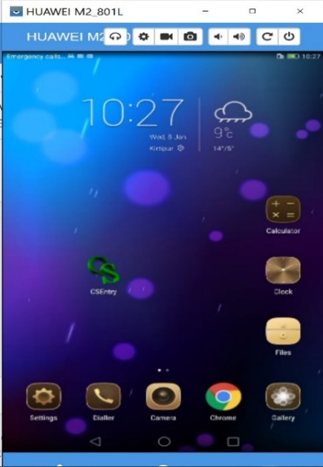

/fli6«o hgu0fgf @)&* sf] nut Joj:yfkg PlKns]zg ;'rf? ug]{ tl/sf
!_ CSEntry apps df Click ug{'xf];\ .
@_ cj /fli6«o hgu0fgf @)&* sf] nflu tof/ kfl/Psf] nut Joj:yfkg k|0ffnLsf] d]g' l;:6d v'Ng]5 .
Click this icon

Slide 10
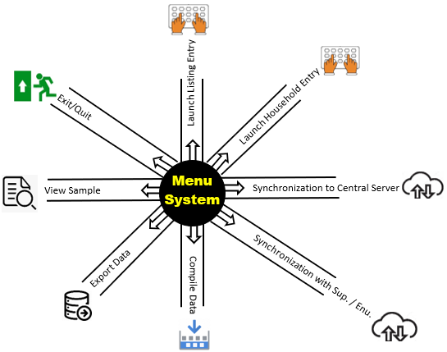
d]g' l;:6d eg]sf] s] xf] <
d]g' l;:6d /fli6«o hgu0fgfsf] ljB'tLo k|ljlw -6\ofan]6_ k|of]u u/L nut ;+sng tyf sfuhL k|ZgfjnLsf] nut k|ljli6sf] nflu agfO{Psf] 5ftf -Umbrella_ k|f]u|fd xf] . o;}af6 /fli6«o hgu0fgfsf] nut Joj:yfkgdf ;+nUg JolQm -s]Gb|Lo ;d"x, ;'k/efO{h/, u0fs_ sf nflu agfOPsf ljleGg PlKns]zgx? / sfo{ (function) ;Grfng / lgoGq0f x'g]5 . d]g' l;:6dnfO{ tnsf] lrqaf6 k|i6 kfg{ vf]lhPsf] 5.
æd]g' PlKns]zg Tof] rf}af6f] xf] hxf+af6 cfkm\gf] uGtJodf hfg] af6f] klxrfg ub{5f}+ / cfkm\gf] uGtJodf k'Ug]5f}+Æ

Slide 11
Population Census Data Management System
Menu System
Miscellaneous work
Control Form Entry
Synchronization
Household Listing Application
Census Main Questionnaire
Community Questionnaire

Slide 12
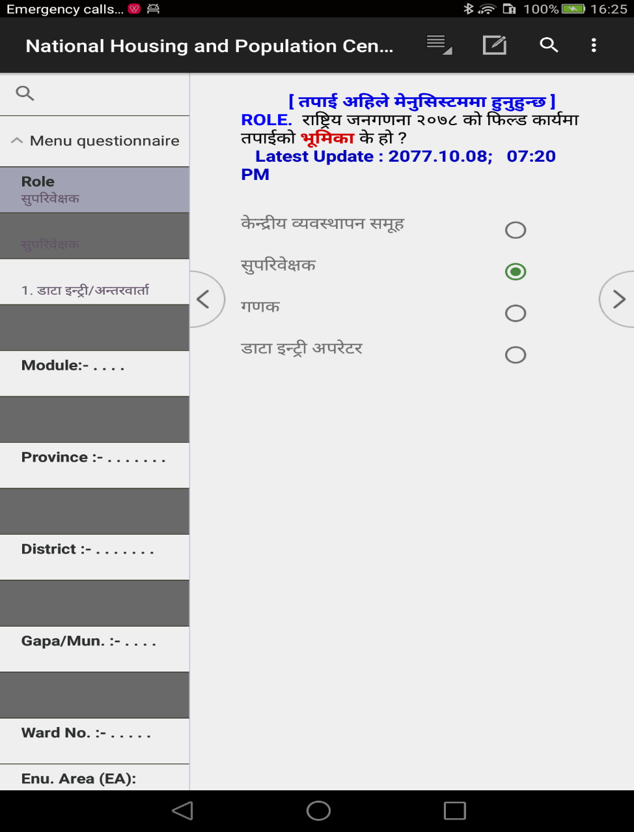
Menu System df k|of]u ePsf ljleGg variable
Menu System af6 hgu0fgfdf agfOPsf] PlKns]zgx? run ug{' cl3 o; d]g' l;:6ddf s]xL ljj/0fx? k|ljli6 ug{' kb{5 . To;sf] ;+lIfKt ljj/0f lgDgfg';f/ 5 .
Role :
tkfO{ ;'k/Lj]Ifssf] /f]ndf sfd ub}{ x'g'x'G5 eg] ;'k/Lj]Ifs 5fGg'xf]; .
tkfO{ u0fssf] /f]ndf sfd ub}{ x'g'x'G5 eg] u0fs 5fGg'xf]; .

Slide 13
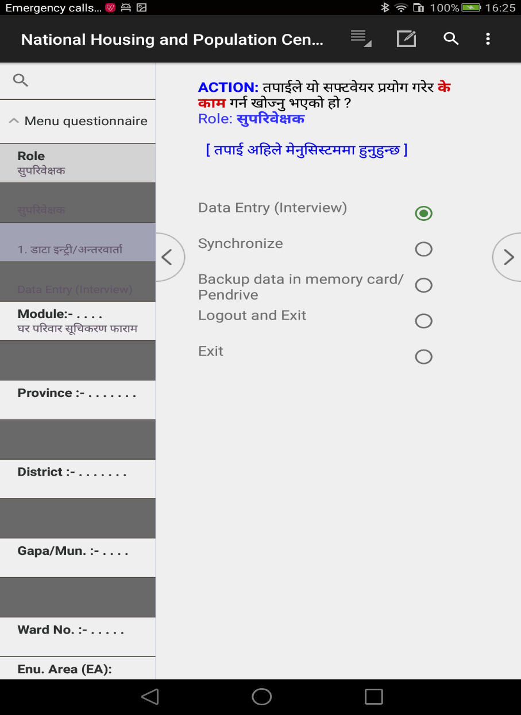
Action :
tkfO{ k|ZgfjnLsf] ljj/0f ;+sng ug{ nfUg' ePsf] xf] eg] 1. Data Entry 5fGg'xf]; .
tkfO{n] csf]{ d]l;g -sDKo'6/ jf 6\ofan]6_ ;+Fu kmfOn cfbfg k|bfg ug{ nfUg' ePsf] xf] eg]
2. Synchronize 5fGg'xf]; .
tkfO{ 6\ofan]6df cfGtl/s ?kdf save ePsf] ljj/0fx? clear u/L PlKns]zgaf6 aflx/ lg:sgsf] nflu 8. Logout and Exit 5fGg'xf]; .
tkfO{ 6\ofan]6df cfGtl/s ?kdf save ePsf] ljj/0fx? clear gu/L PlKns]zgaf6 aflx/ lg:sgsf] nflu 9. Exit 5fGg'xf]; .

Slide 14
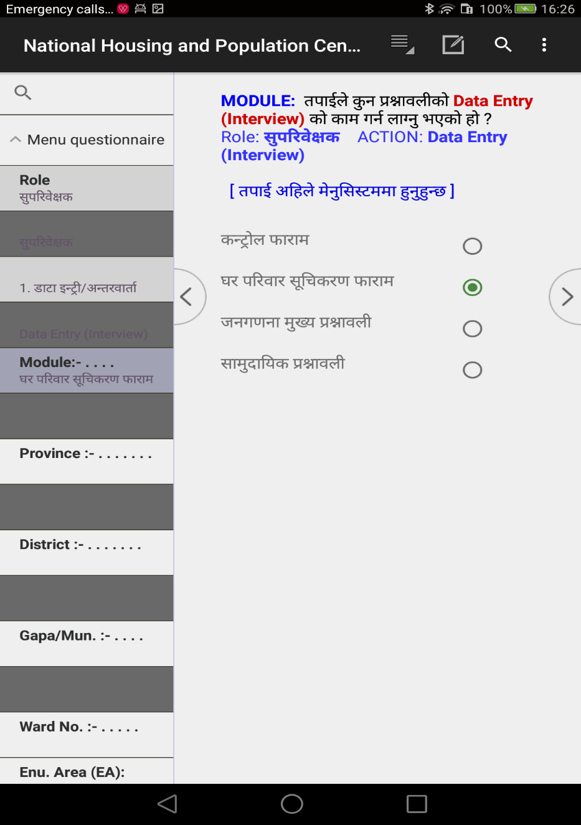
Module:
sG6«f]n kmf/fdsf] nflu sfd ug{' k/]df != sG6|f]n kmf/fd 5fGg'xf]; .
3/kl/jf/ ;"lrs/0f kmf/fdsf] nflu sfd ug{' k/]df @= 3/ tyf 3/kl/jf/ ;"lrs/0f kmf/fd 5fGg'xf]; .
hgu0fgf d'Vo k|ZgfjnLsf] nflu sfd ug{' k/]df #= hgu0fgf d'Vo k|ZgfjnL 5fGg'xf];.
hgu0fgf d'Vo k|ZgfjnLsf] nflu sfd ug{' k/]df $= ;fd'bflos k|ZgfjnL 5fGg'xf]; .

Slide 15
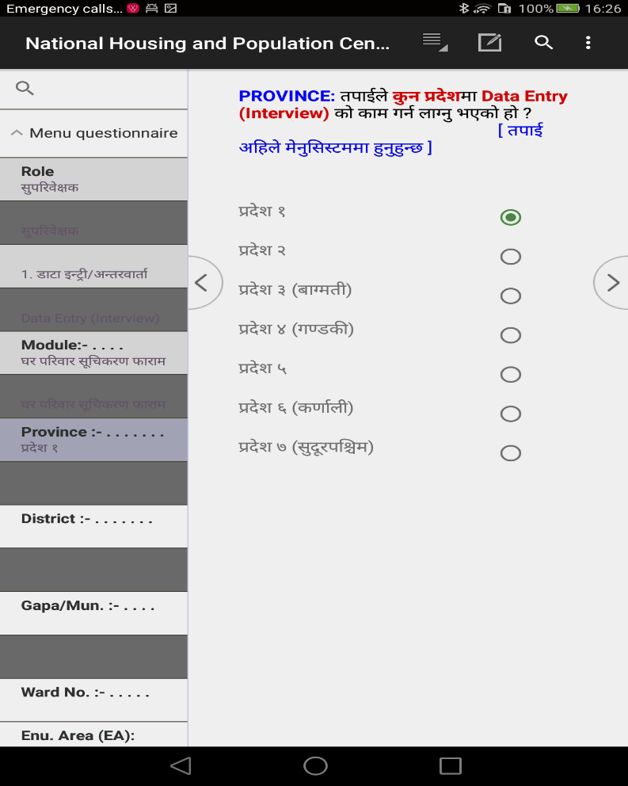
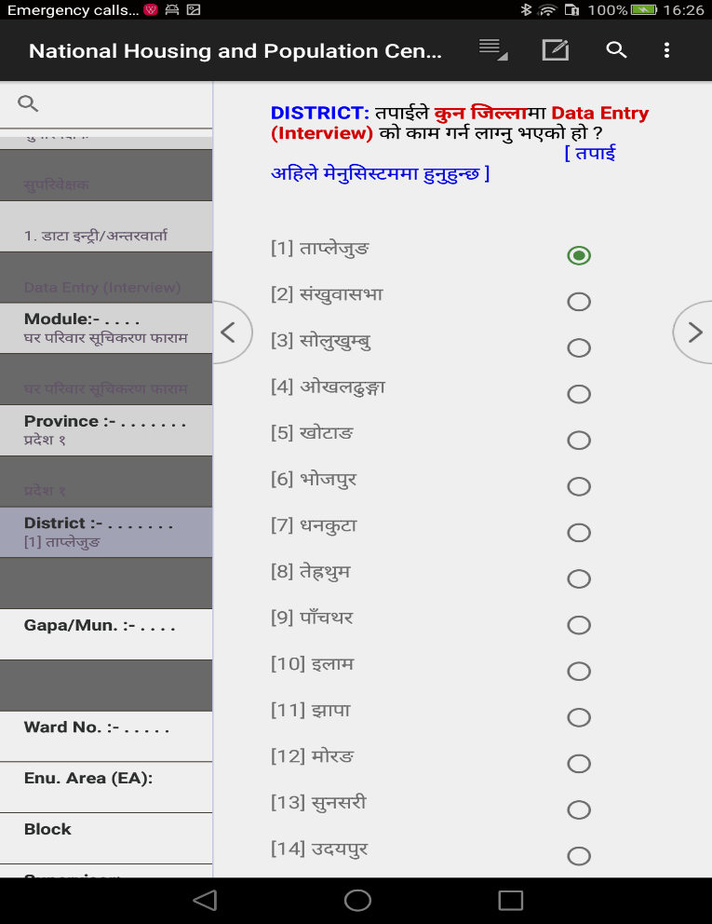
ef}uf]lns If]qsf] klxrfg (Identification of Geographic Area)
;'kl/j]Ifs tyf u0fsn] sfd ug{ nfUg' ePsf] e"uf]n s'g xf] <
Province : k|b]zsf] sf]8 5fGg'xf];
District: lhNnfsf] sf]8 5fGg'xf];

Slide 16
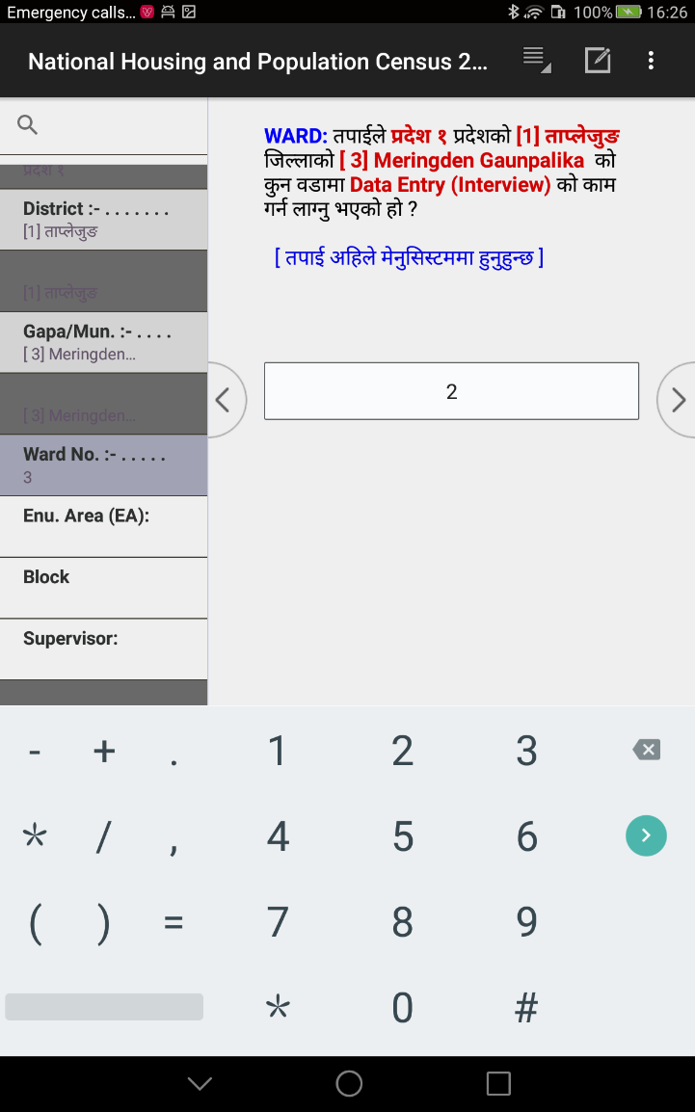
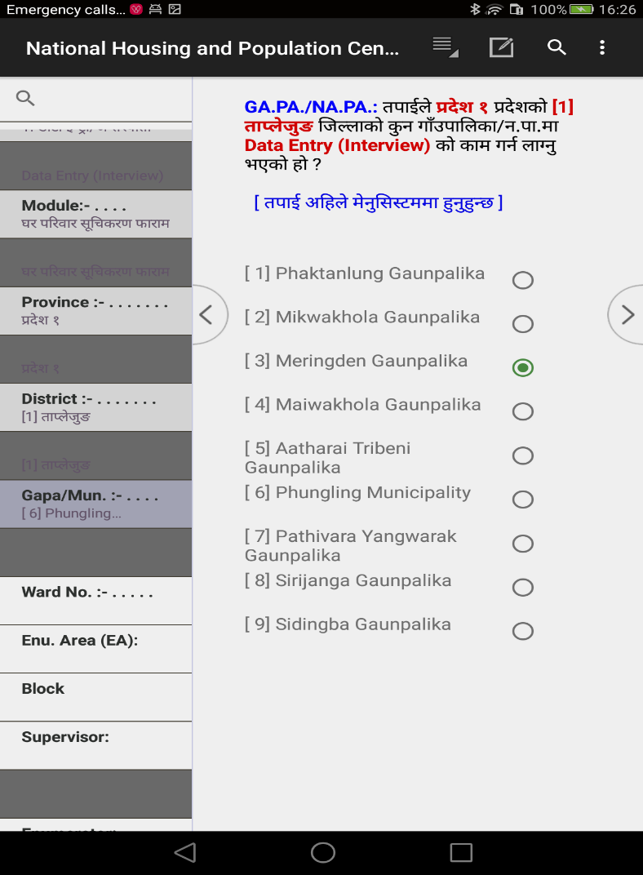
ef}uf]lns If]qsf] klxrfg (Identification of Geographic Area)
Ga.pa./Na.pa: ufp“kflnsf=gu/kflnsf n]Vg'xf];\
Ward No.: j8f g+= n]Vg'xf];\

Slide 17
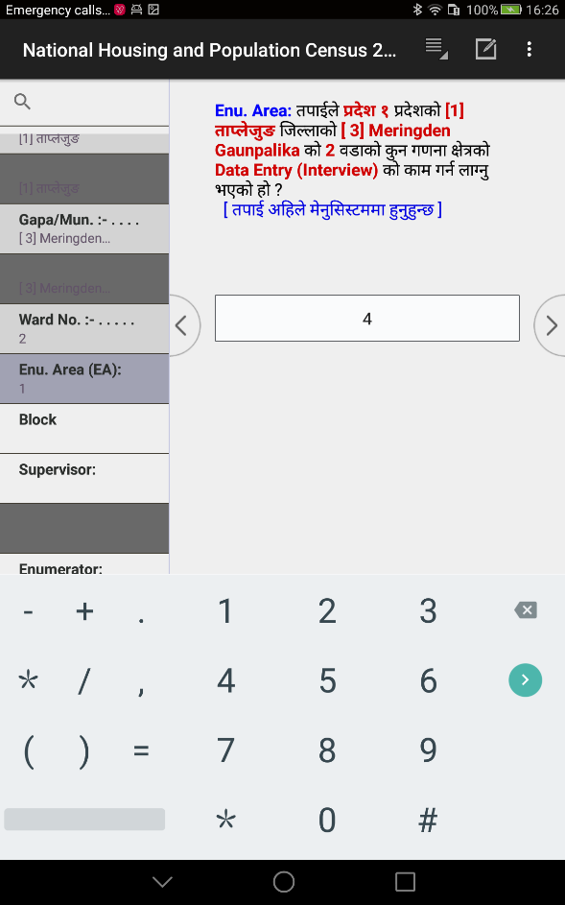
ef}uf]lns If]qsf] klxrfg (Identification of Geographic Area)
EA : u0fgf If]q n]Vg'xf];\ .
gf]6 M u0fgf If]q -EA_ gDa/ / Ans gfd n]Vg' kg]{ eP lhNnf hgu0fgf clwsf/L jf :yfgLo hgu0fgf clwsf/Ln] pknAw u/fpg] 5 .

Slide 18
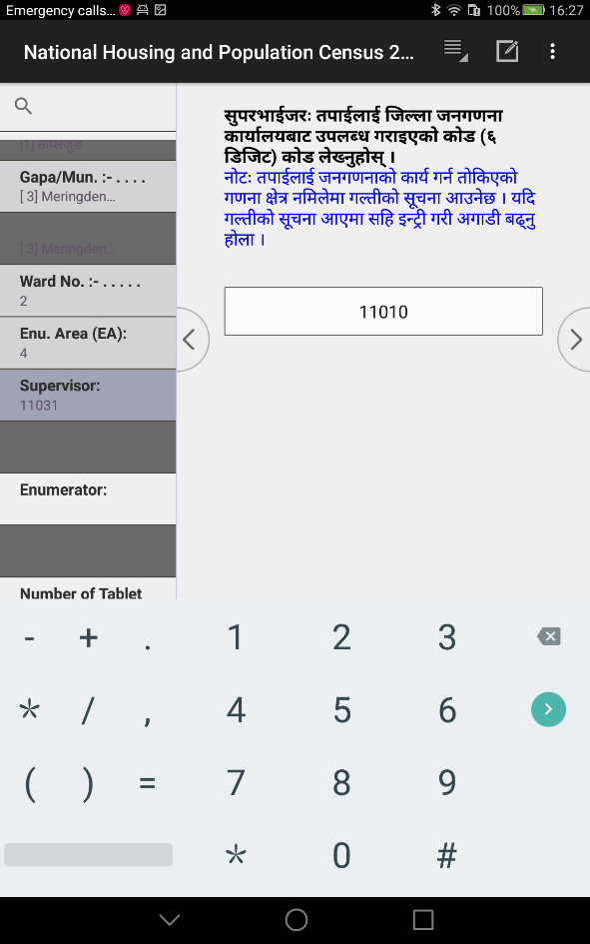
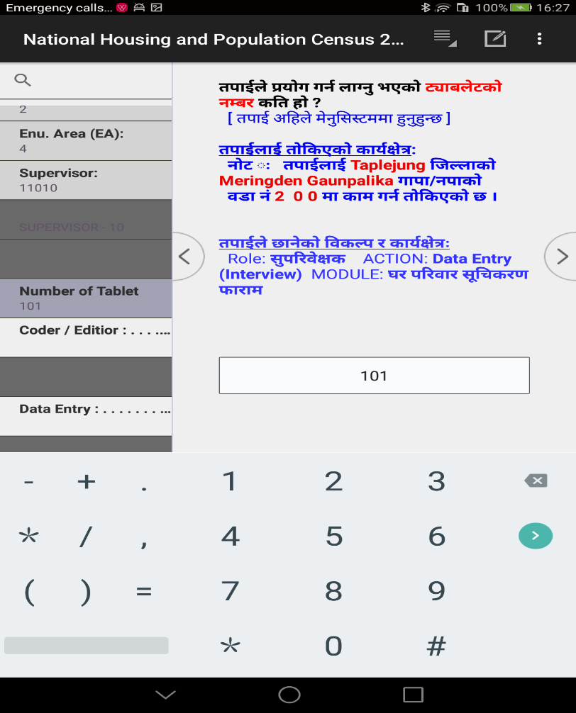
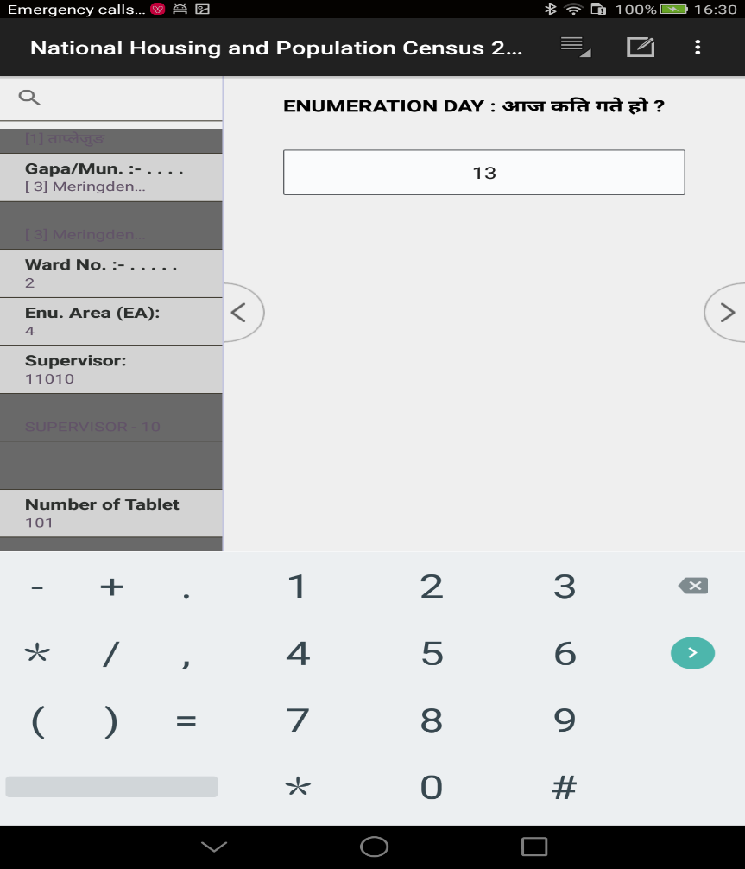
SUPERVISOR : tkfO{nfO{ lhNnf hgu0fgf clwsf/Ln] pknAw u/fPsf] sf]8 n]Vg'xf];\ .
Tablet Number : 6\ofan]6sf] k5f8L :6Ls/df n]lvPsf] 6\ofan]6 gDa/ n]Vg'xf];\ .
lkmN8 sfo{sf] ldlt -dlxgf / ut]_ Mnut ;+sng ug{ uO{ /x]sf] dlxgf / ut] n]Vg'xf];\ .

Slide 19
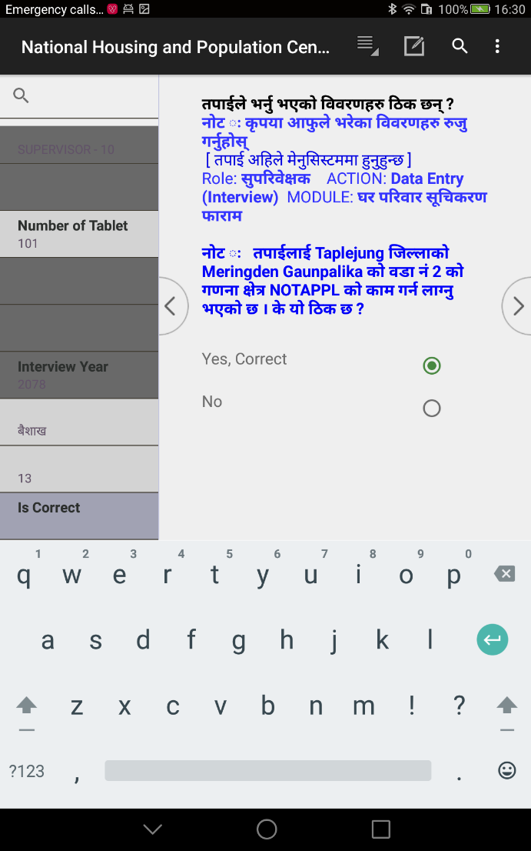
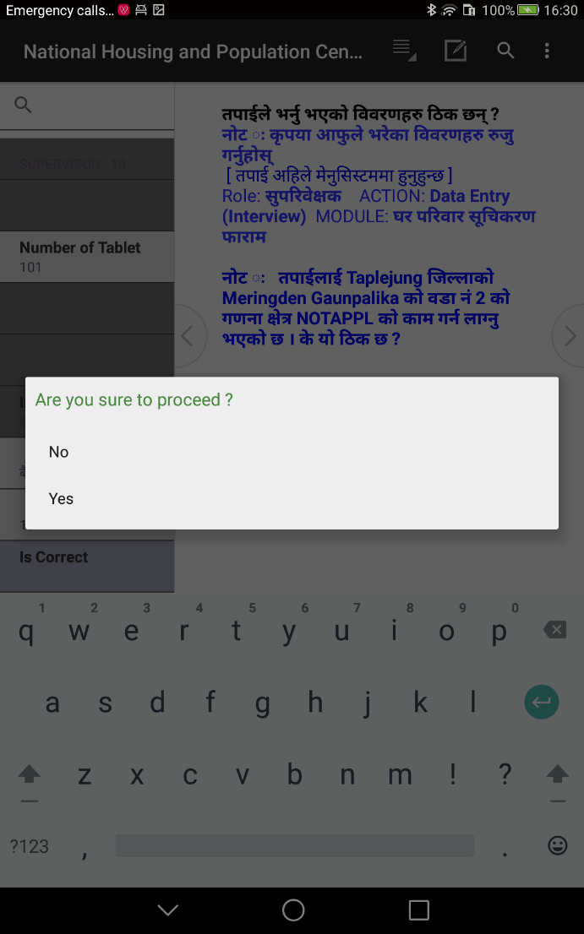
Is Correct ? : tkfO{n] o; cl3 5fg]sf] jf OG6«L u/]sf] ljj/0fx? l7s 5 eg] Yes 5fGg'xf];\ .
Do you want to proceed ? : tkfO{n] 5fg]sf] jf OG6«L u/]sf] ljsNk cg';f/sf] sfd ug{ hfgsf] nflu Yes 5fGg'xf];\ .
d]g' l;:6ddf 5 eg] To;sf] hfgsf/Lsf] nflu tkfO{ clxn] d]g' l;:6ddf x'g'x'G5 eGg] cfO{/x]sf] x'g]5 .

Slide 20
;+lIfKtdf d]g' l;:6ddf hgu0fgf nut Joj:yfkg k|0ffnL ;Grfngsf] nflu lgDg Step x? k'/f ug{'kg]{5 .
STEP 1 |  | STEP 2 |  | STEP 3 |  | STEP 4 |  | STEP 5 |  | STEP 6
ROLE (Supervisor OR Enumerator) |  | ACTION (1.Data Entry OR 2. Synchronization) |  | MODULE (1. Control 2. Listing 3. Main Quationnaire 4. Community Quest.) |  | GEOGRAPHIC IDENTIFICATION (Province, District, GAPA/NAPA, Ward, EA, BLOCK) |  | OTHER INPUT (Tablet Number, Type of House, Date of Enumeration) |  | Confirmation (Iscorrect?, Proceed ?)
gf]6M ;a} sfdsf] nflu ;a} Step df uO{/xg' kg]{5}g, cfjZostf cg';f/ hfg]5 .

Slide 21
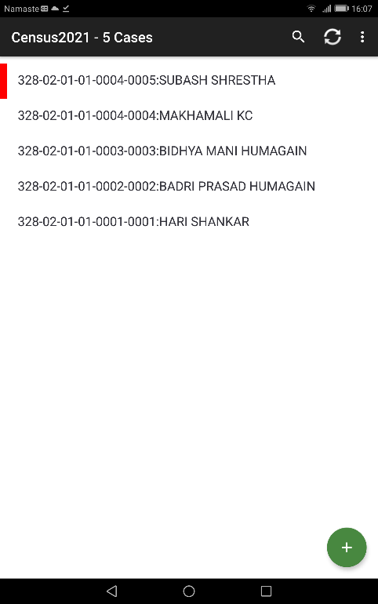
d]g' l;:6daf6 hgu0fgf k|ZgfjnLdf k|j]z u/]kl5sf] tnsf] l:qmg cfpg] 5
klxn] O{G6«L ePsf] Case oxfF b]lvg] 5 . klxn] OG6«L ePsf] ljj/0f ;Rofpg k/]df h'g Case df ;Rofpg' kg]{ xf] To;df click ug{'kg]{5 .
gofF case yk ug{ oxfF lSns ug{'xf];\ .

Slide 22
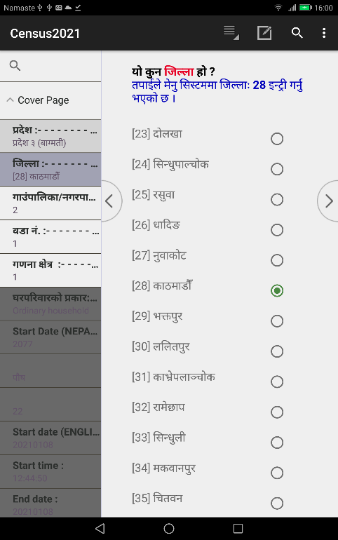
6\ofjn]6sf] dxTjk"0f{ Button x? / To;sf] k|of]u ;DaGwL hfgsf/L
d]g' l;:6daf6 d'n k|ZgfjnLsf] nut ;+sngsf] PlKns]zg ;'rf? x'Fbf z'?df 8f6f OG6«L (Add Mode) df cfpg] 5 -Tof] eg]sf] 6\ofan]6sf] l:qmgdf tkfO{n] sfd ug{ nfUg' ePsf] k|b]z s'g xf] < eGg] cfpg] 5 / Keyboard/Numeric pad/ 5gf}6 ljsNk cfpg] 5 . Add Mode df b]lvg] s]xL pkof]uL Button x? lgDgfg';f/ 5g\
Name of apps
System Button
User Button
Left Navigator Key
Right Navigator Key
ADD/MODIFY MODE
Left Panel
Right Panel
Minimize Key
Restore minimized apps
Back key : to stop entry mode

Slide 23
6\ofjn]6sf] dxTjk"0f{ Button x? / To;sf] k|of]u ;DaGwL hfgsf/L
Number of completed or Partial completed case
Partial Save household are shawn in red border
STOP MODE
List of Saved case
Back key : to exist from entry application, return back to Meny System
Add button

Slide 24
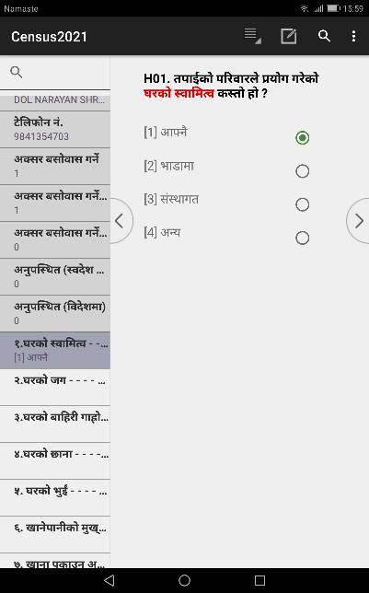
Navigation Key :
Navigation Key > df lSns ubf{ Ps l:qmg k5f8L hfg]5 eg] < df lSns ubf{ Ps l:qmg cuf8L hfg]5 .
Tablet sf] k'5f/sf button x?
Android Tablet sf] k'5f/df /x]sf tLg j6f button x? dxTjk"0f{ 5g\ . oL button x? dWo] n] application back ug]{5, button n] v'Nnf ePsf] application minimize ug]{5 / button n] v'n]/ minimize ePsf application x? s'g active ug]{ eg]/ 5fGgsf] nflu b]lvg]5 . Button n] application g} Close ug]{ ePsf]n] of] Button k|of]u ubf{ lj:tf/} xf]l;of/Lsf ;fy ug{' kb{5 .

Slide 25
Down Key
olb text field jf numeric field 5 eg] Keyboard/Numeric Key Pad b]lvg] 5 . Keyboard/Numeric Key pad aGb ug{ cfjZos ePdf of] Key df Press ug{ ;lsG5 . of] key press ubf{ Keyboard/Numeric Key Pad aGb x'g]5 . of] button keyboard jf numeric Key pad cfPsf] a]nfdf dfq b]lvg]5 .
Tringle (Back) button
of] Key df Press ubf{ clxn] v'n]sf] jf Add mode /x]sf] Program Close x'g]5 . cyf{t k|f]u|fdsf] Add mode jf Edit Mode af6 Stop Mode df hfg]5 . of] dxTjk"0f{ Key xf] lsgeg] o;n] Add jf Edit mode af6 Stop mode df Nofpg] 5 . of] key press ug{' cl3 tkfO{n] clxn] ;Dd e/]sf ljj/0fx? ;'/lIft (Save) ePsf] ;'lglZrt x'g'kg]{5 . Mode Stop ePsf] cj:yfdf clxn] ;Dd el/Psf 3/kl/jf/x?sf] ln:6 / ;+Vof b]lvg] 5 . olb Mode Stop ePsf] cj:yfdf k]m/L Back Arrow Key press u/]df k|f]u|fd g} Close x'g]5 . Mode Stop ePsf] a]nfdf gofF kl/jf/sf] af/]df OG6«L ug{' k/]df + sign (Add button) df Click ug{' kb{5 . olb 8f6f OG6«L eO{ /x]sf] a]nfdf Back Key press u/]df 8f6f save geO{ stop Mode df hfg]5 . t;y{ of] Key press ug]{ a]nfdf xf]l;of/L k'/\ofpg' kb{5 .

Slide 26
Circle (Minimize) button
of] Key df Press ubf{ clxn] v'n]sf] Application aGb geO{ Minimize x'g]5 / k]m/L Tolx 7fpFdf Tolx l:ytLdf Nofpg ;S5f}+ .
Square (Restore) button
of] Key df Press ubf{ Minimize ePsf k|f]u|fdx? b]lvg] 5 / To;dWo] s'g k|f]u|fdnfO{ Restore [jf active] ug]{ xf] Tof] k|f]u|fdnfO{ Click ug{'kg]{5 .
Left or Right Navigation Key
< >
of] Key df Press ubf{ Ps Screen cuf8L jf k5f8L hfg]5 . To;/L hfFbf k|Zgx?sf] pQ/sf aLr ;fdfGh:tf kl/If0f u/L hfg]5 . olb k|Zgx?sf] pQ/sf] ljrdf ;fdfGh:otf 5}g eg] error jf warning message cfpg]5 . error message cfPsf] cj:yfdf cuf8L a9\g] 5}g . Warning Message cfPsf] v08df u0fsn] ljj]s k|of]u ug{'kg]{5 . 5gf}6 ul/Psf] ljsNk pQ/bftfsf] jf:tljstf g} xf] ls 5gf}6 ubf{ uNtL x'g uPsf] xf] . olb pQ/bftfsf] af:tljstf xf] eg] ;'wf/ gu/L cuf8L a9\g' kb{5 eg] xfdLn] 5gf}6 ubf{ jf n]Vbf uNtL x'g uPsf] xf] eg] ;'wf/ u/L cuf8L a9\g' kb{5 .

Slide 27
System Button of CSEntry ( )
nut ;+sngsf] PlKns]zg ;'rf? (Run) eO{/x]sf] cj:yfdf 6\ofan]6sf] Top Right Corner df /x]sf] Button lyRbf tnsf laNsNkx? b]lvg] 5g\ h;sf] sfd 5f]6sf/Ldf lgDgfg';f/ /x]sf] 5 .
Change Language : o; af6 PlKns]zgsf] efiff kl/jt{g ug{ ;lsg]5 .
Advance to End : o; af6 Modification u/]sf] cj:yfdf PlKns]zgsf] h'g;'s} efuaf6 k"0f{?kdf Save u/L Close ug{ ;lsg]5 . Data Modification df of] Option clt pkof]uL x'g]5 .
Hide/Show Navigation Controls : o; af6 Navigation Key On/Off ug{ ;lsg]5 .
Hide/Show Case Tree : o; af6 Left Panel On/Off ug{ ;lsg]5 .
User's Button
PlKns]zgsf] cfjZostf x]/L PlKns]zg lgdf{0fstf{n] ljz]if sfdsf] nflu Button agfPsf] x'G5 . of] PlKns]zgsf] cfjZostf cg';f/ km/s km/s x'g] ePsf]n] ;DalGwt PlKns]zg d} User's Button sf] af/]df rrf{ ul/Psf] 5 . oxfF User's button sf] nflu of] button k|of]u ug{ ;lsG5 eGg] dfq b]vfOPsf] 5 .

Slide 28
3/kl/jf/ ;"lrs/0fsf] nut ;+sng/nut

Slide 29

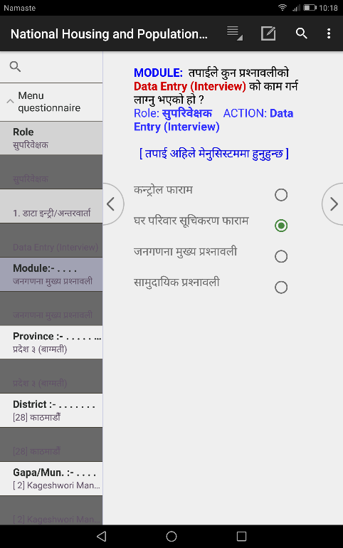
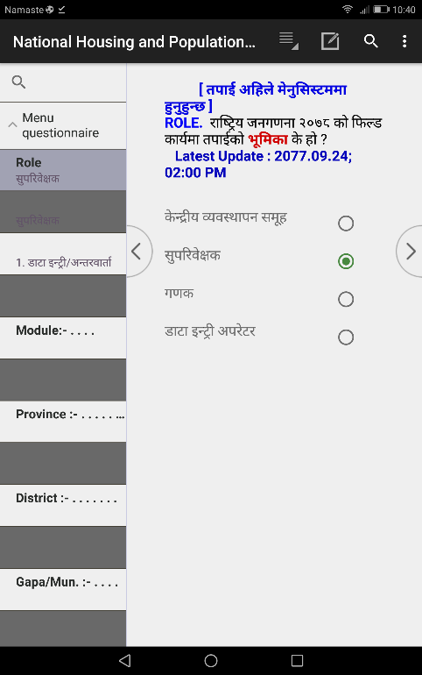
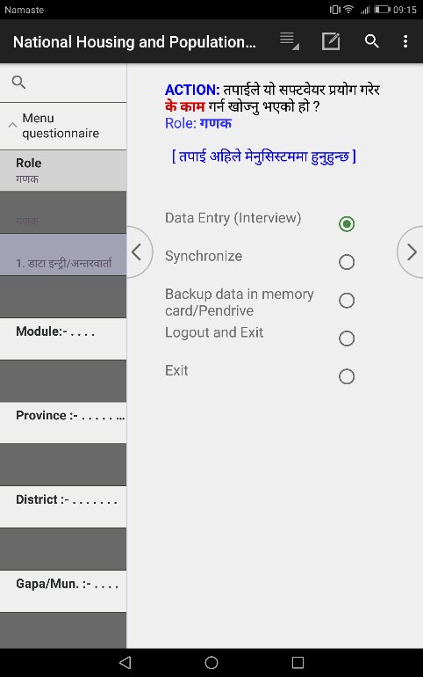
3/kl/jf/ ;"lrs/0fsf] nut ;+sng/nut k|ljli6 ug]{ tl/sf
;'k/efO{h/n] 3/kl/jf/ ;"lrs/0f kmf/fdsf] nut ;+sng tyf k|ljli6sf] nflu tnsf] k|s[of ckgfpg' kg]{5 .
!= /fli6«o hgu0fgf @)^* sf] nut Joj:yfkg k|0ffnLsf] d]g' k|0ffnL Run ug{] -Click on CSEntry_
@= ROLE: @= ;'k/efO{h/
#= ACTION: 1. Data Entry (Interview)
$= MODULE: @= 3/kl/jf/ ;"lrs/0f kmf/fd
Click this icon

Slide 30
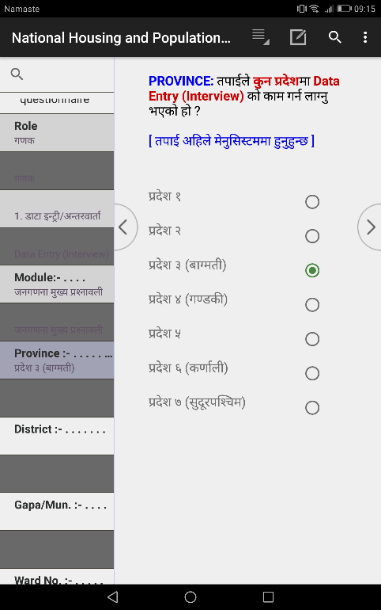
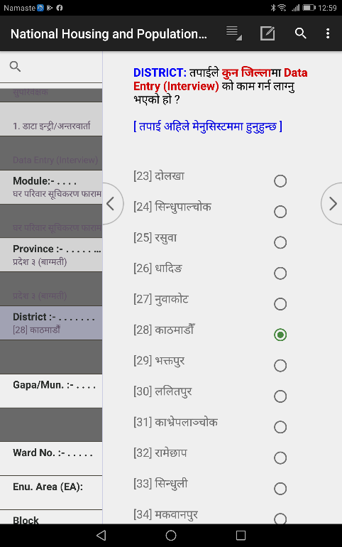
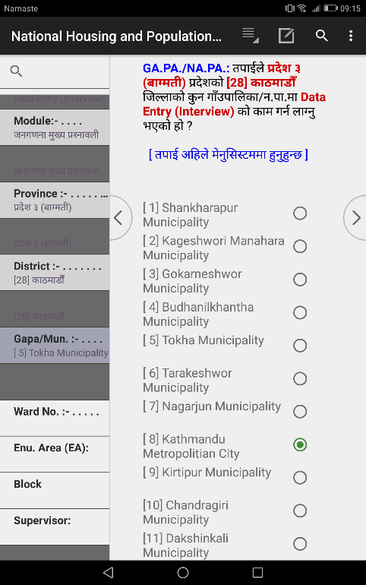
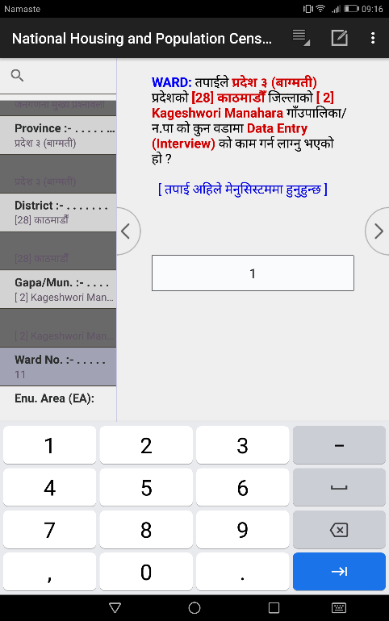
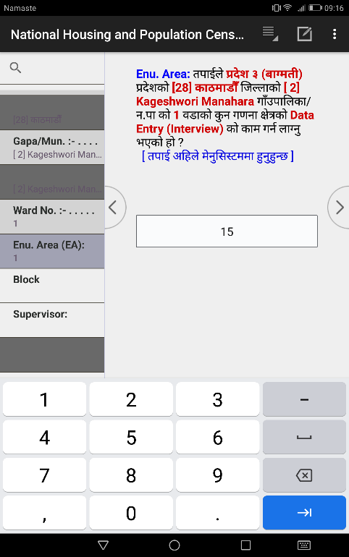
%= ef}uf]lns If]qsf] klxrfg (Identification of Geographical Area)
PROVINCE: tkfO{n] sfd ug{ nfUg'ePsf] k|b]z s'g xf] ;f] k|b]zsf] gfd 5fGg'xf];\ .
DISTRICT: tkfO{n] sfd ug{ nfUg'ePsf] lhNnf s'g xf] ;f] lhNnfsf] gfd 5fGg'xf];\ .
GAPA/NAPA: tkfO{n] sfd ug{ nfUg'ePsf] ufpFkflnsf/gu/kflnsf s'g xf] ;f] ufpFkflnsf / gu/kflnsfsf] gfd 5fGg'xf];\ .
Ward: tkfO{n] sfd ug{ nfUg'ePsf] j8f g+= slt xf] ;f] j8f g+= OG6«L ug{'kg]{5 .

Slide 31
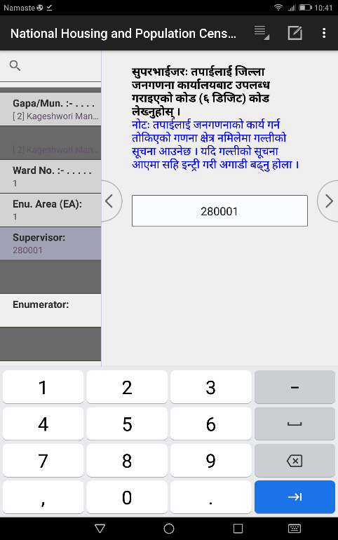
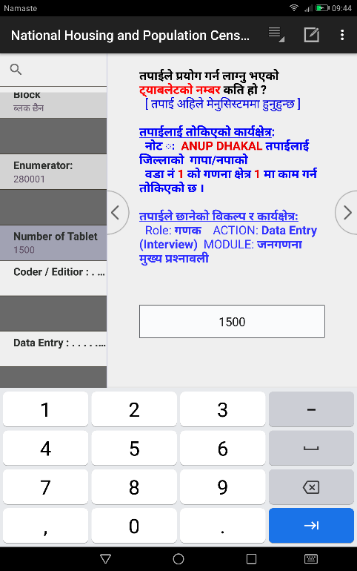
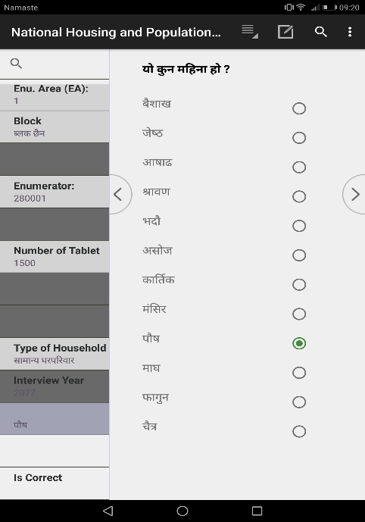
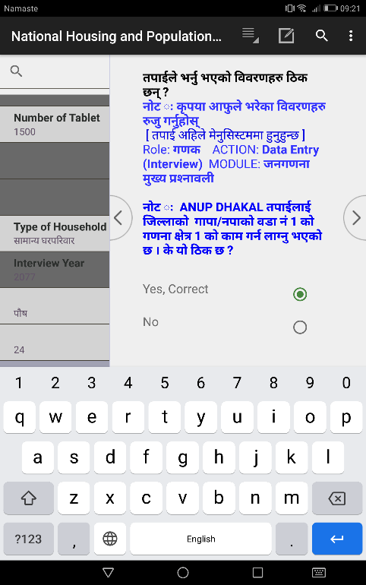
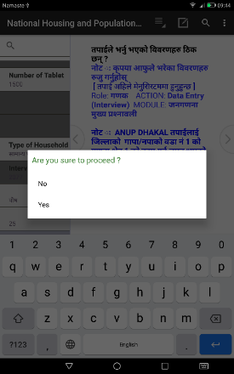
^= SUPERVISOR: lhNnf hgu0fgf sfof{non] ;'k/efO{h/sf] nflu pknAw u/fPsf] IDCODE oxfF k|lji6L ug{' kb{5 . -lj:t[t ljj/0fsf] nflu k'l:tsf x]g{'xf];\_
&= Tablet Number: tkfO{n] k|of]u u/L /xg' ePsf] 6\ofan]6sf] gDa/ slt xf] < 6\ofan]6sf] k5f8L n]lvPsf] 6\ofan]6 gDa/ n]Vg' kb{5 .
*= Interview Date (Month/Day): tkfO{n] nut ;+sng ug{ nfUg' ePsf] ldlt s'g xf] -dlxgf / ut]_ < ;f] oxfF n]Vg' kb{5 .
(= Is Correct: tkfO{n] 5fg]sf jf k|ljli6 u/]sf] ljj/0fx? l7s 5 eg]/ ;f]lwPsf] xf] . olb l7s 5 eg] Yes 5fGg'xf];\ .
!)= Are you sure to Proceed : oxfFaf6 tkfO{n] 5fg]sf] Action cg'';f/sf] sfd ug{ hfgsf] nflu clGtd :jLs[tL lnOPsf] xf].

Slide 32
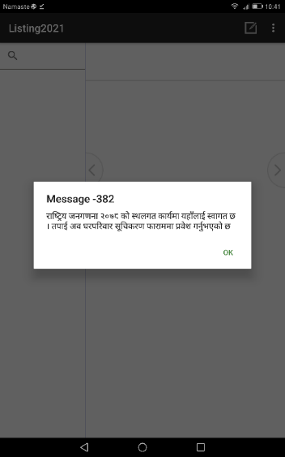
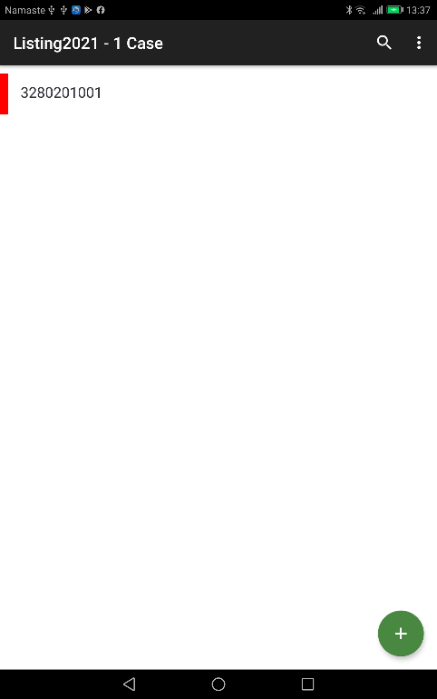
d]g' l;:6ddf Do you want to Proceed < df Yes df lSns u/kl5 tnsf] l:qmg cfpg] 5 . cj tkfO{ lnl6ªsf] nut ;+sngsf] nflu agfOPsf] PlKns]zg v'Ng]5 . d]g' l;:6daf6 3/kl/jf/ ;"lrs/0f kmf/fddf k|j]z u/]sf] hfgsf/Lsf] ;"rgf æ/fli6«o hgu0fgfsf] lkmN8 sfo{df oxfFnfO{ :jfut 5 . ca tkfO{ 3/kl/jf/ ;"lrs/0f kmf/fddf k|j]z ug{'ePsf] 5Æ cfP kl5 k|f]u|fd 8f6fOG6«L -k|ZgfjnL eg]{_ cj:yfdf hfg]5 . o;df Ok df click u/kl5 tnsf] l:qmg cfpg]5 .
klxn] O{G6«L ePsf] lnl:6ªdf yk ug{' k/]df oxf+ Click ug{' xf]nf .
gf]6M Pp6f u0fgf If]qsf] 3/kl/jf/ ;"lrs/0f kmf/fdsf] Pp6f dfq Case aGg] 5 . t;y{ Partial Save ePsf] cj:yfdf csf]{ k6s ;"rLs/0fdf yk ug]{ a]nfdf oxf+ Click u/]/ yk ug{'kg]{5 .
gf]6M Pp6f klg Case O{G6«L ePsf] 5}g eg] gof+ Case O{G6«L ug{sf] nflu oxf+ Click ug{'xf]nf .

Slide 33
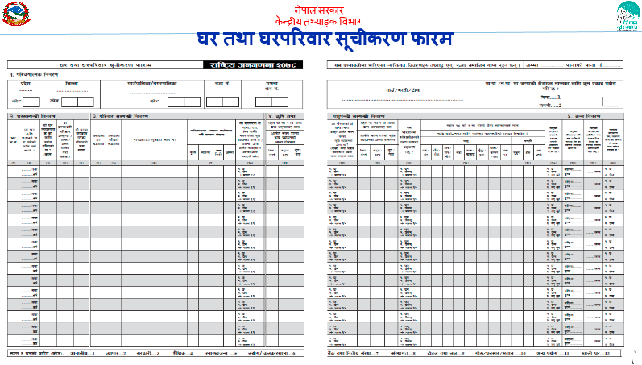
3/ tyf 3/kl/jf/ ;"rLs/0f kmf/fdsf] 6\ofan]6df nut ;+sngsf] axfj
gf]6 M Pp6f u0fgf If]qsf] Pp6f dfq CASE x'g]5 . u0fgf If]q leqsf ;j} 3/ tyf 3/kl/jf/x?sf] ljj/0f olx Case leq tflnsfsf] ?kdf /xg]5 .

Slide 34
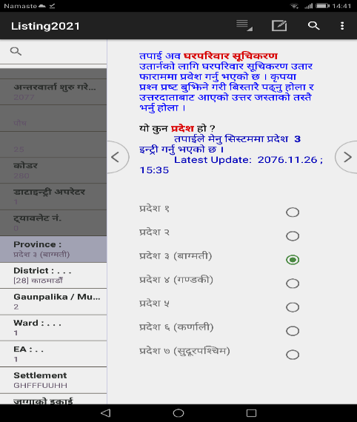
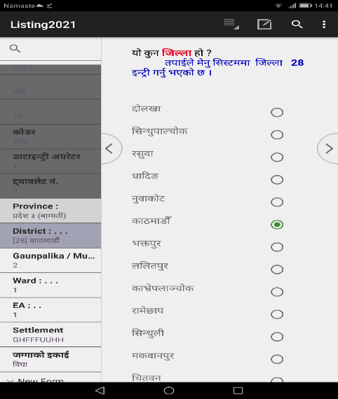
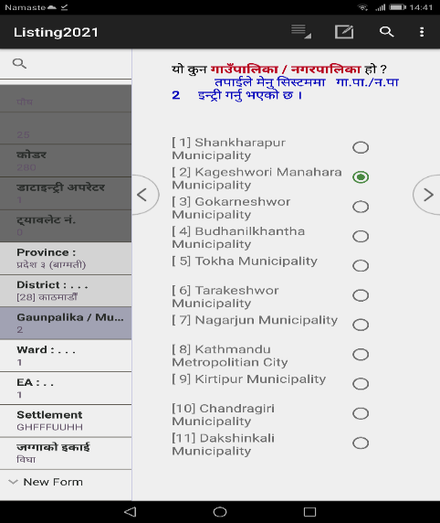
k|b]z lhNnf ufp+ kflnsf÷gu/kflnsf

Slide 35
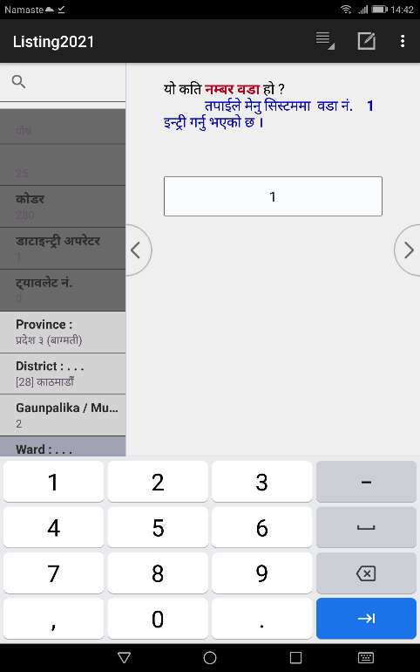
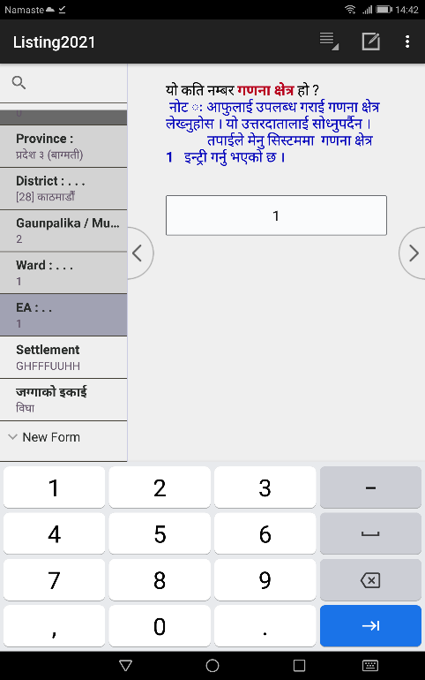
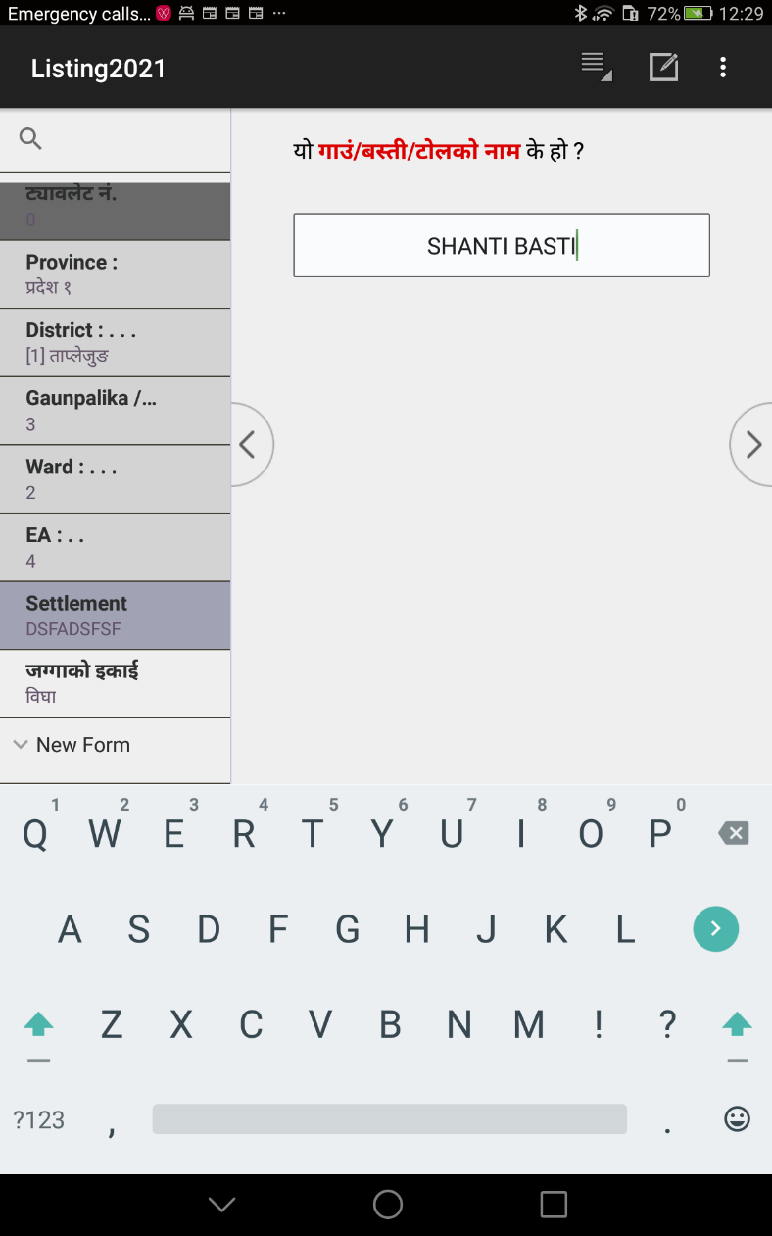
j8f g+= u0fgf If]q ufp+÷a:tL÷6f]nsf] gfd

Slide 36
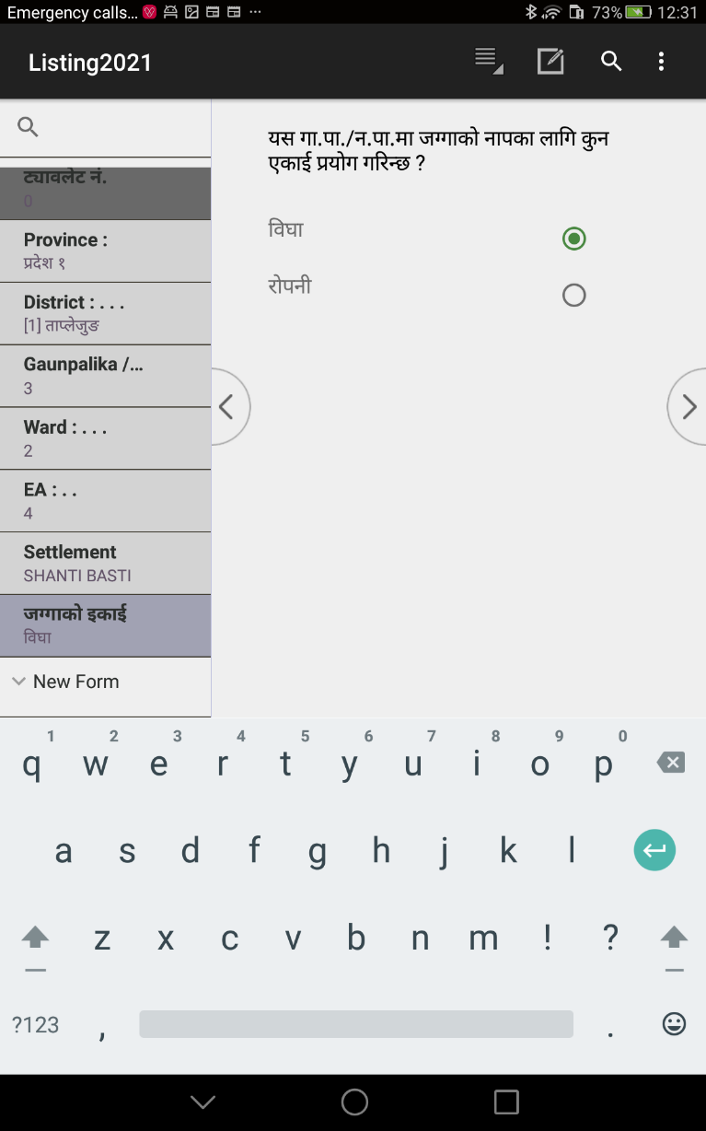
hUufsf] OsfO{ n]Vg'xf];\

Slide 37
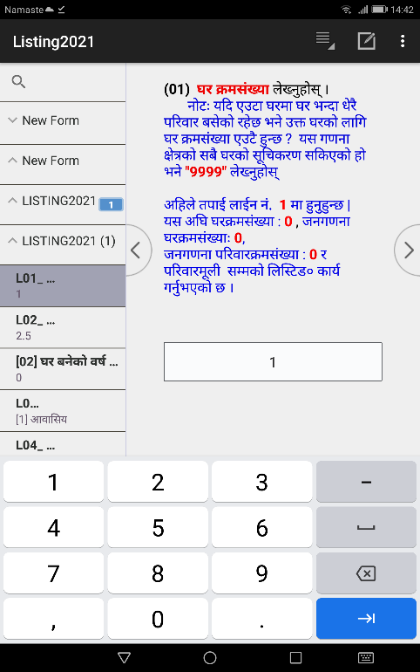
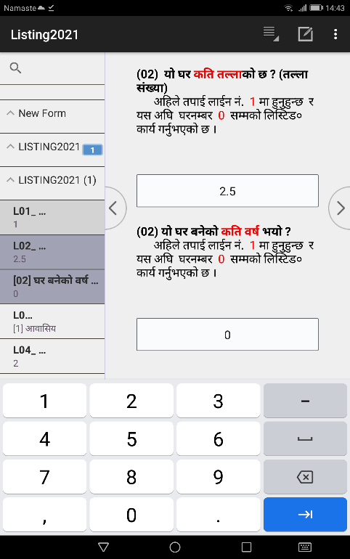
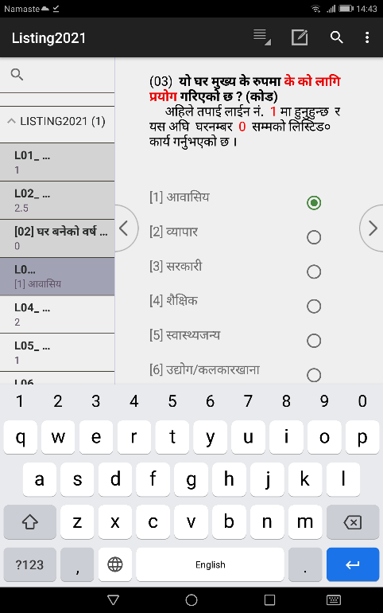
dxn !M 3/qm;+Vof
dxn @M slt tNnf / 3/ ag]sf] jif{
dxn #M 3/sf] d'Vo k|of]u
Pp6f 3/df Ps kl/jf/ eGbf a9L kl/jf/ a;]sf] eP 3/ gDa/ Pp6} x'G5 .
Pp6f 3/df Ps kl/jf/ eGbf a9L kl/jf/ a;]sf] eP bf];|f] kl/jf/ b]lv of] ;f]lwg] 5}g .
Pp6f 3/df Ps kl/jf/ eGbf a9L kl/jf/ a;]sf] eP bf];|f] kl/jf/ b]lv of] ;f]lwg] 5}g .

Slide 38
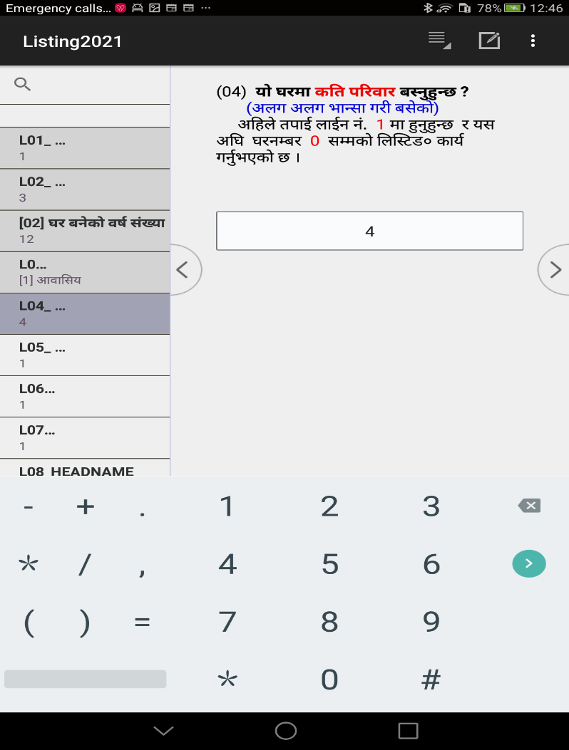
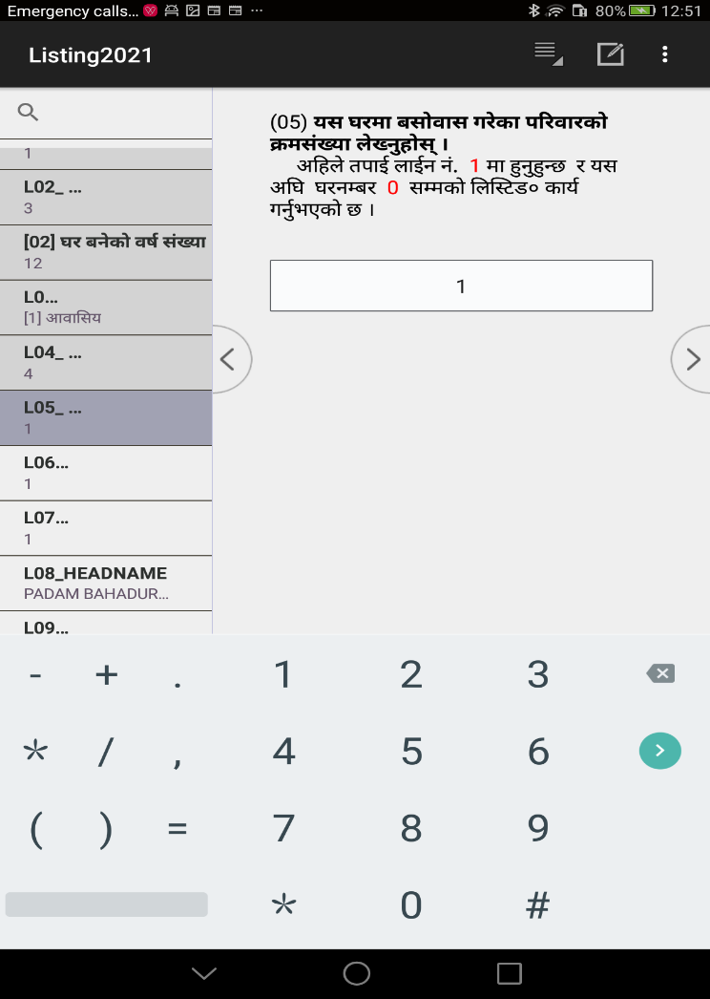
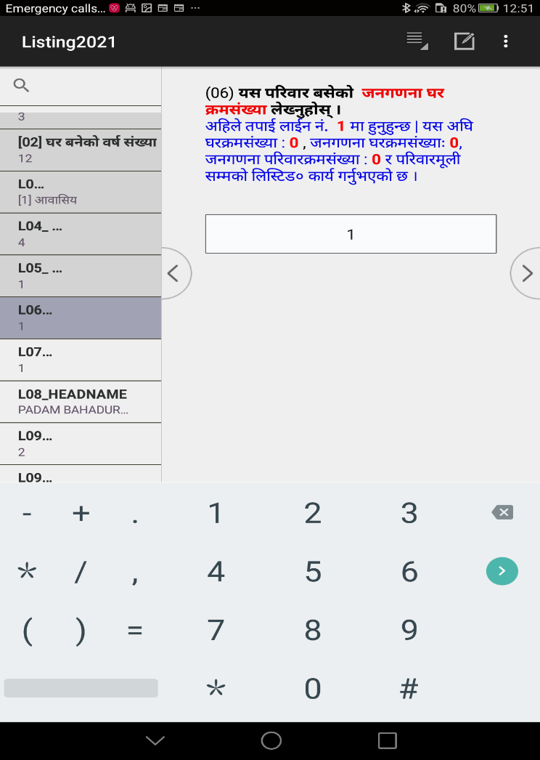
dxn $M o; 3/df a;f]jf;
u/]sf kl/jf/ ;+Vof
dxn %M o; 3/df a;f]jf;
u/]sf kl/jf/sf] qmd;+Vof
dxn ^M hgu0fgf 3/ qmd;+Vof
Pp6f 3/df Ps kl/jf/ eGbf a9L kl/jf/ a;]sf] eP bf];|f] kl/jf/ b]lv of] ;f]lwg] 5}g .
of] dxndf l;:6dn] cfkm} qmd;+Vof /flvlbg]5 .
of] dxndf l;:6dn] cfkm} hgu0fgf 3/qmd;+Vof /flvlbg]5 .

Slide 39
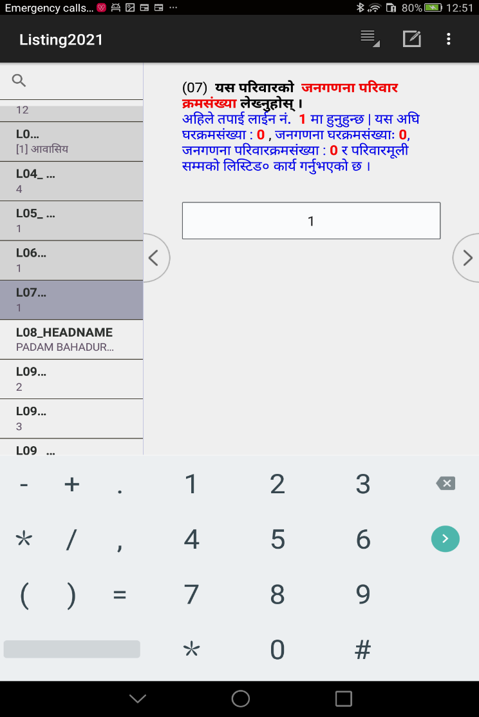
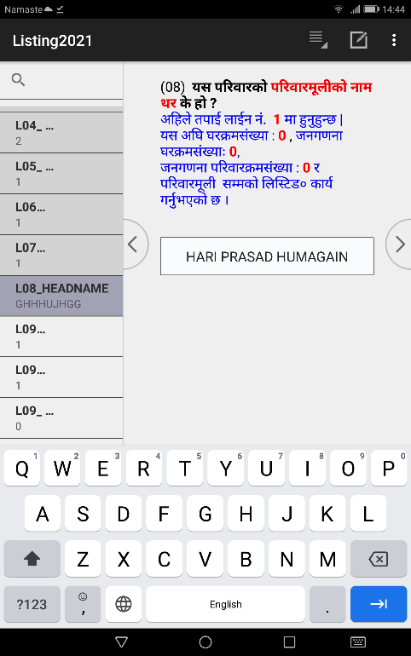
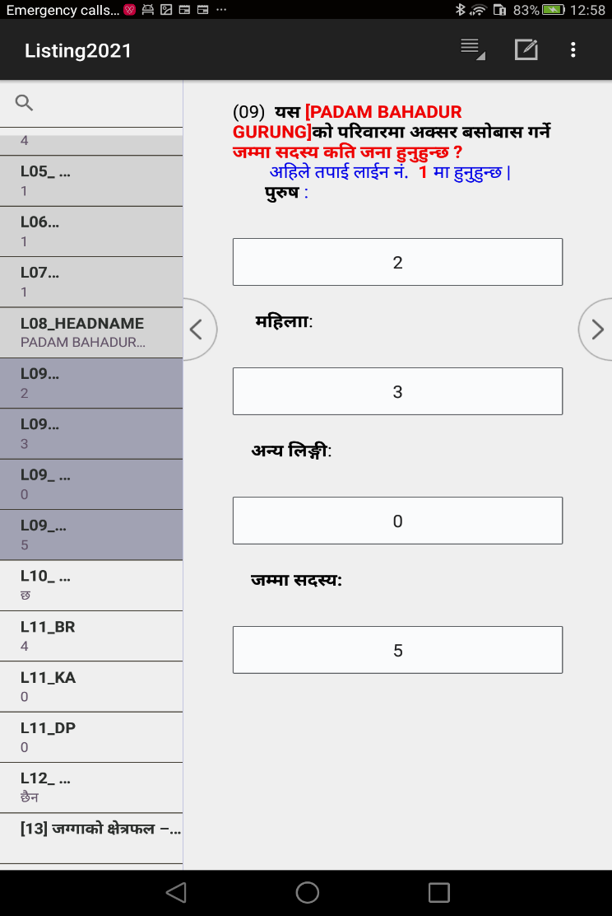
dxn &M hgu0fgf kl/jf/ qmd;+Vof
dxn *M kl/jf/sf] d'nL
dxn (M kl/jf/df cS;/ a;f]jf; ug]{ ;b:o ;+Vof
of] dxndf l;:6dn] cfkm} hgu0fgf 3/qmd;+Vof /flvlbg]5 .
kl/jf/d"nL e]6 ePg eg] REVISIT n]vL cfh jxfFsf] s'g} ljj/0f lng] 5}g . kl5 cfO{ k'gM lng' kg]{5 .
dlxnf, k'?if / cGo lnËLsf] hf]8 hDdf ;+u ldNg' kg]{5 .

Slide 40



dxn !)M ;DalGwt uf=kf=÷g=kf= leq cfk}mn] rng u/]sf] s[lif hUuf 5 <
dxn !!M cfk}mn] rng u/]sf] o; uf=kf=÷g=kf= leqsf] s[lif hUufsf] If]qkmn
dxn !@M ;DalGwt uf=kf=÷g=kf= eGbf aflx/ cfk}mn] rng u/]sf] s[lif hUuf 5 <
dxn !) df hUuf 5}g eGg] cfof] eg] of] dxn ;f]Wg] 5}g .

Slide 41



dxn !#M cfk}mn] rng u/]sf] o; uf=kf=÷g=kf= aflx/sf] s[lif hUufsf] If]qkmn
dxn !$M kl/jf/n] kz'k+IfL
kfn]sf] 5 <
dxn !%M kl/jf/n] kfn]sf] ufO{÷uf]?sf] ;+Vof
dxn !@ df hUuf 5}g eGg] cfof] eg] of] dxn ;f]Wg] 5}g .
dxn !$ df kl/jf/n] kz'kFIfL kfn]sf] 5}g eg] of] dxn ;f]Wg] 5}g .

Slide 42



dxn !%M kl/jf/n] kfn]sf] /f“uf÷e};Lsf] ;+Vof
dxn !%M kl/jf/n] kfn]sf] ofs÷gfs÷rf}/Lsf] ;+Vof
dxn !%M kl/jf/n] kfn]sf] e]8fsf] ;+Vof
dxn !$ df kl/jf/n] kz'kFIfL kfn]sf] 5}g eg] oL dxnx? ;f]Wg] 5}g .

Slide 43



dxn !%M kl/jf/n] kfn]sf] afv|f÷Rofªu|fsf] ;+Vof
dxn !%M kl/jf/n] kfn]sf] ;+u'/÷a+u'/sf] ;+Vof
dxn !%M kl/jf/n] kfn]sf] 3f]8f÷vRr/÷u3fsf] ;+Vof
dxn !$ df kl/jf/n] kz'kFIfL kfn]sf] 5}g eg] oL dxnx? ;f]Wg] 5}g .

Slide 44



dxn !%M kl/jf/n] kfn]sf] cGo kz'sf] ;+Vof
dxn !^M kl/jf/n] kfn]sf] s'v'/f'sf] ;+Vof
dxn !^M kl/jf/n] kfn]sf]
xf“;sf] ;+Vof
dxn !$ df kl/jf/n] kz'kFIfL kfn]sf] 5}g eg] oL dxnx? ;f]Wg] 5}g .

Slide 45



dxn !^M kl/jf/n] kfn]sf]
cGo k+IfLsf] ;+Vof
dxn !&M kl/jf/n] ;/sf/L cg'bfg cGt{ut cfjfl;o 3/ lgdf{0f u/]sf]
dxn !*M a}+s vftf ePsf] kl/jf/sf ;b:o ;+Vof
dxn !$ df kl/jf/n] kz'kFIfL kfn]sf] 5}g eg] of] dxn ;f]Wg] 5}g . t/ dxn !$ df kz'k+IfL kfn]sf] 5 eg] s'g} g s'g} kz'k+IfLsf] ;+Vof cfpg' kb{5 .
dxn )( df kl/jf/sf ;b:o ;+Vof eGbf a9L vftf ePsf] ;b:o ;+Vof cfPdf uNtL x'g]5 .

Slide 46


dxn !(M k|fljlws tyf Joj;flos lzIff jf tflnd lnPsf ;b:o ;+Vof
dxn @)M kl/jf/n] C0f
;'ljwf lnPsf] 5 <
dxn )( df kl/jf/sf ;b:o ;+Vof eGbf a9L ePdf uNtL x'g]5 .

Slide 47
ADD NEW CASE (ADD MODE)
d]g' l;:6daf6 3/kl/jf/ ;"lrs/0fsf] nut ;+sng ug{ k|j]z ugf{;fy PlKs]zg Add Mode df hfg]5 . olb 8f6f OG6«L PlKns]zg STOP MODE df 5 eg] 6\ofan]6sf] k'5f/df /x]sf] + sign df lSns u/L Add Mode df hfg]5 .
SAVE CASE
kfl/jfl/s ;'lrs/0f kmf/fdsf] nut ;+sng ubf{ o; j8fdf /x]sf ;Dk"0f{ 3/kl/jf/sf] nut ;+sngsf] sfo{ ;lsPkl5 cj ;lsof], yk 3/ jf 3/kl/jf/ 5}g eGg] hfgsf/L lbgsf] nflu 9999 gDa/ n]Vg'kb{5 . of] n]lv;s]kl5 Program n] 8f6f Save ug]{ xf] eg]/ ;f]Wg] 5 Tolt a]nf Yes df Click ug{' kb{5 .
olb 8f6f OG6«L k|f]u|fd EDIT Mode df uO{ klxn] e/]sf ljj/0fx? ;'wf/ ub}{ x'g'x'G5 eg] ljr}df complete save ug{ 6\ofan]6sf] right top corner df /x]sf] 7f8f] wsf{df press u/L advance to end df click ug{' kb{5 .

Slide 48
Partial Save
3/kl/jf/ ;"lrs/0fsf] nut ;+sng Ps} lbgdf, Ps} l5gdf ;lsb}5 . o;sf] nflu s]lx lbg nfUg ;S5 . nut ;+sng ub}{ hfFbf clxn];Dd ;+sng u/]sf ljj/0fx? ;'/lIft ub}{ hfg'kb{5 . 3/kl/jf/ ;"lrs/0fsf] PlKns]zgn] k|To]s nx/sf] nut ;+sngsf] sfd ;lsPkl5 cfk}m System n] Partial Save ub{5 . t/ ;'k/efO{h/n] rfx]sf] a]nfdf Partial Save ug{'k/]df top right corner sf] 7f8f] wsf{df Click u/L Partial Save df Click ug{ ;Sg'x'g]5 jf User Menu Button sf] "SavePartial" Button df Press ug{ ;Sg'x'g]5 .
STOP CASE (STOP MODE)
OG6«L ePsf 3/kl/jf/x?sf] ;"rL x]g{' k/]df, OG6«L eO{;s]sf 3/kl/jf/sf] ljj/0fdf ;Rofpg' k/]df jf OG6«L eO{;s]sf 3/kl/jf/ bf]xf]l/Psf] cj:yfdf Pp6f d]6fpg' k/]df Add mode stop ug{' kb{5 . Mode Stop ug{sf] nflu Tablet sf] k'5f/df /x]sf] Back button ( ) nfO{ Ps k6s lyRg' kb{5 . t/ of] Button lyRg' cl3 Partial Save jf Fully Save ePsf] ;'lglZrt x'g'kb{5 . Back Button prese ubf{ "________end Household Listing Entry ? _______" cfpg] 5 olt a]nf olb 3/kl/jf/ ;"lrs/0f kmf/fdsf] O{G6«L PlKns]zgaf6 aflx/ hfg] xf] eg] Yes df lSns ug{'xf];\, 3/kl/jf/ ;"lrs/0f kmf/fdaf6 aflx/ guO{ Mode dfq} Stop ug]{ xf] eg] No ug{' kb{5 .

Slide 49
EDIT CASE
OG6«L ePsf 3/kl/jf/x?sf] ;"rL x]g{' k/]df jf OG6«L eO{;s]sf 3/kl/jf/sf] ljj/0fdf ;Rofpg' k/]df / application 8f6f OG6«L df]8df 5 eg] stop ug{'kb{5 / h'g 3/kl/jf/sf] 8f6f Edit ug]{ xf] To;df lSns ug{' kb{5 . olb 8f6f OG6«L k|f]u|fd EDIT Mode df uO{ klxn] e/]sf ljj/0fx? ;'wf/ ub}{ x'g'x'G5 eg] ljr}df complete save ug{ 6\ofan]6sf] right top corner df /x]sf] 7f8f] wsf{{ - _ df press u/L advance to end df click ug{' kb{5 .
DELETE CASE
o; cl3 OG6«L ePsf 3/kl/jf/ d]6fpg' 5 eg] / 8f6f OG6«L PlKns]zgsf] df]8 STOP ug{' kb{5 . h'g 3/kl/jf/sf] 8f6f delete ug{'kg]{ xf] To;nfO{ select u/]/ Psl5g Hold ug{'xf];\ / delete df select ug{'xf];\ . o; PlKns]zgdf u0fs tyf ;'k/efO{h/n] nut d]6fpg ;Sg] 5}g . nut d]6fpg' k/]sf] v08df s]Gb|Lo nut Joj:yfkgsf ;b:on] dfq d]6fpg ;Sg]5 .

Slide 50
3/kl/jf/ ;"lrs/0f kmf/fdsf] PlKns]zgdf k|of]u ePsf User's Button x?
;+:yfut 3/kl/jf/sf] ;'rLs/0f
;+:yfut 3/kl/jf/sf] ;"lrs/0f ;fdfGo 3/kl/jf/sf] ;"rLs/0f ub}{ u/]sf] ;dodf ldNg] 5}g . 5fqfaf;, j[4f>d, sf/fuf/, Jof/]s h:tf ;+:yfut a;f]jf; ePsf] kl/jf/sf] ;"rLs/0f ;fdfGo 3/kl/jf/sf] ;"rLs/0f ;lsPkl5 ug{' kg]{5 . t;y{, ;+:yfut kl/jf/sf] ;"rLs/0f 8fo/Ldf jf sfuhL k|ZgfjnLdf l6kf]6 u/L ;fdfGo 3/kl/jf/sf] ;"rLs/0f ;lsPkl5 O{G6«L ug{' kb{5 .
3/kl/jf/df k'Ubf pQ/lbg] JolQm ge]l6Psf] cj:yfdf s] ug]{
s'g} 3/kl/jf/df k'Ubf s'g} 3/df a;f]jf; ug]{ kl/jf/sf ;b:o e]6 ePg eg], cem egf} Ps 3/df Ps eGbf a9L kl/jf/ a;f]jf; u/]sf] 5 / To; dWo] s'g} Ps kl/jf/ e]6 ePg eg] pQm kl/jf/sf] kl/jf/d"nLsf] gfd n]Vg] dxn -dxn *_ ;Dd OG6|L ug]{ / kl/jf/d"nLsf] gfd n]Vg] 7fpFdf "REVISIT" n]Vg] . ;DalGwt u0fgf If]qdf REVISIT u/]/ k'/f ug{'kg]{ 3/kl/jf/x?sf] ;"rL x]g{' k/]df Button df lSns u/L ;DalGwt 3/kl/jf/df hfg ;lsG5 .

Slide 51
3/kl/jf/ ;"lrs/0f kmf/fdsf] PlKns]zgdf k|of]u ePsf User's Button x?
3/kl/jf/df k'Ubf pQ/lbg] JolQm ge]l6Psf] cj:yfdf s] ug]{
s'g} 3/kl/jf/df k'Ubf s'g} 3/df a;f]jf; ug]{ kl/jf/sf ;b:o e]6 ePg eg], cem egf} Ps 3/df Ps eGbf a9L kl/jf/ a;f]jf; u/]sf] 5 / To; dWo] s'g} Ps kl/jf/ e]6 ePg eg] pQm kl/jf/sf] kl/jf/d"nLsf] gfd n]Vg] dxn -dxn *_ ;Dd OG6|L ug]{ / kl/jf/d"nLsf] gfd n]Vg] 7fpFdf "REVISIT" n]Vg] . ;DalGwt u0fgf If]qdf REVISIT u/]/ k'/f ug{'kg]{ 3/kl/jf/x?sf] ;"rL x]g{' k/]df Button df lSns u/L ;DalGwt 3/kl/jf/df hfg ;lsG5 .

Slide 52
3/kl/jf/ ;"lrs/0f kmf/fdsf] PlKns]zgdf k|of]u ePsf User's Button x?
Language
of] Button df Click ubf{ PlKns]zg g]kfnL / c+u|]hL efiffdf kl/jt{g x'g]5 .
Calculator
of] Button df Click ubf{ SofNs'n]6/ v'Ng]5 .
SavePartial
k|To]s nfO{g OG6«L ;lsPkl5 automatically Partial Save x'g]5 . To;afx]s of] Button df Click ubf{ clxn] hxfF ;Dd nut ;+sng ePsf] 5 ToxfF;Ddsf] ljj/0f Partial Save x'g]5 .

Slide 53
3/kl/jf/ ;"lrs/0f kmf/fdsf] PlKns]zgdf k|of]u ePsf User's Button x?
Goto Last Household
Partially save ePsf] data df gofF 3/ jf 3/kl/jf/sf] ljj/0f yk ug{ hfg' k/]df Ps Ps lkmN8 x'Fb} hfFbf lgs} lg/z / ;do nfUg]5 t;y{ System n] g} clGtddf hfg] Joj:yf ldnfPsf] 5 . of] Button df Click ubf{ Listing sf] clGtdsf] x/kmsf] klxnf] dxndf k'Ug]5 . olb Warning Message cfO{ ljrdf /f]lsPsf] jf s'g} sf/0fa; Ps k6s Click ubf{ k'u]g eg] k'gM bf]xf]/\ofpg' kb{5 .
Show Last 10 Household
6\ofan]6 k|of]u u/]/ lnl:6Ësf] ljj/0f ;+sng ubf{ Psk6sdf Pp6f dfq lkmN8 b]lvg] ePsf]n] o; cl3 nuQ} s'g s'g 3/ jf 3/kl/jf/sf] ljj/0f ;+sng ul/Psf] 5 x]g{ cfjZos kg{ ;S5 . of] Button df Click ubf{ Listing sf] OG6«L ePsf] kl5Nnf] !) j6f x/kmsf] 8f6f b]vfpg] 5 . o;n] ;'k/efO{h/nfO{ nuQ} o; cl3 s'g s'g 3/ / 3/kl/jf/sf] lnl:6ª sfo{ ul/ ;lsPsf] /x]5 eg] x]g{ ;xh x'g]5 .

Slide 54
3/kl/jf/ ;"lrs/0f kmf/fdsf] PlKns]zgdf k|of]u ePsf User's Button x?
Show REVISIT HHLD
3/kl/jf/sf ;b:ox? e]6 gePsf] cj:yfdf k'g ljj/0f lng cfpg' kg]{ ePsf]n] kl/jf/d"nsf] gfd n]Vg] :yfgdf REVISIT n]vL cuf8L a9]sf] cj:yfdf ;DalGwt u0fgf If]q e/Ldf REVISIT ug{'kg]{ 3/kl/jf/ s'g s'g xf] egL x]g{sf] nflu button df lSns ug{'kg]{5 . ;fy} Revisit ug{'kg]{ 3/kl/jf/ 5fGof] To;sf] ljj/0f eg{sf] nflu Tolx nfO{gdf hfg]5 .

Slide 55
3/kl/jf/ ;"lrs/0f kmf/fdsf] ;fdGoh:otf ;DaGwL ljj/0f -3/kl/jf/ ;"lrs/0f kmf/fdsf] ;fdGoh:otf ;DaGwL ljj/0f x]g{sf] nflu nut ;+sng k'l:tsfsf] ====== k]h x]g{'xf]nf_
यो प्रोग्राम सिधै RUN हुनेछैन । कृपया मेनु प्रोग्रामबाट RUN गर्नुहोस
{=======================< Introduction >==============================}
001 मेनु सिस्टममा छानेको प्रदेश [=%d] र यहाँ छानेको प्रदेश [=%d] फरक भयो, एउटै हुनुपर्दछ ।
002 मेनु सिस्टममा छानेको जिल्ला [=%d] र यहाँ छानेको जिल्ला [=%d] फरक भयो, एउटै हुनुपर्दछ ।
003 मेनु सिस्टममा छानेको गाउँपालिका/नगरपालिका [=%d] र यहाँ छानेको गाउँपालिका/नगरपालिका [=%d] फरक भयो, एउटै हुनुपर्दछ ।
004 मेनु सिस्टममा लेखेको वडा नम्बर [=%d] र यहाँ लेखेको वडा नम्बर [=%d] फरक भयो, एउटै हुनुपर्दछ ।
005 मेनु सिस्टममा लेखेको गणना क्षेत्र [=%d] र यहाँ लेखेको गणना क्षेत्र [=%d] फरक भयो, एउटै हुनुपर्दछ ।
010 गाउँ/बस्ती/टोलको नाम छोटो (५ अक्षर भन्दा कम) भयो ।
011 गाउँ/बस्ती/टोलको नाममा नम्बर आयो ।
{ ============================< ROSTER >==================================}
{ -------------------> Housing Section <------------------}
0101 [L01/R-%03d] पहिलो घर/भवनको घर क्र.सं. १ बाट शुरु हुनु पर्दछ ।
0102 [L01/R-%03d] यो अर्को घर हो । त्यसैले यो घरको घर क्र.सं. अघिल्लो घरको घरक्र.सं. भन्दा १ ले बढी हुनु पर्दछ।

Slide 56
3/kl/jf/ ;"lrs/0f kmf/fdsf] ;fdGoh:otf ;DaGwL ljj/0f= =======
0103 [L01/R-%03d] यस अघिको घर र यो घर एउटै हो । तसर्थ अघिल्लो घरको घर क्र.सं. [=%d] र यस घरको घर क्र.सं. एउटै हुनुपर्दछ । यो घरमा [=%d] परिवारहरु बसोवास गरेका छन् । ती सवै परिवारको लगत भरेर सकाउनुहोला ।
0201 [L02/R-%03d] घरको तल्ला संख्या १० भन्दा बढी भयो । कृपया निश्चित हुनुहोस् ।
0401 [L04/R-%03d] WARNING !!! यो घरमा १५ पविार भन्दा बढी परिवार बसोवास गरेको आयो । कृपया निश्चित हुनुहोस् ।
0501 [L05/R-%03d] पहिलो परिवारको परिवार क्र.सं. १ बाट शुरु हुनु पर्दछ ।
0502 [L05/R-%03d] यस घरमा बसोवास गरेका परिवारहरु मध्ये पहिलो परिवारको परिवार क्रमसंख्या १ हुनु पर्दछ ।
0503 [L06/R-%03d] यस घरमा बसोवास गरेका परिवारहरुको परिवार क्रमसंख्या क्रमबद्धरुपमा मिलेको हुनुपर्दछ । [अघिल्लो परिवार क्रमसंख्या =%d यस परिवारको परिवार क्रमसंख्या =%d]
{ -------------------> Household Section : Census House and Household <------------------}
0601 [L06/R-%03d] पहिलो जनगणना घरको घर क्र.सं. १ बाट शुरु हुनुपर्दछ ।
0602 [L06/R-%03d] यो अर्को जनगणना घर हो । त्यसैले यो जनगणना घरको घर क्र.सं. अघिल्लो जनगणना घरको घर क्र.सं. भन्दा १ ले बढी हुनुपर्दछ ।
[L06/R-%03d] यस अघिको जनगणना घर र यो जनगणना घर एउटै हो । तसर्थ अघिल्लो जनगणना घरको घर क्र.सं. [=%d] र यस जनगणना घरको घर क्र.सं. एउटै हुनुपर्दछ ।
0701 [L07/R-%03d] पहिलो जनगणना परिवारको परिवार क्र.सं. १ बाट शुरु हुनुपर्दछ ।

Slide 57
3/kl/jf/ ;"lrs/0f kmf/fdsf] ;fdGoh:otf ;DaGwL ljj/0f= =======
0702 [L07/R-%03d] जनगणना परिवार क्र.सं.को क्रमवद्धता मिलेन ।
{ -----------------> Household Section : Population <------------------}
0801 [L08/R-%03d] परिवारमूलीको नाम छोटो (५ अक्षर भन्दा कम) भयो ।
0802 [L08/R-%03d] परिवारमूलीको नाममा नम्बर आयो ।
0901 [L09/R-%003d] WARNING! (%d) जना अन्य लिङ्गीको संख्या आयो । लेखेको ठिक छ ? यकिन गर्नुहोस् ।
0902 [L09/R-%003d] (%d) कुल संख्या र पुरुष, महिला र तेस्रो लिङ्गीको जोड बराबर भएन ।
{ -------------------> Household Section : Land <------------------}
1101 [L11/R-%003d] WARNING ! ८० विघा भन्दा बढी जग्गा कृर्षि प्रयोजनको लागि प्रयोग गरेको आयो । विघामा लेखेको अंक ठिक छ < यकिन हुनुहोस् ।
1102 [L11/R-%003d] विघामा लेखिएको संख्या शुन्य भन्दा कम भयो ।
1103 [L11/R-%003d] कम्तीमा कुनै एउटा इकाई (बिघा, कठ्ठा वा धुर) मा जग्गाको क्षेत्रफल आउनु पर्दछ ।
1201 [L12/R-%003d] १५० रोपनी भन्दा बढी जग्गा कृर्षि प्रयोजनको लागि प्रयोग गरेको आयो । रोपनीमा लेखेको अंक ठिक छ ? यकिन हुनुहोस् ।
1202 [L12/R-%003d] रोपनीमा लेखिएको संख्या शुन्य भन्दा कम भयो ।
1203 [L12/R-%003d] कम्तीमा कुनै एउटा इकाई (रोपनी, आना वा पैसा) मा जग्गाको क्षेत्रफल आउनु पर्दछ ।

Slide 58
3/kl/jf/ ;"lrs/0f kmf/fdsf] ;fdGoh:otf ;DaGwL ljj/0f= =======
{ -------------------> Household Section : Livestock <------------------}
1401 [L14/R-%003d] WARNING ! कृषि प्रयोजनको लागि पालिएका गाई/गोरुको संख्या २५ भन्दा बढी भयो । लेखेको अंक ठिक छ ? निश्चित हुनुहोस् ।
1402 [L14/R-%003d] कृषि प्रयोजनको लागि पालिएका गाई/गोरुको संख्या शुन्य भन्दा कम भयो ।
1403 [L14/R-%003d] WARNING ! कृषि प्रयोजनको लागि पालिएका भैसी/राँगाको संख्या १५ भन्दा बढी भयो ।
1404 [L14/R-%003d] कृषि प्रयोजनको लागि पालिएका भैसी/राँगाको संख्या शुन्य भन्दा कम भयो ।
1405 [L14/R-%003d] तराईका जिल्लामा याक/चौरी/नाक आउनु भएन ।
1406 [L14/R-%003d] WARNING ! पहाडी जिल्लामा याक/चौरी/नाक आयो । लेखेको अंक ठिक छ ? निश्चित हुनुहोस्
1408 [L14/R-%003d] कृषि प्रयोजनको लागि पालिएका याक/चौरी/नाकको संख्या शुन्य भन्दा कम भयो ।
1409 [L14/R-%003d] WARNING ! कृषि प्रयोजनको लागि पालिएका भेडाको संख्या ५० भन्दा बढी भयो । लेखेको अंक ठिक छ ? निश्चित हुनुहोस् ।
1410 [L14/R-%003d] कृषि प्रयोजनको लागि पालिएका भेडाको संख्या शुन्य भन्दा कम भयो ।
1411 [L14/R-%003d] WARNING ! कृषि प्रयोजनको लागि पालिएका बाख्राको संख्या ५० भन्दा बढी भयो । लेखेको अंक ठिक छ ? निश्चित हुनुहोस् ।
L14/R-%003d] कृषि प्रयोजनको लागि पालिएका बाख्राको संख्या शुन्य भन्दा कम भयो ।
1413 [L14/R-%003d] WARNING ! कृषि प्रयोजनको लागि पालिएका बंगुर/सुंगुरको संख्या १५ भन्दा बढी भयो । लेखेको अंक ठिक छ ? निश्चित हुनुहोस्
1414 [L14/R-%003d] कृषि प्रयोजनको लागि पालिएका बंगुर/सुंगुरको संख्या शुन्य भन्दा कम भयो ।

Slide 59
3/kl/jf/ ;"lrs/0f kmf/fdsf] ;fdGoh:otf ;DaGwL ljj/0f= =======
1415 [L14/R-%003d] WARNING ! कृषि प्रयोजनको लागि पालिएका घोडाको संख्या ५ भन्दा बढी भयो । लेखेको अंक ठिक छ ? निश्चित हुनुहोस् ।
1416 [L14/R-%003d] कृषि प्रयोजनको लागि पालिएका घोडाको संख्या शुन्य भन्दा कम भयो ।
1417 [L14/R-%003d] WARNING ! कृषि प्रयोजनको लागि पालिएका अन्य पशुको संख्या १५ भन्दा बढी भयो । लेखेको अंक ठिक छ ? निश्चित हुनुहोस् ।
[L14/R-%003d] कृषि प्रयोजनको लागि पालिएका अन्य पशुको संख्या शुन्य भन्दा कम भयो ।
{ -------------------> Household Section : Poultry <------------------}
1501 [L15/R-%003d] WARNING ! कृषि प्रयोजनको लागि पालिएका कुखुराको संख्या १०० भन्दा बढी भयो । लेखेको अंक ठिक छ ? निश्चित हुनुहोस् ।
1502 [L15/R-%003d] कृषि प्रयोजनको लागि पालिएका कुखुराको संख्या शुन्य भन्दा कम भयो ।
1503 [L15/R-%003d] WARNING ! कृषि प्रयोजनको लागि पालिएका हाँसको संख्या १०० भन्दा बढी भयो । लेखेको अंक ठिक छ ? निश्चित हुनुहोस् ।
1504 [L15/R-%003d] कृषि प्रयोजनको लागि पालिएका हाँसको संख्या शुन्य भन्दा कम भयो ।
1505 [L15/R-%003d] WARNING ! कृषि प्रयोजनको लागि पालिएका अन्य पंक्षीको संख्या ५० भन्दा बढी भयो । लेखेको अंक ठिक छ ? निश्चित हुनुहोस् ।
1506 [L15/R-%003d] कृषि प्रयोजनको लागि पालिएका अन्य पंक्षीको संख्या शुन्य भन्दा कम भयो ।
1507 [L15/R-%003d] कृषि प्रयोजनको लागि पालिएका कुनै एक प्रकारको पशु वा पंक्षी आउनु पर्दछ ।

Slide 60
cEof; M
! Hardcopy df pknAw u/fOPsf] 3/ tyf 3/kl/jf/ ;"rLs/0f kmf/fdsf] s]xL nx/ eg]{
@= k|f]u|fdaf6 k'/} aflx/ hfg]
#= Entry ug{ afFsL efu OG6«L k'/f ug]{, Entry k'/f ug{ hfFbf User Buttonsf] ;xof]u lng]
$ User's Button df elgPsf] function x? x]g{]
% s'g uNtL x'Fbf s'g uNtL jf ;r]t ;"rgf cfpFbf] /x]5 s]xL r]s ug]{
^= klxn] eGbf km/s ef}uf]lns If]q /fv]/ df]s cGt/jftf{ u/L s]xL 3/ tyf 3/kl/jf/ ;"lrs/0f kmf/fd eg]{

Slide 61
3/kl/jf/ d'Vo k|ZgfjnLsf] nut ;+sng ;DalGwt hfgsf/L -u0fs / ;'kl/j]Ifssf] nflu_

Slide 62


3/kl/jf/ d'Vo k|ZgfjnLsf] nut ;+sng sfo{ s;/L ;'?jft ug]{
!= /fli6«o hgu0fgf @)^* sf] nut Joj:yfkg k|0ffnLsf] d]g' k|0ffnL Run ug'{xf];\ . -Click on CSEntry)
@= ROLE: -3_ u0fs 5fGg'xf];\ .
Click this icon

Slide 63

#= ACTION: 1.Data Entry (Interview) 5fGg'xf];\ .
$= MODULE: 3. Census Main Questionnaire 5fGg'xf];\ .

Slide 64


%= ef}uf]lns If]qsf] klxrfg (Identification of Geographic Area)
PROVINCE: tkfO{n] sfd ug{ nfUg'ePsf] k|b]z s'g xf] ;f] k|b]zsf] gfd 5fGg'xf];\ .
DISTRICT: tkfO{n] sfd ug{ nfUg'ePsf] lhNnf s'g xf] ;f] lhNnfsf] gfd 5fGg'xf];\ .

Slide 65


GAPA/NAPA: tkfO{n] sfd ug{ nfUg'ePsf] ufpFkflnsf/gu/kflnsf s'g xf] ;f] ufpFkflnsf / gu/kflnsfsf] gfd 5fGg'xf];\ .
Ward: tkfO{n] sfd ug{ nfUg'ePsf] j8f g+= slt xf] ;f] j8f g+= n]Vg'xf];\ .

Slide 66


EA: tkfO{nfO{ sfd ug{ tf]lsPsf] u0fgf If]q slt xf] ;f] u0fgf If]q n]Vg'xf];\.
BLOCK: olb Pp6f u0fgf If]qdf Ps} hgf u0fsn] hgu0fgfsf] sfd ug]{ ePdf Ans 5}g eGgsf] nflu X 5fGg' kb{5. olb Ps hgf u0fsn] Pp6f u0fgf If]qdf sfd ug{ g;sfpg] eP/ Ps eGbf a9L u0fs k|of]u u/]sf] eP lhNnf hgu0fgf clwsf/Lsf] k|ToIf lgb]{zgdf klxnf] u0fsn] Ans A, bf];|f] u0fsn] Ans B, t];|f] u0fsn] Ans C 5fGg' kb{5.

Slide 67



^= ENUMERATOR: lhNnf hgu0fgf sfof{non] u0fssf] nflu pknAw u/fPsf] IDCODE oxfF k|lji6L ug{' kb{5 . -lj:t[tsf] nflu hgufgf nut Joj:yfkg k|0ffnL k'l:tsf x]g{'xf];\_
&= Interview Date (Month/Day): tkfO{n] nut ;+sng ug{ nfUg' ePsf] ldlt s'g xf] -dlxgf / ut]_ < ;f] n]Vg' kb{5 .

Slide 68


*= TABLET NUMBER: hgu0fgfsf] lkmN8 sfo{df tkfO{nfO{ pknAw u/fPsf] 6\ofan]6sf] gDa/ slt xf], 6\ofan]6sf] k5f8L k6\6L n]lvPsf] gDa/ x]/L n]Vg' kb{5.
(= tkfO{ clxn] s:tf] k|sf/sf] 3/sf] ljj/0f lng nfUg' ePsf] xf] <
;fdfGo 3/kl/jf/, ;+:yfut 3/kl/jf/ jf 3/jf/ lalxg s:tf] k|sf/sf] 3/kl/jf/sf] ljj/0f nfu]sf] xf] oxfF 5fGg'xf];\ .

Slide 69


!)= Is Correct: tkfO{n] o; 5fg]sf jf OG6«L u/]sf] ljj/0fx? l7s 5 eg]/ ;f]lwPsf] xf] . olb l7s 5 eg] Yes 5fGg'xf];\ .
!!= Are you sure to Proceed : cj tkfO{n] 5fg]sf] Action cg'';f/sf] sfd ug{ hfgsf] nflu clGtd :jLs[lt lnOPsf] xf] . oxfF Yes 5fGg'xf];\ .

Slide 70

d]g' l;:6daf6 hgu0fgf dVo k|ZgfjnLsf] nut ;+sng ug]{ eg]/ cfPsf] cj:yfdf hgu0fgf d'Vo k|ZgfjLsf] nut ;+sngsf] nflu agfOPsf] PlKns]zg v'Ng]5 . o;sf] ;"rgfsf] nflu hgu0fgf d'Vo k|ZgfjnLsf] PlKns]zg v'Ngf ;fy æ/fli6«o hgu0fgf @)&* sf] :ynut sfo{df oxfFnfO{ :jfut 5 . cj tkfO{ hgu0fgf d'Vo k|ZgfjnLdf k|j]z ug{' ePsf] 5 Æ eGg] Message cfpg] 5 .

Slide 71


hgu0fgf d'Vo k|ZgfjnLsf] 6\ofan]6df nut ;+sngsf] axfj
1
2
3
4
1
2
1
3
2
4
3
4
gf]6M Pp6f 3/kl/jf/sf] nutsf] Pp6f Case x'g]5 .

Slide 72







kl/rofTds ljj/0f
hgu0fgf d'Vo k|ZgfjnLsf] nut ;+sng ubf{ ;j}eGbf klxn] kl/rofTds ljj/0f eg{'kg]{5 . ef}uf]lns If]qsf] ljj/0f lbbf d]g' l;:6ddf h'g ef}uf]lns If]qsf] ljj/0f n]v]sf] xf] oxfF klg x'ax' ldNg' kb{5 . gldn]df unt ;Gb]z cfpg] 5 .
pbfx/0f nflu kl/rofTds ljj/0fsf s]xL k|Zgx?sf] 6\ofjn]6sf screen shot lgDgfg';f/ /x]sf] 5 .

Slide 73





kfl/jfl/s ljj/0f
gf]6M pQ/ eg]{ qmddf Pp6f k|Zg / csf]{ k|Zgsf] ljrsf] ;fdfGh:otf gldn]df ;r]t tyf uNtL ;Gb]z cfpg]5 . lj:t[t ljj/0fsf] nflu ;fdGh:otf ;]S;g x]g{'xf]nf .

Slide 74






d[To' ;DaGwL ljj/0f
olb 3/kl/jf/df ljut ! jif{ leq kl/jf/sf ;b:osf] d[To' ePsf] 5 eg] ækl/jf/df ljut ! jif{df s;}sf] d[To' ePsf] lyof] <Æ eGg] k|Zgdf æ!= lyof]Æ eg]/ 5fGg'kb{5 / slt hgf JolQmsf] d[To' ePsf] lyof] ;f] ;+Vof n]Vg' kb{5 . oxfF hlt hgf JolQmsf] d[To' ePsf] lyof] Tolt g} hgf JolQmsf] ljj/0fsf] af/]df nut ;+sng ug{' kb{5 . olb d[To' ePsf] 5}g eg] æ@= lyPgÆ eg]/ 5fGg'kb{5 .

Slide 75






ljb]z cg'kl:yt ;DaGwL ljj/0f
olb 3/kl/jf/sf ;b:o dWo] sf]xL ;b:o ljb]zdf cg'kl:yt ePsf] eP kl/rofTds ljj/0fdf cg'kl:yt ljb]z uPsf ;+Vofsf] nx/df dlxnf / k'?ifsf] ;+Vof n]lvPsf] x'g]5 . kl/rofTds ljj/0fdf slt hgf JolQm ljb]zdf cg'kl:yt x'g'x'G5 oxfF Tolt g} hgf JolQm -dlxnf / k'?if ;d]t_ sf] ljj/0f cfpg' kg]{5 . Pp6f JolQmsf] ljj/0f el/ ;s]kl5 bf];|f] JolQmsf] af/]df ;f]Wg]5.

Slide 76
JolQmut v08
hgu0fgf d'Vo k|ZgfjnLsf] 6\ofan]6df nut ;+sngsf] axfj
JolQmut ljj/0fsf] nut ;+sng ubf{ k|To]s JolQmsf] gfd b]lv ;Dk"0f{ ljj/0f Ps} k6s ;f]4f s'g} JolQmsf] ljj/0f ;f]Wg 5'6\g ;S5 -h:t} ev{/} hGd]sf afnaflnsf, kl/jf/sf h]i7 ;b:o cflb_ t;y{ oxfF JolQmsf] lj:t[t ljj/0f ;f]Wg' cl3 pQm 3/kl/jf/df sf] sf] JolQm cS;/ ?kdf a;f]jf; ug{'x'G5 kl/jf/d"nL b]lv lnP/ kfl/jfl/s xfFuf] (Family Tree) cg';f/ kl/jf/sf ;a} JolQmsf] gfd n]Vg] / To;kl5 qmd};Fu k|To]s JolQmsf] cnu cnu ljj/0f lng] u/L PlKns]zgsf] 9fFrf tof/ kfl/Psf] 5 . kl/jf/df cS;/ a;f]jf; ug]{ JolQm slt hgf 5g\ tL JolQmsf] gfd qmd};Fu ;f]lw ;s]kl5 bf];|f] r/0fdf klxnf] JolQmb]lv k|To]s JolQmsf] JolQmut ;Dk"0f{ ljj/0fx? ;f]Wg] 5 . Pp6f JolQmsf] ;Dk"0f{ ljj/0f eg{ ;lsPkl5 bf];|f] JolQmsf], t];|f] JolQmsf] u/L ;Dk"0f{ JolQmsf] ljj/0f ;f]Wg] 5 .
l;=g+= | kl/jf/df cS;/ a;f]jf; ug]{ JolQmsf] gfd / y/ -kl/jf/sf JolQmsf] gfd / y/ n]Vbf ;a}eGbf klxn] kl/jf/d"nLsf] gfd n]vL afFsL ;b:ox?sf] qmd};Fu n]Vg'xf];\_
-!_ | -@_
!
@
#
$
%
^
&
*

Slide 77
hgu0fgf d'Vo k|ZgfjnLsf] 6\ofan]6df nut ;+sngsf] axfj
l;=g+= | [gfd] kl/jf/d"nLsf] s] gftf kg{'x'G5 < | [gfd] sf] lnË s'g xf] < | ….. | [gfd] n] slt jif{df ljjfx ug{' eof] < |  | l;=g+= | [gfd] n] k9\n n]Vg hfGg' ePsf] 5 < | ….. | [gfd] o; :yfgdf a;f]jf; ug{' jf cfpg'sf] d'Vo sf/0f s] xf] < |  | l;=g+= | [gfd] xfn;Dd slt hgf hLljt aRrf hGdfpg' eof] < |  | ….. | [gfd] n] ut !@ dlxgfdf cfly{s sfd vf]Hg'ePsf] jf sfdsf] nflu pknAw x'g' ePsf] lyof] <
 |  | k'?if =====!
 |  | dlxnf ====@ |  |  |  |  |  |  |  |  |  | 5f]/f | 5f]/L
-!_ | -#_ | -#_ | .... | -!$_ |  | -!_ | -!%_ | .... | -@%_ |  | -!_ | -@^_ |  | .... | -#&_
! |  |  | ….. |  |  | ! |  | ….. |  |  | ! |  |  | …..
@ |  |  | ….. |  |  | @ |  | ….. |  |  | @ |  |  | …..
# |  |  | ….. |  |  | # |  | ….. |  |  | # |  |  | …..
$ |  |  | ….. |  |  | $ |  | ….. |  |  | $ |  |  | …..
% |  |  | ….. |  |  | % |  | ….. |  |  | % |  |  | …..
^ |  |  | ….. |  |  | ^ |  | ….. |  |  | ^ |  |  | …..
& |  |  | ….. |  |  | & |  | ….. |  |  | & |  |  | …..
* |  |  | ….. |  |  | * |  | ….. |  |  | * |  |  | …..

Slide 78






JolQmut k|ZgfjnLsf] 6\ofjn]6sf] s]xL Screen shot
kfl/jfl/s xf“uf] (Family Tree) cg';f/sf] 3/kl/jf/sf k|To]s JolQmsf] gfd
klxnf] JolQm bf];|f] JolQm t];|f] JolQm rf}yf] JolQm kf“rf} JolQm 5}7f} JolQm

Slide 79







klxnf] JolQmsf] ljj/0f

Slide 80




bf];|f] JolQmsf] ljj/0f
………...>

Slide 81




clGtd JolQmsf] ljj/0f
…………….>

Slide 82

cGo pQ/
s'g} s'g} k|Zgdf xfn eO{/x]sf] 5gf}6 ljsNkeGbf afx]s cfpg] c? pQ/x? klg dxTjk"0f{ x'g ;S5 . t;y{ k|ZGffjnLdf ePsf pQ/x? eGbf afx]s æcGoÆ pQ/ cfPdf cGo eg]sf] s] xf] Text d} pQ/ n]lv nut k|ljli6sf] sfo{ ;DkGg ePkZrft cGodf cfPsf pQ/x?nfO{ ljZn]if0f ug{ ;lsG5 . o;/L ljZn]i0f u/L cGodf Ps} lsl;dsf] w]/} pQ/ cfPdf 5'6\6} 5gf}6 ljsNk agfpg ;lsG5 eg] ToxfF ePs} 5gf}6 ljsNkdf kg{' kg]{ t/ pQ/bftf jf k|Zgstf{n] ga'emL cGodf /flv lbPsf] /x]5 eg] ToxfF ePs} s'g} ljsNkdf ;dfof]hg ug{ klg ;lsG5 jf cGodf guGo dfqfdf pQ/ cfPsf] 5 eg] To:tf] cj:yfdf æcGoÆ ljsNkd} /fVg klg ;lsG5 .
/fli6«o hgu0fgf @)&* df k|of]u ePsf] k|ZgfjnLdf hDdf % k|sf/sf k|ZgfjnLdf cGodf pQ/ cfPdf Tof] cGo eg]sf] s] xf] elg v'nfpg' kg]{5 . o:tf] cj:yfdf cGo sf]8 n]Vgf;fy Pp6f cGo eg]sf] s] xf] Text n]Vgsf] nflu 5'6\6} Secondary form v'Ng]5 .

Slide 83
/fli6«o hgu0fgf @)&* df cGodf pQ/ cfPdf v'nfpg' kg]{ k|Zgx? / cGosf] sf]8 lgDgfg';f/ /x]sf] 5 .
l;=g+= | k|Zg g+= | k|Zg | cGosf] sf]8
!= | Q07 | [gfd] sf] hfthflt s] xf] < | 996
@= | Q08 | [gfd] sf] k'vf{sf] efiff s'g xf] < | 996
#= | Q09 | [gfd] sf] dft[efiff s'g xf] < | 996
$= | Q10 | [gfd] sf] bf];|f]efiff s'g xf] < | 996
%= | Q11 | [gfd] n] s'g wd{ dfGg'x'G5 < | 96

Slide 84
SAVE CASE
ADD NEW CASE (ADD MODE)
d]g' l;:6daf6 k|ZgfjnLdf k|j]z u/]sf] hfgsf/Lsf] ;"rgf æ/fli6«o hgu0fgf @)&* sf] :ynut sfo{df oxfFnfO{ :jfut 5 . ca tkfO{ hgu0fgf d'Vo k|ZgfjnLdf k|j]z ug{'ePsf] 5Æ eGg] Message cfP kl5 k|f]u|fd nut ;+sngsf] -k|ZgfjnL eg]{_ cj:yfdf hfg]5 . Tof] eg]sf] 6\ofan]6sf] l:qmgdf ætkfO{n] sfd ug{ nfUg' ePsf] k|b]z s'g xf] <Æ eGg] k|Zg cfpg] 5 . of] cfPdf 8f6f OG6«L PlKns]zg Add mode df /x]sf] eg]/ yfxf kfpg' kg]{5 . olb 8f6f OG6«L PlKns]zg STOP MODE df 5 eg] 6\ofan]6sf] k'5f/df /x]sf] + sign df lSns u/L Add Mode df hfg ;lsg]5 .

Slide 85
SAVE CASE
Pp6f 3/kl/jf/sf] kfl/jfl/s ljj/0f / kl/jf/sf ;Dk"0f{ JolQmsf] JolQmut ljj/0f ;+sng ul/;s]kl5 ljj/0f pknAw u/fpg] JolQmsf] gfd ;f]Wg] 5 . ;f] JolQmsf] ljj/0f pknAw u/fO{;s]kl5 Accept this case ? eg]/ cfpg]5 Tolt a]nf Yes df Click ug{' kb{5 . olb 8f6f OG6«L k|f]u|fd EDIT/MODIFY Mode df uO{ klxn] e/]sf ljj/0fx? ;'wf/ ub}{ x'g'x'G5 eg] ljr}df Complete Save ug{ Tablet sf] Top Right Corner df ePsf] 7f8f] wsf{ - | _ df Press u/L Advance to end df Click ug{'xf]nf .
Partial Save
hgu0fgf d'Vo k|ZgfjnLsf] nflu Partial save ug]{ x'Fb} hfg]5 . t/ u0fsn] s'g} klg 3/ Partial save /xg] u/L eg'{ x'g] 5}g . ;a} 3/kl/jf/sf] ljj/0f k'/f ug{'kg]{5 .
DELETE CASE
OG6«L ePsf 3/kl/jf/x? x6fpg' 5 eg] / 8f6f OG6«L PlKns]zgsf] df]8 STOP ug{' kb{5 . h'g Household delete ug{'kg]{ xf] To;nfO{ select u/]/ Psl5g Hold ug{'xf];\ / delete df select ug{'xf];\ . gf]6M u0fs tyf ;'k/Lj]Ifsn] el/;s]sf nut d]6fpg ;Sg] 5}g . s]Gb|Lo ut JHoj:yfkgsf ;b:on] dfq el/;s]sf] nut d]6fpg ;Sg]5 .

Slide 86
STOP CASE (STOP MODE)
OG6«L ePsf 3/kl/jf/x?sf] ;"rL x]g{' k/]df, OG6«L eO{;s]sf 3/kl/jf/sf] ljj/0fdf ;Rofpg' k/]df jf OG6«L eO{;s]sf 3/kl/jf/ bf]xf]l/Psf] cj:yfdf d]6fpg' k/]df Add mode nfO{ stop ug{' kb{5 . Mode Stop ug{sf] nflu Tablet sf] k'5f/df /x]sf] Back button ( ) nfO{ Ps k6s lyRg' kb{5 . of] Button lyRg' cl3 clxn];Dd e/]sf 3/kl/jf/sf] ljj/0f k"0f{?kdf Save ePsf] ;'lglZrtt x'g'kg]{5 . Back Button press ubf{ "________end Household Entry ? _______" cfpg] 5 olt a]nf olb 3/kl/jf/ ;"lrs/0f kmf/fdsf] O{G6«L PlKns]zgaf6 aflx/ hfg] xf] eg] Yes df lSns ug{'xf];\, 3/kl/jf/ ;"lrs/0f kmf/fdaf6 aflx/ guO{ Mode dfq} Stop ug]{ xf] eg] No ug{' kb{5 .
EDIT/MODIFY CASE
Edit/Modify Mode klg Add Mode h:t} xf] km/s olQ xf] ls o;df klxNo} el/Psf nut jf 5fg]sf ljsNkx? b]lvG5 eg] Add Mode df Data el/Psf] x'g] 5}g .
OG6«L ePsf 3/kl/jf/x?sf] ;"rL x]g{' k/]df jf OG6«L eO{;s]sf 3/kl/jf/sf] ljj/0fdf ;Rofpg' k/]df Add Mode stop ug{'kb{5 / h'g Household sf] Edit ug]{ xf] To;df lSns ug{' kb{5 . olb 8f6f OG6«L k|f]u|fd EDIT Mode df uO{ klxn] e/]sf ljj/0fx? ;'wf/ ub}{ x'g'x'G5 / ljr}df complete save ug{ 6\ofan]6sf] right top corner df /x]sf] 7f8f] wsf{df press u/L advance to end df click ug{' kb{5 .

Slide 87


hgu0fgf d'Vo k|ZgfjnLsf] 8f6f OG6«L k|f]u|fddf /flvPsf User's Button x? / To;sf] k|of]u
English Language : of] Button n] PlKns]zgnfO{ c+u|]hL jf g]kfnL efiffdf kl/jt{g ug]{5 .
Calculator : of] Button df Click ubf{ SofNs'n]6/ v'Ng]5 .
GoTo …
of] Button df Click ubf{ ;DalGwt Section dWo] h'g Section 5fGof] To; Section sf] klxnf] lkmN8df Pointer hfg]5 . olb Individual information 5fg]sf] v08df s'g JolQmsf]df hfg] xf] 5fGgsf] nflu JolQmx?sf] list cfpg]5 / h'g JolQm 5fGof] Tolx JolQmsf] ;DalGwt section sf] klxnf] lkmN8df hfg]5 . h:t}M olb Migration Section df Click u/]/ kl/jf/sf] t];|f] JolQmdf Click u/]sf] v08df t];|f] JolQmsf] Migration Section sf] klxnf] k|Zgdf hfg]5 .
gf]6 M olb Ps k6s Click ubf{ ;DalGwt 7fpFdf k'u]g eg] t'?Gt} k]m/L 5fGg'xf]nf

Slide 88

Show HHLD Member
of] Button df Click u/]sf v08df kl/jf/df /x]sf JolQmx?sf] ljj/0f gfd, kl/jf/d"nL;Fusf] gftf, lnË / pd]/ ;lxt b]vfpg] 5 .
Household Report
of] Button df Click ubf{ clxn] h'g Hosuehold v'n]sf] 5 Tof] Household sf] OG6«L ePsf] 8f6f Html format df v'Ng]5 . 6\ofan]6 k|of]ustf{n] Pp6f 3/kl/jf/sf] ljj/0fx? Ps} 7fpFdf x]g{ ;s'g\ eg]/ of] Button sf] Joj:yf ul/Psf] 5 . of] Report v'n]sf] cj:yfdf o;nfO{ aGb ug{ Ps k6s 6\ofan]6sf] k'5f/df /x]sf] Back Button Press ug{'kb{5 .
Show Docs and Map
of] Button df Click ubf{ Pdf format df ePsf d'Vo hgu0fgf k|ZgfjnL, u0fs k'l:tsf, nut Joj:yfkg k|0ffnL ;Grfng k'l:tsf / u0fgf If]qsf] gS;f v'Ng]5 .

Slide 89
cEof; M
! Hardcopy df pknAw u/fOPsf] slDtdf # j6f hgu0fgf d'Vo k|ZgfjnLsf] kmf/fd eg]{
@= cfkm\gf] 3/nfO{ cfwf/dfgL hgu0fgf d'Vo k|ZgfjnLsf] nut eg]{
#= rf/ hgfsf] u|'k agfO{ cfk'm' afx]s c?sf] df]s cGt/jftf{ u/L slDtdf # j6f 3/kl/jf/sf] df]s cGt/jftf{ ug]{
$= klxn] e/]sf 3/kl/jf/sf] nut ;'wf/ u/L x]g]{ / o;/L 3/kl/jf/sf] nut ;'wf/ ug{ hfFbf User's Button sf] k|of]u ug]{ .
%= User's Button x?sf] k|of]u u/L x]g]{ .

Slide 90
d'Vo k|ZgfjnLsf] nut ;+sng jf 8f6f OG6«L ug]{ qmddf cfpg ;Sg] ;r]t tyf uNtLsf] ;Gb]zx? / To;sf] ;Defljt sf/0fsf] ljj/0f
0001 of] PlKns]zg l;w} rNg] 5}g CENSUS DATA MANAGEMENT MENU SYSTEM af6 z'? ug{'xf]nf .
0003 ufpFkflnsf÷gu/kflnsfsf ;DaGwL ljj/0f [GaunPalikaInfo.d%s] nf]8 x'g ;s]g
0004 hft / dft[efiff r]s ug]{ kmfOn pknAw ePg
0005 hft / wd{ r]s ug]{ kmfOn pknAw ePg
0006 cGt/jftf{ ug]{ pko'Qm ;do ePg .
{ ======================== INTRODUCTION ========================}
1001 [EA] k|b]z (%d), lhNnf(%d), ufpFkflnsf÷gu/kflnsf(%d), j8f g+=(%d) / u0fgf If]q(%d) df n]lvPsf] sf]8 d]g'l;:6ddf n]v]sf] eGbf km/s eof]
1002 [HNO]3/ qmd;+Vof z'GoeGbf 7'nf] x'g'kb{5
1003 [HNO]k|ZgfjnL a'ssf] k|sf/ (=%d) / 3/ qmd;+Vof [=%d] ldn]g
1004 [HHLD] 3/kl/jf/ qmd;+Vof (=%d) z'GoeGbf 7'nf] x'g'kb{5
1005 [HHLD] k|ZgfjnL a'ssf] k|sf/ (=%d) / kl/jf/ qmd;+Vof [=%d] ldn]g
1006 [HHLD] 3/ qmd;+Vof (%d) eGbf 3/kl/jf/ qmd;+Vof (%d) ;fgf] x'g' ePg
1007 [SETTLMNT] ufpF÷a:tL÷6f]ndf n]lvPsf] gfd w]/} 5f]6f] [=%d digit] eof]
1008 [SETTLMNT] ufpF÷a:tL÷6f]ndf n]lvPsf] gfddf c+s cfof]
1009 [HEADNAME] kl/jf/d"nLsf] gfd w]/} 5f]6f] [=%d digit] eof]
1010 [HEADNAME] kl/jf/d"nLsf] gfddf c+s cfof]
1011 [PHONE]6]lnkmf]g gDa/ [=%d digit] w]/} 5f]6f] eof]

Slide 91
d'Vo k|ZgfjnLsf] nut ;+sng jf 8f6f OG6«L ug]{ qmddf cfpg ;Sg] ;r]t tyf uNtLsf] ;Gb]zx? / To;sf] ;Defljt sf/0fsf] ljj/0f
1012 [PHONE] 6]lnkmf]g gDa/df cIf/ cfof]
1015 [TOTAL] WARNING!!! ;fdfGo 3/kl/jf/df hDdf ;b:o ;Vof [=%d] %) hgf eGbf a9L eof]
1016 [TOTAL] ;fdfGo 3/kl/jf/df hDdf ;b:o ;Vof [=%d] !%) hgf eGbf a9L eof]
1017 [TOTAL] WARNING!!! ;fd'lxs cfjf; ePsf 3/kl/jf/df hDdf ;b:o ;Vof [=%d] @%) hgf eGbf a9L eof]
1018 [MALE] kl/jf/df cS;/ a;f]jf; ug]{ hDdf ;b:o ;Vof (%d) / dlxnf / k'?if ;b:o ;+Vofsf] hf]8 (%d)a/fa/ ePg
1021 [ABSNT_CNTRY_TOT] ;+:yfut kl/jf/df :jb]z leqsf] cg'kl:yt ;+Vof cfpg' ePg
1022 [ABSNT_CNTRY_TOT] :jb]z leqsf] cg'kl:yt ;+Vof %) hgf eGbf a9L eof]
1023 [ABSNT_CNTRY_FEML] :jb]z leqsf] cg'kl:yt hDdf ;+Vof(%d) / cg'kl:yt dlxnf / k'?ifsf] ;+Vofsf] hf]8 (%d) a/fa/ ePg
1026 [] ;+:yfut kl/jf/df ljb]z uPsf JolQmsf] ;+Vof cfpg' ePg
1027 [] ljb]z uPsf JolQmsf] ;+Vof @% hgf eGbf a9L eof]
1028 [] ljb]z uPsf] hDdf ;+Vof(%d) / ljb]z uPsf dlxnf / k'?ifsf] ;+Vofsf] hf]8 (%d) a/fa/ ePg
{ ========================< HOUSEHOLD INFORMATION >========================}
2001 [H03] 3/sf] husf] k|sf/ (H02=%d, %s) / 3/sf] aflx/L uf/f]sf] lardf ;fdfGh:otf (H03=%d, %s) ldn]g
2002 [H04] 3/sf] 5fgfsf] k|sf/ (H04=%d, %s) / 3/sf] husf] lardf ;fdfGh:otf (H02=%d, %s) ldn]g
2003 [H04] 3/sf] aflx/L uf/f] (H03=%s) / 3/sf] 5fgf(H04=%s)sf] ljrdf ;fdfGh:tf ldng]
2004 [H04] WARNING!!! lxdfnL lhNnf / kxf8L lhNnfdf df6f]sf] 5fgf cfof] .

Slide 92
d'Vo k|ZgfjnLsf] nut ;+sng jf 8f6f OG6«L ug]{ qmddf cfpg ;Sg] ;r]t tyf uNtLsf] ;Gb]zx? / To;sf] ;Defljt sf/0fsf] ljj/0f
2005 [H04] t/fO{sf] lhNnfdf df6f]sf] 5fgf l:jsfo{ 5}g
2006 [H04] WARNING!!! lxdfnL lhNnfdf vfg]kfgLsf] >f]t (%s) c:jefljs 5 [District=%s] .
2007 [H07] WARNING!!! lxdfnL / kxf8L lhNnfdf vfgf ksfpg] d'Vo O{Gwg u'O{7f÷uf]/xf cfof] [District=%s] .
2008 [H08] vfgf ksfpg] d'Vo O{Gwg ljh'nL 5 t/ alQafNg] d'Vo O{Gwg lah'nL jf ;f]nf/ eGbf afx]s c? OGwg (%d) cfPdf cfof] .
2009 [H09] WARNING!!! lxdfnL lhNnfdf ;fj{hlgs 9ndf hf]l8Psf] km\n; zf}rfno cfof], [District=%s]
2021 [H10] kl/jf/df ePsf] s]xL ;'ljwfsf ;fwg 5flgPsf] 5 / To; ;+u;+u} s'g} klg ;'ljwfsf ;fwg gePsf] klg 5flgPsf] 5
2022 [H10] Warning!!! kl/jf/df sf/÷hLk÷Eofg 5 t/ 6]lnlehg / df]afOn kmf]g gePsf] eGg] cfof] .
2023 [H10] Warning!!! kl/jf/df sDKo'6/ 5 t/ 6]lnlehg / df]afOn kmf]g gePsf] eGg] cfof] .
2024 [H10] kl/jf/df OG6/g]6 ;'ljwf 5 t/ 6]lnlehg / :df6{ df]afOn kmf]g gePsf] eGg] cfof] .
2025 [H10] kl/jf/df /]lk|mh]/]6/ -lk|mh_ jf jfl;ª d]l;g jf Po/sl08;g/ 5 t/ 6]lnlehg / df]afOn kmf]g gePsf] eGg] cfof] .
2026 [H10] kl/jf/df ljB't 5}g /]lk|mh]/]6/ -lk|mh_ cyjf jfl;ª\ d]l;g jf Po/sl08;g/ 5 eGg] cfof]
2027 [H10] kl/jf/df ljB't jf ;f}o{ phf{ 5}g t/ 6]lnlehg jf df]afO{n kmf]g 5 eGg] cfof]
2031 [H11] Warning !!! kl/jf/df dlxnf ;b:o 5}g t/ dlxnfsf] gfddf 3/ jf hUuf 5 eGg] cfof] .
{ =========================< DEATH INFORMATION >============================}
2101 [H15NUM] d[To' ePsf] JolQm ;+Vof z'Go x'g' ePg
2102 [H15NUM] d[To' ePsf] JolQm ;+Vof !% hgf eGbf a9L x'g' ePg

Slide 93
d'Vo k|ZgfjnLsf] nut ;+sng jf 8f6f OG6«L ug]{ qmddf cfpg ;Sg] ;r]t tyf uNtLsf] ;Gb]zx? / To;sf] ;Defljt sf/0fsf] ljj/0f
2103 [H16NAME/R-%d] d[To' ePsf] JolQmsf] gfd w]/} 5f]6f] [=%d digits] eof]
2104 [H16NAME/R-%d] d[To' ePsf] JolQmsf] gfddf c+s cfof]
2105 [H16RSN/R-%02d] dft[d[To' ;DaGwL sf/0f !% b]lv $( jif{sf] dlxnfsf] nflu dfq l:jsf/ x'g]5 (Sex=%d, Age=%d)
2106 [H16CONTD/R-%02d] d[To'sf] sf/0f k|hgg;Fu ;DalGwt 5 t/ d[To'x'Fbfsf] cj:yf cGo eg]/ cfof]
{ ================< MIGRATION (ABSENTEES) INFORMATION >=====================}
3001 [H17] kl/rofTds ljj/0fdf cg'kl:yt JolQm ljb]zdf uPsf] ;+Vof cfPsf] 5 t/ oxfF ljb]z uPsf] JolQm 5}g jf yfxf 5}g eGg] cfof]
3002 [H17] kl/rofTds ljj/0fdf cg'kl:yt JolQm ljb]zdf uPsf] ;+Vof cfPsf] 5}g t/ oxfF ljb]z uPsf] JolQm 5 eGg] cfof]
3003 [H18NAME/R-%d] ljb]z uPsf] JolQmsf] gfd w]/} 5f]6f] eof] [=%d digits]
3004 [H17NAME/R-%d] ljb]z uPsf] JolQmsf] gfddf c+s cfof]
3005 [H17EDU/R-%02d] ljb]z uPsf] JolQm ljb]z hfFbfsf] pd]/ (=%d) / ljb]z hfg' cl3 cWoog u/]sf] tx (=%d) ldn]g
3006 [H17DRTN/R-%02d] ljb]z uPsf] JolQm ljb]z hfFbfsf] pd]/ / ljb]z uPsf] cjlwsf] hf]8 !!% jif{ eGbf a9L (%d) eof]
3007 [H17RSN/R-%02d] % jif{ eGbf sd jf *) jif{ eGbf a9L pd]/sf] JolQm ljb]z hfg'sf] sf/0f (%d=%s) ldn]g
3008 [H17RSN/R-%02d] % jif{ b]lv !) jif{ ;Ddsf] JolQmsf] nflu ljb]z hfg'sf] sf/0f (%d=%s) ldn]g
3009 [H17RSN/R-%02d] WARNING!!! ljb]z hfg'sf] sf/0f(%d=%s) / ljb]z hfFbfsf] pd]/ (%d year) d]n vfPg
3010 [H17RSN/R-%02d] WARNING!!! ljb]z hfg'sf] sf/0f(%d=%s) / ljb]z hfFbfsf] pd]/ (%d year) d]n vfPg
3011 [H17CNTRY/R-%02d] Warning!!! ljb]z hfg'sf] sf/0f(%d=%s) / ljb]z hfFbfsf] pd]/ (%d year) ef/t eGbf afx]ssf b]zsf] nflu d]n vfPg

Slide 94
d'Vo k|ZgfjnLsf] nut ;+sng jf 8f6f OG6«L ug]{ qmddf cfpg ;Sg] ;r]t tyf uNtLsf] ;Gb]zx? / To;sf] ;Defljt sf/0fsf] ljj/0f
3012 [H17CNTRY/R-%02d] WARNING!!! cg'kl:yt JolQm uPsf] b]z [=%s] cS;/ ?kdf hfg] b]z xf]Og . s[kof olsg ug{'xf];\ .
3013 [H17] kl/rofTds ljj/0fdf n]lvPsf] ljb]z uPsf] k'?if ;+Vof (%d) / ljb]z uPsf JolQmx?sf] ljj/0faf6 k'?ifx? uGtL ubf{sf] ;+Vof (%d) ldn]g
3014 [H17] kl/rofTds ljj/0fdf n]lvPsf] ljb]z uPsf] dlxnf ;+Vof (%d) / ljb]z uPsf JolQmx?sf] ljj/0faf6 dlxnfx? uGtL ubf{sf] ;+Vof (%d) ldn]g
{ ====================< INDIVIDUAL INFORMATION >===================}
4001 [Q02NME/R-%03d] kl/jf/df cS;/ a;f]jf; ug]{ JolQmsf] gfd w]/} 5f]6f] eof]
4002 [Q02NME/R-%03d] kl/jf/df cS;/ a;f]jf; ug]{ JolQmsf] gfddf c+s cfof]
4003 [Q03/R-%03d] kl/jf/sf] klxnf] JolQm kl/jf/d"nL g} x'g' kb{5
4004 [Q03/R-%03d] kl/jf/sf] bf];|f] JolQm b]lv kl/jf/d"nL x'g' x'Fb}g
4005 [Q04/R-%03d] >Ldfg>LdtLsf] ln+u kl/jf/d"nLsf] eGbf ljkl/t x'g'k/\of] .
4006 [Q05/R-%03d] WARNING!!! hGdldltaf6 u0fgf ul/Psf] pd]/ [%d] / n]lvPsf] pd]/ [%d] ldn]g .
4007 [Q05/R-%03d] kl/jf/d"nLsf] pd]/ (=%d) !) jif{ jf ;f] eGbf a9L x'g'k¥of]
4008 [Q05/R-%03d] >Ldfg>LdtLsf] pd]/ (=%d) !) jif{ jf ;f] eGbf a9L x'g'k¥of]
4008 [Q05/R-%03d] >Ldfg>LdtLsf] pd]/ (=%d) !) jif{ jf ;f] eGbf a9L x'g'k¥of]

Slide 95
d'Vo k|ZgfjnLsf] nut ;+sng jf 8f6f OG6«L ug]{ qmddf cfpg ;Sg] ;r]t tyf uNtLsf] ;Gb]zx? / To;sf] ;Defljt sf/0fsf] ljj/0f
4009 [Q05/R-%03d] cfdfafa' jf ;f;';;'/fsf] pd]/ @% jif{ jf ;f] eGbf a9L x'g'k¥of]]
4010 [Q05/R-%03d] a'xf/Lsf] pd]/ !) jif{ jf ;f] eGbf a9L x'g'k¥of]
4011 [Q05/R-%03d] HjfO{sf] pd]/ !) jif{ jf ;f] eGbf a9L x'g'k¥of]
4012 [Q05/R-%03d] Warning!!! >Ldfg\sf] pd]/ >LdtLsf] pd]/ eGbf #% jif{ eGbf a9Ln] w]/} eof]; %s
4013 [Q05/R-%03d] Warning!!! >Ldfg\sf] pd]/ >LdtLsf] pd]/ eGbf !% jif{ eGbf a9Ln] sd eof]; %s
4014 [Q05/R-%03d] Warning!!! cfdfafa' / 5f]/f5f]/L larsf] pd]/ cGt/ (=%d) !% jif{ eGbf sd eof]; %s
4015 [Q05/R-%03d] cfdfafa'sf] pd]/ eGbf 5f]/f5f]/Lsf] pd]/ a9L eof]; %s
4016 [Q05/R-%03d] Warning!!! ;f;';;'/f / a'xf/L jf HjfO{sf] larsf] pd]/ cGt/ (=%d) !) jif{ eGbf sd eof]; %s
4017 [Q05/R-%03d] Warning!!! ;f;';;'/fsf] pd]/ eGbf a'xf/L jf HjfO{sf] pd]/ a9L eof]; %s
4018 [Q05/R-%03d] gftLgftLgL / xh'/a'jfcfdfsf] pd]/ cGt/ #) jif{ eGbf sd (=%d jif{) eof]
4019 [Q05/R-%03d] xh'/a'jfcfdfsf] pd]/ eGbf gftLgftLsf] pd]/ a9L eof]; %s

Slide 96
d'Vo k|ZgfjnLsf] nut ;+sng jf 8f6f OG6«L ug]{ qmddf cfpg ;Sg] ;r]t tyf uNtLsf] ;Gb]zx? / To;sf] ;Defljt sf/0fsf] ljj/0f
{------------------------Social Information Section----------------------------}
4101 [Q07/R-%03d] WARNING!!! %s को जात (%d=%S) र परिवारमूलीको जात (%d=%s) इन्ट्री गर्दा गलत ईन्ट्री भयो कि ? यकिन गर्नुहोस् ।
4102 [Q08/R-%03d] WARNING! जात (%d=%s) and पूर्खाको भाषा (%d=%s) इन्ट्री गर्दा गलत ईन्ट्री भयो कि ? यकिन गर्नुहोस् ।
4103 [Q08/R-%03d] WARNING!!! जात (%d=%S) र मातृभाषा (%d=%s) इन्ट्री गर्दा गलत ईन्ट्री भयो कि ? यकिन गर्नुहोस् ।
4104 [Q09/R-%03d] dft[efiff / bf];|f] efiff Pp6} n]Vg' x'Fb}g .
4105 [Q11/R-%03d] जात (%s) र धर्ममा (%s) इन्ट्री गर्दा गलत ईन्ट्री भयो कि ? निश्चित गर्नुहोस्
4106 [Q12/R-%03d] WARNING! परिवारमूलीको नाता (%s), नागरिकता (%s) र परिवारमूलीको नागरिकता (%s) इन्ट्री गर्दा गलत ईन्ट्री भयो कि ? निश्चित गर्नुहोस्
4111 [Q13/R-%03d] cfdfafa' jf ;f;';;'/fsf] a}jflxs l:ylt ljjfx gu/]sf] x'g'ePg
4112 [Q13/R-%03d] a'xf/Lsf] a}jflxs l:ylt ljjfx gu/]sf] x'g'ePg
4113 [Q13/R-%03d] a'xf/Lsf] a}jflxs l:ylt kf/kfr's] x'g'ePg
4114 [Q13/R-%03d] WARNING!!! a'xf/Lsf] a}jflxs l:ylt 5'l§Psf] cfof], olsg ug{'xf];\ .
4115 [Q13/R-%03d] HjfO{sf] a}jflxs l:ylt ljjfx gu/]sf], 5'l6\6Psf] jf kf/kfr's] x'g'ePg

Slide 97
d'Vo k|ZgfjnLsf] nut ;+sng jf 8f6f OG6«L ug]{ qmddf cfpg ;Sg] ;r]t tyf uNtLsf] ;Gb]zx? / To;sf] ;Defljt sf/0fsf] ljj/0f
{------------------------Social Information Section----------------------------}
4116 [Q13/R-%03d] >Ldfg>LdtL gftf cfPsf]n] kl/jf/d"nLsf] a}jflxs l:ylt ljjflxt g} x'g'k/\of]
4117 [Q13/R-%03d] >LdtLsf] a}jflxs l:ylt ljjflxt x'g' k/\of]
4118 [Q14/R-%03d] klxnf] k6s ljjfx u/]sf] pd]/ (%d) clxn]sf] pd]/ (%d) eGbf ;fgf] jf a/fa/ x'gk/\of]
4119 [Q14/R-%03d] klxnf] k6s ljjfx u/]sf] pd]/ [%d] % jif{ eGbf sd jf &% jif{ eGbf a9L eof] .
4120 [Q14/R-%03d] WARNING!!! klxnf] k6s ljjfx u/]sf] pd]/ [%d] ljjfx ug]{ k|rlnt pd]/ eGbf aflx/ eof] [5:12 or 45:75]
{-----------Household composition-------------------------------}
4201 kl/rofTds ljj/0fdf n]lvPsf] hDdf k'?if ;b:o ;+Vof (%d) / kl/jf/sf k'?if ;b:o uGtL ubf{sf] ;+Vof (%d) ldn]g
4202 kl/rofTds ljj/0fdf n]lvPsf] hDdf dlxnf ;b:o ;+Vof (%d) / kl/jf/sf dlxnf ;b:o uGtL ubf{sf] ;+Vof (%d) ldn]g
4203 WARNING!!! Pp6} kl/jf/df # hgf eGbf a9L >LdtL cfof]
4204 Pp6} kl/jf/df ! hgf eGbf a9L >Ldfg cfof]
4205 Pp6} kl/jf/df ! hgf eGbf a9L a'jf cfof]
4206 Warning !!! Pp6} kl/jf/df ! hgf eGbf a9L cfdf cfof]

Slide 98
d'Vo k|ZgfjnLsf] nut ;+sng jf 8f6f OG6«L ug]{ qmddf cfpg ;Sg] ;r]t tyf uNtLsf] ;Gb]zx? / To;sf] ;Defljt sf/0fsf] ljj/0f
{-----------------------Education Information Section------------------------}
5001 [Q16/R-%03d] pd]/ %) jif{eGbf a9L eof], k9\g / n]Vg hfGb}g t/ pm clxn] :s'n sn]h k9\g uO{/x]sf] 5 .
5002 [Q16/R-%03d] WARNING!!! pd]/ %) jif{eGbf a9L eof], k9\g / n]Vg, jf k9\g hfGb5 . xfn pm :s'n sn]h k9\g uO{/x]sf] 5 .
5003 [Q17/R-%03d] Age(=%d) and education(=%d) not matched
5003 [Q17/R-%03d] pd]/ (=%d) / k9fO{sf] tx (=%d) ldn]g
5004 [Q17/R-%03d] sIff % eGbf dfly k9]sf] JolQm k9\g / n]Vg ghfg]sf] eGg] cfof]
5005 [Q17/R-%03d Warning!!! तपाईले जातजाति [%s] वा पास गरेको तह [%s] लेख्दा गल्ती गर्नुभयो कि? यकिन गर्नुहोस् ।
5006 [Q17/R-%03d Warning!!! तपाईले जातजाति [%s] वा पास गरेको तह [%s] लेख्दा गल्ती गर्नुभयो कि? यकिन गर्नुहोस् ।
{================================< MIGRATION >=============================}
6001 [Q20/R-%03d] hGd:yfg [=%s] , hGd lhNnf[=%s] / u0fgf ePsf] lhNnf [=%s] ldn]g
6002 [Q20/R-%03d] hGd:yfg[=%s] / hGd]sf] b]z[=%s] ldn]g
6003 [Q22/R-%03d] यस अघिको बसोवास [=%s], बसेको जिल्ला [=%s] र गणना भएको जिल्ला [=%s] मिलेन
6004 [Q22/R-%03d] यस अघिको बसोवास [=%s], र बसेको देश [=%s] मिलने
6005 [Q25/R-%03d] यस जिल्ला [=%s] मा हालसम्म एउटा पनि नगरपालिका छैन
6006 [Q23/R-%03d] यहाँ बसोवास गरेको वर्ष [%d] भन्दा उमेर [%d] सानो भयो
6007 [Q26/R-%03d] pd]/ [=%d] / oxfF a;f]jf; ug{'sf] jf cfpg'sf] sf/0f [=%s] ldn]g
6008 [Q26/R-%03d] WARNING!!! k'?ifsf] nflu oxfF a;f]jf; ug{'sf] jf cfpg'sf] sf/0f ljjfx eg]/ cfof]

Slide 99
d'Vo k|ZgfjnLsf] nut ;+sng jf 8f6f OG6«L ug]{ qmddf cfpg ;Sg] ;r]t tyf uNtLsf] ;Gb]zx? / To;sf] ;Defljt sf/0fsf] ljj/0f
{-----------------Fertility Related Information---------------------------------}
7001 [Q27/R-%03d] WARNING!!! aRrfsf] ;+Vof [%d] * hgf eGbf a9L cfof] . olsg ug{'xf];\
7002 [Q27/R-%03d] aRrfsf] ;+Vof (%d) / cfdfsf] pd]/ (%d) ldn]g
7003 [Q27/R-%03d] Warning !!! aRrfsf] ;+Vof (%d) / ljjfx u/]sf] cjlw (%d) sf] ljrdf ;fdGoh:tf ePg . pd]/ (=%d) klxnf] k6s ljjfx u/]sf] pd]/ (=%d)
7004 [Q27/R-%03d] laut ! jif{df hGd]sf] aRrfsf] ;+Vof $ hgf eGbf a9L eof]
7005 [Q27/R-%03d] WARNING !!! laut ! jif{df hGd]sf] aRrfsf] ;+Vof @ hgf eGbf a9L eof] . olsg ug{'xf];\
7006 [Q29/R=03%d] %s ले हालसम्म जन्माएको छोराको संख्या [%d] भन्दा विगत १ वर्षमा जन्माएको छोराको संख्या [%d] धेरै भयो ।
7007 [Q29/R=03%d] %s ले हालसम्म जन्माएको छोरीको संख्या [%d] भन्दा विगत १ वर्षमा जन्माएको छोरीको संख्या [%d] धेरै भयो ।
7008 kl/jf/df ! jif{ gk'u]sf aRrfx?sf] ;+Vof [=%d] 5 t/ pQm kl/jf/sf !% b]lv $( jif{sf dlxnfn] ljut ! jif{df hGdfPsf aRRfsf] ;+Vof [%d] 5 olsg ug{'xf];\ .
//---------------------Living arrangement ----------------------------------
7101 [Q30/R-%03d] of] JolQm kl/jf/d"nLsf] 5f]/f 5f]/L xf] t;y{ a;f]jf;sf] cj:yf ! b]lv % leqsf] x'g'kb{5 .
7102 [Q30/R-%03d] of] JolQm kl/jf/d'nLsf] cGo gftf kb{5 . o; JolQmsf] a;f]jf;sf] cj:yf [%s] ldn]g

Slide 100
d'Vo k|ZgfjnLsf] nut ;+sng jf 8f6f OG6«L ug]{ qmddf cfpg ;Sg] ;r]t tyf uNtLsf] ;Gb]zx? / To;sf] ;Defljt sf/0fsf] ljj/0f
//Disability Related Information----------------------------------------------
7201 [Q31/R-%03d] cli6hd÷af}l4s ckfËtf ckfËtf ePsf] JolQm kl/jf/d"nL x'g ;Sb}g .
7202 [Q31/R-%03d] dft[efiff ;fFs]lts efiff n]lvPsf] 5 t;y{ o:tf] JolQm s'g} g s'g} k|sf/sf] ckfËtf x'g'kb{5 .
7211 [Q30/R-%03d] Warning!!! अपङ्गताको प्रकार [%s] र उत्तिर्ण गरेको तह [%s] लेख्दा गल्ती भयो कि, यकिन गर्नुहोस् ।
7212 [Q30/R-%03d] अपङ्गताको प्रकार [%s] र उत्तिर्ण गरेको तह [%s] मिलेन
//{---------------------------Economic Activities------------------------------}
8001 [Q33TXT/R-%03d] d'Vo ?kdf u/]sf] sfd n]lvPsf] w]/} 5f]6f] eof]
8002 [Q33TXT/R-%03d] d'Vo ?kdf u/]sf] sfdsf] gfddf c+s cfof]
8003 [Q33/R-%03d] pd]/ (=%d) / k]zf (%d=%s) df ;fdGh:otf ldn]g
8004 [Q32/R-%03d] Warning!!! जातजाति [%s] र पेशा [%s] लेख्दा गल्ती [Miskeying] भयो कि ? यकिन गर्नुहोस् ।
8005 [Q32/R-%03d] Warning!!! जात जाति [%s] र पेशा [%s] लेख्दा गल्ती [Miskeying] भयो कि ? यकिन गर्नुहोस् ।
8006 [Q32/R-%03d] Warning!!! अपाड०्गता [%s] र पेशा [%s] लेख्दा गल्ती [Miskeying] भयो कि ? यकिन गर्नुहोस् ।

Slide 101
d'Vo k|ZgfjnLsf] nut ;+sng jf 8f6f OG6«L ug]{ qmddf cfpg ;Sg] ;r]t tyf uNtLsf] ;Gb]zx? / To;sf] ;Defljt sf/0fsf] ljj/0f
8007 [Q32/R-%03d] व्यक्तिको अपाड०्गता [%s] र पेशा [%s] मिलेन
8008 [Q34TXT/R-%03d]d'Vo pTkflbt a:t'sf] gfd w]/} 5f]6f] eof]
8009 [Q34/R-%03d] d'Vo pTkflbt a:t'sf] gfddf c+s cfof]
8010 [Q34/R-%03d] k]zf (%d=%s) / pTkflbt a:t' (%d=%s) sf] ljrdf ;fdGoh:otf ldn]g
8111 [Q36/R-%03d] ^) jif{eGbf a9L pd]/sf] JolQmsf] cfly{s sfd gug{'sf d'Vo sf/0f ljBfyL{ cfof]
8112 [Q36/R-%03d] xfn :s'n÷sn]h cyjf Joj;flos lzIffsf] nflu uO{/x]sf] 5 t/ cfly{s sfd gug{'sf d'Vo sf/0f ljBfyL{ afx]s (%s) cfof]
8113 [Q36/R-%03d] %) jif{eGbf sd pd]/sf] dflg;sf] cfly{s sfd gug{'sf] d'Vo sf/0f a[4 cfof]
8114 [Q36/R-%03d] WARNING!!! pd]/ [=%d] 5 t/ cfly{s sfd gug{'sf] d'Vo sf/0f a[4 cfof], s[kof olsg ug{'xf];\
8115 [Q36/R-%03d] pd]/ *% jif{eGbf a9L 5 t/ cfly{s sfd gug{'sf] d'Vo sf/0f a[4 eGbf afx]s c? g} cfof]
8116 [Q36/R-%03d] WARNING!!! उमेर [%d] वर्ष छ तर काम नगर्नुको कारण वृद्ध बाहेक अरु कारण [%s] आयो, यकिन गर्नुहोस् ।
8117 [Q36/R-%03d] WARNING!!! ckfËtf gePsf] JolQmsf] nflu cfly{s sfd gug{'sf] d'Vo sf/0f ckfËtf cfof]
8118 [Q36/R-%03d] WARNING!!! ckfËtf ePsf] JolQmsf] nflu cfly{s sfd gug{'sf] d'Vo sf/0f ckfËtf afx]s c? cfof]
99003 [%s] slDtdf Ps j6f ljsNk 5gf}6 ug{'xf];\ .

Slide 102
cEof; M
! sDtLdf $/% kl/jf/sf] hgu0fgf d'Vo k|ZgfjnL kmf/fd eg]{ / k|ltlglw d"ns Consistent gldNg] nut OG6«L u/L s] s:tf] cj:yfdf s:tf] ;r]t / uNtL ;Gb]znfO{ Verify ug]{

Slide 103



WORKING WITH MENY SYSTEM
1. Synchronization
Synchronization eGgfn] Pp6f device sf] kmfOn -8f6f kmfOn / PlKns]zg kmfO{n_ csf]{ device df k7fpg] jf Nofpg] k|s[ofnfO{ a'emfpF5 . Synchronization sf] nflu b'O{j6f device sf] lardf kmfOn cfbfg k|bfg x'g h?/L 5 . o;df sDKo'6/ / 6\ofan]6 (Android) larsf] cfbfgk|bfg, Pp6f 6\ofan]6 / csf]{ 6\ofan]6 larsf] cfbfgk|bfg, tyf Pp6f sDKo'6/ / s]Gb|Lo ;e{/larsf] cfbfgk|bfg Pj+ 6\ofan]6 / s]Gb|Lo ;e{/ larsf] cfbfgk|bfg kb{5 . oxfF ljz]if u/L ;'k/efO{h/ / u0fs larsf] 8f6fkmfOn / PlKns]zg kmfOnsf] cfbfg k|bfg / ;'k/efO{h/ / s]Gb|Lo ;e{/larsf] kmfOn cfbfg k|bfgnfO{ rrf{ ul/Psf] 5 .
Bluetooth
Bluetooth
Server
Bluetooth
Field Supervisor
Enumerators

Slide 104
1.2 ;'k/efO{h/ / s]Gb|Lo ;e{/ larsf] Synchronization
d'VotM oL b'O{j6f sfdsf] nflu ;'k/efO{h/sf] device / s]Gb|Lo ;e{/ Ps cfk;df connection / synchronization x'g h?/L 5 .
;'k/efO{h/n] ;+sng u/]sf] 3/kl/jf/ ;"lrs/0f jf ;fd'bflos k|ZgfjnLsf] 8f6f jf u0fsn] ;+sng u/]sf] hgu0fgf d'Vo k|ZgfjnLsf] 8f6f cfkm\gf] device df NofO{ ;s]kl5 ;'k/efO{h/n] s]Gb|Lo ;e{/df k7fpg' kg]{5 .
olb PlKns]zgdf s]xL ;'wf/ ug{'kg]{ cj:yf cfO{k/]df s]Gb|Lo 8f6f Joj:yfkg ;d"xaf6 PlKns]zgdf ck8]6 u/]kl5 ;e{/df /flvlbg] 5 . ;'k/efO{h/n] s]Gb|Lo ;e{/af6 cfkm\gf] 6\ofan]6df updated application download ug{'kg]{5 .
Server
Field Supervisor

Slide 105
1.2.1 Send data to Central Server
;'k/efO{h/n] cfk'mn] ;+sng u/]sf] nut / u0fsaf6 ;+sng ul/Psf] nut -cfkm\gf] 6\ofan]6df NofO{;s]kl5_ s]Gb|Lo ;e{df k7fpg' kg]{5 . ;'kl/j]Ifssf] 6\ofan]6df ePsf] 8f6f s]Gb|Lo ;e{/df k7fpgsf] nflu lgDg r/0fx? k'/f ug{'kg]{5 .
1. Run Census2021 menu application
2. Role: 2 Supervisor
3. Action: 2. Synchronization
2. Sync with Central Server: 2. Send (Upload) data to CENTRAL SERVER
4. Select Module : Type of Census questionnaire
5. Enter Geographic Identification (Census Enumeration Area)
6. Is Correct : Yes
7. Do you want to proceed : Yes

Slide 106
1.2.2 Download data from CENTRAL SERVER
s]Gb|Lo ;e{/df Transfer ePsf] nut s]Gb|Lo ;e{/df Transfer eof] ePg olsg ug{sf] nflu cfkm\gf] 6\ofan]6df Download u/L Report agfpg ;lsg] 5 . s]Gb|Lo ;e{/df 6«fG;km/ ePsf] 8f6f cfkm\gf] 6\ofan]6df Nofpgsf] nflu lgDg r/0fx? k'/f ug{'kg]{5 .
1. Run Census2021 menu application
2. Role: 2 Supervisor
3. Action: 2. Synchronization
3. Sync with Central Server: 3. Download data from Central Server
4. Select Module : Type of Census questionnaire
5. Enter Geographic Identification [Census Enumeration Area]
6. Is Correct : Yes
7. Do you want to proceed : Yes

Slide 107
1.2.3 Updated apps from CENTRAL SERVER
s]Gb|Lo nut Joj;Yfkgaf6 PlKns]zgdf ;'wf/ u/L ;e{/df /flvlbPsf] cj:yfdf ;'k/efO{h/n] cfkm\gf] 6\ofan]6sf] PlKns]zgnfO{ ;e{/sf] PlKns]zgaf6 Update ug{' kg]{5 . s]Gb|Lo ;e{/df ePsf] kl5Nnf] application n] cfkm\gf] 6\ofan]6sf] application update ug{ nflu lgDg r/0fx? k'/f ug{'kg]{5 .
1. Run Census2021 menu application
2. Role: 2 Supervisor
3. Action: 2. Synchronization
3. Sync with Central Server: 4. Updated apps from CENTRAL SERVER
4. Select Module : Type of Census questionnaire
5. Enter Province Code
6. Is Correct : Yes
7. Do you want to proceed : Yes

Slide 108
;'k/efO{h/ / s]Gb|Lo ;e{/ larsf] Synchronization gx'g'sf] ;Defljs sf/0fx?
;'k/efO{h/n] s]Gb|Lo ;e{/;Fu Synchrnization ubf{ Network Connectivity df ;d:of, w]/} hgfn] Ps}k6s ;e{/df access ubf{ ;e{/ Jo:t x'g], Transmission df Bandwidth gk'Ug] cflb sf/0fn] slxn] sfFxL Ps} k6ssf] k|of;df Synchronization ;kmn gx'g ;S5 . t;y{ ;'k/efO{h/n] s]Gb|Lo ;e{/;Fu Synchronization ubf{ Off Time -/ftL * ah] b]lv ljxfg ^ ah] leq_ ug{'x'g cg'/f]w 5 .
s]Gb|Lo ;e{/;Fu Synchronization ePg eg] lgDg lnlvt ;Defljt sf/0fx? dWo] s'g} Ps sf/0f x'g ;S5 .
    6\ofan]6df Wifi/3G/4G/5G ;]jf ON ePsf] 5}g ls <
    Connectivity 5}g jf Signal Strength ;fx|} sd 5 ls <
    s]Gb|Lo ;e{/ Down 5 jf w]/} hgfaf6 Ps k6s access u/]sfn] Server n] Function ug{ g;s]sf] sf/0fn] xf] ls <

Slide 109








gd"gfsf] ?kdf Synchronization sf] s]lx Screen shot lgDgfg';f/ /x]sf 5 —

Slide 110

3. Working with User's Button
English Language
of] button n] g]kfnL efiff / cu|]hL efiffsf] k|ZgfjnLdf kl/jt{g ub{5 . English language b]lvPsf] a]nfdf button sf] gfd Nepal Language b]lvg] 5 eg] application Nepali version df run eO{/x]sf] a]nfdf button df English Language b]lvg]5 .
Listing in Excel
o; Button df click ubf{ ;DalGwt u0fgf If]q -h'g u0fgf If]q d]g' l;:6ddf el/Psf] 5_ df el/Psf 3/kl/jf/ ;"lrs/0fsf] 8f6f excel format df convert x'g]5 / excel df v'Ng]5 . of] kmfOn Census2021\Entry\Listing\Data leq h'g k|b]zsf] lhNnfdf sfd u/]sf] xf] ;f]xL cg';f/sf] kmf]N8/ leq aGg]5 . -gf]6M Microsoft excel "C:\Program Files\Microsoft Office\Office16" df install ePsf] v08df excel df convert ePkl5 excel df cfk}m v'Ng]5 excel sf] kmf]N8/ gldn]sf] v08df cfk}m v'Ng]5}g_
Send/Receive Excel Listing
o; Button df click ubf{ @ j6f sub-menu cfpg]5 h;sf] klxnf] ljsNkdf click ubf{ Excel df convert ePsf] csv file, (Listing in Excel button n] convert u/]sf] csv file_ nfO{ Central Server df upload ug]{5 eg] bf];|f] Option df click ubf{ Central Server df Upload ePsf] excel file Computer/Tablet df Download x'g]5 / Excel df v'Ng]5 . Excel df convert ug]{ / Central Server df k7fpg] sfd ;'k/efO{h/n] ug{'kg]{5 eg] Central Server df upload ePsf] Excel sf] 3/kl/jf/ ;"lrs/0f kmf/fdsf] kmfO{n lhNnf hgu0fgf clwsf/Ln] Download u/L lk|G6 u/L u0fsnfO{ pknAw u/fpg' kg]{5 .

Slide 111
Count HHLD
o; Button df click ubf{ ;DalGwt u0fgf If]q -Ans xf] eg] ;DalGwt Anssf]_ -h'g u0fgf If]q d]g' l;:6ddf el/Psf_ df slt hgf 3/kl/jf/, hDdf slt hgf hg;+Vof, k'?if hg;+Vof / dlxnf hg;+Vof slt 5 eg]/ report cfpg]5 . h;af6 sG6«f]n kmd{ eg{ ;xof]u k'Ug]5 .
Get HHLD Data From Server
Web Server df Upload u/]sf] 8f6f ;a} Web server df upload eof] ls ePg lglZrt ug{sf] nflu of] Button agfOPsf] 5 . of] Button click ubf{ ;e{/af6 download eP/ csf]{ gfddf ;'k/efO{h/sf] 6\ofan]6df cfpg]5 / To;af6 CountHHLD sf] same summary aGg]5 . of] sfd Menu sf] Action af6 hfFbf klg ug{ ;lsg]5 .
Docs and Map
hgu0fgfsf] nflu tof/ kfl/Psf ljleGg Manual x? Digital form df x]g{sf] nflu o; BUTTON df Click ug{' kg]{5 .
Show Other Answer (HHLD)
o; Button df Click ubf{ hgu0fgf d'Vo k|ZgfjnLdf cGodf pQ/ n]lvPsf pQ/x? b]lvg]5 . u0fsn] u0fgfsf] ;dodf s'g} k|Zgdf t'?Gt} sf]8 /fVg g;s] tTsfnsf nflu cGo sf]8 /fvL cIf/df n]Vg ;Sg]5g\ . t/ o;/L sf]8 /fVg' kg]{df cGo /fvL n]lvPsf] cj:yfdf kl5 af:tljs sf]8 s] xf] ;f] sf]8 /fVg' kg]{5 . slxn]sfFxL cGodf n]lvPsf] ljj/0fsf] sf]8 /fVg 5'6\g ;S5 . o; Button df Click ubf{ s'g s'g k|Zgdf cGo cfPsf] 5 x]g{ ;lsg]5 . sf]8 /fVg ldNg] cGo 5 ;DalGwt 3/kl/jf/sf] 8f6f vf]nL af:tljs sf]8 /fVg'kg]{5 .

Slide 112
cg';"rL ! M ;'k/efO{h/sf] sf]8 / sfd ug{ tf]lsPsf] If]q
lhNnf sf] sf]8 | lhNnf hgu0fgf sfof{nosf] sf]8 | ;'k/ efO{h/sf] sf]8 | ;'k/efO{h/sf] gfd | kmf]g gDa/ | /fli6«o hgu0fgf @)&* sf] lkmN8 sfo{ ug{ tf]lsPsf] :yfg
 |  |  |  |  | k|b]zsf] sf]8 | lhNnfsf] sf]8 | lhNnfsf] gfd | g=kf=sf] sf]8 | g=kf=sf] gfd | klxnf] j8f | bf];|f] j8f | t];|f] j8f | 6\ofan]6 g+=
28 | z 1 | 281001 | SUPERVISOR NAME | 9841000000 | 3 | 28 | Kathmandu | 8 | Kathmandu Metropolitian City | 21 | 32 | 0 | 501
gf]6 M k|To]s lhNnf hgu0fgf sfof{no cGt/ut vl6g] ;'k/efO{h/sf] sf]8 ))! af6 z'? ug{'xf]nf .
of] ljj/0f ;e{/df /fv]/ k|To]s ;'k/efO{h/sf] 6\ofan]6df /fVg' kg]{ ePsf]n] s[kof c+u|]hL [ENGLISH] efiffdf eg{' kg]{5 .

Slide 113
cg';"rL @ M u0fssf] sf]8 / sfd ug{ tf]lsPsf] If]q
lhNnf sf] sf]8 | lhNnf hgu0fgf sfof{nosf] sf]8 | u0fssf] sf]8 | u0fssf] gfd | kmf]g gDa/ | /fli6«o hgu0fgf @)&* sf] lkmN8 sfo{ ug{ tf]lsPsf] :yfg
 |  |  |  |  | k|b]zsf] sf]8 | lhNnfsf] sf]8 | lhNnfsf] gfd | g=kf=sf] sf]8 | g=kf=sf] gfd | j8f g+= | u0fgf If]q | Ans | 6\ofan]6 g+=
28 | 1 | 281101 | ENUMERATOR NAME | 9842000000 | 3 | 28 | Kathmandu | 8 | Kathmandu Metropolitian City | 21 | 15 | X | 105
hgu0fgf sfof{no cGt/ut vl6g] u0fssf] sf]8 !)! af6 z'? ug{'xf]nf .
of] ljj/0f ;e{/df /fv]/ k|To]s u0fssf] 6\ofan]6df /fVg' kg]{ ePsf]n] s[kof c+u|]hL [ENGLISH] efiffdf eg{' kg]{5 .

Slide 114
;'kl/j]Ifs tyf u0fsnfO{ yk lgb]{zg
!= 6\ofan]6df s'g} klg Setting kl/jt{g ug{' x'g] 5}g .
@= 6\ofan]6df Install ePsf] s'g} klg Software Uninstall ug{'x'g] 5}g .
#= 6\ofan]6df c? s'g} klg ;km\6j]o/ Install ug{' x'g] 5}g .
$= Wifi pknAw eP;Dd x/]s lbg cfk'mn] ;+sng u/]sf] nut Sync ug{'kg]{5 tfls tkfO{sf] 6\ofan]6df s]xL k|fljlws ;d:of cfPdf clxn];Dd ;+sng u/]sf] ljj/0f ;'/lIft /xg] 5 .
%= ljj/0f ;e{/df k7fpFbf Off time a]n'ls ^ ah] b]lv laxfg ^ ah];Dd k7fpg' x'g cg'/f]w 5 . o;n] internet df traffic sf] ;d:ofn] sync ubf{ ;d:of sd x'g]5 .

Slide 115
d]g' l;:6ddf ePsf] User's Button x? / ltgsf] sfd
of] Button d]g' l;:6ddf ePsf] Variable x? g]kfnL jf c+u|]hL efiffdf kl/jt{g ug{ of] Button k|of]u ug{ ;lsg] 5 .
oL b'O{ j6f Button x? 3/ tyf 3/kl/jf/ ;"lrs/0f kmf/fd;Fu ;DalGwt 5g\ .
Listing in Excel : 3/ tyf 3/kl/jf/ ;"lrs/0f kmf/fdsf] 8f6faf6 3/kl/jf/ ptf/ kmf/fd agfpg of] Button df lSns ug{' kb{5 . t/ of] button df lSns ug{' cl3 8f6f OG6«Ls} k|f];];df uP/ k|b]z, lhNnf, ufpFkflnsf/gu/kflnsf, j8f g+= / u0fgf If]qdf 8f6f el/Psf] x'g'kg]{5 . h'g k|b]z, lhNnf, ufpFkflnsf/gu/kflnsf, j8f g+= / u0fgf If]q el/Psf] 5 To;}sf] 3/kl/jf/ ptf/ kmf/fd tof/ x'g]5 . olb 6\ofan]6df Microsoft office install 5 eg] convert ePsf] ptf/ kmf/fd excel df v'Ng]5 . olb 6\ofan]6df Microsoft office install 5}g eg] v'Ng] 5}g t/ kmfOn eg] ag]sf] x'g]5 .

Slide 116

Send/Receive Excel Listing: o;df lSns ubf{ @ j6f Option b]lvg]5 .
klxn] Option "1. Send Excel file of Household Listing in Central Server" df lSns ubf{ Excel df ag]sf] 3/kl/jf/ ptf/ kmf/fd ;e{/df hfg]5 . t/ of] button df lSns ug{' cl3 8f6f OG6«Ls} k|f];];df uP/ k|b]z, lhNnf, ufpFkflnsf/gu/kflnsf, j8f g+= / u0fgf If]qdf 8f6f el/Psf] x'g'kg]{5 .
bf];|f] Option "2. Download Excel file of Household Listing from Central Server" n] ;e{/df 6«fG;km/ ePsf] Excel kmfOnnfO{ tkfO{sf] Device df Nofpg] 5 . t/ of] button df lSns ug{' cl3 8f6f OG6«Ls} k|f];];df uP/ k|b]z, lhNnf, ufpFkflnsf/gu/kflnsf, j8f g+= / u0fgf If]qdf 8f6f el/Psf] x'g'kg]{5 .

Slide 117
oL dflysf # j6f Button x? hgu0fgf d'Vo k|ZgfjnLsf] 8f6f;Fu ;DalGwt 5g\ .
klxnf] Button Count HHLD n] Pp6f u0fgf If]qdf u0fsn] e/]sf ;j} 3/kl/jf/sf] 8f6faf6 clxn] ;Dd hDdf slt 3/kl/jf/, slt hg;+Vof, k'?if / dlxnf slt slt hgf u0fgf eof] eg]/ lbg]5 . h;sf] ;xfotfn] u0fsn] sG6«f]n kmf/fd eg{ ;Sg]5 . t/ of] Button lSns ug{' cl3 hgu0fgf d'Vo k|ZgfjnLsf] 8f6fOG6«L ug]{ k|s[ofaf6 uP/ BLOCK ;Dd OG6«L u/]sf] x'g'kb{5 .
bf];|f] Button Get HHLD data from Server n] ;e{/df 6\fG;km/ ePsf] hgu0fgf d'Vo k|ZgfjnLsf] 8f6f csf]{ gfddf tkfO{sf] device df cfpg] 5 . Count Hhld Button n] h:t} Report lbg]5 . of] button n] ;e{/df 8f6f uPsf] ;'lglZrt u/fpg] 5 . of] Button lSns ug{' cl3 OG6«L s} k|s[ofdf uP/ BLOCK ;Dd OG6«L u/]sf] x'g'kb{5 .

Slide 118

of] Button n] 3/ tyf 3/ kl/jf/ ;"lrs/0f kmf/fd jf hgu0fgf d'Vo k|gfjnLsf] ljj/0f ebf{ Fully save 5 jf Partial save 5 eg]/ b]vfpg]5 .
3/ tyf 3/kl/jf/ ;'lrs/0f kmf/fd Pp6f u0fgf If]qsf] Pp6} dfq Case x'g] ePsf]n] Tof] Pp6f Case Partially save 5 jf Fully save eg]/ b]vfpg]5 eg] hgu0fgf d'Vo k|ZgfjnLdf w]/} 3/kl/jf/sf] ljj/0f x'g] ePsf]n] slt j6f 3/kl/jf/sf] ljj/0f Partially save 5 / slt j6f 3/kl/jf/sf] ljj/0f fully save eg]/ b]vfpg]5 .
t/ of] Button Click ug{'cl3 3/ tyf 3/kl/jf/ ;"rLs/0f kmf/fd Partially Save 5 5}g eg]/ x]g]{ eP 3/ tyf 3/kl/jf/ ;"lrs/0f kmf/fd OG6«L ug]{ k|s[ofaf6 EA ;Dd Entry ug{'kg]{5 / To;kl5 dfq} of] Button df lSns ug{' kg]{5 . To:t} hgu0fgf d'Vo k|ZgfjnLdf el/Psf 3/kl/jf/x? dWo] slt 3/kl/jf/sf] ljj/0f Fully save 5 / slt 3/kl/jf/sf] ljj/0f Partially save 5 eg]/ x]g{' 5 eg] hgu0fgf d'Vo k|ZgfjnL eg]{ k|s[ofaf6 Block ;Dd OG6«L u/L ;s]kl5 of] Button df lSns ug{'kg]{5 .

Slide 119
3/ tyf 3/kl/jf/ ;"lrs/0f kmf/fddf k|j]z u/]kl5sf] User's Button x? / ltgsf] sfd
English Language
of] Button 3/ tyf 3/kl/jf/ ;"lrs/0f kmf/fddf ePsf] Variable x? g]kfnL jf c+u|]hL efiffdf kl/jt{g ug{ of] Button k|of]u ug{ ;lsg] 5 .
Calculator
of] Button lSns ubf{ 6\ofjn]6sf] SofNs'n]6/ v'Ng]5 .
SavePartial
of] Button lSns ubf{ clxn] hxfF;Ddsf] ;'lrs/0f ePsf] 5 ToxfF ;Ddsf] 8f6f Partially Save x'g]5 . 3/kl/jf/ ;"lrs/0f kmf/fddf ePsf] Variable x? g]kfnL jf c+u|]hL efiffdf kl/jt{g ug{ of] Button k|of]u ug{ ;lsg] 5 .

Slide 120
Goto…
of] Button lSns u/]kl5 slt gDa/ nfO{gdf hfg] eg]/ ;f]Wg]5 . ToxfF xfdLn] hlt gDa/ lbof} Tolt gDa/ nfO{g -nx/_ sf] klxnf] dxn -)! 3/ qm=;+=_ df hfg]5 . s'g} nfO{gdf ePsf] ljj/0f ;'wf/ ug{' 5 eg] of] Button pkof]uL x'g]5 . nfO{g gDa/ kQf nufpg View LISTING Report Button df lSns ubf{ k'/f 3/ tyf 3/kl/jf/ ;"lrs/0f kmf/fdsf] ljj/0f b]lvg] 5, ToxfFaf6 nfO{g gDa/ lng ;Sg'x'g]5 .
Goto Last Hhld
of] Button lSns u/]kl5 3/ tyf 3/kl/jf/ ;"lrs/0f kmf/fd slt nfO{g el/Psf] 5 To;sf] clGtd nx/sf] klxnf] dxn -)! 3/ qm=;+=_ df hfg]5 . cl3Nnf] lbg ;'rLs/0f u/L partial save u/]sf] cj:yfdf Tolx 3/kl/jf/ b]lv c? 3/ kl/jf/sf] ljj/0f yKb} hfg' kg]{ cj:yfdf of] button pkof]uL x'g]5 .
Show Last 10 Rows
of] Button lSns ubf{ clxn] cursor ePsf] nx/ -Row) b]lv dflysf !) nx/x?sf] )! 3/ qm=;+=, )@ tnf ;+Vof, )# 3/sf] k|of]u, )$ 3/df a:g] kl/jf/ ;+Vof, )% of] 3/df a:g] kl/jf/sf] qmd;+Vof, )^ hgu0fgf 3/qm;+=, )& hgu0fgf kl/jf/ qm;+Vof / )* kl/jf/d"nLsf] gfd b]vfpg] 5 . o;n] cl3Nnf] lbg 5f8]sf] 3/ eGbf cuf8L s'g s'g 3/ tyf 3/kl/jf/sf] ;"lrs/0f ;lsPsf] /x]5 eg]/ x]g{ sfd nfUg]5 .

Slide 121
Show REVISIT HHLD
3/ tyf 3/kl/jf/ ;"lrs/0f kmf/fd eb}{ hfFbf s'g} 3/df s'g} 3/kl/jf/ e]6 ePg / kl5 cfpFbf e]6 x'G5 eg] To:tf] 3/kl/jf/sf] ;"lrs/0f kmf/fd dxn )! b]lv dxn )& ;Dd eb}{ hfg'kg]{5 . dxn )* df kl/jf/d"nLsf] gfd n]Vg' kg]{ 7fpFdf xfnnfO{ REVISIT n]Vg' kg]{5 . of] n]lv;]kl5 dxn )* eGbf k5f8Lsf] s'g} klg dxn ;f]Wg] 5}g . csf]{ 3/ tyf 3/kl/jf/sf] ;"lrs/0f ug{sf] nflu dxn )! df hfg] 5 . o;/L u0fgf ub}{ hfFbf kl/jf/ ge]l6P/ REVISIT n]v]sf] 3/kl/jf/sf] nflu JolQm e]l6g ;Sg] a]nfdf uP/ k'/f ug{'kg]{5 .
o; Button n] Pp6f u0fgf If]q e/L o:tf REVISIT n]v]sf] s'g s'g 3/kl/jf/ xf] b]vfpg] 5 . o; h'g 3/ kl/jf/df lSns u/\of] Tolx nfO{gsf] REVISIT n]v]sf] 3/kl/jf/df k'Ug]5 .
View LISTING Report
o; Button n] clxn];Dd e/]sf ;Dk"0f{ ;"lrs/0f kmf/fdnfO{ HTML format df b]vfpg] 5 . of] 3/kl/jf/ ;"lrs/0f kmf/fddf yk Pp6f dxndf k|To]s nfO{g -nx/_ gDa/ ;d]t /fVg]5 . h'g gDa/ Goto… Button df k|of]u u/L cfk'mnfO{ rflxPsf] nx/df hfg ;lsg] 5 .

Slide 122
hgu0fgf d'Vo k|ZgfjnLdf k|j]z u/]kl5sf] User's Button x? / ltgsf] sfd
English Language
of] Button 3/ tyf 3/kl/jf/ ;"lrs/0f kmf/fddf ePsf] Variable x? g]kfnL jf c+u|]hL efiffdf kl/jt{g ug{ of] Button k|of]u ug{ ;lsg] 5 .
Calculator
of] Button lSns ubf{ 6\ofjn]6sf] SofNs'n]6/ v'Ng]5 .
Goto…
of] Button df Click ubf{ ;DalGwt Section dWo] h'g Section 5fGof] To; Section sf] klxnf] lkmN8df Pointer hfg]5 . olb Individual information 5fg]sf] v08df s'g JolQmsf]df hfg] xf] 5fGgsf] nflu JolQmx?sf] list cfpg]5 / h'g JolQm 5fGof] Tolx JolQmsf] ;DalGwt section sf] klxnf] lkmN8df hfg]5 . h:t}M olb Migration Section df Click u/]/ kl/jf/sf] t];|f] JolQmdf Click u/]sf] v08df t];|f] JolQmsf] Migration Section sf] klxnf] k|Zgdf hfg]5 . h'g 3/kl/jf/sf] Entry jf Modify Mode df 5 Tolx kl/jf/sf] nflu nfu' x'g]5 .

Slide 123
Show HHLD Member
of] Button lSns ubf{ ljj/0f e/]sf kl/jf/sf ;b:ox?sf] gfd, kl/jf/d"nL;Fusf] ;DaGwdf, lnË / pd]/ b]lvg]5 . of] nut ;+sngsf] sfd ub}{ hfFbf JolQmut ljj/0f el/;s]kl5 ToxfFaf6 aflx/ lg:sbf JolQmut ljj/0fdf el/Psf dlxnf / k'?ifsf] ;+Vof Count ug]{ 5 h'g kl/rofTds ljj/0fdf e/]sf] hDdf k'?if / hDdf dlxnf ;+Vof;Fu gldn]sf] v08df Error Message cfO{ cuf8L a9\g] 5}g . Tolt a]nf kl/jf/sf s'g s'g ;b:osf] lnË s] el/Psf] 5 x]/]/ lgSof}{n ug{ d4t x'g]5 . To:t} Family composition h:t} slt hgf >Ldfg\ cfof] , slt hgf >LdtL cfof], slt hgf cfdf cfof], slt hgf a'jf cfof] cflb klg Count ug]{5 . olb Pp6f kl/jf/df oL gftf kg]{ JolQmsf] ;+Vof c:jfefljs cfPsf] 5 eg] klg Error message cfpg]5 . olt a]nf klg kl/jf/d'nLsf] s'g JolQmsf] s] s] gftf k5{ elg /flvPsf] 5 x]g{sf] nflu sfd nfUg]5 .
Household Report
Pp6f kl/jf/sf] e/]sf ;Dk"0f{ ljj/0f x]g{sf] nflu of] Button lSns ug{' kb{5 .

Slide 124
How to Update Application:
Run CSEntry
ROLE: Supervisor
ACTION: Synchronization
4. Sync with Central Server - Update Application from Central Server
MODULE : Household Listing
And
MODULE : Census Main Questionnaire
EXIT from CSEntry
6. Run CSEntry again

Slide 125
SEND DATA IN CENTRAL SERVER
ENSURE YOU ARE IN MENU SYSTEM
ENSURE WIFI CONNECTION IS OK
ROLE: SUPERVISOR
ACTION : SYNCHRONIZATION
2. SEND (UPLOAD) DATA IN CENTRAL SERVER
5. MODULE: 2. HOUSEHOLD LISTING OR 3. CENSUS MAIN QUESTIONNAIRE
6. SELECT GEOGRAPHIC IDENTIFICATION (PROVINCE, DISTRICT, GAUNPALIKA/NAGARPALIKA, WARD, EA, (BLOCK NAME if Census Main Questionnaire select)
7. Iscorrect ? : Yes
8. Are you sure to proceed ? : Yes

Slide 126
Prepare Household Listing Form for Enumerator
ROLE : Supervisor
ACTION: Dataentry
MODULE : Household Listing
SELECT GEOGRAPHIC IDENTIFICATION (PROVINCE, DISTRICT, GAPA/NAPA, WARD, EA)
CLICK ON LISTING IN EXCEL ON USER’S BUTTON
(If there are Microsoft office in your tablet, listing file will open in excel)

Slide 127
SEND LISTING IN EXCEL IN FTP SERVER
ENSURE WIFI CONNECTION IS OK
ROLE : Supervisor
ACTION: Dataentry
MODULE : Household Listing
SELECT GEOGRAPHIC IDENTIFICATION (PROVINCE, DISTRICT, GAPA/NAPA, WARD, EA
CLICK ON SEND/RECEIVE LISTING IN EXCEL ON USER’S BUTTON
SEND EXCEL FILE OF HOUSEHOLD LISTING IN CENTRAL SERVER
DOWNLOAD EXCEL FILE OF HOUSEHOLD LISTING FROM CENTRAL SERVER

Slide 128
Count Number of Household, Total Population, Male and Female for CONTROL FORM
Ensure you are in MENU SYSTEM
ROLE: ENUMERATOR
ACTION: DATA ENTRY
MODULE: CENSUS MAIN QUESTIONNAIRE
ENTER GEOGRAPHICAL IDENTIFICATION (PROVINCE, DISTRICT, GAPA/NAPA, WARD, EA, BLOCK)
CLICK ON COUNT HHLD FROM USER’S BUTTON

Slide 129
धन्यवाद!

