Slide 1

efu !!M dxn #! – ckfËtf ;DaGwL ljj/0f / sIffut cEof;
गणक तालिम
पोखरा , कास्की
फागुन २९ देखि चैत्र ०६ , २०७६

Slide 2
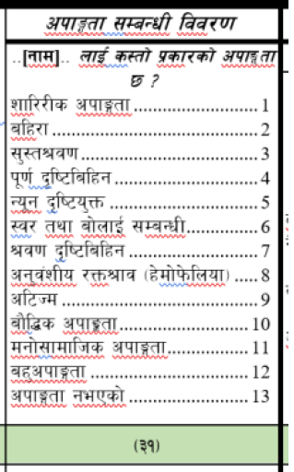
dxn #! M==-gfd_== nfO{ s:tf] k|sf/sf] ckfËtf 5 <
Uf0fgf x'g] k|To]s JolQmsf] zf/Ll/s / dfgl;s cj:yfsf] hfgsf/L /fVg] x]t'n] of] k|Zg /flvPsf] 5 .
s'g} JolQmdf s'g} Ps lsl;dsf] jf ljleGg lsl;dsf] ckfËtf x'g;Sb5 jf s'g} lsl;dsf] ckfËtf gePsf] -;fË_ klg x'g ;Sb5 .
cS;/ a;f]jf; u/]sf k|To]s ;b:osf] af/]df Ps Ps u/L ;f]wL ckfËtf eP gePsf] pko'Qm sf]8 n]Vg'kb{5 .

Slide 3
dxn #! M==-gfd_== nfO{ s:tf] k|sf/sf] ckfËtf 5 <
ckfËtfsf] kl/efiffM
z/L/sf cËx¿ / zf/Ll/s k|0ffnLdf ePsf] ;d:ofsf] sf/0f ef}lts, ;fdflhs, ;+f:s[lts jftfj/0fsf] ;fy} ;~rf/ ;d]taf6 l;h{gf ePsf] cj/f]w ;d]tn] b}lgs lqmofsnfk ;fdfGo¿kdf ;+rfng ug{ Pj+ ;fdflhs hLjgdf k"0f{ ;xefuL x'g sl7gfO{ x'g] cj:yfnfO{ ckfËtf elgG5 .
u0fgf k|of]hgsf] lgldQ ljleGg lsl;dsf ckfËtfnfO{ afx| -!@_ lsl;ddf juL{s/0f ul/Psf] 5 .

Slide 4
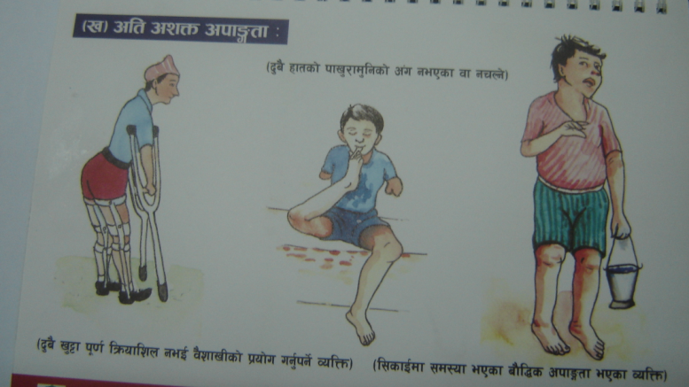
dxn #! M==-gfd_== nfO{ s:tf] k|sf/sf] ckfËtf 5 <
zf/Ll/s ckfËtf -sf]8 1_
:gfo', df+;k]zL / hf]gL{x¿ tyf x8\8Lsf] agfj6 Pj+ ;~rfng sfo{x¿df ePsf] ;d:ofsf] sf/0faf6 JolQmdf zf/Ll/s cËx¿sf] ;~rfng, k|of]u / lxF88'ndf cfPsf] ;d:of zf/Ll/s ckfËtf xf]
z/L/sf] cË h:t}M xft÷v'§f n'nf] / ;f+u'/f] ePsf], 5f]6f] jf c//f] ePsf] jf k"/f z/L/ aflËPsf] jf
oL s'g} c+udf ;fdfGo¿kn] sfd ug{ gx'g] u/L s'g} lsl;dsf] ljrng ePsf] eP zf/Ll/s ckfËtf ePsf] a'em\g'k5{ .
h:t} M afn kIf3ft -kf]lnof]_,
dl:tis kIf3ft (Cerebral Palsy),
zf/Ll/s cËljxLgtf,
s'i7/f]u,

Slide 5
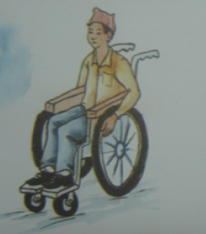
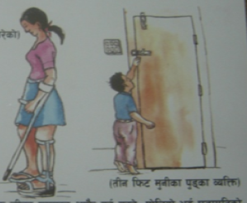
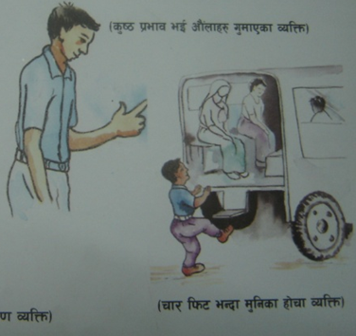
dxn #! M==-gfd_== nfO{ s:tf] k|sf/sf] ckfËtf 5 <
zf/Ll/s ckfËtf -sf]8 1_
pbfx/0f

Slide 6
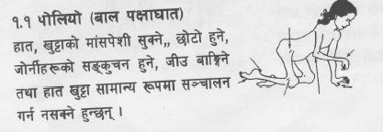
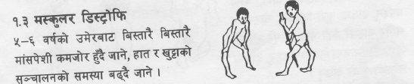
dxn #! M==-gfd_== nfO{ s:tf] k|sf/sf] ckfËtf 5 <
df+;k]zL ljrng (Muscular Dystrophy),
hf]gL{ / d]¿b08;DaGwL :yfoL ;d:of,
Sna lkm6 -k}tfnf kms]{sf]_,
l/s]6\;,
x8\8L;DaGwL ;d:ofsf sf/0f pTkGg czQmtf OToflb zf/Ll/s ckfËtf xf] .
xf]rf k'8\sfx¿ klg zf/Ll/s ckfËtfcGtu{t kb{5g\ .
olb dfly plNnlvt s'g} zf/Ll/s¿kdf ckfËtf ePsf JolQm eP sf]8 1 n]Vg'k5{ .

Slide 7
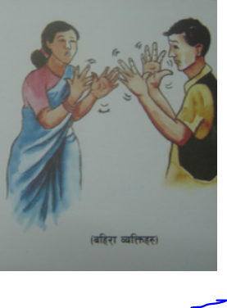
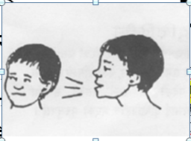
dxn #! M==-gfd_== nfO{ s:tf] k|sf/sf] ckfËtf 5 <
alx/f -sf]8 2_
g;'Gg], c:ki6 af]Ng] jf af]Ng g;Sg] / ;+rf/sf nflu ;f+s]lts efiff k|of]u ug'{kg]{ JolQm alx/f xf] .
*) 8]l;j]neGbf dflysf] Wjlg klg ;'Gg g;Sg] JolQmnfO{ alx/f dflgPsf] 5 .
;fdfGo cy{df cfˆgf] glhsdf ePsf b'O{ JolQmn] u/]sf] ;fdfGo s'/fsfgL g;'Gg] jf sfg k"/f g;'Gg]nfO{ sfg g;'Gg] jf alx/f ckfË a'em\g'k5{ .
o:tf] ckfËtf ePsf JolQm eP sf]8 2 n]Vg'k5{ .

Slide 8
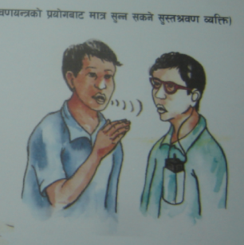
dxn #! M==-gfd_== nfO{ s:tf] k|sf/sf] ckfËtf 5 <
;':t >j0f -sf]8 3_
sfg sd dfq ;'Gg] t/ sd ;'g]/ :ki6;Fu af]Ng ;Sg], ;'Ggsf] nflu sfgdf >j0f oGq /fVg'kg]{ JolQm ;':t >j0f ePsf] JolQm xf] .
^% 8]l;j]nb]lv *) 8]l;j]n;Ddsf] Wjlg ;'Gg ;Sg] JolQmnfO{ ;':t >j0f ;d:of ePsf] a'em\g' kb{5 .
o:tf] ckfËtf ePsf JolQm eP sf]8 3 n]Vg'k5{ .

Slide 9
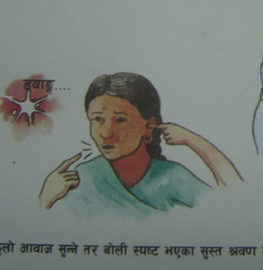
dxn #! M==-gfd_== nfO{ s:tf] k|sf/sf] ckfËtf 5 <
;':t >j0f -sf]8 3_
b|i6JoM af]Ng g;Sg] jf af]n]sf] s'/f :ki6 ga'lemg] u/L c:ki6 af]Ng]nfO{ k/Dk/fut ¿kdf nf6f] elgG5 t/ pgLx¿ ;':t>j0f g} x'g\ .
o:tf JolQm k|foM sfg g;'Gg] x'G5g\ .
t/ ;a} sfg g;'Gg] JolQm nf6f] x'Fb}gg\ .
:ki6 af]Ng g;Sg] jf af]n]sf] s'/f :ki6 ga'lemg] / sfg g;'Gg] eP klg sf]8 3n]Vg'k5{ .

Slide 10
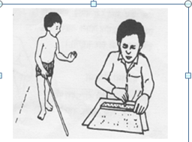
dxn #! M==-gfd_== nfO{ s:tf] k|sf/sf] ckfËtf 5 <
k"0f{ b[li6ljlxg -sf]8 4_
;fdfGotof cfˆgf] jl/kl/sf j:t' :ki6 gb]Vg] ;d:of ePsf, j:t' wldnf] b]Vg] jf k"/} gb]Vg] jf b]Vg g;Sg] ;d:of ePsf
b[li6;DaGwL ;d:ofsf sf/0faf6 JolQmdf s'g} klg j:t'sf] cfs[lt, cfsf/, ¿k / /Ësf] 1fg gx'g] l:ylt b[li6;DaGwL ckfËtf xf] .
o; cGtu{t k"0f{ ¿kdf pHofnf] jf cFWof/f] 5'6\ofpg g;Sg] JolQmnfO{ k"0f{ b[li6ljlxg dflgPsf] 5 .
o:tf] ckfËtf ePsf JolQm eP sf]8 4 n]Vg'k5{ .

Slide 11
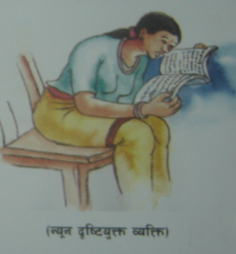
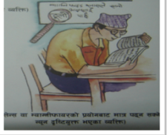
dxn #! M==-gfd_== nfO{ s:tf] k|sf/sf] ckfËtf 5 <
Go"g b[li6o'Qm -sf]8 5_
s'g} JolQmsf] cf}ifwL, zNo lrlsT;f tyf r:df k|of]u h:tf pkrf/af6 klg @) lkm6sf] b"/Laf6 xftsf] cf}Fnf 5§ofpg ;Sb}g
cyf{t :g]n]g rf6{ (Snellen Chart) sf] rf}yf] nfOgsf] cIf/ -^÷!*_ k9\g ;Sb}g eg] To:tf] JolQmnfO{ Go"g b[li6o'Qm dflgPsf] 5 .
o:tf] ckfËtf ePsf JolQm eP sf]8 5 n]Vg'k5{ .

Slide 12
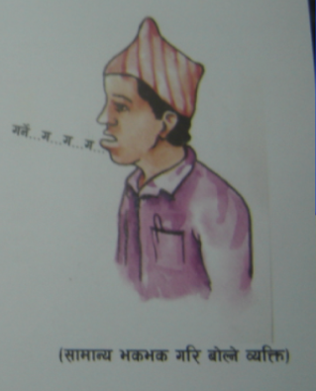
dxn #! M==-gfd_== nfO{ s:tf] k|sf/sf] ckfËtf 5 <
:j/ af]nfO;DaGwL -sf]8 6_
:j/ / af]nfO;DaGwL c+ux¿df pTkGg cK7]/f]sf sf/0f tyf af]Nbf :j/sf] ptf/r9fjdf sl7gfO ePsf], af]nL :ki6 gePsf], af]Nbf zAb jf cIf/ bf]xf]l/g] ;d:of ePsf] JolQmnfO{ :j/ af]nfO;DaGwL ckfËtf ePsf] a'em\g'kb{5 .
cf]7 jf tfn' kmf6]sf] JolQmnfO{ klg af]nL;DaGwL ckfËtfdf u0fgf ul/G5 .
o:tf] ckfËtf ePsf JolQm eP sf]8 6 n]Vg'k5{ .

Slide 13
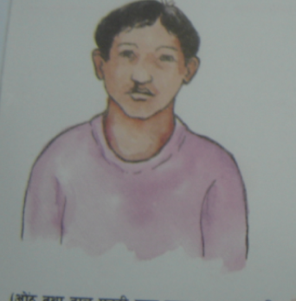
dxn #! M==-gfd_== nfO{ s:tf] k|sf/sf] ckfËtf 5 <
cf]7 jf tfn' kmf6]sf] JolQmnfO{ klg af]nL;DaGwL ckfËtfdf u0fgf ul/G5 .
o:tf] ckfËtf ePsf JolQm eP sf]8 6 n]Vg'k5{ .

Slide 14
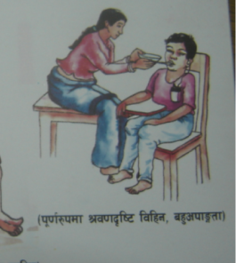
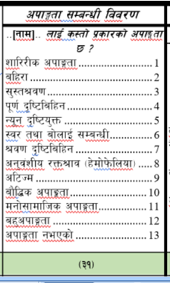
dxn #! M==-gfd_== nfO{ s:tf] k|sf/sf] ckfËtf 5 <
>j0f b[li6ljlxg ckfËtf -sf]8 7_
;'gfO ;DaGwL / b[li6;DaGwL b'j} ckfª\utf ePsf] jf b'O{j6f OGb|Lo ;DaGwL ckfª\utfsf] ;+o'Qm cGt/lqmof /x]sf] JolQmnfO{ >j0f b[li6ljxLg ckfËtf ePsf] a'em\g'kb{5 .
o:tf] ckfËtf ePsf JolQm eP sf]8 7 n]Vg'k5{ .

Slide 15
dxn #! M==-gfd_== nfO{ s:tf] k|sf/sf] ckfËtf 5 <
cg'j+zLo /Qm>fj -x]df]k]mlnof_ -sf]8 8_
cg'j+zLo c;/sf sf/0f /utdf x'g] ˆofS6/df ljrng cfO{ /ut hDg] sfo{df ;d:of pTkGg x'g] zf/Ll/s cj:yfsf] JolQm o; cGtu{t kb{5g\ .
o:tf] ckfËtf ePsf JolQm eP sf]8 8 n]Vg'k5{ .

Slide 16
dxn #! M==-gfd_== nfO{ s:tf] k|sf/sf] ckfËtf 5 <
cl6Hd -Autism_ -sf]8 9_
hGdhft gzf jf tGt'sf] ljsf; / ;f]sf] sfo{df cfPsf] ;d:of ePsf] JolSt h:t} ;~rf/ ug{, ;fdfGo ;fdflhs lgod a'‰g / k|of]u ug{ sl7gfO{ x'g]
tyf pd]/sf] ljsf;;Fu} ;fdfGo Joaxf/ gb]vfpg',
hGdhft ¿kdf s'g} JolQmsf] pd]/sf] ljsf;;Fu} ;fdfGo Jojxf/ gb]lvg',
c:jfefljs k|ltlqmof b]vfpg',
Pp6} lqmof bf]xf]¥ofO/xg',
cGo JolQm;Fu 3'nldn gug'{ jf tLa| dfgl;s c:j:ytf,
cflb k|ltlqmof b]vfpg] ;d:of ePsf JolQmnfO{ cl6Hd cGtu{t /fvL sf]8 9 n]Vg'kb{5 .

Slide 17
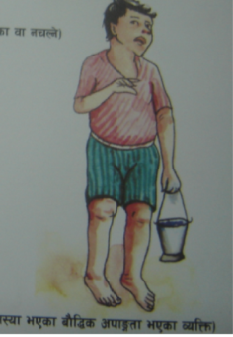
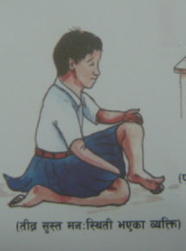
dxn #! M==-gfd_== nfO{ s:tf] k|sf/sf] ckfËtf 5 <
af}l4s ckfËtf -sf]8 10_
!* jif{sf] pd]/ cufj} af}l4s ljsf; gePsf] sf/0fn] pd]/ jf jftfj/0f ;fk]If lqmofsnfkx¿ ug{ sl7gfO x'g] cj:yfnfO{ af}l4s ckfËtf jf ;':tMdgl:ylt ;d:of ePsf] a'em\g'kb{5 .
af}l4s ckfËtf s'g} /f]u xf]Og, of] Pp6f cj:yf xf] .
of] cj:yf hGdhft klg x'g;Sb5 .
;fdfGo cy{df pd]/ cg';f/ ug{'kg]{ b}lgs hLjgofkgsf s[ofsnfkx¿ h:t}M vfgf vfg], n'uf nufpg], lb;f lk;fa / cfˆgf] :ofxf/df c¿sf] d2t rflxg] jf :d/0f zlQm sd x'g] -h:t} l56f] la;{g], 8fpg l;G8«f]d ;d]t_
jf pd]/ cg';f/sf] s'g} s'/f l;Sg l9nf] x'g'nfO{ ;':tMdgl:ylt ePsf] a'em\g'k5{ / af}l4s ckfËtf cGtu{t /fvL sf]8 10 n]Vg'kb{5 .

Slide 18
dxn #! M==-gfd_== nfO{ s:tf] k|sf/sf] ckfËtf 5 <
dgf];fdflhs ckffËtf -sf]8 11_
dl:tis / dfgl;s c+udf cfPsf] ;d:of tyf ;r]tgf, cled"lvs/0f, :km"lt{, :d/0f zlSt, efiff, u0fgfh:tf af}l¢s sfo{ ;Dkfbgsf ;Gbe{df cfpg] ;d:ofsf] sf/0fn] pd]/ / kl/l:ylt cg';f/ Jojxf/ ug{ ;d:of x'g] cj:yfsf] JolQm o; cGtu{t kb{5g\ .
dgf]];fdflhs ckfËtf Pp6f /f]u xf] . of] /f]u s'g} JolQmdf x'g] c;kmntf, lvGgtf jf tgfj cflbsf] sf/0fn]] dflg;sf] h'g;'s} pd]/ jf cj:yfdf b]vfkg{ ;Sb5 .

Slide 19
dxn #! M==-gfd_== nfO{ s:tf] k|sf/sf] ckfËtf 5 <
dgf];fdflhs ckffËtf -sf]8 11_
of] hGdhft x'Fb}g, pkrf/ u/]sf] cj:yfdf lgsf] x'g ;Sb5 .
dfgl;s c:j:ytf jf ljrng jf ljs[ltsf] sf/0f b}lgs hLjgofkg ug{ sl7gfO ePsf czQm JolQmnfO{ dfgl;s jf dgf];fdflhs ckfËtf ePsf] a'em\g'kb{5 .
o:tf dfgl;s ;d:ofx¿ ePsf JolQm eP sf]8 11 n]Vg'kb{5 .

Slide 20
dxn #! M==-gfd_== nfO{ s:tf] k|sf/sf] ckfËtf 5 <
ax'ckfËtf -sf]8 12_
dfly pNn]v ePsf ! b]lv !! ;Ddsf ckfËtf dWo] Pp6} JolQmdf s'g} b'O{ jf b'O{ eGbf a9L ckfËtf ePsf] JolSt o; cGtu{t kb{5 . h:t} M dl:tis kIf3ft cflb . o; k|sf/sf] ax' ckfËtf ePsf] eP sf]8 12 n]Vg' kb{5 .
ckfËtf gePsf] -sf]8 13_
u0fgfsf] ;dodf olb JolQmdf s'g} lsl;dsf] ckfËtf gePdf ckfËtf gePsf] hgfpg sf]8 13 n]Vg'kb{5 .

Slide 21
अतिरिक्त जानकारीको लागि निर्देशिकाको
विस्तृत अध्ययन गर्नुहोला ।
धन्यवाद!

Slide 22
अतिरिक्त जानकारीको लागि सुपरिवेक्षक निर्देशिकाको पेज नं ७ देखि १० सम्म विस्तृत अध्ययन गर्नुहोला ।
धन्यवाद!

