Slide 1
Gfd'gf -kfOn6_ hgu0fgfsf]
d'Vo k|ZgfjnL lstfjsf] se/ k]h
sG6«f]n kmf/fd eg]{ tl/sf
Consistency Check
Efl/Psf kmf/fdx?sf] k'0f{tf (completeness) hfFr
sfo{ ;DkGf kmf/fd eg]{ tl/sf
Kf|rf/ k|;f/

Slide 2
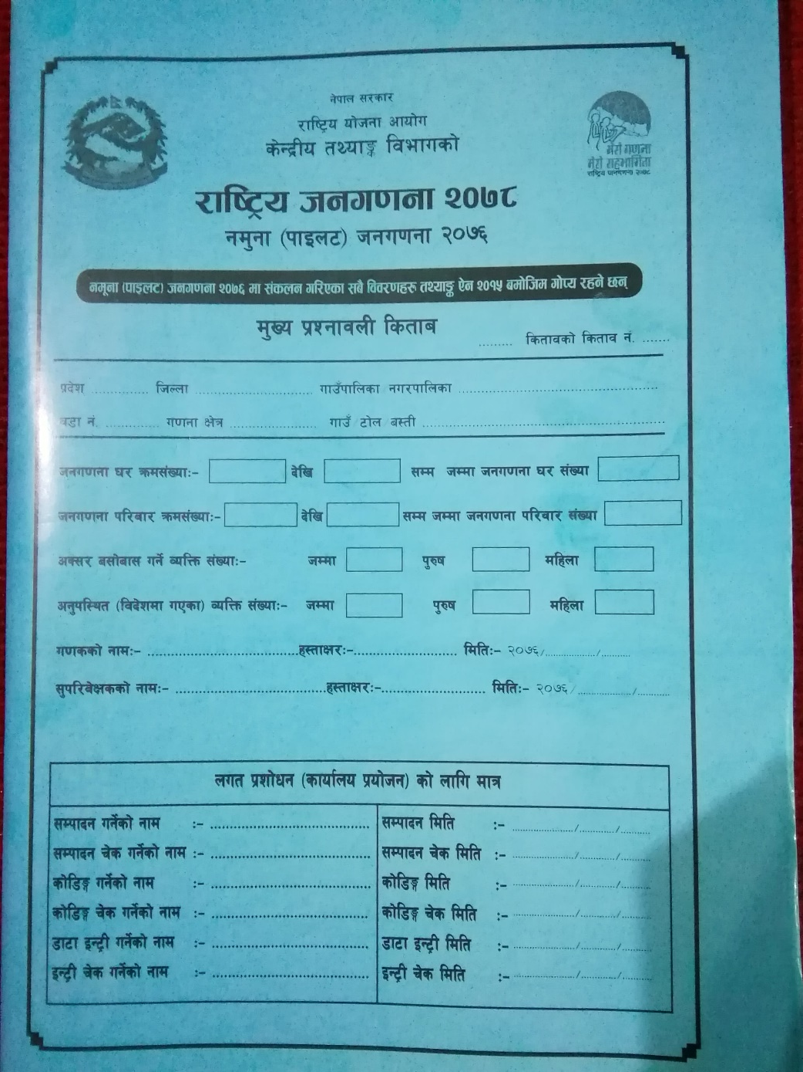
d'Vo k|ZgfjnLsf] cfj/0f k[i7 - se/ k]h _

Slide 3
cfj/0f k[i7 eg]{ tl/sf
/fli6«o hgu0fgf @)&* cGtu{t gd'gf -kfOn6_ hgu0fgfsf] ljj/0f ;+sng ug{ d'n k|ZgfjnLnfO{ !)) / $) kl/jf/sf] ljj/0f eg]{ u/L b'O{ lsl;dsf lstfadf jfOlG8ªsf] ul/Psf] 5 .
Pp6f j8f jf u0fgf If]qdf u0fgf ;lsPsf] t/ lstfasf kfgf afFsL eP afFsL ePsf kfgf vfnL 5f]8\g' k5{ . Pp6f lstfadf PseGbf a9L j8fsf] ljj/0f ;+sng ug{' x'Fb}g . obL s'g} j8fdf Ps eGbf a9L u0fgf If]q sfod ul/Psf] eP k|To]s u0fgf If]qsf] nflu 5'§f5'§} lstfa k|of]u ePsf] x'g' kb{5 .

Slide 4
Df'Vo k|ZgfjnLsf] se/ k]h eg]{ tl/sf
Tff]lsPsf] u0fgf If]qsf d'n k|ZgfjnLsf] dfq lstfa eg'{kg]{ ;Dk"0f{ 3/kl/jf/df ljj/0f ;++sng u/L;s]k5L x/]s u0fsn] pQm lstfa dWo] k|of]u ePsf ;a} lstfasf] cuf8Ltkm{sf] aflx/L k[i7 -se/k]h_ df lgwf{l/t ljj/0fx? e/]/ dfq cfkm\gf] ;'kl/j]Ifs ;dIf j'emfpg' kb{5 . ;'kl/j]Ifsx?n] oxL se/k]hdf lbOPsf ljj/0fx? g} d'n k|ZgfjnL a'em\g] sG6«f]n kmf/fddf pNn]v u/L kmf/fdx? a'em\g] ePsfn] clgjfo{?kdf :ki6;Fu ljj/0f el/Psf] x'g'kb{5 .
;'kl/j]Ifsx?n] klg se/k]h e/] ge/]sf] x]/]/ gel/Psf] eP eg{ nufP/ dfq lstfax? a'lemlng' kb{5 .

Slide 5

se/ k]h

Slide 6
Df'Nf k|ZgfjnL sf] se/ k]h eg]{ tl/sf
Kf|b]z, lhNnf, ufpFkflnsf÷gu/kflnsf, j8f g+=, u0fgf If]q g+, ufpF÷a:tL ÷6f]n h:tf ljj/0f o; lstfadf u0fgf z'? ug{' cl3 n]Vg pko'Qm x'G5 .
o; kl5sf ljj/0f ;DjlGwt lstfasf] ;j} kfgfdf u0fgf eP kl5 n]Vg' k5{ .
nut k|zf]wg -sfof{no k|of]hg_sf nflu egL n]lvPsf] :yfgdf s'g} ljj/0f n]Vg' x'b}g .
Kf|b]z M lstfaleq k|ZgfjnLdf el/Psf ljj/0fx? s'g k|b]zsf x'g\ ;f]xL k|b]zsf] k'/f gfd l/Qm :yfgdf n]Vg' kb{5 .
lhNnf – lstfaleq k|ZgfjnLdf el/Psf ljj/0fx? s'g lhNnfsf x'g\ ;f]xL lhNnfsf] k'/f gfd l/Qm :yfgdf n]Vg' kb{5 .

Slide 7
Df"n k|ZgfjnL sf] se/ k]h eg]{ tl/sf
ufpFkflnsf÷g=kf= – ;+sng ul/Psf ljj/0fx? s'g ufpFkflnsf jf dxfgu/kflnsf, pkdxfgu/kflnsf, gu/kflnsfsf x'g\, To;}sf] k'/f gfd n]Vg' kb{5 . olb ufpFkflnsf eP se/k]hdf n]lvPsf] g=kf=nfO{ sf6\g' kb{5 / g=kf= eP n]lvPsf] ufpFkflnsf sf6\g' kb{5 . h:t} olb :ofªhf lhNnfsf] la?jf ufpFkflnsf df u0fgf ul/Psf] lstfa eP ufpFkflnsf÷g=kf= M – lj?jf n]Vg' kb{5 .
j8f g+= – lstfa leq k|ZgfjnL kmf/fddf el/Psf ljj/0f u0fgf ul/Psf] ;DalGwt ufpFkflnsf÷g=kf= sf] slt gDa/ j8fdf el/Psf x'g\ l/Qm :yfgdf j8f gDa/ n]Vg' kb{5 .

Slide 8
Df'Vo k|ZgfjnLsf] se/ k]h eg]{ tl/sf
u0fgf If]q – k|of]u ul/Psf] lstfa u0fgf ul/Psf] ufpFkflnsf÷g=kf= sf] j8fsf] slt gDa/ u0fgf If]qdf el/Psf x'g\ l/Qm :yfgdf ;DjlGwt u0fgf If]q gDa/ n]Vg' kb{5 .
Pp6f j8fdf u0fgf ;lsPsf] t/ lstfasf kfgf afFsL eP afFsL ePsf kfgf vfnL 5f]8\g' k5{ . Pp6f lstfadf PseGbf a9L u0fgf If]qsf]] u0fgf ug{' x'Fb}g .
======== lstfasf] lstfa g+= ============ x/]s j8f jf u0fgf If]qdf ToxfFsf] cg'dflgt hg;+Vof cg';f/ k|ZgfjnL lstfasf] Joj:yf ul/Psf] 5 . o;/L j8fdf u0fgf ubf{ To; j8f jf j8fv08sf Pp6f dfq lstfadf ;a} kl/jf/sf] ljj/0fx? ;+sng ug{ Pp6f dfq lstfadf k|ofKt gx'g ;Qm5 . b'O{ jf b'O{ eGbf a9L lstfax? k|of]u ug'{kg]{ x'g ;Qm5 .

Slide 9
Df"n k|ZgfjnLsf] se/ k]h eg]{ tl/sf
======== lstfasf] lstfa g+= ============ u0fgf ul/Psf] j8f jf u0fgf If]qsf] ;j} kl/jf/sf] u0fgf ;lsPkl5 pQm j8f jf u0fgf If]qdf hDdf sltj6f lstfa k|of]u eP ;f] ;+Vof lstfasf] se/df lgwf{l/t :yfgsf] cuf8Lsf] efudf n]Vg'kb{5 .
s'n dWo] k|To]s lstfa s'g xf] -klxnf], bf]>f], t]>f], rf}yf]_ Tof] k5f8Lsf] vfnL 7fpFdf n]Vg' kb{5 .
olb s'g} Pp6f j8fdf $ lstfa k|of]u ePsf] eP ==========lstfasf] vfnL 7fpFdf $ -$ j6} lstfadf_ / lstfa g+= ======== df klxnf] lstfa eP !, bf];|f] lstfa eP @, t]>f] lstfa eP #, / rf}yf] lstfa eP $ ;f]xL cg';f/ n]Vg' kb{5 .
h:t} $ lstfasf] lstfa g+= ! =
$ lstfasf] lstfa g+= @ =
$ lstfasf] lstfa g+= # =
$ lstfasf] lstfa g+= $ =

Slide 10
D"fn k|ZgfjnLsf] se/ k]h eg]{ tl/sf
hguu0fgf 3/ qmd;+Vof M 3/ qmd ;+Vof n]Vbf k|To]s lstfadf u0fgf ePsf kl/jf/ a;]sf 3/sf] z'? / clGtd qmd;+Vof n]Vg'k5{ .
of] qmd;+Vof lstfasf] klxnf] kfgfdf n]lvPsf] 3/ qmd;+Vof / clGtdsf] kfgfdf n]lvPsf] clGtd 3/qmd ;+Vof g}} xf] .
klxnf] kfgfdf n]lvPsf] 3/qmd;+Vof klxnf] sf]7fdf / clGtd kfgfsf] clGtd hgu0fgf 3/ qmd;+Vof bf]>f] sf]7fdf -tLg c+sdf_ n]Vg' k5{ . o;af6 o; lstfadf sltj6f hgu0fgf 3/sf] u0fgf eP5, hfgsf/L x'G5 .

Slide 11
D"fn k|ZgfjnLsf] se/ k]h eg]{ tl/sf
clGtd hgu0fgf 3/qmd ;+Vof a/fa/ g} hDdf hgu0fgf 3/ ;+Vof gx'g ;Sb5 lsgeg] qmd;+Vof n]Vbf s'g} g+= x6]sf] x'g;Sb5 . Tf;y{ pQm lstfadf hDdf slt j6f hgu0fgf 3/sf] ljj/0f el/Psf] 5 pQm ljj/0f hDdf hgu0fgf 3/ ;+Vof kl5sf] sf]7fdf n]Vg'kb{5 .
h:t} s'g} lstfadf ! b]lv *% ;Ddsf] qmd;+Vofsf 3/x?sf] ljj/0f ;+sng ul/Psf 5g\ / lstfa leq dfq *! Jf6f 3/sf] dfq ljj/0f ;+sng ul/Psf] eP
hgu0fgf 3/ qmd;+Vof ))! b]lv )*% ;Dd hDdf hgu0fgf 3/ ;+Vof )*!

Slide 12
Df"n k|ZgfjnLsf] se/ k]h eg]{ tl/sf
Hfgu0fgf kl/jf/ qmd;+Vof – 3/ qmd;+Vof h:t} kl/jf/ qmd;+Vofsf] sf]7fdf klg j8f jf u0fgf If]qsf] To; lstfadf u0fgf ePsf] z'?sf] kl/jf/sf] z'?sf] qmd;+Vof / clGtd kl/jf/sf] clGtd qmd;+Vof n]Vg' kb{5 .
Ps3/df PseGbf a9L kl/jf/ klg a;f]jf; ug{ ;Sg] ePsf]n] kl/jf/ qmd;+Vof / 3/qmd;+Vof km/s km/s kg{ ;Sb5 .
klxnf] lstfadf ! b]lv $) ;Ddsf kl/jf/ u0fgf ePsf eP
kl/jf/ qmd;+Vof ))! b]lv )$) ;Dd
csf]{ lstfadf $! b]lv !!) ;Ddsf] 3/kl/jf/x?sf ljj/0f ;+sng ul/Psf 5g\ eg]
kl/jf/ qmd;+Vof )$! b]lv !!) ;Dd

Slide 13
d'n k|ZgfjnLsf] se/ k]h eg]{ tl/sf
cS;/ a;f]jf; ug]{ JolQm ;+Vof, hDdf, k'?if / dlxnf– k|To]s lstfasf k|of]u ePsf k|ZgfjnLx?df u0fgf ePsf kl/jf/df cS;/ a;f]jf/ ug]{ hDdf JolQm ;+Vof, k'?ifsf] ;+Vof / dlxnfsf] ;+Vof hf]8]/ lbOPsf] sf]7fdf n]Vg' kb{5 . se/k]hdf hg;+Vofsf] ljj/0f n]Vbf To; lstfa leq u0fgf ePsf k|To]s kl/jf/sf JolQmsf] k'?if / dlxnf cnu–cnu uGtL u/L olsg ePkl5 dfq n]Vg'kb{5 .
of] ljj/0f k|of]udf cfPsf] lstfa leq el/Psf nut ! sf] kl/rofTds v08sf] bfFof tkm{sf] tflnsfdf pNn]lvt kl/jf/df cS;/ a;f]jf; ug]{ ;b:ox¿sf] x/]s k|ZgfjnLsf] hf]8 u/L eg'{ kb{5 .

Slide 14
d'n k|ZgfjnLsf] se/ k]h eg]{ tl/sf
cg'kl:yt -ljb]zdf uPsf_ JolQm ;+Vof -hDdf, k'?if / dlxnf_ – k|To]s lstfadf u0fgf ePsf kl/jf/df cS;/ a;f]jf; gug]{ ljb]zdf uPsf hDdf JolQm ;+Vof, k'?ifsf] ;+Vof / dlxnfsf] ;+Vof lbOPsf] sf]7fdf n]Vg' kb{5 .
se/k]hdf ljb]zdf uPsf hg;+Vofsf] ljj/0f n]Vbf To; lstfa leq ljb]zdf uPsf JolQmsf] ¿kdf u0fgf ePsf k|To]s kl/jf/sf ;b:osf]] k'?if / dlxnf cnu–cnu uGtL u/L olsg ePkl5 dfq n]Vg'kb{5 .
of] ljj/0f k|of]udf cfPsf] lstfa leq el/Psf nut ! sf] kl/rofTds v08sf] bfFof tkm{sf] tflnsfdf pNn]lvt kl/jf/df cS;/ a;f]jf; gug]{ ljb]zdf uPsf ;b:ox¿sf] dfq ulGt u/L eg'{ kb{5 .

Slide 15
d'n k|ZgfjnLsf] se/ k]h eg]{ tl/sf
u0fssf] gfd, ;xL, ldlt M– h'g u0fsn] lstfaleqsf ljj/0f ;+sng u/]sf] 5 ;f]xL u0fssf] gfd n]lv k|i6 a'lemg] u/L ;xL ug{'kb{5 . / To;/L lstfa leqsf ljj/0fx? ;+sng ul/ ;s]kl5 ;lsPsf] ldlt n]Vg'kb{5 . ldlt n]Vbf c+sdf ut] dlxgf / jif{ n]Vg'kb{5 . h:t} r}q !@, @)&^ eP @)&^.!@.!@ n]Vg' kb{5 .
;'k/Lj]Ifssf] gfd, ;lx / ldlt M– o; lstfadsf] ljj/0fx? ;+sng ubfg]{ sfdsf] lg/LIf0f u/]sf ;'kl/j]Ifsn] sfd ;lsPkl5 el/Psf ;j} kfgfsf] ljj/0fx? ;DalGwt ;'k/Lj]Ifsn] hfFRg'kb{5 .
;'kl/j]Ifs cfk}m+n] k|To]s el/Psf kfgfx? x]/L ljj/0fdf q'6L ePsf], 5'6]sf 5, 5}g uGtL u/L olsg ug{' kb{5 / ;Rofpg ;lsg] q'6L eP ;Rofpg' k5{ . tfls n]lvPsf] ljj/0f ;xL xf];\ . ljj/0fx? hfFlr;s]kl5 ;DalGwt ;'k/Lj]Ifsn] cfˆgf] gfd :ki6 n]lv ;xL u/L ldlt n]Vg' kb{5 .

Slide 16
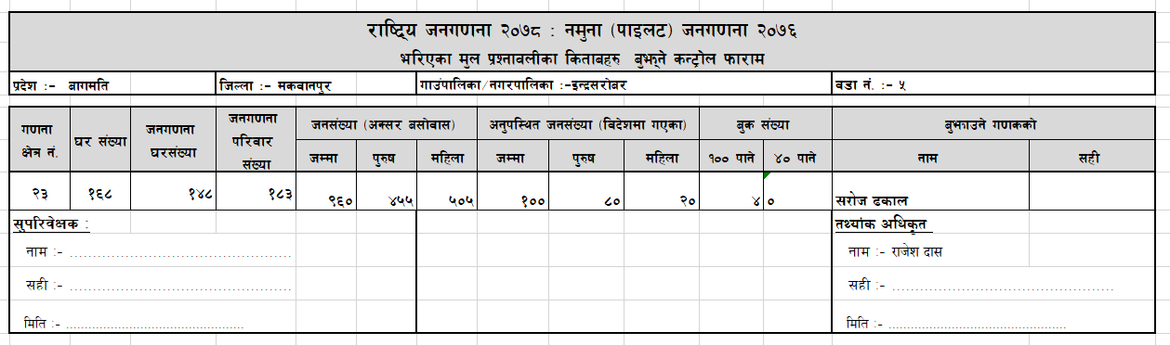
Efl/Psf d'Vo k|ZgfjnL a'em\g] sG6«f]n kmf/fd eg]{ tl/sf
hgu0fgfsf] ;Dk"0f{ sfo{ ;dfKt ePkl5 ;'kl/j]Ifsn] cfkm" cGtu{tsf u0fsx?af6 el/Psf k|Zgfjnlx? a'emL lng'kb{5 . Efl/Psf d'Vo k|ZgfjnL kmf/fdx? Af'em\gsf]] sG6«f]n kmf/fd tof/ ul/Psf] 5 h'g ;'kl/j]Ifsn] eg]{ kmf/fd xf] . cfkm"cGtu{tsf s'g u0fsn] s] slt el/Psf d'n k|ZgfjnL sf lstfax¿ ;'kl/j]Ifs;dIf a'emfPsf] ;f]] ljj/0f / pQm ljj/0f ;xL xf] egL ;DalGwt u0fsn] x:tfIf/ ul/Psf] ljj/0f kq xf] .

Slide 17
Efl/Psf d'Vo k|ZgfjnL a'em\g] sG6«f]n kmf/fd
o; kmf/fddf lbOPsf] ljj/0fx¿ lhNnf, ufpF÷gu/, j8f g+=, u0fgf If]q;+Vof, 3/;+Vof, kl/jf/;+Vof, hg;+Vof -hDdf, k'?if, dlxnf_, !)) kfg] / $) kfg] lstfa ;+Vof s] slt j6f el/Psf 5g\ ?h' u/L u0fssf] gfd / ;xL u/fO{ a'emL lng''kb{5 .
of] sG6«f]n kmf/fddf eg{'kg]{ 3/;+Vof, kl/jf/;+Vof / hg;+Vof;DaGwL ljj/0f el/Psf d'n k|ZgfjnLsf] lstfasf] se/k]hdf ptf/ ul/Psf] ljj/0faf6 x'ax' ;fl/Psf] x'g'kb{5 .

Slide 18
Df'n k|ZgfjnL a'em\g] sG6«f]n kmf/fd
cfkm" cGtu{tsf ;Dk"0f{ u0fsx?af6 nut lstfax? a'emL ;'kl/j]Ifsn] cfˆgf] gfd / ;xL u/L ;Dk"0f{ el/Psf lstfax? :yfgLo hgu0fgf sfof{nodf a'emfpg'kb{5 .
oL ljj/0fx¿n] hgu0fgfsf] k|f/lDes glthf k|sfzgsf] nflu ljz]if dxTj /fVg] ePsf]n] o;nfO{ ;'kl/j]Ifsn] ;'/lIft;fy oyfzL3| :yfgLo hgu0fgf sfof{nodf a'emfpg'kb{5 .
tYof+s sfof{nox?n] klg ;'kl/j]Ifsn] j'emfPsf lstfax? / sG6«f]n kmf/fdx? ?h' u/]/ dfq a'lemlng' kb{5 .

Slide 19
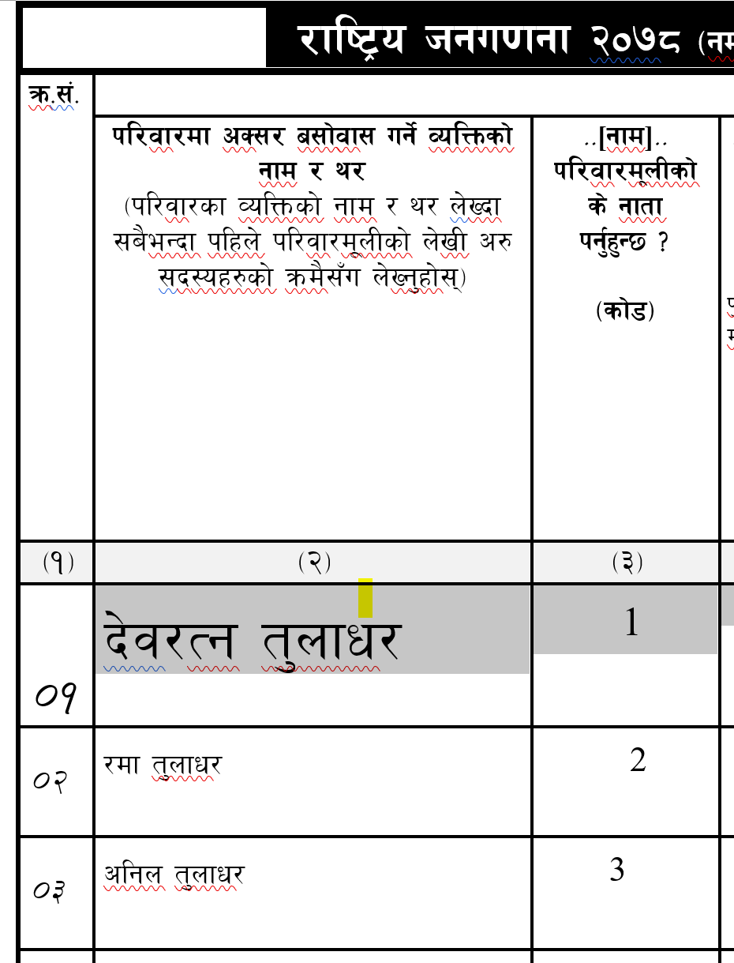
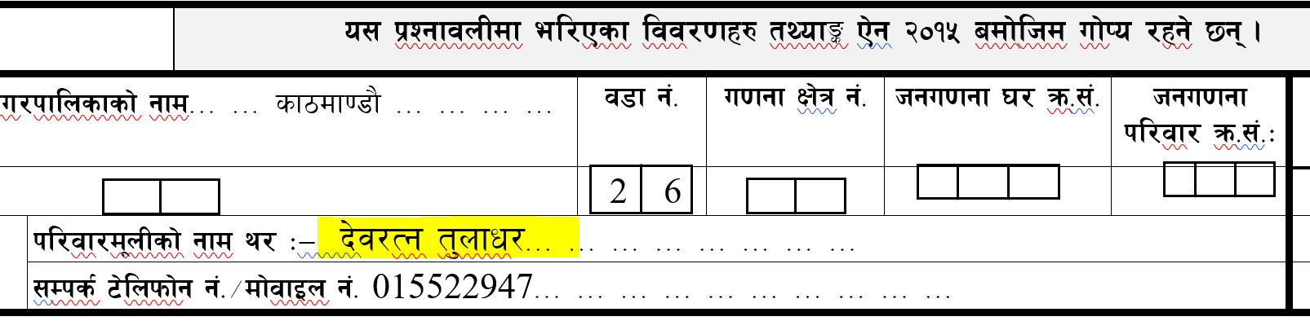
Consistency Check
/fli6o hgu0fgf @)&* cGtu{t gd'gf hgu0fgf @)&^ nflu tof/ ul/Psf] d'n k|ZgfjnLdf ;dfj]z ul/Psf] k|Zgx? Ps csf]{ aLr cGt/ ;DalGwt x'G5g\ . To; k|Zgx?sf] ;fdGh:otf kl/If0f -check) ug'{kb{5 .
Hf:t} M kfl/jfl/s ljj/0fsf] z'?df n]lvPsf] kl/jf/d'nLsf] gfd / JolQmutsf] dxn @ sf] qm=;+= ! Dff n]lvPsf] gfd Pp6} x'g'kb{5 .
Hf:t}M

Slide 20
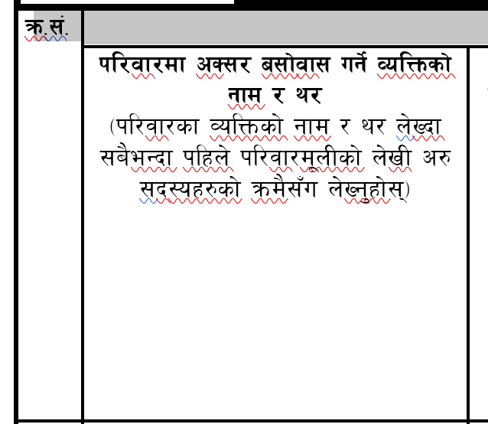
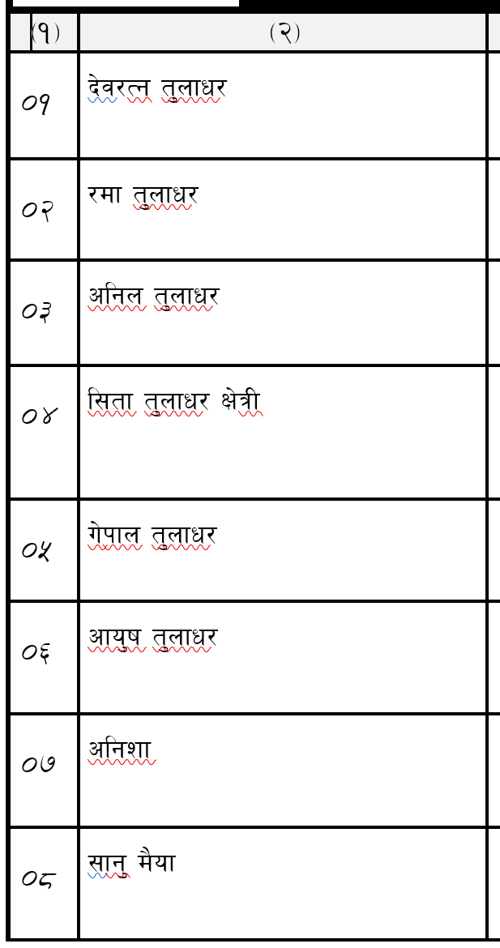
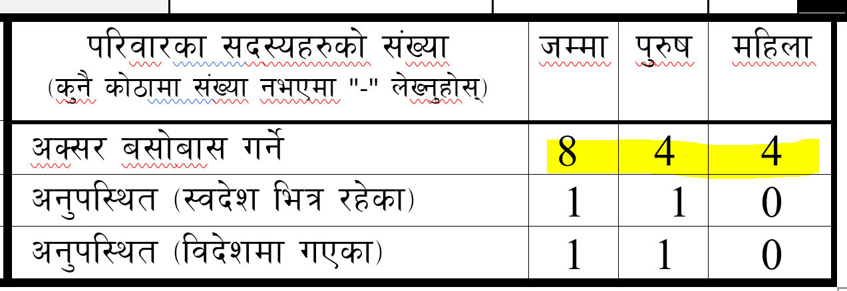
Consistency Check
o;}u/L cGo cGt/;DalGwt k|Zgx?df
!= cS;/ a;f]jf; ug]{sf] hDdf JolQmutsf] dxn @ sf] hDdf ;+Vof

Slide 21
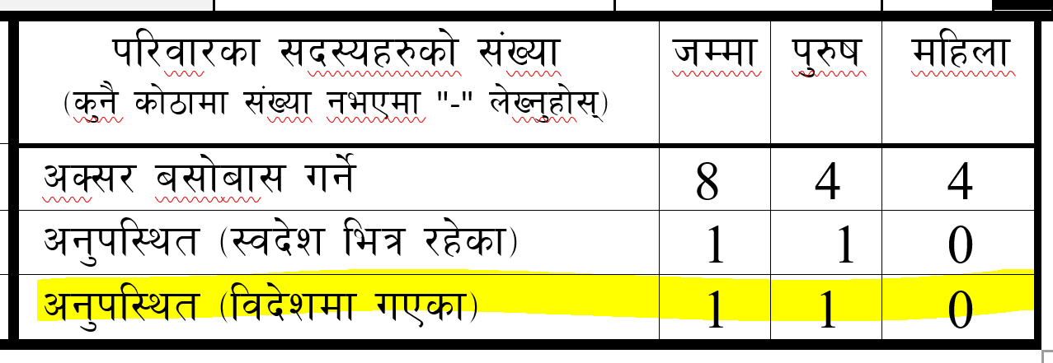
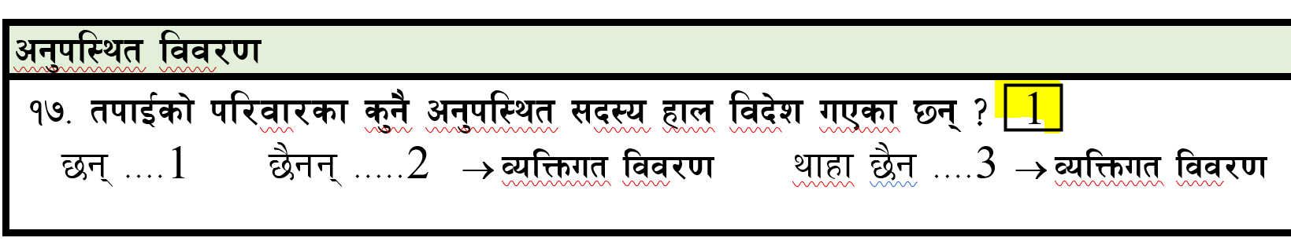
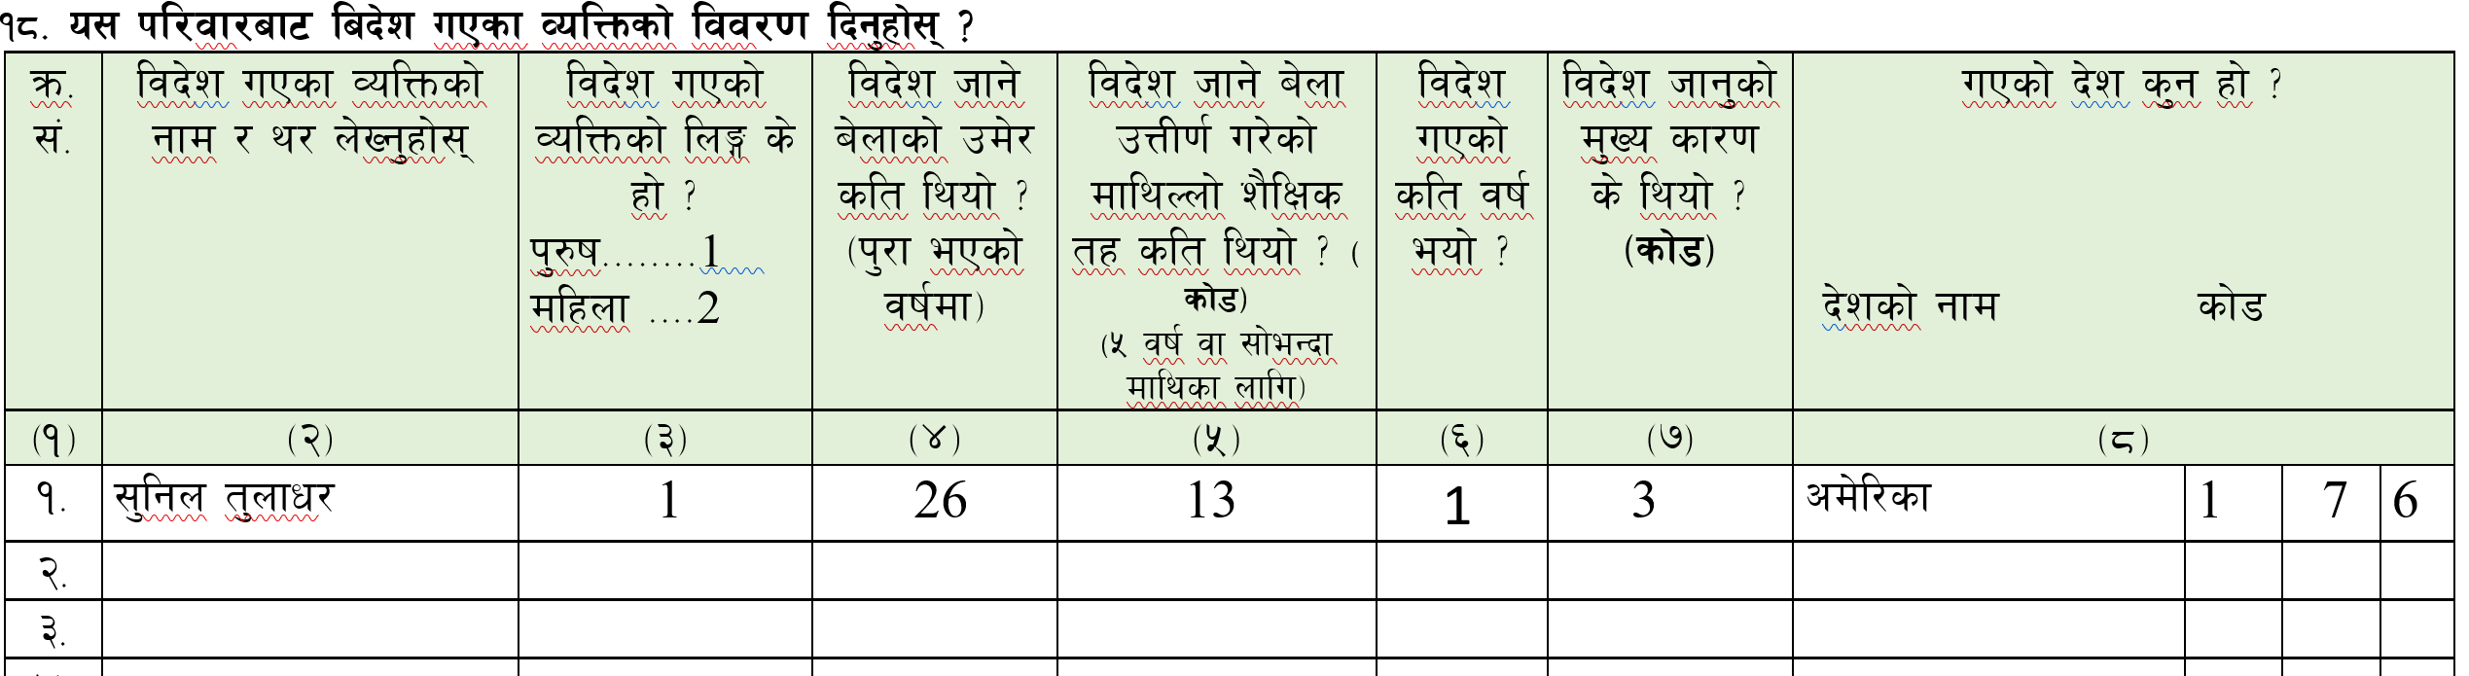
Consistency Check
o;}u/L cGo cGt/;DalGwt k|Zgx?df
@= cg'kl:yt -ljb]z uPsf_sf] hDdf kfl/jf/Ls v08sf] k|Zg !& sf] ljb]z uPsf] ;+Vof

Slide 22
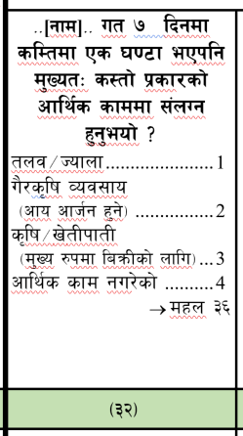
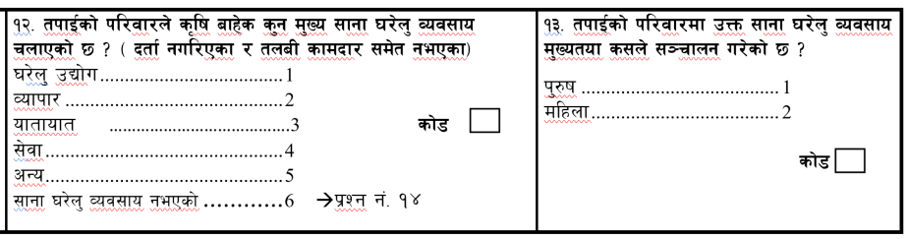
Consistency Check
o;}u/L
#= kfl/jfl/s ljj/0fsf] k|Zg g++ !@ / !@ JolQmut v08sf] dxn #@
M olb !@ df ;fgf 3/]n' Joj;fo rnfPsf] b]lvPdf / pQm Joj;fo d'Vo cflYf{s sfd /x]5 eg] dxn #@ df kl/jf/sf s'g} ;b:osf] cfly{s sfddf b]lvg;Sb5 . ljj/0f ebf{ ljrf/ ug'{kb{5 .

Slide 23
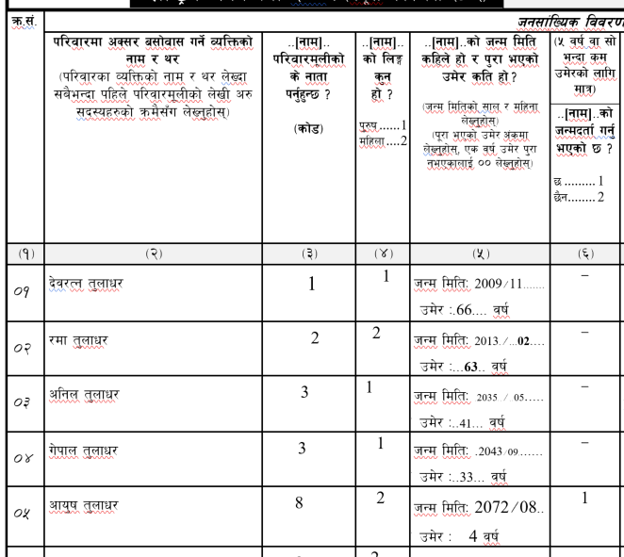
Consistency Check
JolQmut v08sf] dxn %
dxn % df pd]/ % eGbf sd ePsf]nfO{ dfq dxn ^ ;f]Wg'kb{5 .
JolQmut v08sf] dxn ^

Slide 24
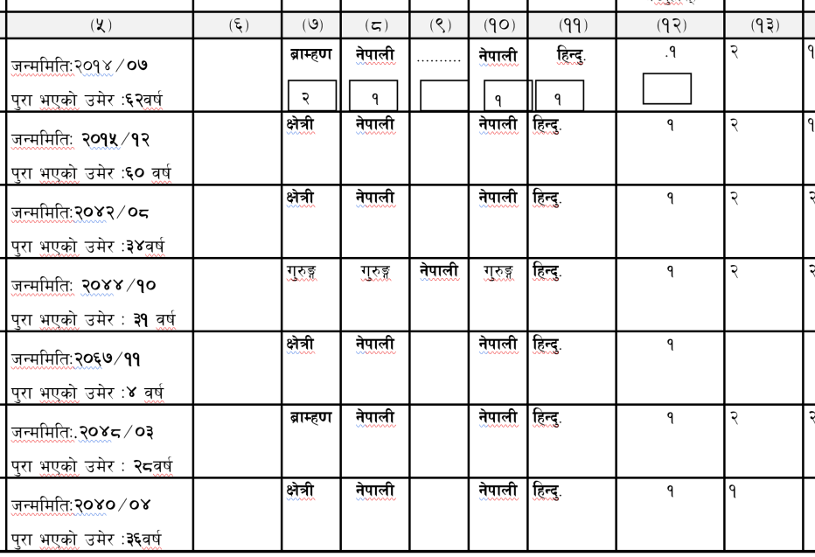
Consistency Check
JolQmut v08sf] dxn %
dxn % df pd]/ !) jf ;f] eGbf dfly ePsf]nfO{ dfq dxn !# ;f]Wg'kb{5 .
JolQmut v08sf] dxn !#

Slide 25
Consistency Check
JolQmut v08sf] dxn $ / % -lnË / pd]/_
JolQmut v08sf] dxn @& b]vL @( -k|hgg\_
Dfxn !#
-ljjflxt / cljflxt_
dxn $ df @ sf]8 / dxn % df !% b]lv $( jif{ pd]/ ePsf] / dxn !# df @ b]lv % sf] ePsf]nfO{ dfq dxn @& b]lv @( ;Dd ;f]Wg'kb{5 .

Slide 26
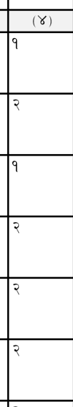
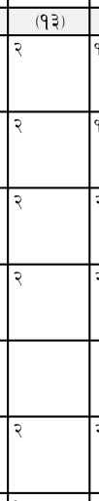
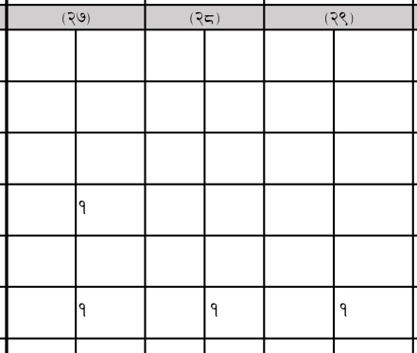
Consistency Check
lnË pd]/ a}afjlxs l:ylt k|hgg\

Slide 27
Consistency Check
o;}u/L cGo cGt/;DalGwt k|Zgx?df
JolQmut v08sf] dxn % JolQmutsf] dxn !%
Dfxn % df pd]/ % jif{ jf ;f] eGbf dfly ePdfq lzIff
;DaGwL k|Zgx? Dfxn !% b]vL !* sf k|Zg ;f]Wg'kb{5 .
dxn !^ df sf]8 % cfP dxn !( df hfg] .
Dfxn !& df sf]8 !#, !$ / !% cfPdf dxn !( ;f]Wg'kb{5 gq dxn !( ;f]Wg gkg]{

Slide 28
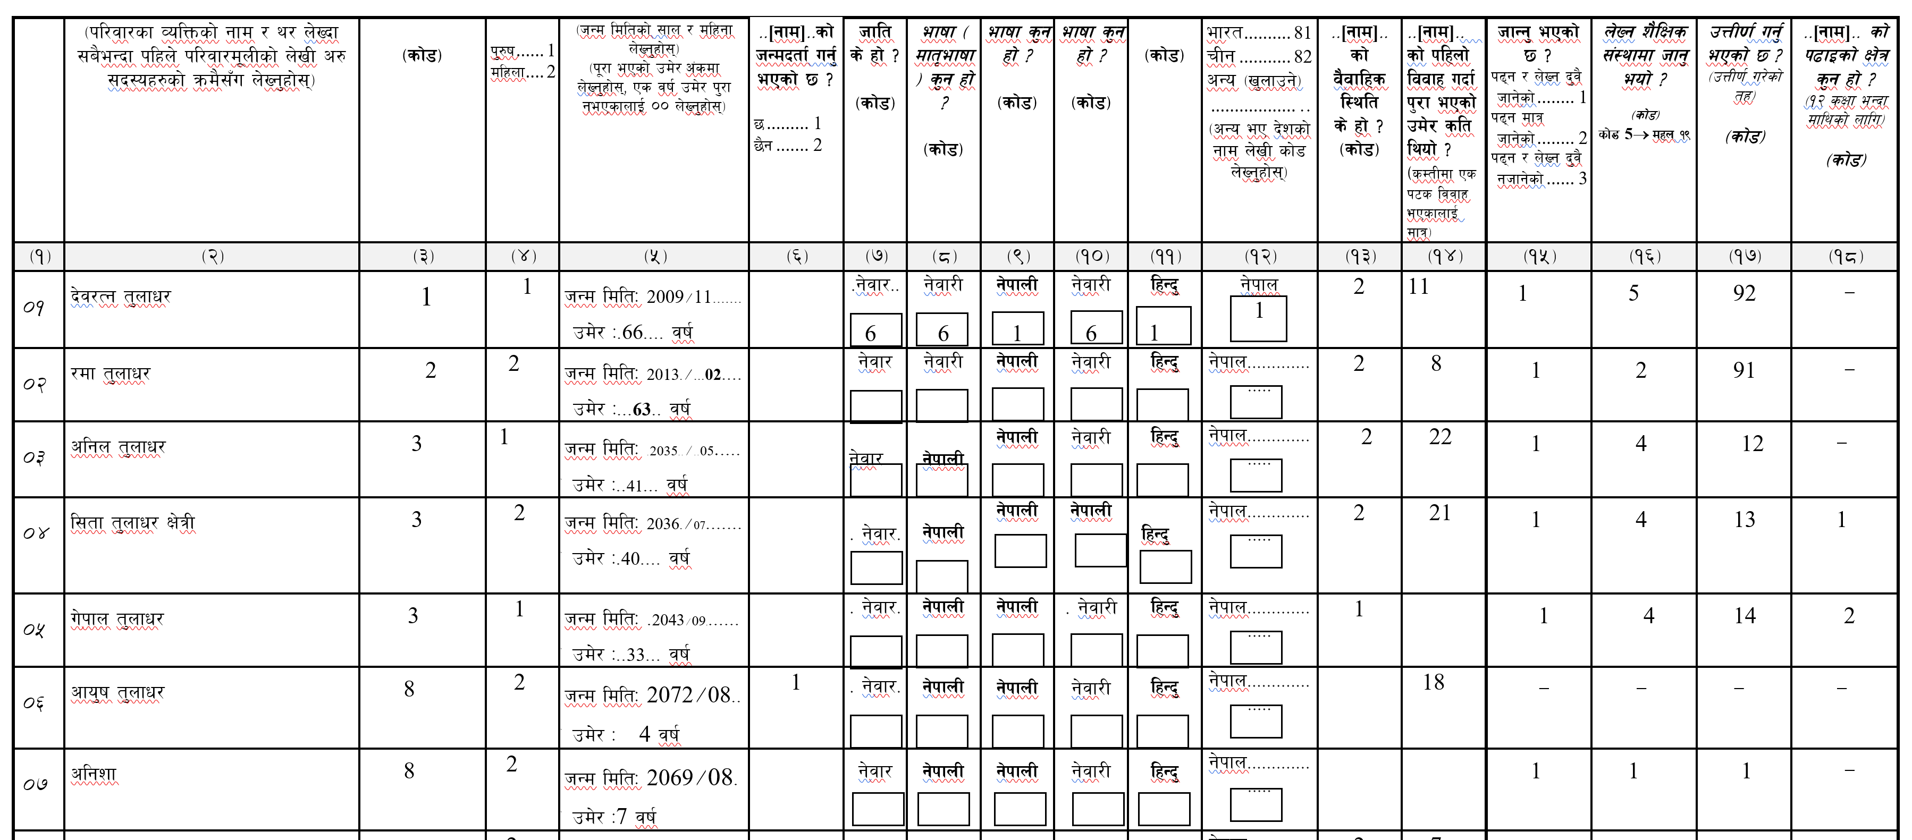

Slide 29
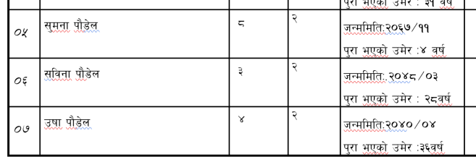
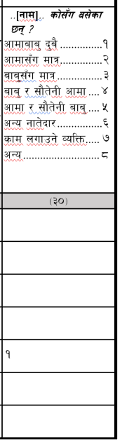
Consistency Check
JolQmut v08sf] dxn % -pd]/_
JolQmut v08sf] dxn #) -a;f]jf;sf] l:ylt_
dxn % df !* jif{ eGbf sd pd]/ ePsf] ePsf]nfO{ dfq dxn #) ;f]Wg'kb{5 .

Slide 30
Consistency Check
JolQmut v08sf] dxn % -pd]/_
JolQmut v08sf] dxn #@ -cfly{s sfd_
dxn % df !) jif{ eGbf a9L pd]/ ePsf] ePsf]nfO{ dfq dxn #@ ;f]Wg'kb{5 .

Slide 31
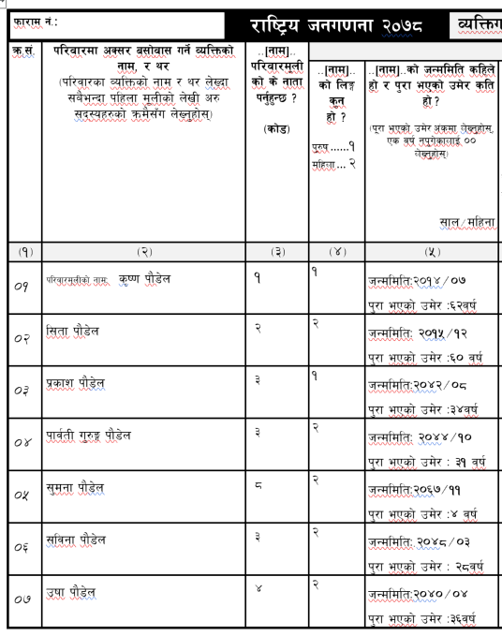
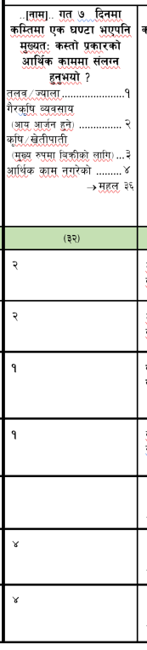
Consistency Check

Slide 32
el/Psf kmf/fd बुझ्ने तथा र चेकजाँचको Joj:yf -a/a'emf/y_ (१/२)M
Df'Vo u0fgfsf] ;dodf g} ;'kl/j]Ifsn] Uf0fsaf6 el/Psf k|ZgfjnL tyf cGo kmf/fdx?sf] k|To]s kfgf r]shfFr u/L olb s'g} vfnL kfO{Pdf k'gM u0fsnfO{ ;DalWft 3/df g} uO{ ljj/0f eg{ nufpg'kg]{5 .
u0fgf sfo{ ;DkGg ePk5L u0fs cfkm}n] klg e/]sf d'n k|ZgfjnLx? Nfufot cGo kmf/fdx? ;a{k|yd cfkm}Nf] /fd|f] ;Fu r]s ug'{kg]{5 .
Df'Vo u0fgfsf] ;dodf g} ;'kl/j]Ifsn] Uf0fsaf6 el/Psf k|ZgfjnL tyf cGo kmf/fdx?sf] se/ k]h ;lxt k|To]s kfgf r]shfFr u/]/ dfq se/ kfgfdf x:tfIf/ ug'{kg'{] .

Slide 33
el/Psf kmf/fd बुझ्ने तथा र चेकजाँचको Joj:yf -a/a'emf/y_ (२/३)M
:yfgLo hgu0fgf sfof{nodf ;'kl/j]Ifs / ;'kl/j]Ifs dfkm{t u0fsn] a'emfpg NofPsf -el/Psf_ k|ZgfjnL tyf cGo kmf/fdx? ?h' hfFr u/L dfq a'emg] Joj:yf ldnfO{g]
Efl/Psf kmf/fdx? Af'em\gsf] nflu # hgfsf] b]xfo cg';f/sf] sfo{ ;d'x agfO{g]5 .
तथ्यांक कार्यालय कर्मचारी १ जना
कार्यालको सहयोगी
१ जना
सुपेरिवेक्षक मध्येबाट
१ जना

Slide 34
el/Psf kmf/fd बुझ्ने तथा र चेकजाँचको Joj:yf -a/a'emf/y_ (३/३)M
pQm sfo{;d'xn] ;'kl/j]Ifs tyf u0fsn] a'emfpg] ;a} k|ZgfjnL tyf cGo kmf/fdx? se/ k]h ;lxt k|To]s kfgf r]s hfFr u/]/ dfq a'em\g'kb{5 .
pQm sfo{;d"xsf] sfo{ ;DkGg kmf/fd (work clearance Form ) l;kmf/Lzsf] cfwf/df hgu0fgf clwsf/Ln] k|dfl0ft ug'{Kfb{5 . sfo{ ;DkGg kmf/fdsf] gd'gf ljefun] pknAw u/fpg] .
sfo{ ;DkGg kmf/fd (work clearance Form ) sf] cfwf/df dfq ;'kl/j]Ifs tyf u0fsnfO{ n]vf zfvfn] afFsL cfly{s ;'ljwf e'QmfgL lbg]5 .

Slide 35
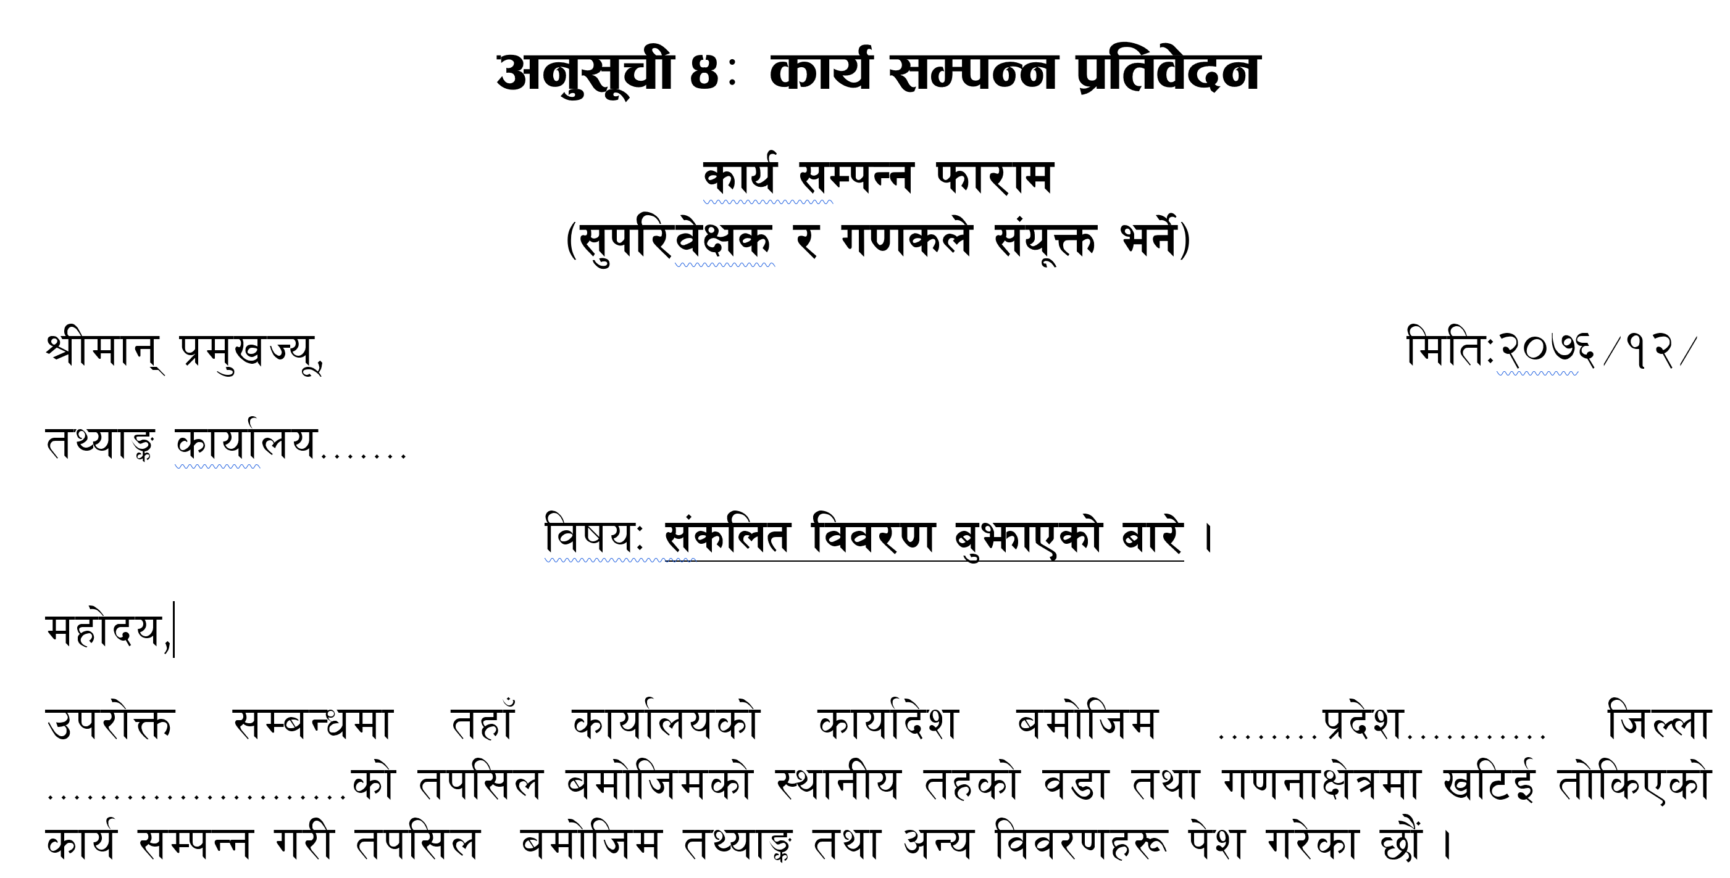
कार्य सम्पन्न फारम : सुपरिवेक्षक निर्देशिका अनुसूची ४

Slide 36
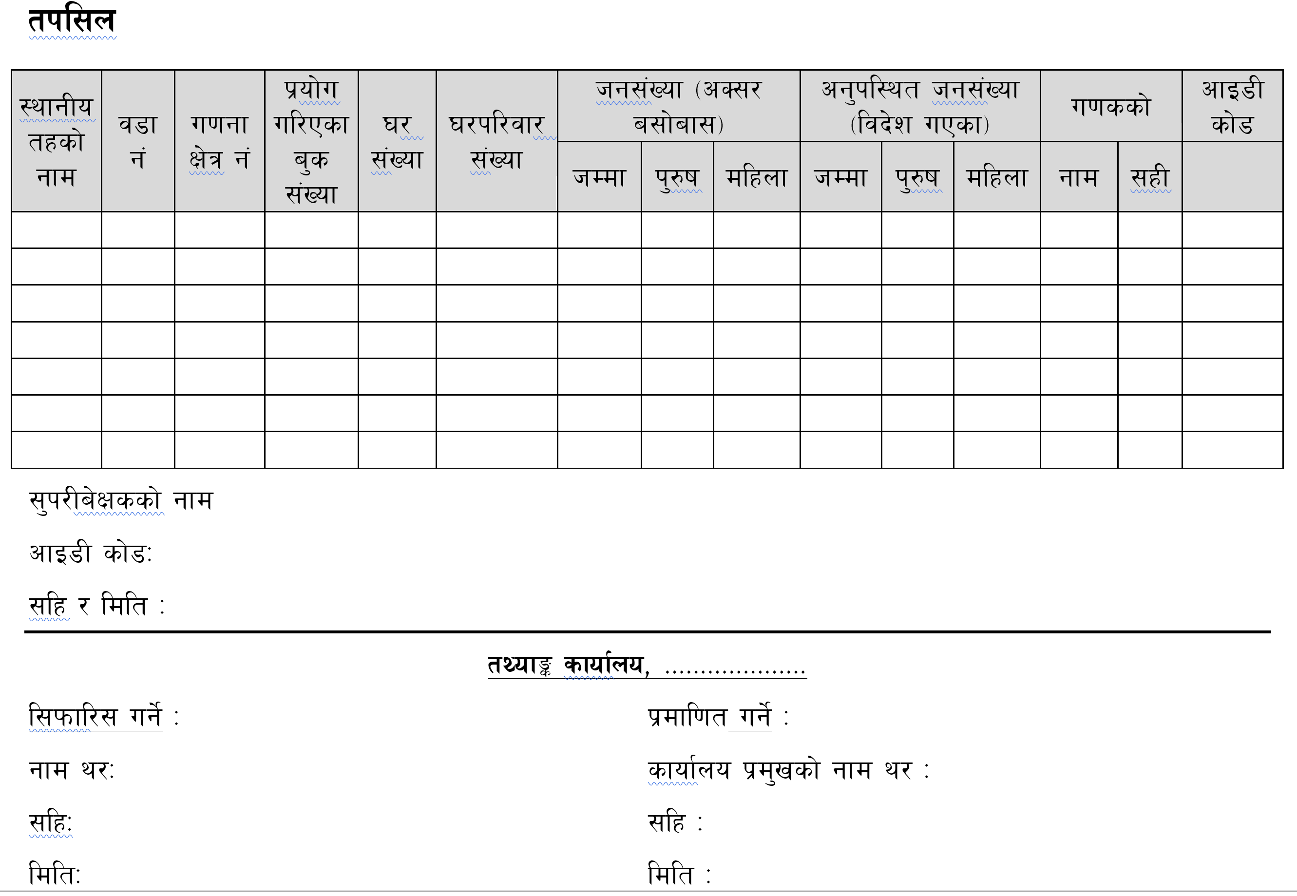
कार्य सम्पन्न फारम : सुपरिवेक्षक निर्देशिका अनुसूची ४

Slide 37
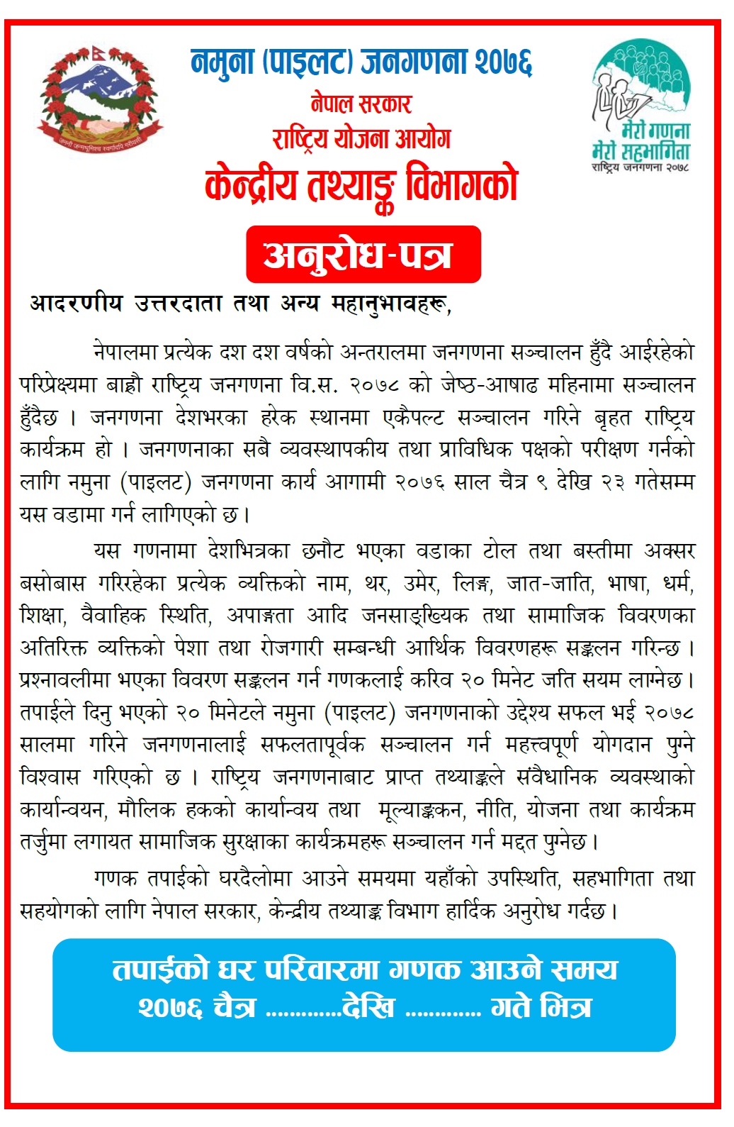
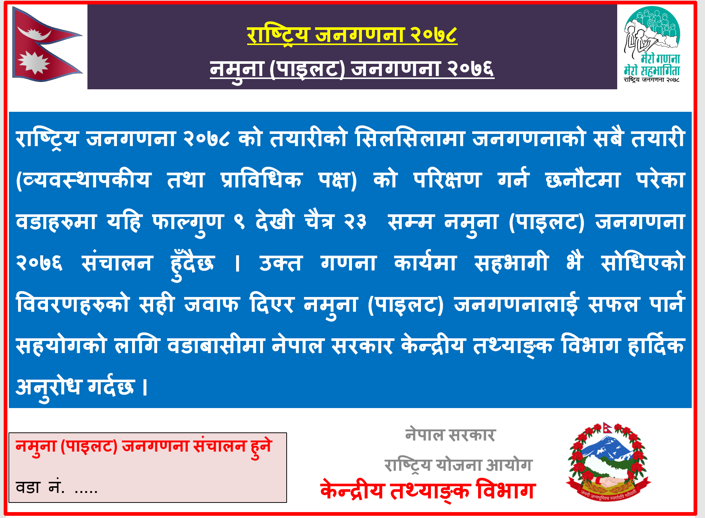
प्रचार प्रसार (१/२)

Slide 38
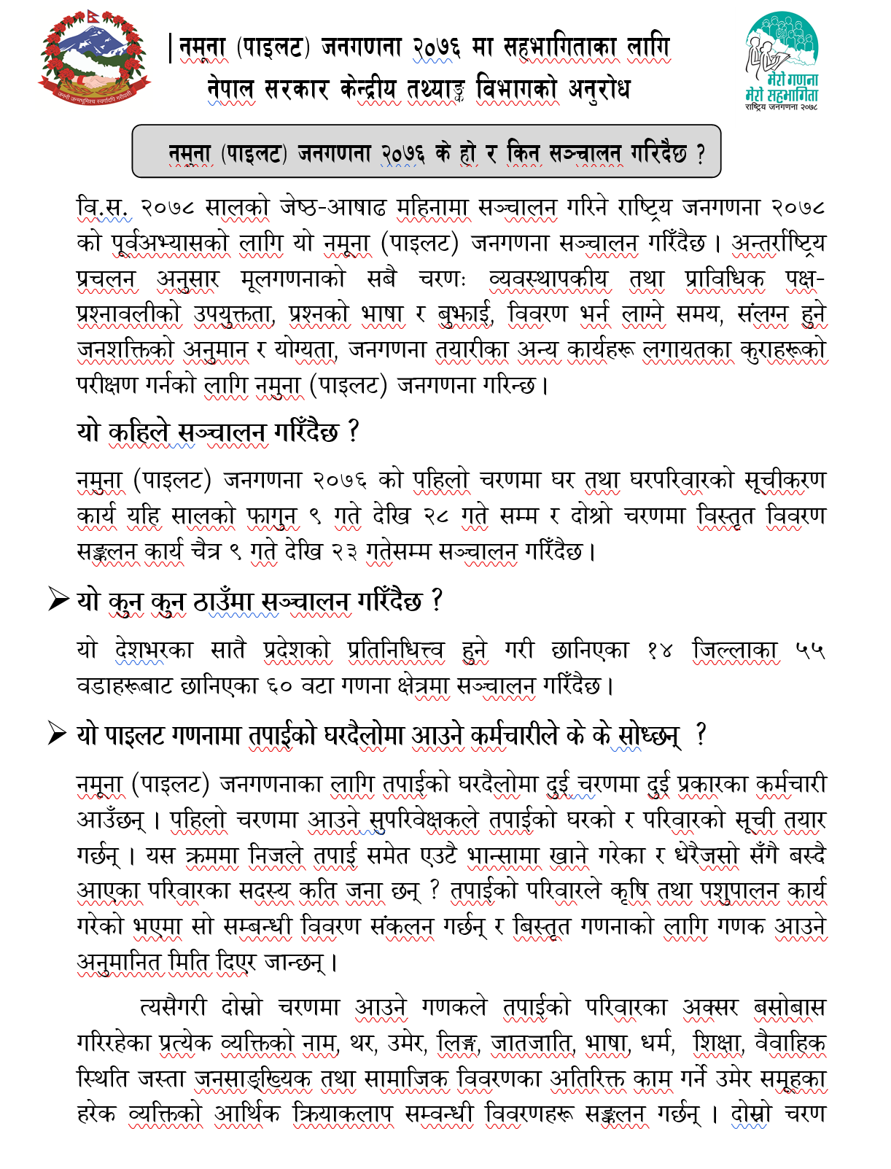
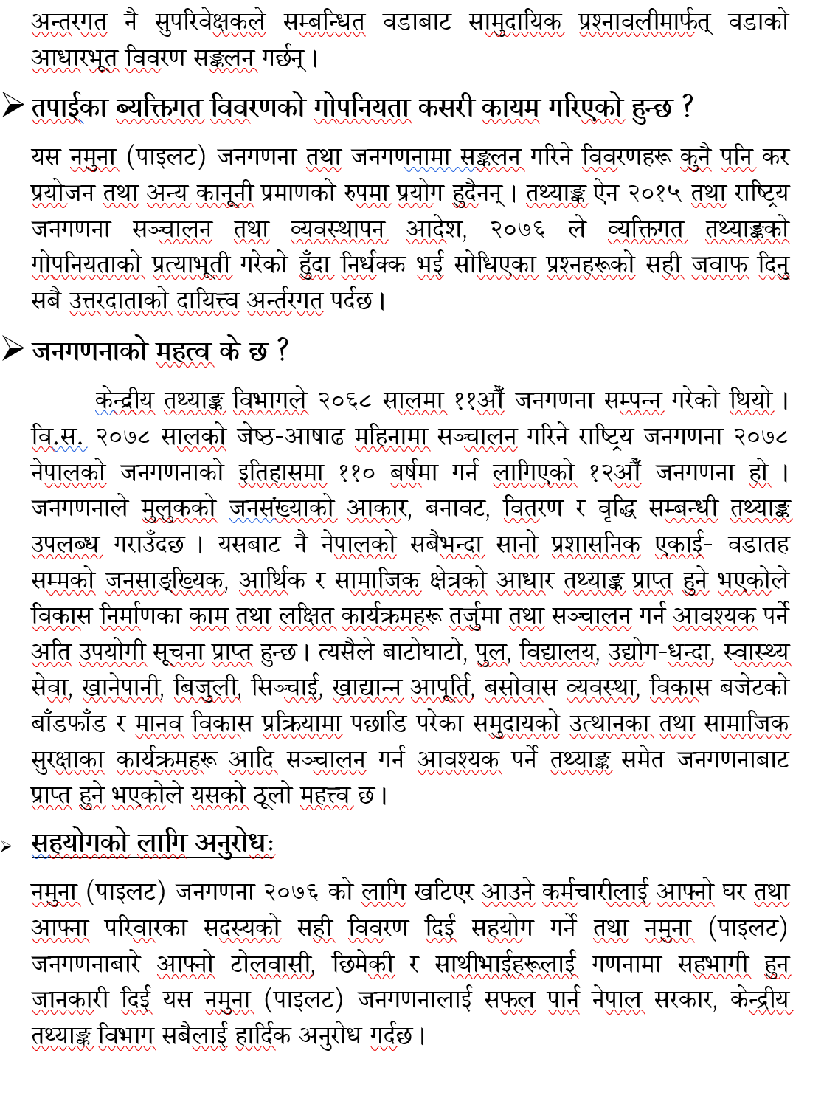
प्रचार प्रसार (२/२)

Slide 39
अतिरिक्त जानकारीको लागि निर्देशिकाको विस्तृत अध्ययन गर्नुहोला ।
धन्यवाद!

